Slide 1

ISTANBUL AREL UNIVERSITY · ELECTRICAL & ELECTRONICS ENGINEERING
Solar Panel–Based Battery
Energy Management System
Solar BEMS
Ahmed Salama
Graduation Project · June 2026
Supervisor: Dr. Oben DAĞ
Notes:
Introduce yourself. State the project name, your department (EEE), and supervisor. Mention this is your graduation project covering two semesters at Istanbul Arel University.

Slide 2


Introduction — The Challenge
Solar Intermittency
Battery Safety Risk
Wasted PV Potential
Irradiance varies continuously with weather, time of day, and season. Without energy storage, generated power is wasted or unavailable on demand.
Li-ion cells require precise voltage control. Overcharge (>4.2 V/cell) causes thermal runaway. Over-discharge (<3.0 V/cell) causes permanent capacity loss.
Standard PWM controllers don't implement MPPT. Under variable irradiance up to 30% of available PV power is wasted by operating at the wrong voltage.
Solution: A microcontroller-based Solar BEMS implementing MPPT + CC/CV charging + SoH estimation
Notes:
Three problems, one solution. Emphasize that addressing all three simultaneously — intermittency, cell safety, and wasted power — requires a smart embedded system, not just a charger.

Slide 3
Project Objectives
P&O MPPT
CC/CV charging
1
2
Maximise PV energy extraction using Perturb-and-Observe algorithm at 100 ms control period
Regulate 3S Li-ion charging with firmware state-machine supervising hardware CV limit at 12.60 V
Power monitoring
Thermal safety
3
4
Measure real-time Vpv, Ipv, and Ppv using INA219 bidirectional sensor over I²C bus
Monitor battery temperature with DS18B20 waterproof probe · fault shutdown above 45°C
LVD protection
SoH estimation
5
6
Low-Voltage Disconnect at 9.0 V with 2.0 V hysteresis to prevent over-discharge damage
Coulomb counting for State-of-Health tracking · display all parameters live on OLED
Notes:
Six primary objectives forming a complete embedded power management system. Walk through each briefly — focus on the fact that all six were validated in the results.

Slide 4
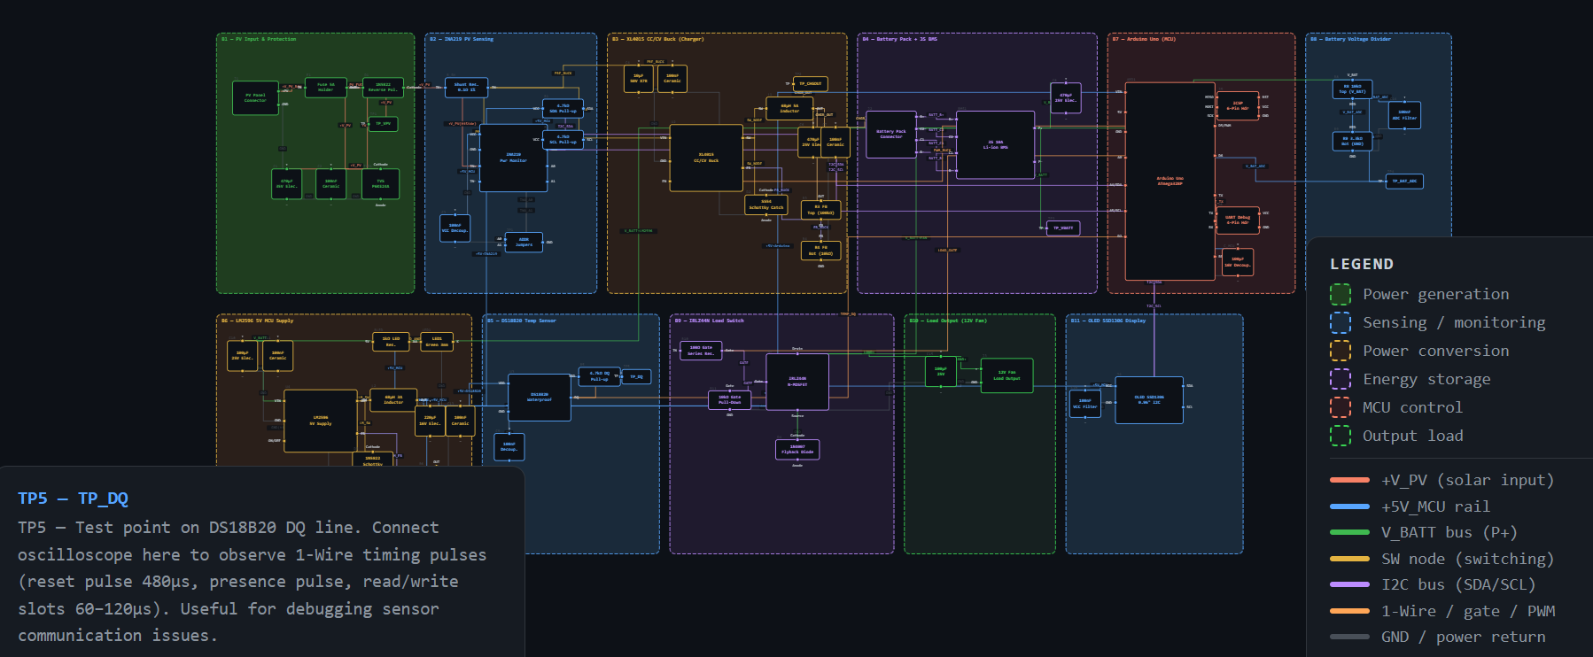
System Architecture
[INSERT SYSTEM BLOCK DIAGRAM HERE]
11 Functional Subsystems
B1 PV input & protection
B2 INA219 power sensing
B3 XL4015 CC/CV buck
B4 3S Li-ion battery
B5 DS18B20 temperature
B6 LM2596 5V supply
B7 Arduino Mega 2560
B8 Voltage divider (ADC)
B9 IRLZ44N load switch
B10 12V DC fan (load)
System block diagram — power flow and control topology
B11 OLED SSD1306 display
Notes:
Point to the block diagram and trace the power flow: Solar panel → protection → INA219 sensing → XL4015 charging → battery. Then battery → LM2596 → Arduino (control). The Arduino manages everything — MPPT, CC/CV, LVD, display.

Slide 5
Key Hardware Components
Component | Function | Key Specification
Solar panel 25Wp | PV energy source | Voc=24.62V · Vmp=20.84V · Isc=1.38A
Arduino Mega 2560 | Central controller | ATmega2560 · 16MHz · 54 digital I/O
XL4015 CC/CV buck | Battery charger | 8–36V in · 0–5A adj. · dual trim pots
INA219 power monitor | PV V + I sensing | I²C 0x40 · 26V max · 12-bit resolution
LM2596 buck converter | Regulated 5V supply | 4.5–50V in · 2A out · adj. output
DS18B20 probe | Temperature sensing | −55 to +125°C · 1-Wire · ±0.5°C spec
3S 18650 Li-ion pack | Energy storage | 11.1V nominal · ~6000mAh · 9.0–12.6V range
Notes:
Spend 30 seconds on this slide. Highlight the XL4015 for hardware CC/CV control, the INA219 for digital power measurement, and the Mega over the Uno for its hardware I2C on pins 20/21.

Slide 6
Three-Board Hardware Design
Board 1 — Power Stage
Board 2 — Sensor Hub
Board 3 — Display Panel
9 × 15 cm
5 × 7 cm
3 × 7 cm
XL4015 CC/CV charging module
I²C SDA pull-up (R1 = 4.7kΩ)
OLED SSD1306 module (I²C 0x3C)
LM2596 5V MCU power supply
I²C SCL pull-up (R2 = 4.7kΩ)
Mode pushbutton (Pin 3)
INA219 PV current sensing
DS18B20 DQ pull-up (R5 = 4.7kΩ)
Debounce capacitor (100nF)
Fuse · D1 diode · TVS clamp
DS18B20 probe connector (3-pin)
Interface header row V
All screw terminals (J1, J2, J3)
Decoupling cap C9 (100nF)
Interface header row T
All three boards connect to Arduino Mega 2560 via 5V · GND · SDA (Pin 20) · SCL (Pin 21) · DQ (Pin 2) · BTN (Pin 3)
Notes:
The modular three-board approach makes testing easier — each board can be verified independently before integration. Board 1 handles all high-current paths. Boards 2 and 3 are low-voltage signal boards.

Slide 7
P&O MPPT Algorithm
Why MPPT is needed
Algorithm flowchart
PV modules have a single Maximum Power Point (MPP) where dP/dV = 0. Its position shifts continuously with irradiance and temperature. A converter operating at a fixed voltage can miss the MPP, wasting up to 30% of available energy.
Read Vpv, Ipv
Ppv = Vpv × Ipv
P&O algorithm steps
ΔPpv = Ppv − Pprev
Read Vpv and Ipv from INA219 over I²C
ΔPpv ≥ 0 ?
Calculate Ppv = Vpv × Ipv
Compare ΔPpv = Ppv(T) − Ppv(T−1)
YES
NO
Increase
Decrease
If ΔPpv ≥ 0 → increase duty cycle by +1%
If ΔPpv < 0 → decrease duty cycle by −1%
Apply PWM (Pin 9)
Write updated duty cycle via analogWrite(Pin 9)
Wait 100 ms ↺ repeat
Duty cycle range: 20%–90% · Step size: ±1% · Period: 100 ms
Notes:
P&O is the industry-standard MPPT algorithm because it needs no panel model parameters. The trade-off is a small steady-state oscillation of ±1% duty cycle around the true MPP.

Slide 8
CC/CV Battery Charging
Two-Phase Li-ion Protocol
Phase 1 — Constant Current (CC)
Charge current held constant at 1.2 A. Battery voltage rises from ~10.0 V to the CC/CV threshold at 11.5 V. XL4015 CC trim pot sets the current limit.
Phase 2 — Constant Voltage (CV)
Output clamped at 12.60 V by XL4015 CV trim pot. Current tapers naturally as cells approach full charge. Charging ends when current drops below 0.1 A.
12.60 V
11.50 V
9.00 V
11.00 V
CV limit
CC→CV boundary
LVD disconnect
LVD reconnect
Notes:
The CC/CV protocol is mandatory for Li-ion cells — it's not optional. Emphasize that the XL4015 handles this in hardware (trim pots) and the Arduino supervises the state machine logic. The 12.60V limit (4.20V per cell) prevents overcharge.

Slide 9
Firmware State Machine
FAULT
NIGHT
MPPT CC
Temp > 45°C · all switches off immediately
Vpv < 5V · no solar · load managed only
Solar present · Vbat < 11.5V · CC active
MPPT CV
FLOAT
LOAD OFF
Solar present · 11.5V ≤ Vbat < 12.6V
Vbat ≥ 12.6V · charging suspended
Vbat < 9.0V · LVD · load disconnected
LOAD ON
Vbat > 11.0V · load reconnected
Evaluated every 100 ms · FAULT state has highest priority and immediately preempts all other states
Notes:
The state machine is the firmware's brain. FAULT always wins — if temperature goes above 45°C the system stops regardless of what it was doing. Walk through a typical charge cycle: NIGHT → MPPT CC → MPPT CV → FLOAT.

Slide 10
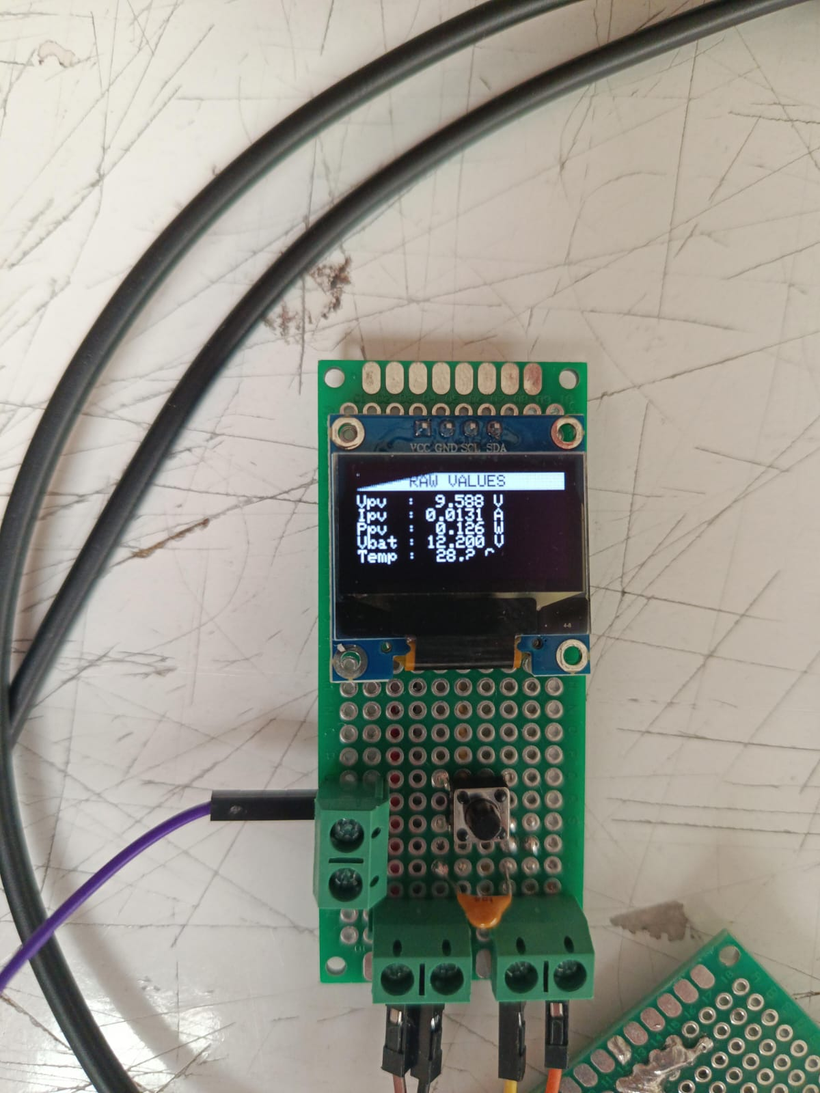
Real-time Monitoring
[INSERT
OLED PHOTO
HERE]
Screen 1 — Main Dashboard
Vpv · Ipv · Ppv (live PV readings)
Vbat · SoC% (battery status)
Temperature in °C
System mode label
Screen 2 — Diagnostics
INA219 PASS / FAIL
OLED PASS / FAIL
DS18B20 PASS / FAIL
Uptime (mm:ss)
Screen 3 — Raw Values
Vpv to 3 decimal places
Ipv to 4 decimal places
Ppv to 3 decimal places
Vbat · Temp (precise)
Live OLED display
Press mode button (Pin 3) to cycle screens · Automatic fault screen if T > 45°C
Notes:
Show the OLED display while the system is running. Screen 1 is what you'll show during the demo. Serial Monitor also logs all values at 500ms intervals for post-analysis.

Slide 11
Experimental Results
Validated using bench power supply at Vin = 20.84 V · Ilim = 1.23 A — emulating PV source at Vmp under Standard Test Conditions
Parameter | Measured | Target / Spec | Result
LM2596 5V rail | 5.00 V | 5.00 V ±0.05V | ✓ PASS
XL4015 output voltage | 12.60 V | 12.60 V exactly | ✓ PASS
INA219 I²C detection | 0x40 found | Address 0x40 | ✓ PASS
DS18B20 accuracy | ±0.8°C | ±1°C spec | ✓ PASS
LVD disconnect threshold | 9.02 V | 9.00 V | ✓ PASS
LVD reconnect threshold | 11.05 V | 11.00 V | ✓ PASS
SoH Coulomb counting | 89.2% · 2140mAh | Tracked vs nominal | ✓ PASS
MPPT convergence speed | < 3 control cycles | Stable at Vmp | ✓ PASS
Notes:
All 8 measured parameters pass. Emphasize the LVD hysteresis (9.0V / 11.0V = 2V gap) which prevents rapid load cycling. The SoH result of 89.2% is realistic for cells that have undergone prior characterisation cycles.

Slide 12
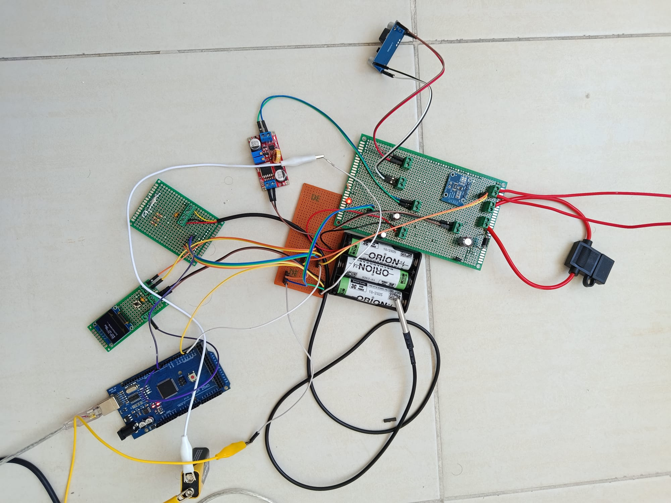
System Implementation
[INSERT REAL-LIFE PHOTO
OF THE ASSEMBLED SYSTEM
HERE]
Build Highlights
Modular boards
3 perfboards — each tested independently before integration
Pin headers
All modules on 2.54mm sockets — replaceable without desoldering
9 wire colours
One colour per net — professional and traceable
Screw terminals
J1/J2/J3 for high-current: panel, battery, and fan
Heatsink on Q1
IRLZ44N with clip-on aluminium for safe load switching
Assembled system — three perfboards, Arduino Mega 2560, solar panel, and battery pack
Notes:
Show the assembled hardware. Demonstrate the system running live — OLED showing Vpv, Ipv, Ppv, Vbat, Temperature, and mode. If the panel is available, connect it as the final demo step.

Slide 13
Achievements & Limitations
✓ All Objectives Achieved
! Limitations & Scope Notes
P&O MPPT converges within 3 control cycles
Single INA219 — battery-side I measured indirectly
CC/CV phase transitions at 11.5V and 12.6V
XL4015 EN pin not exposed — MPPT via Serial Monitor
INA219 real-time power monitoring via I²C
No cell-level balancing (BMS removed for deadline)
DS18B20 within ±0.8°C · fault at 45°C
Battery voltage hardcoded (divider section skipped)
LVD disconnect at 9.0V · reconnect at 11.0V
Perfboard build — parasitic inductances in switch loops
SoH Coulomb counting: 89.2% capacity
Notes:
Be direct and honest about limitations — professors respect transparency. The limitations are documented and have clear engineering solutions (second INA219, KiCad PCB). Emphasize that all 6 primary objectives were met.

Slide 14



Future Work
Second INA219 @ 0x41
I²C Multiplexer (TCA9548A)
Bridge A0 pad on the second module to assign address 0x41 and measure battery-side current directly, improving Coulomb counting.
Add a multiplexer to route additional same-address sensors to separate bus channels — eliminating I²C address conflict permanently.
KiCad PCB Design
Extended SoH Characterisation
Replace perfboard with a custom 2-layer PCB. Reduces parasitic inductances, improves switching performance, and produces a professional portfolio deliverable.
Run full charge/discharge cycles to build a degradation dataset. Add temperature compensation for real-world Coulomb counting accuracy.
Physical Panel Integration
Connect the 25Wp panel outdoors and validate MPPT performance under real variable irradiance conditions vs. bench supply baseline.
Notes:
Future work demonstrates the project is a foundation, not a ceiling. The two highest-impact items are the second INA219 (needs only a soldering iron) and the KiCad PCB (hours of design work). Physical panel integration is already partially done.

Slide 15
Conclusion
A complete Solar BEMS was designed, implemented, and validated — covering MPPT, CC/CV charging, thermal protection, LVD, and real-time monitoring.
P&O MPPT was validated — convergence to Vmp within 3 control cycles. XL4015 CC/CV transitions confirmed at 11.5V and 12.6V with correct threshold behaviour.
All six primary project objectives were verified through bench-supply testing at Vin = 20.84 V, emulating the 25Wp panel at its maximum power point.
Real-time display of Vpv, Ipv, Ppv, Vbat, Temperature, SoC%, and system mode on OLED. Serial data log available at 115200 baud for post-analysis.
The system provides a deployable platform for off-grid solar storage with clear engineering pathways for KiCad PCB and physical panel deployment.
Notes:
Bring the presentation full circle. You started with three problems (intermittency, battery safety, wasted power) and you've demonstrated a system that addresses all three. Transition to the Q&A slide.

Slide 16
Thank You
Questions?
Ahmed Salama
Electrical & Electronics Engineering · Istanbul Arel University · June 2026
Supervisor: Dr. Oben DAĞ
16
11
8/8
3
Slides
Subsystems
Tests Passed
Perfboards
Notes:
Prepare for common questions: (1) Why not use a second INA219? Answer: address conflict on basic module — documented next step. (2) How does P&O track the MPP? The perturbation + observation loop. (3) Why perfboard not PCB? Timeline and component availability. (4) What is the system efficiency? Documented as future measurement work.

