Slide 1


GRIND & CRUMB
THE MILLION-
POUND QUESTION
£1.11M SALES
£47.8K LOSS
Why is the busiest café losing money—and why did the app lose orders?
TEAM HONOURABLE • 180 DEGREES × ENACTUS × TECHVISION

Slide 2


GRIND & CRUMB / TEAM HONOURABLE
EXECUTIVE DIAGNOSIS • 02 / 09
13 WARNING SIGNS.
2 DECISIONS.
PRIORITY 01
Flagship economics
Piccadilly loses £47.8k despite £1.11m of sales.
PRIORITY 02
Direct app recovery
Own-app sales fell 33.1% from February to March.
THE OTHER ELEVEN
Delivery fees • Leeds overlap • Oat surcharge • Staffing • Waste
Customer sentiment • Seasonal trade • Delayed profit • Data quality
Chain stores remain profitable overall (£1.07m); we are fixing critical weak points.

Slide 3


GRIND & CRUMB / TEAM HONOURABLE
PROBLEM 01 / RENT • 03 / 09
THE BUSIEST CAFE
IS THE ONLY LOSS-MAKER
£1.11M
Annual sales • Manchester Piccadilly
−£47,828
Annual store-level operating result
40.2% OF REVENUE IS RENT + RATES
£366k base rent + £80.5k rates = £446.5k
Source: starter_store_monthly_pnl.csv and stores.csv | FY Jul 2025–Jun 2026

Slide 4
GRIND & CRUMB / TEAM HONOURABLE
PROBLEM 01 / RENT • 03 / 09
MANCHESTER PICCADILLY
  Rent Negotiation & Commercial Space Monetisation: Sub-Leasing & Pop-Ups
  Increased and Focused Staffing
Source: starter_store_monthly_pnl.csv and stores.csv | FY Jul 2025–Jun 2026

Slide 5
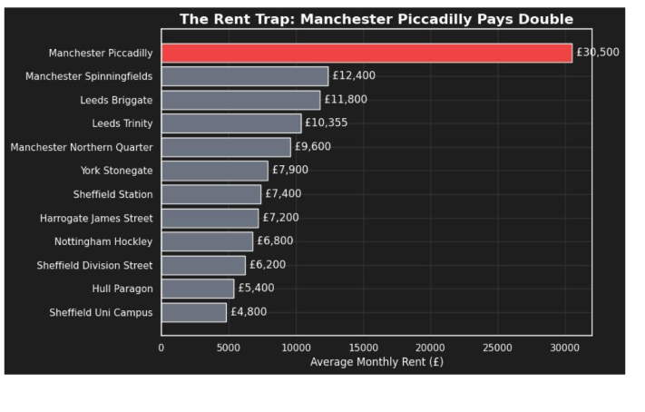
The Problem: The Rent prices at Manchester Piccadilly
The Solution:
  Keep the site due to high sales
  Attempt to negotiate a base rent reduction of 15%, reducing our loss by £55,000
  Move to a ‘grab n’ go’ model
  Allow small local businesses to hold pop-up stalls using the space during peak hours
  Financial Lift: Hosting 2 evening corporate hires per week (£1,000 venue fee) plus micro-retail pop-ups (£100 a day) generates £52,000 to £104,000+ per year in high-margin additional revenue to directly offset fixed occupancy costs.

Slide 6
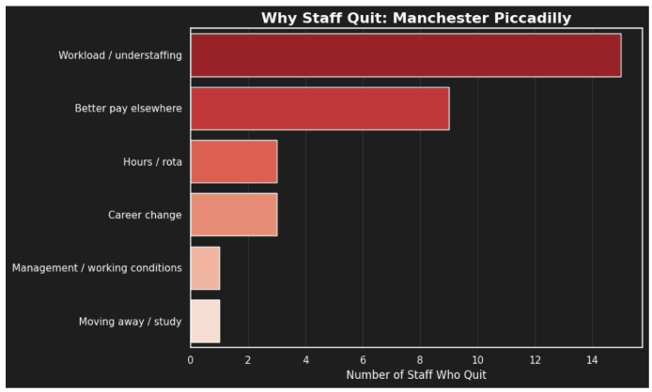
Increased and Focused Staffing
The Solution:
  Reallocate labour hours to double-staff the coffee and dispatch counters specifically during the 7:30–9:30 AM and 12:00–14:00 PM peak rush windows.
  Increase staff pay by 50p an hour to improve retention
  Implement dedicated delivery order counter allowing customers to be separated from delivery orders, reducing waiting times
  Financial Lift: Wage increase will cost £12k a year, however annual staff turnover will go down as well as onboarding costs allowing us to recover £50,000 in costs

Slide 7

GRIND & CRUMB / TEAM HONOURABLE
PROBLEM 02 / APP • 05 / 09
DOWNLOADS
ARE NOT ORDERS.
CHAIN-WIDE OWN-APP SALES
FEB 2026
App v3.0 shipped 2 March 2026. Customers reported checkout failures and missing loyalty stamps.
£95,176
MAR 2026
1. Enhanced Click & Collect (Order Ahead)
£63,666
2. Loyalty Expansion & App-Exclusive Free Oat Milk
Checkout crashes • Lost rewards • Order-ahead complaints
Caution: February double-stamps promotion ended, so not all decline can be attributed to v3.0.
−33.1% MONTH-ON-MONTH
Source: daily_store_sales.csv, business_events.csv, interviews & reviews | Feb–Mar 2026

Slide 8
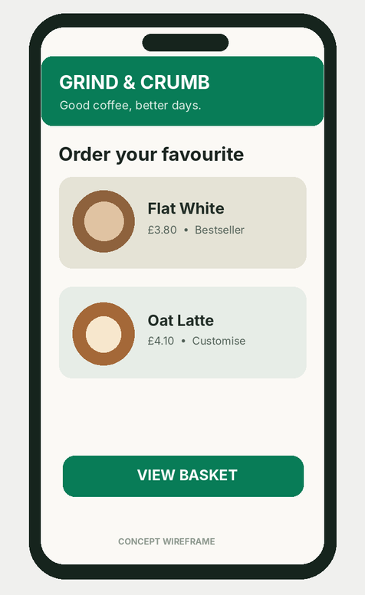
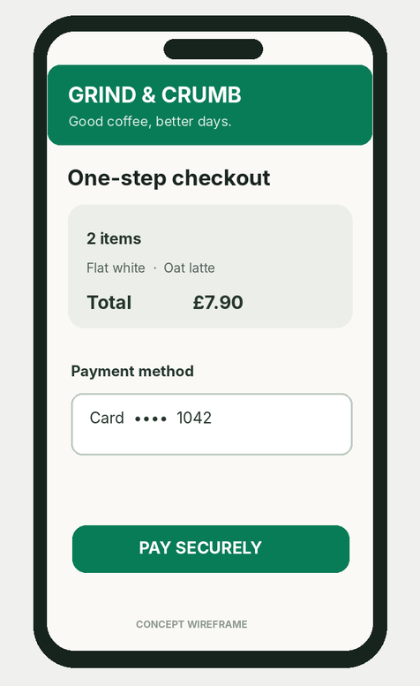
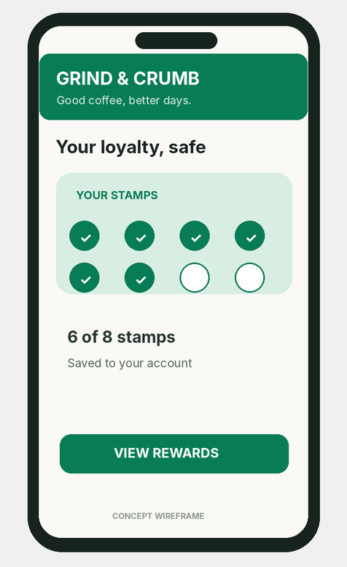
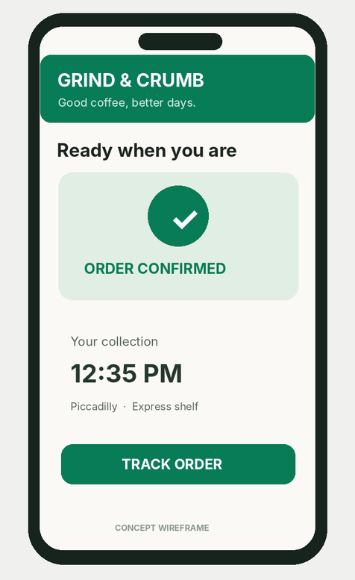
GRIND & CRUMB / TEAM HONOURABLE
SOLUTION 02 / CONSUMERS • 06 / 09
BETTER COFFEE. LESS FRICTION.
01 FIND IT FAST
02 CHECK OUT
03 KEEP REWARDS
04 COLLECT EASY
Reliable checkout comes first. Loyalty and order tracking must work—not just look good.
Illustrative consumer-app concept | Production requires payment, order and rewards integration.

Slide 9
LOYALTY APP
  Make oat milk 100% free exclusively for customers who use the app to order or scan at checkout, while keeping the 40p charge for standard walk-ins and third-party delivery apps.
  Encourages people to download the app, incentivising click and collect service
  Able to get more data on customer spending habits allowing for targeted offers and push notifications
  As suggested by Head of Digital, add personalised offers
Tiered loyalty:
Financial Lift: Protects non-app surcharge revenue (around £120k a year), stops customer churn, and is used as an acquisition tool for driving app downloads among the 18–34 demographic.
FEB 2026
MAR 2026
£63,666

Slide 10
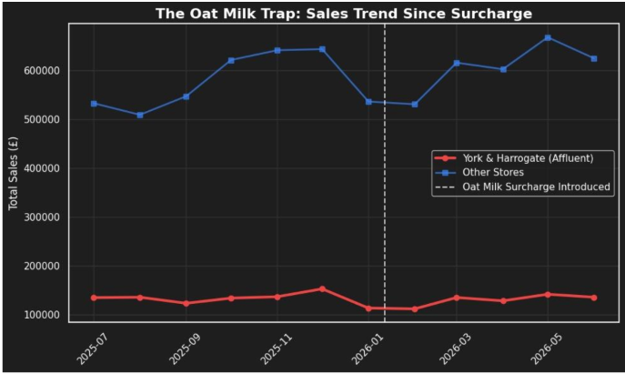

Slide 11
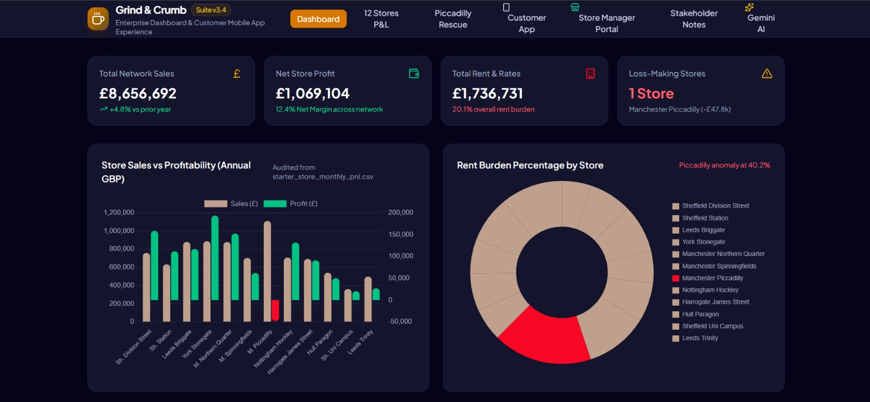
TWO PRODUCTS, ONE SYSTEM • 07 / 09
The dashboard measures change. The app creates better direct-order experiences.
Verified metrics are drawn from case records; live data refresh would need a production pipeline.

Slide 12
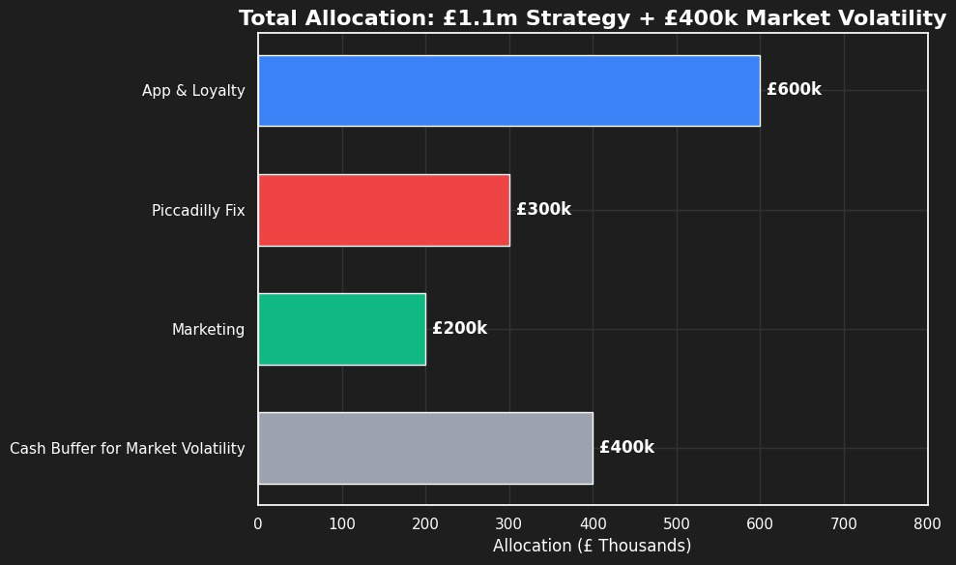
GRIND & CRUMB / TEAM HONOURABLE
FUNDING THE TURNAROUND • 08 / 09
WHERE THE £1.5M GOES
Illustrative planning allowances (not supplier quotes); £1.5m includes £375k retained reserve.

Slide 13





USE OF AI

