Slide 1

Power window using freeRTOS

Slide 2
Team 21
Ahmed Wael Ibrahim – 20P3343
Mustafa Usama Abdelrahman – 20P5556
Ahmed Sameh Mahmoud Nabieh – 20P2914
Farah Ahmed Abdelrehim Tharwat – 20P1269
Salma Mohamed Elsoly – 20P6375

Slide 3
Application Layer
FreeRTOS kernel
Windows Application
main
Hardware Abstraction Layer (HAL)
Interrupt Abstraction Module
motor
Microcontroller Abstraction Layer (MCAL)
TM4C123GH6PM
DIO

Slide 4
Windows Application
Generic Passenger Task
xBinarySemaphore
Semaphore Jamming Task
Generic Passenger Task
Generic Passenger Task
xCommandsQueue
Motor Task
Generic Passenger Task

Slide 5
Windows Application
Generic Passenger Task
xBinarySemaphore
Semaphore Jamming Task
Generic Passenger Task
Generic Passenger Task
xCommandsQueue
Motor Task
Generic Passenger Task

Slide 6
Code implementation

Slide 7
Demo project

Slide 8
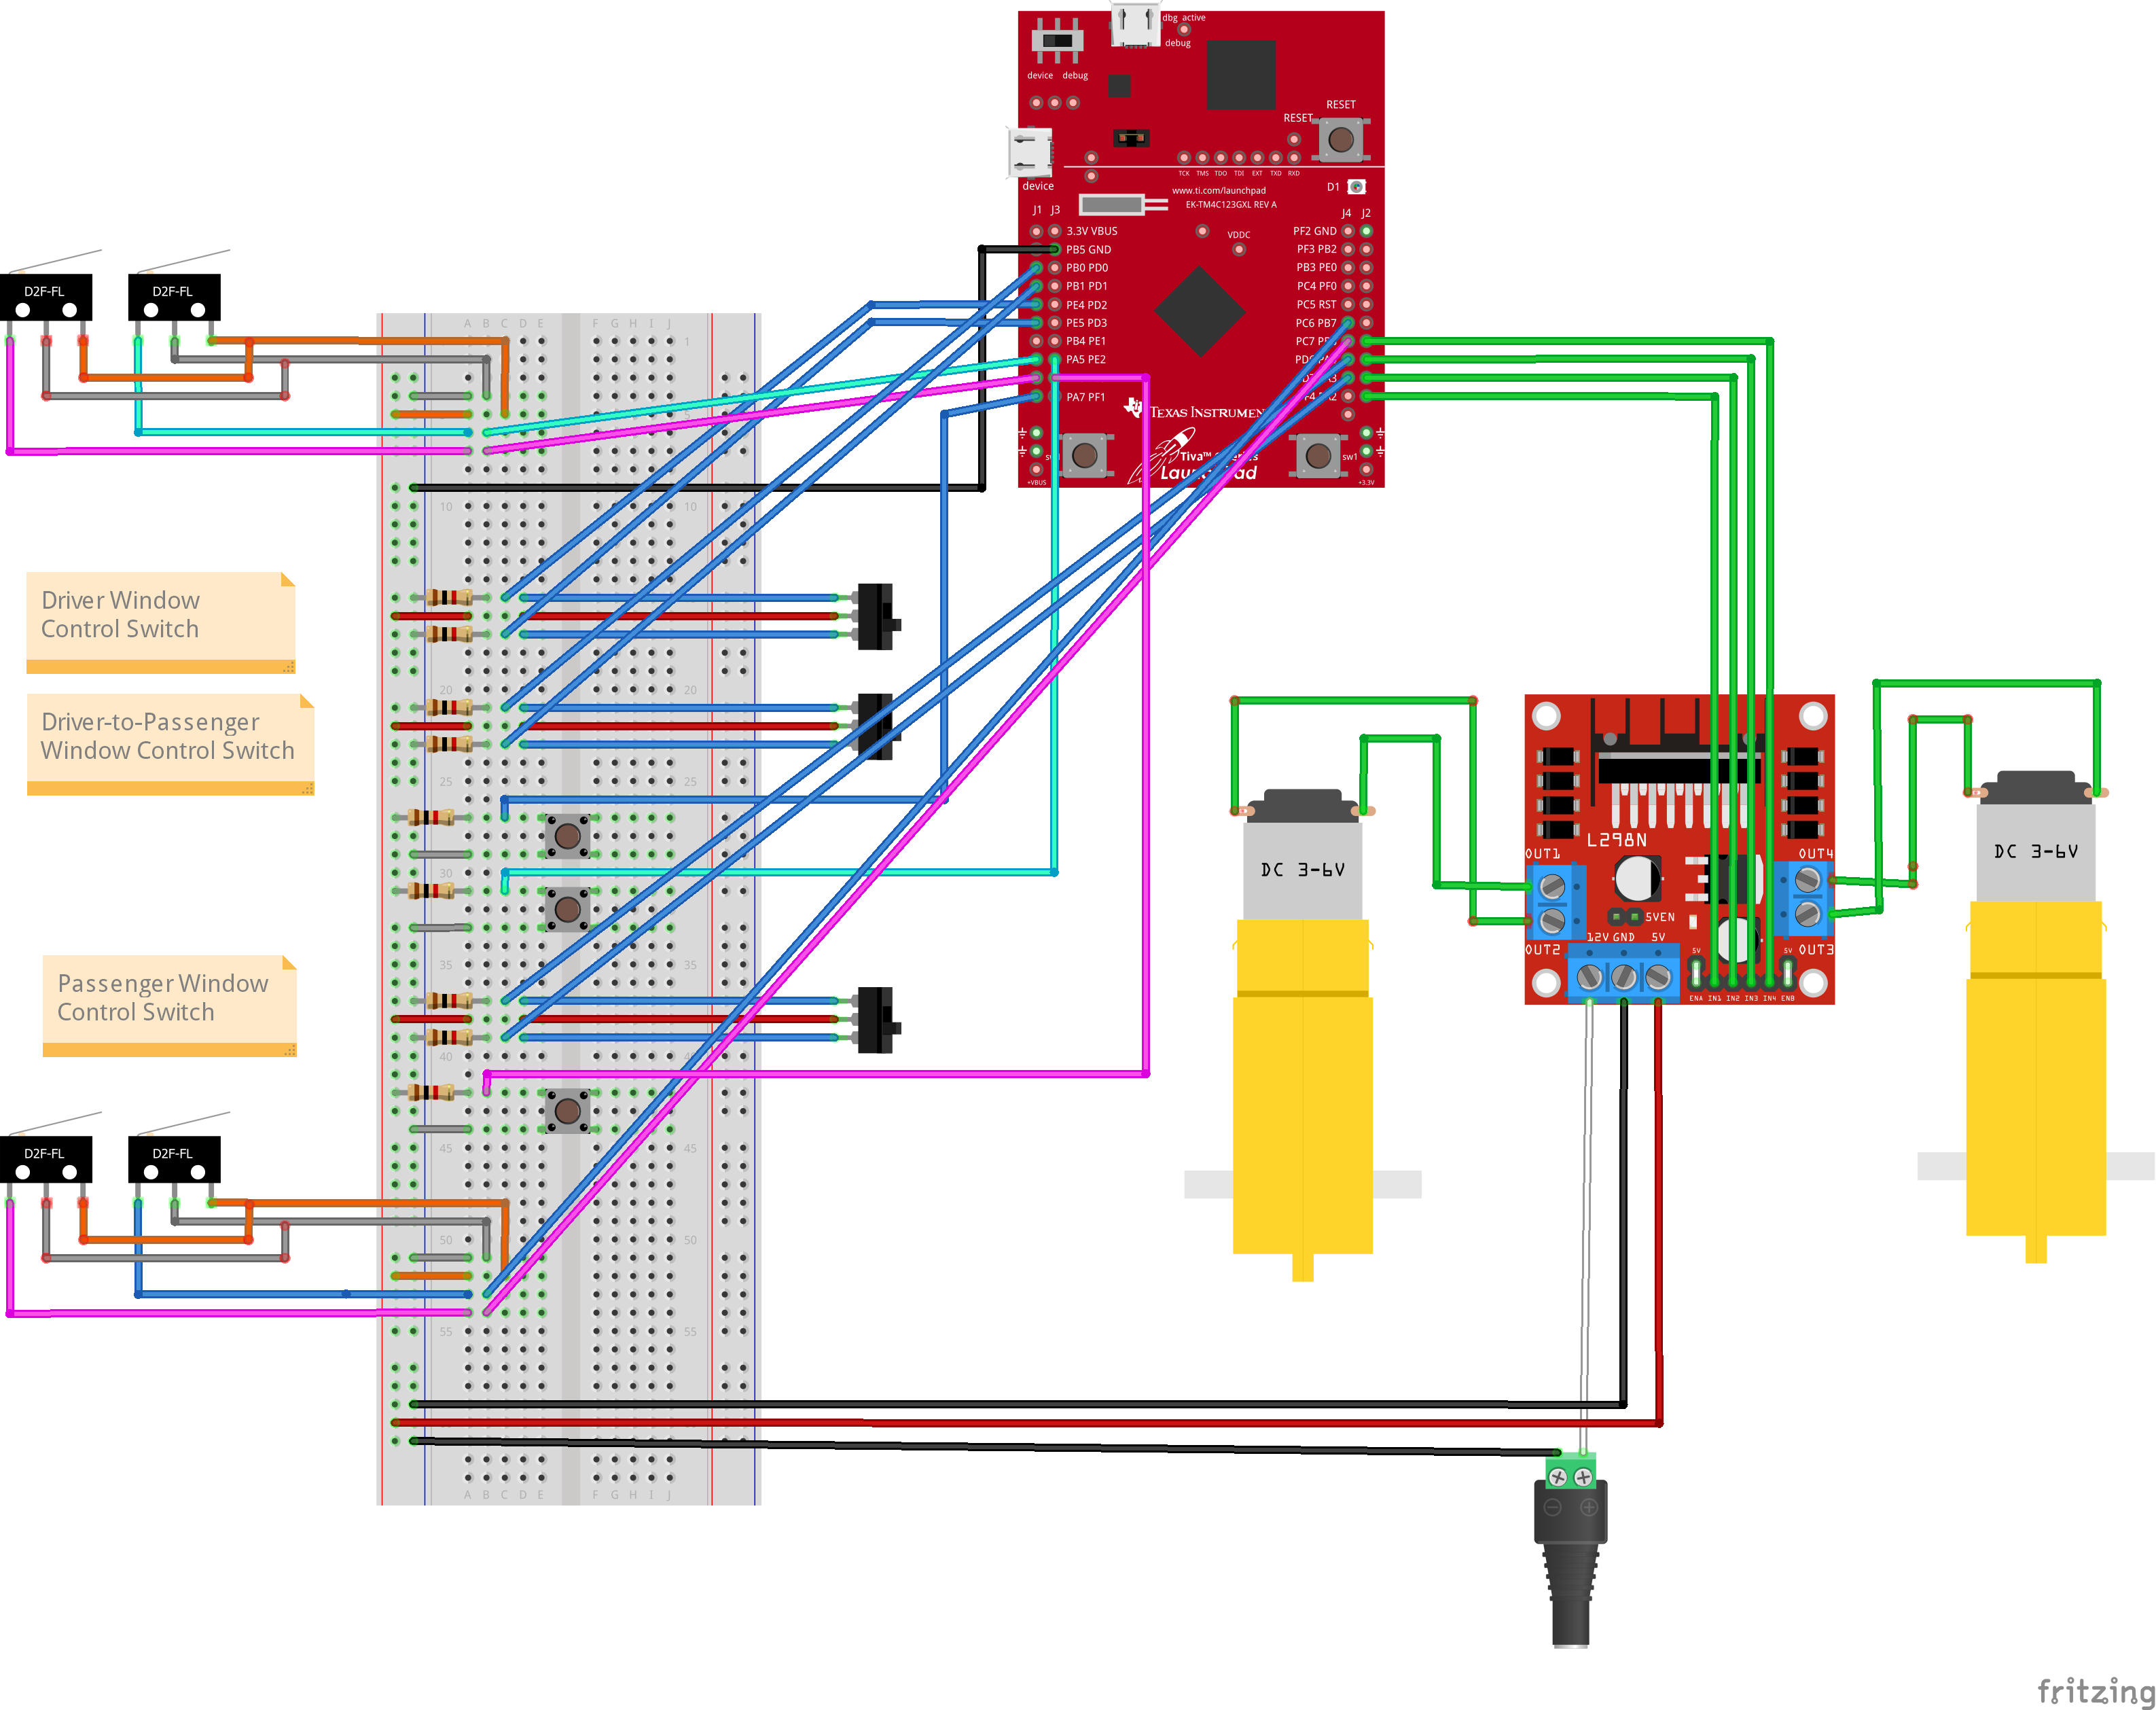

Slide 9
Two panels are installed to control the passenger’s window?
FreeRTOS is used in the project implementation?
Implementation of 2 limit switches to limit the window motor from top and bottom limits of the window?
When the power window switch is pushed or pulled continuously, the window opens or closes until the switch is released?
When the power window switch is pushed or pulled shortly, the window fully opens or closes?
When the window lock switch is turned on, the opening and closing of all windows except the driver’s window is disabled?
Jam Protection is implemented?
Queues are used in the project implementation?
Semaphores/Mutex are used in the project implementation?
Documentation project is made?

