Slide 1



Presentation
By Younus Ahmed

Slide 2
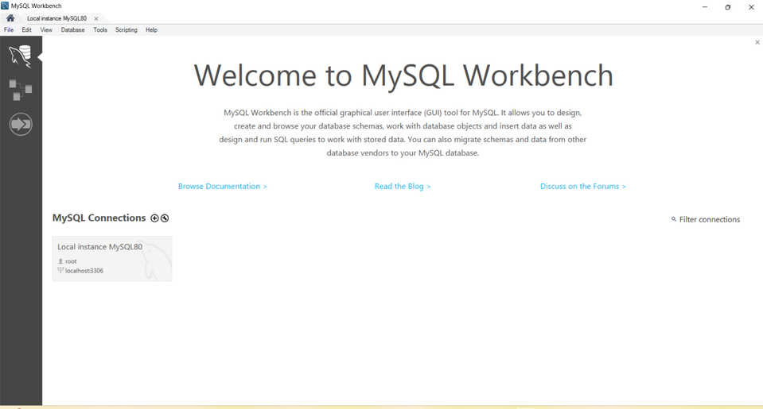


Introduction
Title: Recipe Manager Database System
Content:
The Recipe Manager Database is a SQL-based application designed to store, manage, and retrieve cooking recipes efficiently.
The system helps users:
Store recipes digitally
Manage ingredients and pantry items
Track cooking history
Review and rate recipes
Get meal planning support
This project demonstrates the use of relational database concepts such as tables, relationships, constraints, triggers, and queries.

Slide 3
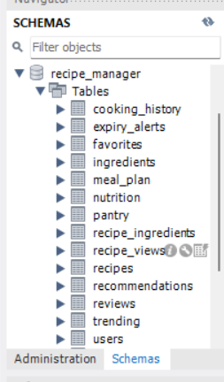
Problem Statement
People usually store recipes in notebooks, screenshots, or scattered notes.
This creates several problems:
Difficult to search recipes
Ingredients not tracked properly
Duplicate recipes occur
No meal planning support
Cannot track nutrition or history
Solution:
Build a structured relational database that organizes recipes, ingredients, users, and cooking activities in one centralized system.

Slide 4
Objectives
Project Objectives:
Design a normalized relational database
Implement constraints (PK, FK, UNIQUE, CHECK)
Perform complex SQL queries
Automate operations using triggers
Maintain data integrity and security
Improve search and retrieval performance

Slide 5
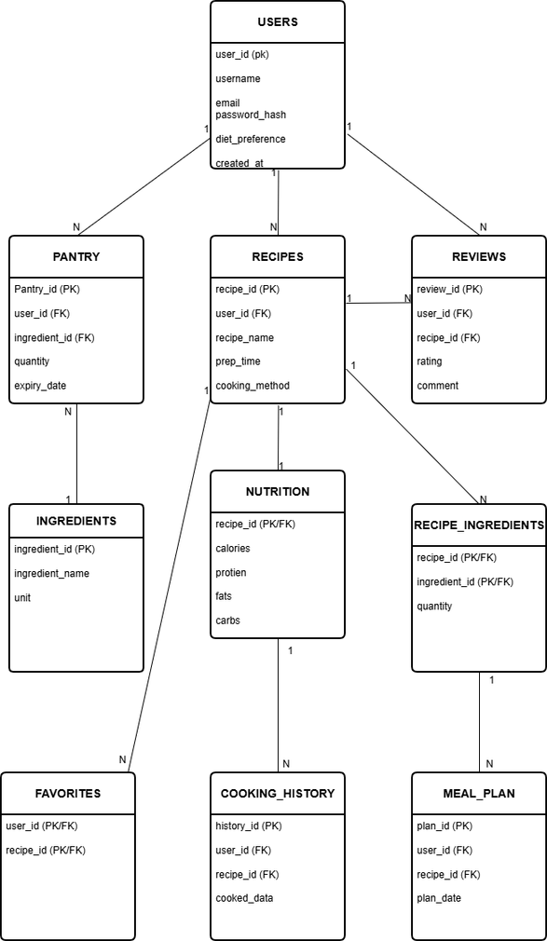
ER DIAGRAM

Slide 6
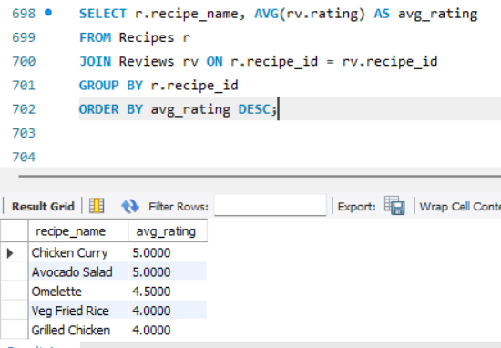
How System Works
System Modules:
Automation Used:
User registers and stores recipes
Ingredients linked to recipes
Pantry tracks available ingredients
Cooking history updated automatically
Meal planning supported
Triggers
Constraints
Foreign keys

Slide 7
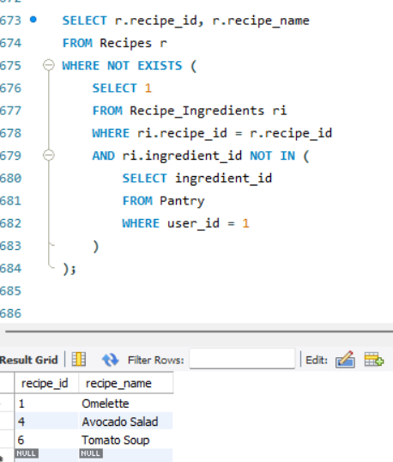
SQL Queries & Automation
Important Queries Implemented:
Recipes that can be cooked from pantry
Most popular recipes (ratings)
Vegetarian recipes < 30 mins
High protein low carb recipes
Triggers Implemented:
Auto cooking history entry
Pantry quantity update after cooking
Expiry alert for ingredients

Slide 8
Advantages
Centralized recipe management
Avoids duplicate recipes
Tracks nutrition values
Smart ingredient tracking
Automatic updates using triggers
Improves searching speed
Supports meal planning

Slide 9
Conclusion & Future Scope
Conclusion:
The Recipe Manager Database successfully demonstrates:
Relational database design
SQL querying
Constraints and relationships
Automation using triggers
Future Improvements:
Mobile application integration
Recipe recommendation system
AI-based diet planner
Online sharing platform

Slide 10
Thank You

