Slide 1
Data Mining: Data
Lecture Notes for Chapter 2
Introduction to Data Mining , 2nd Edition
by
Tan, Steinbach, Kumar

Slide 2
Outline
Attributes and Objects
Types of Data
Data Quality
Data Preprocessing
Similarity and Distance

Slide 3
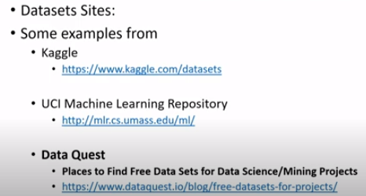
Knowledge about the Data( meta data)
Google data set
Get hub
Paper with code
Dataport
Opendata
Data catalog

Slide 4
Data Preprocessing
Aggregation
Sampling
Discretization and Binarization
Attribute Transformation
Dimensionality Reduction
Feature subset selection
Feature creation

Slide 5
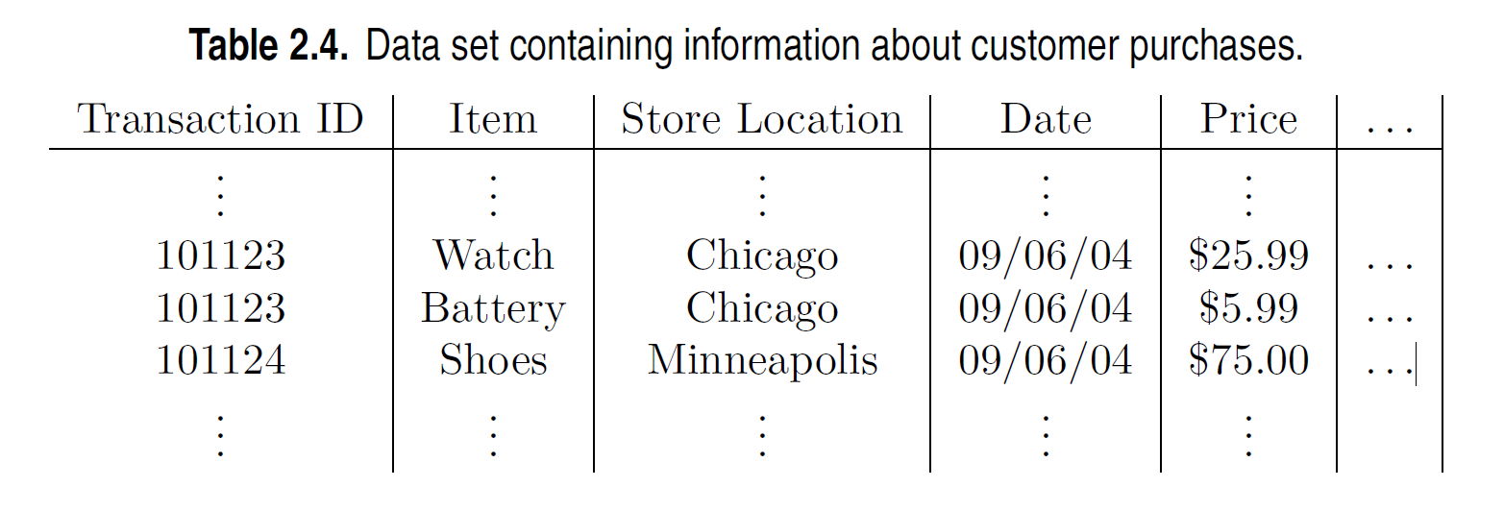
Aggregation
Combining two or more attributes (or objects) into a single attribute (or object)
Purpose
Data reduction - reduce the number of attributes or objects reduce time of processing and memory
Change of scale high level view of data
Cities aggregated into regions, states, countries, etc.
Days aggregated into weeks, months, or years

Slide 6
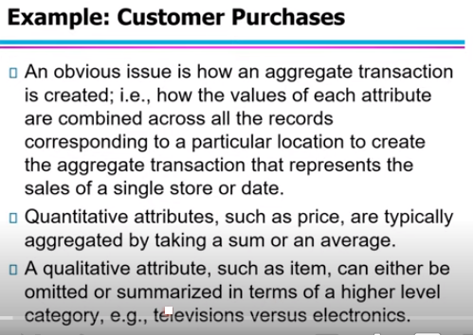
Aggregation

Slide 7
Example: Precipitation in Australia
This example is based on precipitation in Australia from the period 1982 to 1993.
The next slide shows
A histogram for the standard deviation of average monthly precipitation in Australia, and
A histogram for the standard deviation of the average yearly precipitation for the same locations.
The average yearly precipitation has less variability than the average monthly precipitation.
All precipitation measurements (and their standard deviations) are in centimeters.

Slide 8
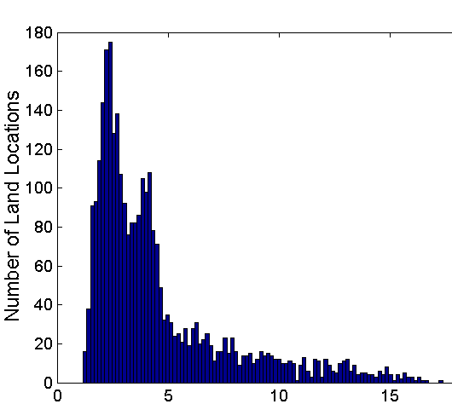
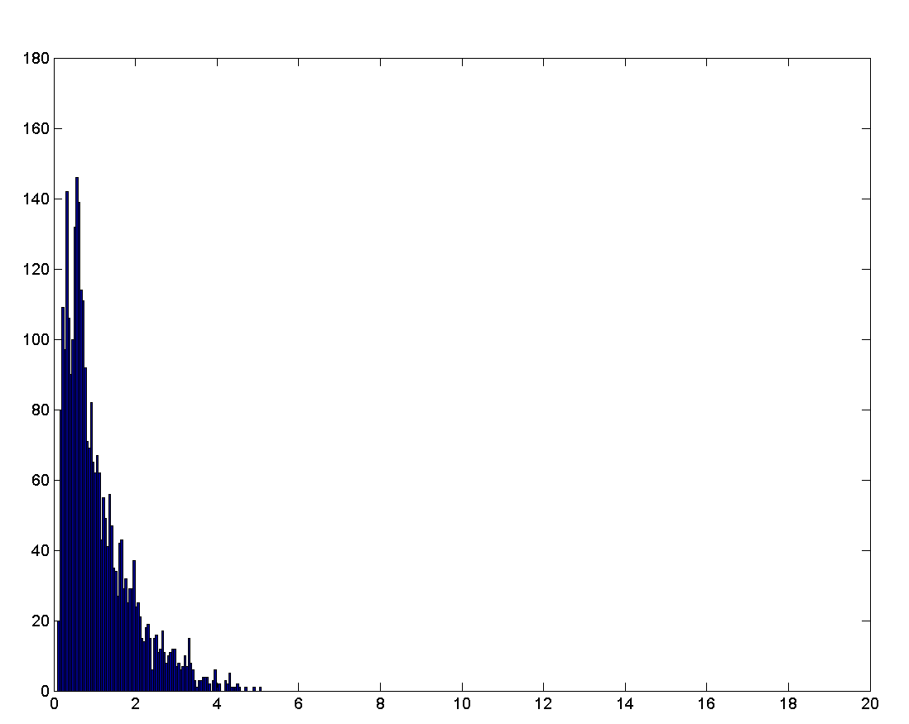
Example: Precipitation in Australia …
Variation of Precipitation in Australia
Standard Deviation of Average Monthly Precipitation
Standard Deviation of Average Yearly Precipitation

Slide 9
Sampling
Sampling is the main technique employed for data reduction.
It is often used for both the preliminary investigation of the data and the final data analysis.
Statisticians often sample because obtaining the entire set of data of interest is too expensive or time consuming.
Sampling is typically used in data mining because processing the entire set of data of interest is too expensive or time consuming.

Slide 10
Sampling …
The key principle for effective sampling is the following:
Using a sample will work almost as well as using the entire data set, if the sample is representative
A sample is representative if it has approximately the same properties (of interest) as the original set of data

Slide 11

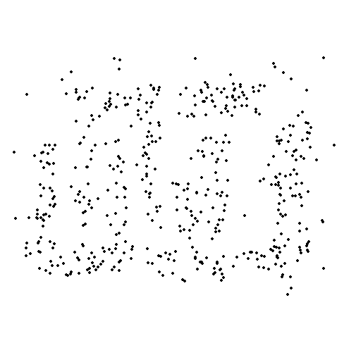
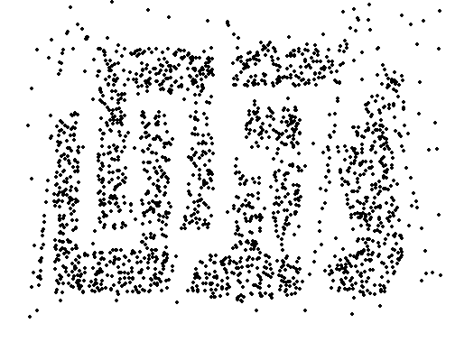
Sample Size
8000 points 2000 Points 500 Points

Slide 12
Types of Sampling
Simple Random Sampling:(The simplest type of sampling )
There is an equal probability of selecting any particular item
Sampling without replacement
As each item is selected, it is removed from the population
Sampling with replacement
Objects are not removed from the population as they are selected for the sample.
In sampling with replacement, the same object can be picked up more than once
Stratified sampling
Split the data into several partitions; then draw random samples from each partition

Slide 13
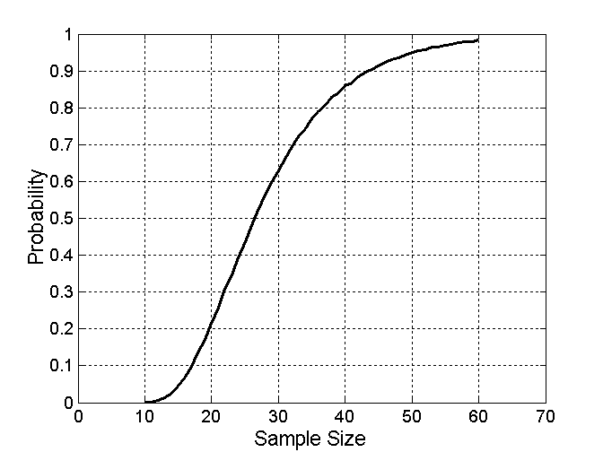


Sample Size
What sample size is necessary to get at least one object from each of 10 equal-sized groups.

Slide 14
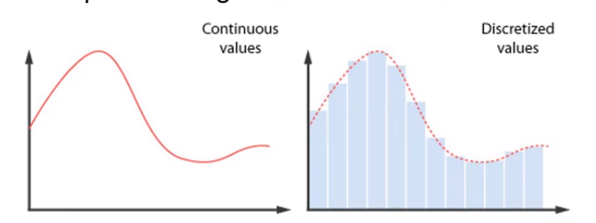
Discretization
Discretization is the process of converting a continuous attribute into an categorical attribute
A potentially infinite number of values are mapped into a small number of categories
Discretization is used in both unsupervised and supervised settings

Slide 15
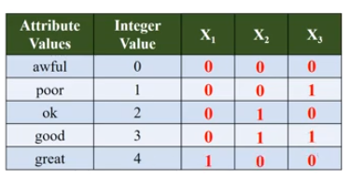
Binarization
Binarization maps a continuous or categorical attribute into one or more binary variables

Slide 16
Attribute Transformation
An attribute transform is a function that maps the entire set of values of a given attribute to a new set of replacement values such that each old value can be identified with one of the new values
Normalization
Refers to various techniques to adjust to differences among attributes in terms of frequency of occurrence, mean, variance, range
In statistics, standardization refers to subtracting off the means and dividing by the standard deviation

Slide 17
Dimensionality Reduction
Purpose:
Avoid curse of dimensionality
Reduce amount of time and memory required by data mining algorithms
Allow data to be more easily visualized
May help to eliminate irrelevant features or reduce noise
Techniques
Principal Components Analysis (PCA)

Slide 18
Dimensionality Reduction: PCA
Goal is to find a projection that captures the largest amount of variation in data
x₂
e
x₁

Slide 19
Feature Subset Selection
Another way to reduce the dimensionality is to use only a subset of the features. While it might seem that such an approach would lose information,this is not the case if redundant and irrelevant features are present.
Redundant features
Duplicate much or all of the information contained in one or more other attributes
Example: purchase price of a product and the amount of sales tax paid
Irrelevant features
Contain no information that is useful for the data mining task at hand
Example: students' ID is often irrelevant to the task of predicting students' GPA

Slide 20
Feature Creation
Create new attributes that can capture the important information in a data set much more efficiently than the original attributes
general methodologies:
Feature extraction
Example: extracting edges from images
Feature construction
Example: dividing mass by volume to get density

