Slide 1
MP3 Player
By JAVA

Slide 2
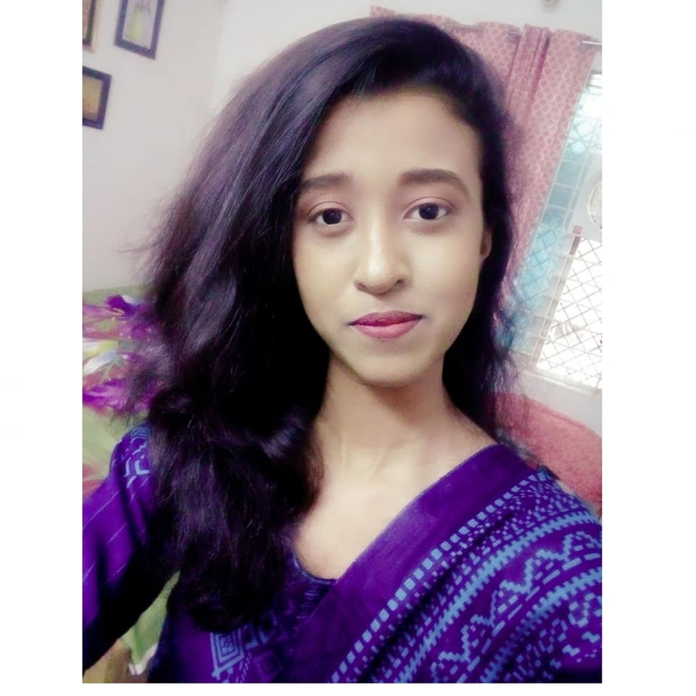
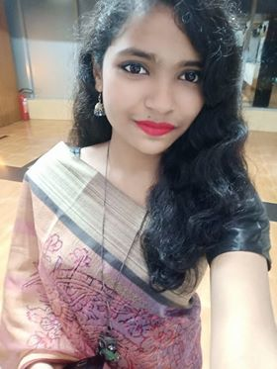
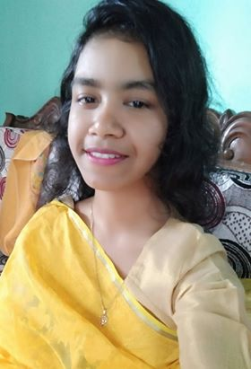
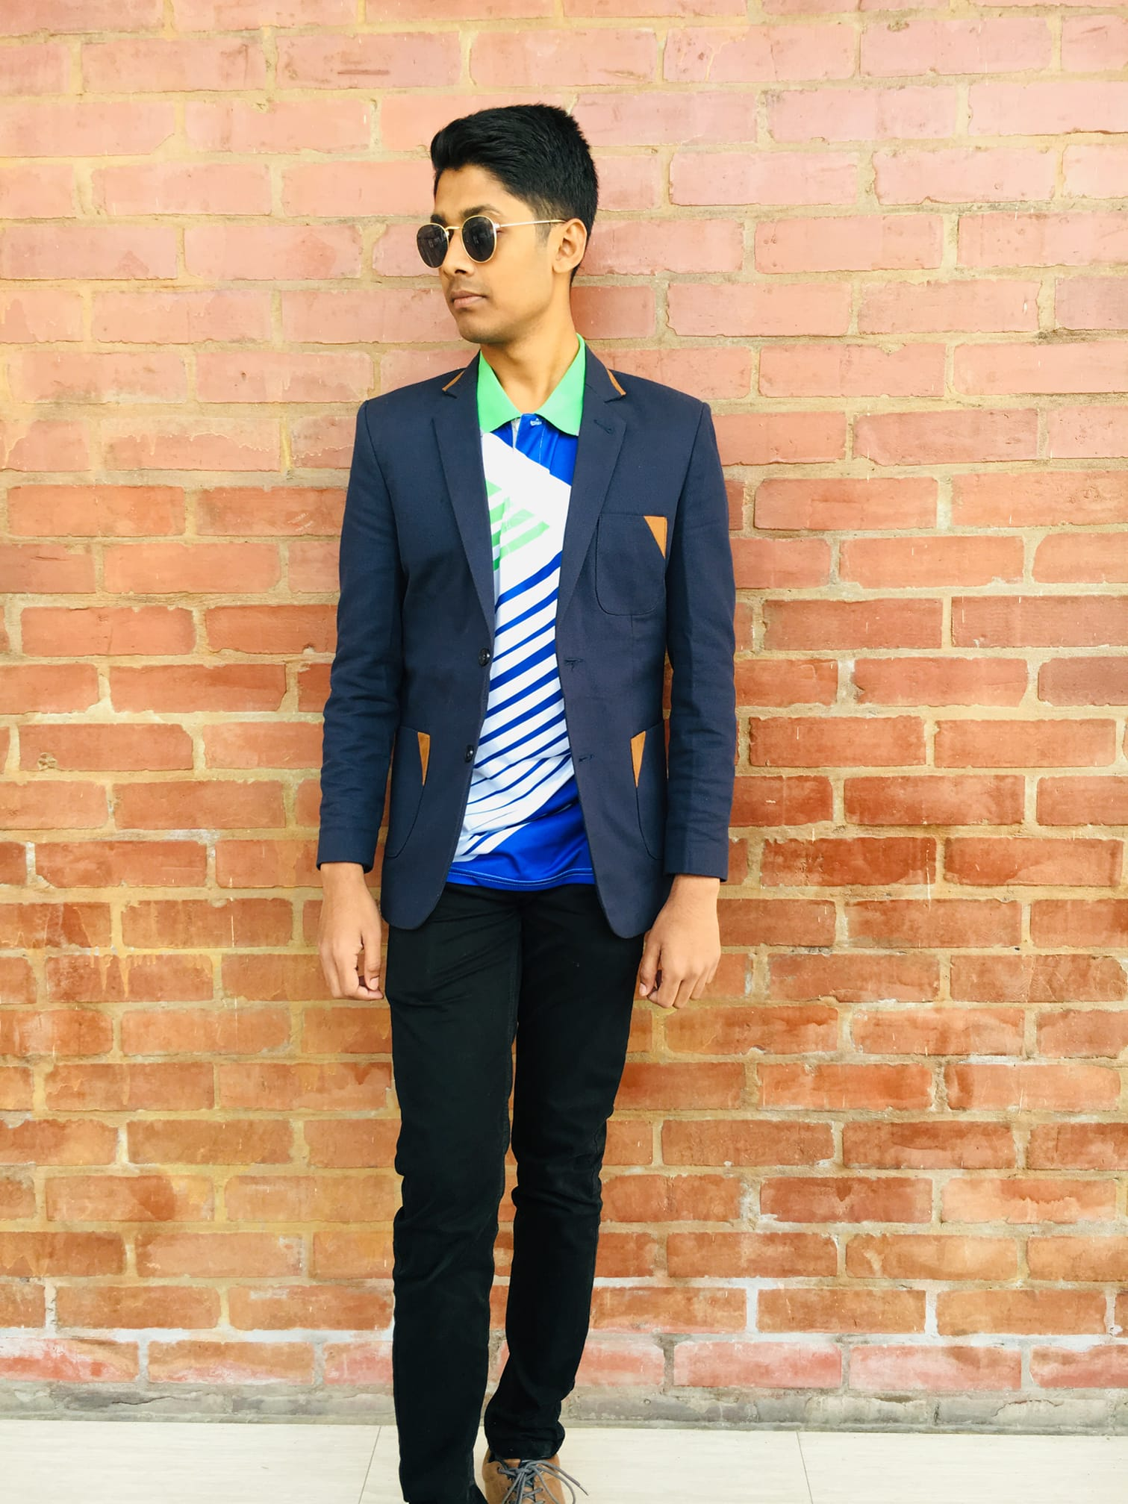
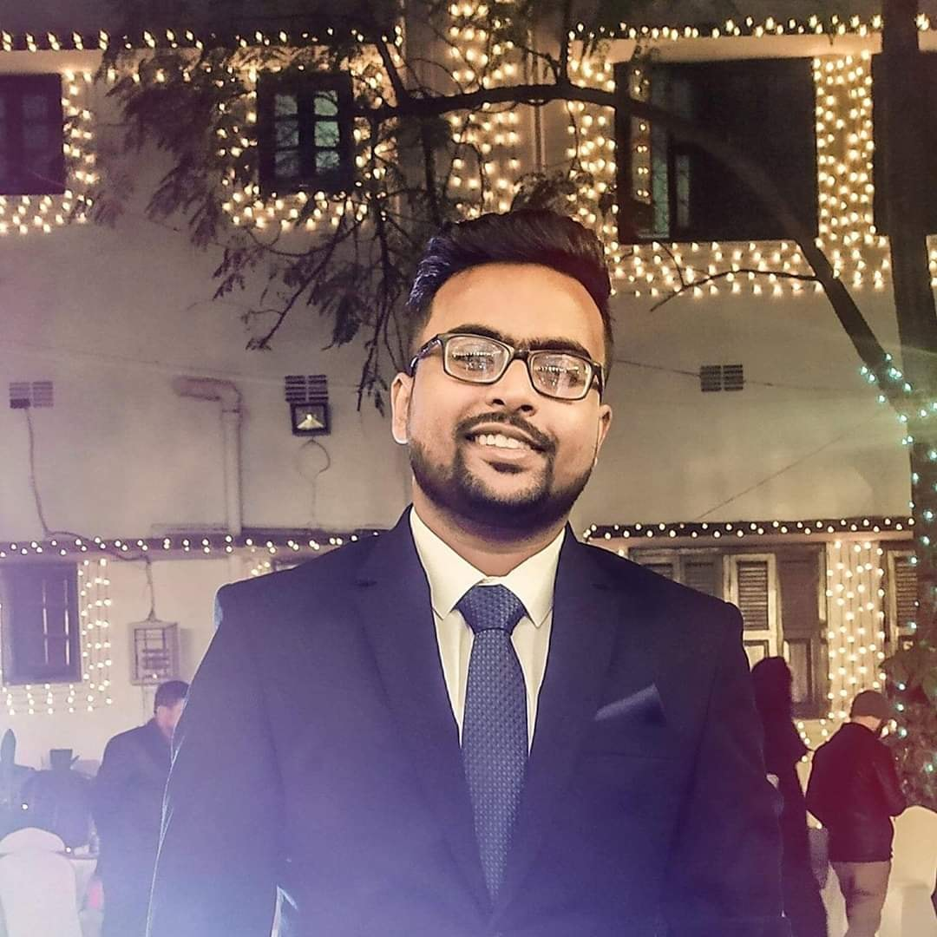
TEAM OVERVIEW
Farhana Smritee
Tandra Rani
Karmakar
Mosa. Rabeya
Robayet Hossain Niloy
Ahmed Zubayer Sunny
191-15-12146
191-15-12134
191-15-12145
191-15-12944
191-15-12960

Slide 3
Farhana Smritee
191-15-12146

Slide 4
Final Testing and Submitting
100%
Simulating
80%
Team Working
60%
Analysis
40%
Choosing Project
20%

Slide 5
Tandra Rani
Karmakar
191-15-12134

Slide 6
Main Features of our Project
Store
Stop & Pause
Resume

Slide 7
Ahmed Zubayer Sunny
191-15-12960

Slide 8
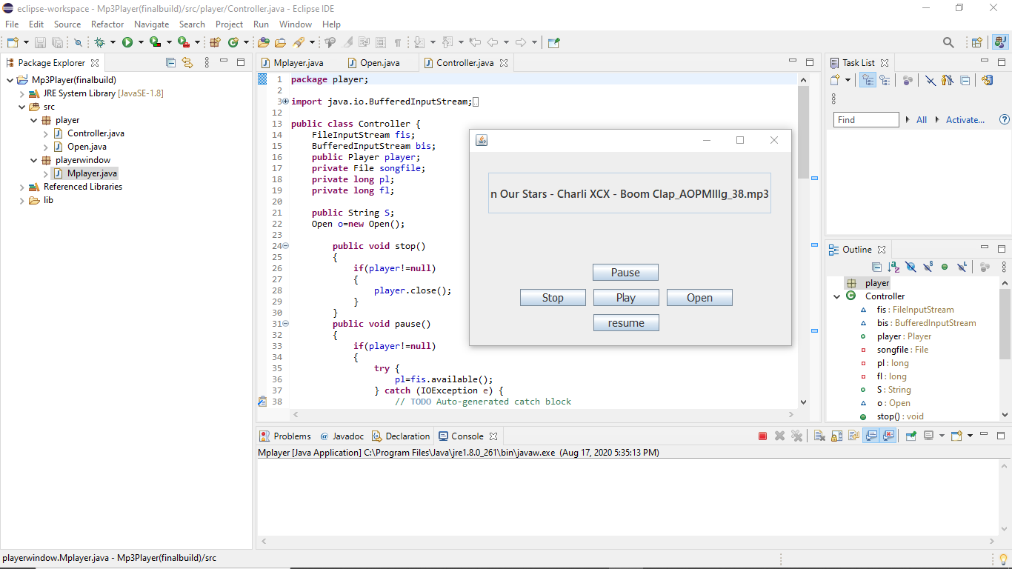

Slide 9
Mosa. Rabeya
191-15-12145

Slide 10
3 Main Classes use in the Java Code of our Project
01
Controller Class
02
Open Class
03
MPplayer Class

Slide 11
Robayet Hossain Niloy
191-15-12944

Slide 12
Make It Better For Users
Adding New Features
Reduce Time Complexity
Reducing Bugs
Quality Sound System

Slide 13


