Slide 1
Electric Growers

Slide 2
Hypothesis:
Who are our target customers?
How should they be approached to maximize the sales
of the client’s new home security systems?
Using the data, figure out the attributes of the customer who wants to install an advanced, hi-tech security system and the attributes of a person who would switch security system brands.

Slide 3
Average House Value by State
Washington D.C., New Jersey and California are the states with higher average price of Houses.
People who lives in these states can be more interested in House Security System

Slide 4
Number of Crimes by states
California, New York and massachusetts are the States with more Burgalaries.
Personal Home Security Solutions which are customized shall have very large markets here.

Slide 5
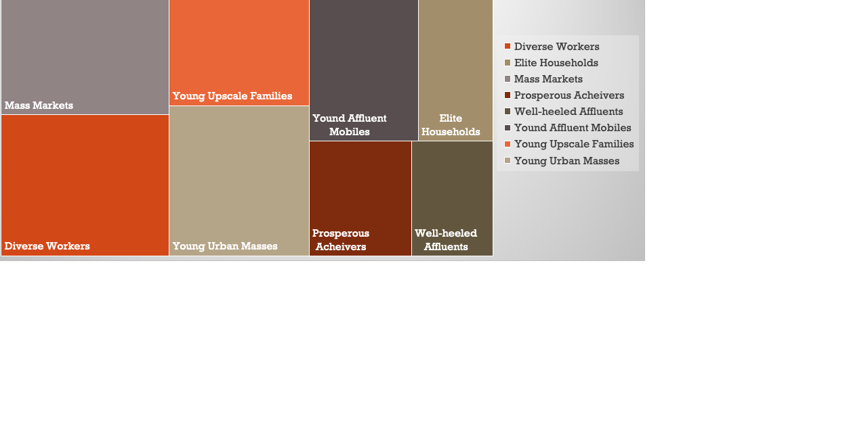
Willingness to Buy Security Devices by Customer Market Segment
Top 5 segments of ideal customer
Mass Markets
Diverse Workers
Young Upscale Families
Young Urban Masses
Yound Affluent Mobiles

Slide 6
Survey of Customer Segments For Willingness to buy v/s switch brands

Slide 7
recommendations
Target California, and New York
Expand to the other top 10 Cities
Marketing strategy for Hi-tech marketing segment
Marketing strategy for brand switching segment

Slide 8
QUESTIONS?

Slide 9
Thank you!
Made by: Ahmed Magdy

