Slide 1
Analyzing Daily Screen Time
Research Question: Does daily screen time exceed the recommended 2 hour limit?

Slide 2
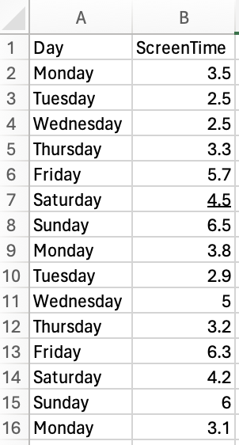
Data Collection
The data was gathered through a dedicated app that monitors daily screen time. It records usage across different apps and sends a daily report notification.
Then, it was stored in an Excel Sheet.
Two column – Screen Time and Weekday

Slide 3

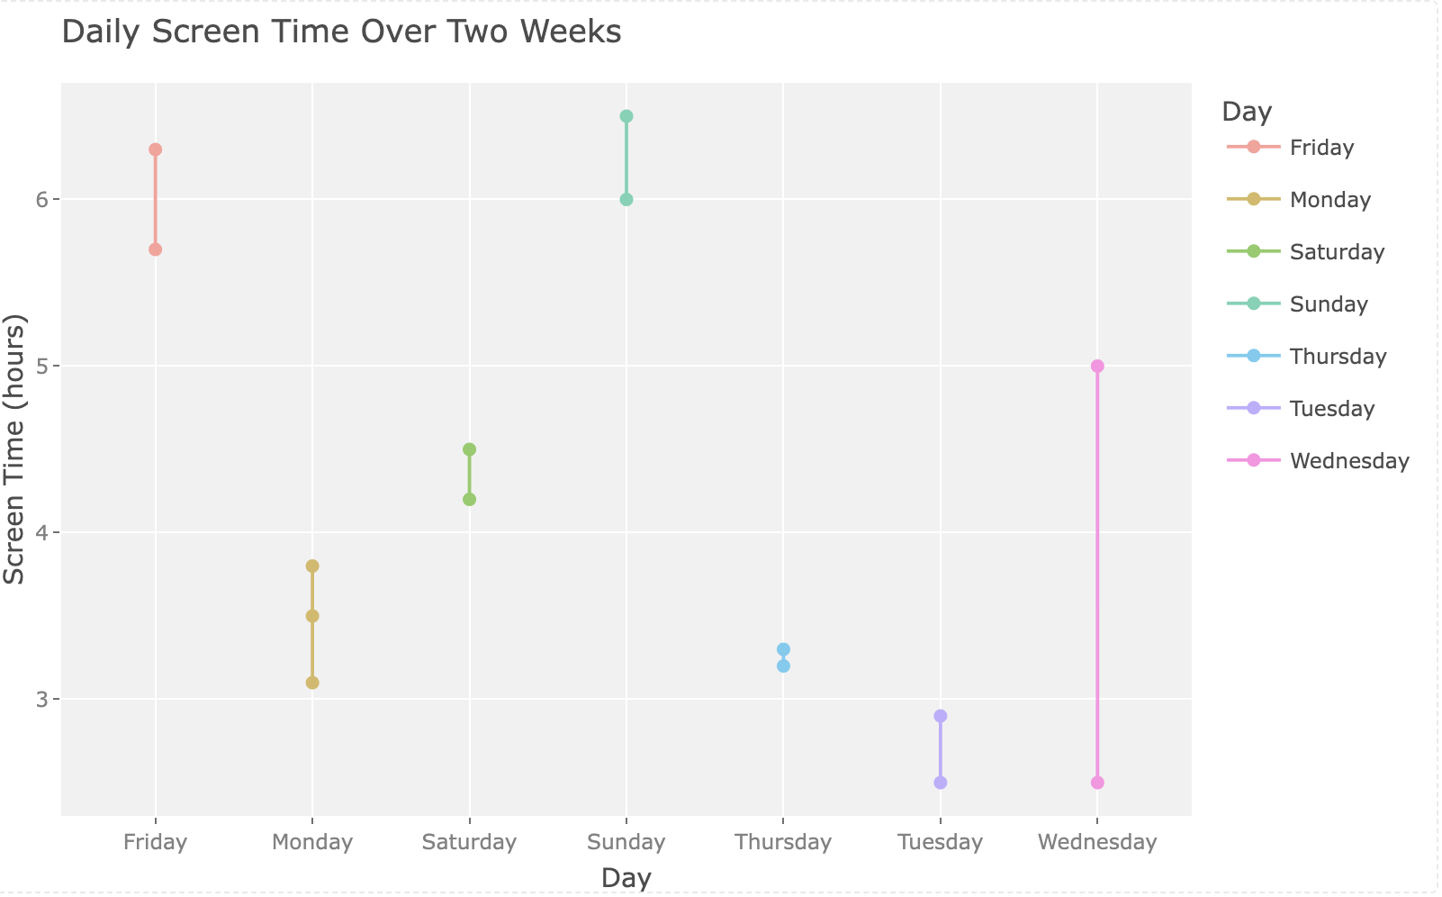



Daily Screen Time Over Two Weeks

Slide 4
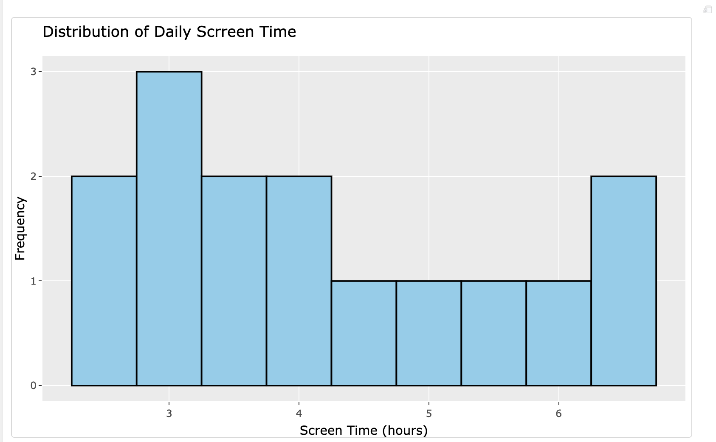
Distribution of Daily Screen Time
The histogram shows the disribution of daily screentime, with each bar representing the frequency of screen time within a certain range of hours.

Slide 5
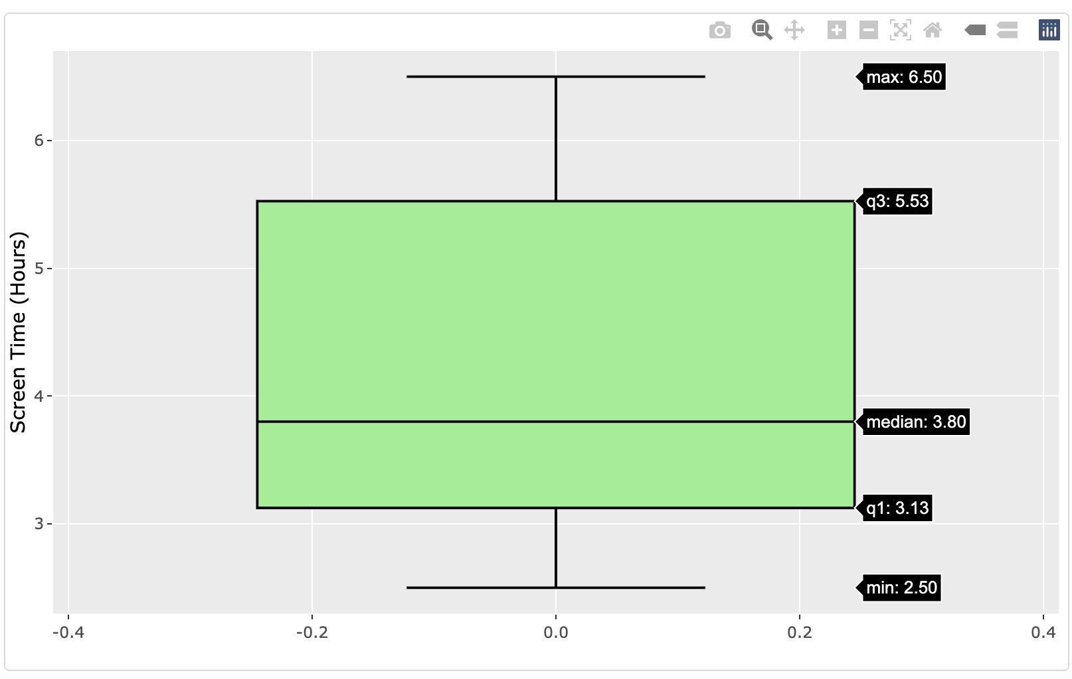
Boxplot
No outliers for the Screen time data. Screen time is between 2.5 - 6.5

Slide 6
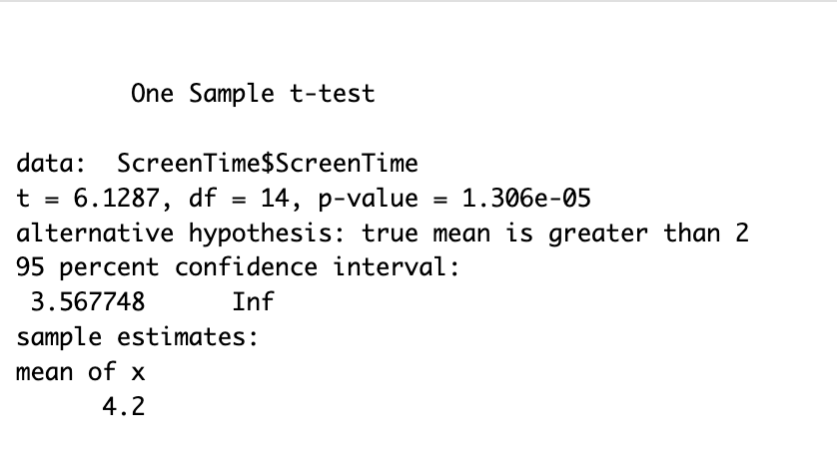
One sample T-test
H0: My average daily screen time is less than or equal 2.
Ha: My average daily screen time exceeds the 2 hours recommended time.
$H0: p = 2.0$ $Ha: p > 2.0$
Experts say adults should limit screen time to 2 hours. In this case, i will be using recommended limit time of 2 hours.
We reject the null hypothesis because the average daily screen is significantly greater than the two -hour limit suggested for screen time.

Slide 7
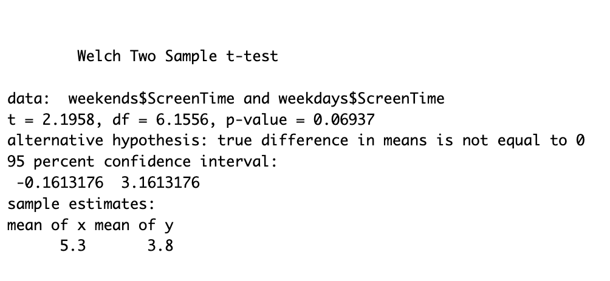
T-Test
H0:There is no significant difference between the average screen time on weekends and weekdays.
HA: The average screen time on weekends differs from weekdays.
$H0: weekends = weekdays$ $Ha: weekends \ne weekdays$
With a p-value = 0.67 we fail to reject the null hypothesis. This proves that there is not evidence to support that average screen time on weekends differs significantly from weekdays.

Slide 8
Summary
The analysis of daily screen time over a two-week period revealed that the mean daily screen time was 4.2 hours, which exceeds the recommended 2-hour limit.
Hypothesis testing showed that there was no significant difference between the average screen time on weekends and weekdays, indicating consistent screen usage patterns across the week.

