Slide 1

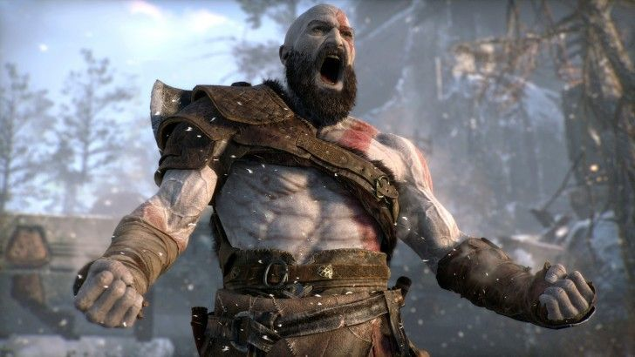
Color Fill 3D
Ahmed Danish| Game Developer

Slide 2
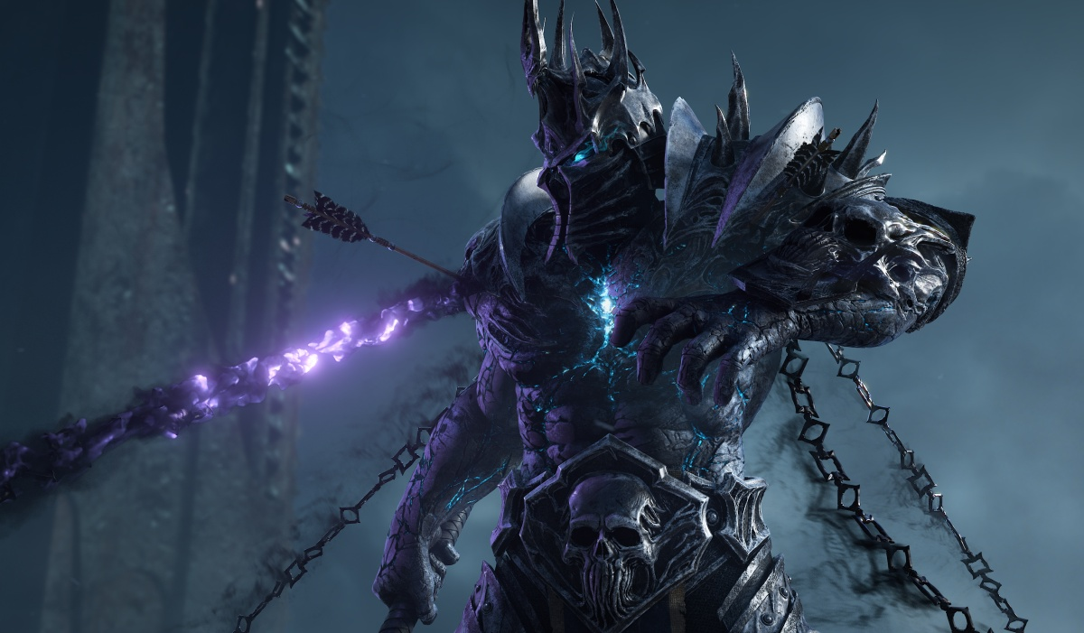
Features Implemented
Swipe movement
Enemy Spawns with dynamic movement length.
Block Reverse Swipe.
Scriptable Objects for Creating levels(Inifinte levels can be created).
Custom editor for Scriptable object for creating level.
Box Fill System.
All other necessary ingredients.
2 different modes (orthographic and perspective)
Project is build in 2019.2.17

Slide 3
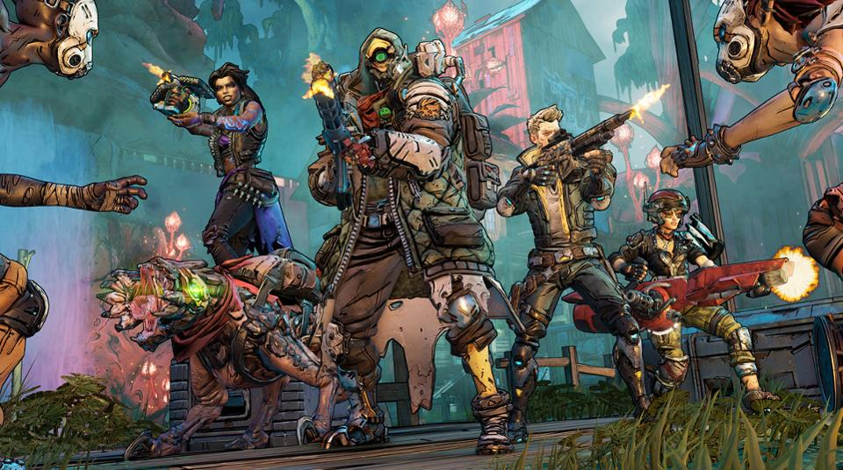
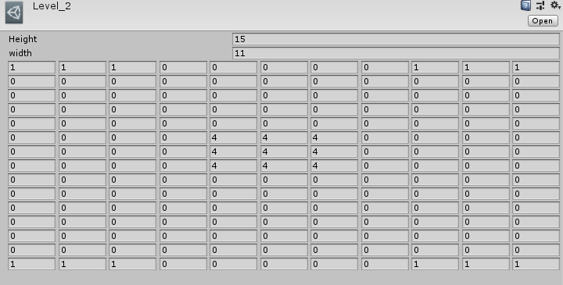
Level Creating Overview
0 = For Spawning A tile.
1 = transparent White wall.
2 = Enemy with 2 unit up distance.
3,4,5---- = Same enemy with input distance covered.

Slide 4

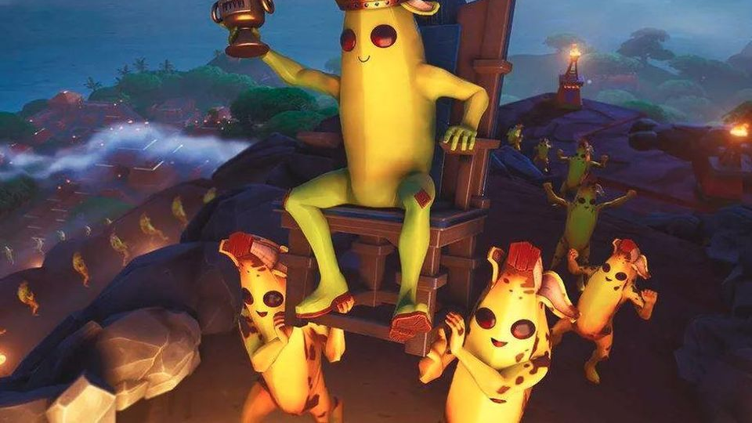



Regards, Ahmed Danish.
Thank You

