Slide 1
TECHNICAL DESIGN REVIEW
UART Transmitter (UART_TX)
RTL — Design, Verification & Debug
UART_TX
Verilog HDL · Verified in QuestaSim · Synthesized in Intel Quartus Prime
Presented by: Ahmed Gamal Khalaf
2026/8 · Digital IC Design Review Committee
Notes:
Open by framing this as a completed, verified IP block ready for review — not a work-in-progress. State the one-line summary: a parameterized UART Transmitter, taken from RTL through simulation debug to FPGA synthesis. Set expectations for the flow of the talk: spec, architecture, FSM, datapath, RTL elaboration, verification, results, and two real debug case studies before closing on next steps.

Slide 2
02
PROJECT SCOPE
Objective & Core Specifications
Design, verify, and debug a fully synthesizable UART Transmitter RTL IP core implementing standard asynchronous serial framing with optional parity — ready for FPGA and ASIC integration.
INTERFACE SIGNALS
Signal | Dir | Description
clk | IN | System clock
Rst_n | IN | Synchronous reset
tx_data_in | IN | Parallel data byte to transmit
we_en | IN | Valid pulse (1 clock cycle)
Parity_en | IN | Parity enable
Parity_bit_state | IN | Parity type select (even / odd)
TX_OUT | OUT | Serial transmit line
Busy | OUT | High while a frame is in process
PROTOCOL
Standard UART TX with direct (FIFO) handshaking
Handshake: clk, rst, tx_data_en, we_en (single-cycle valid pulse), parity_en, parity_bit_en
Outputs: TX_OUTPUT (serial line), BUSY (transmission-in-progress flag)
Handshake Constraint: The core must ignore any new we_en pulse while Busy is high.
PROJECT SCOPE
UART_TX IP Core | 02 / 24
Notes:
Walk the committee through the interface contract before any internals: three input control signals beyond CLK/RST, one data bus, two outputs. Emphasize the handshake constraint explicitly — it's a correctness requirement we verified, not just a nice-to-have, and it comes back in the debug case studies later.

Slide 3
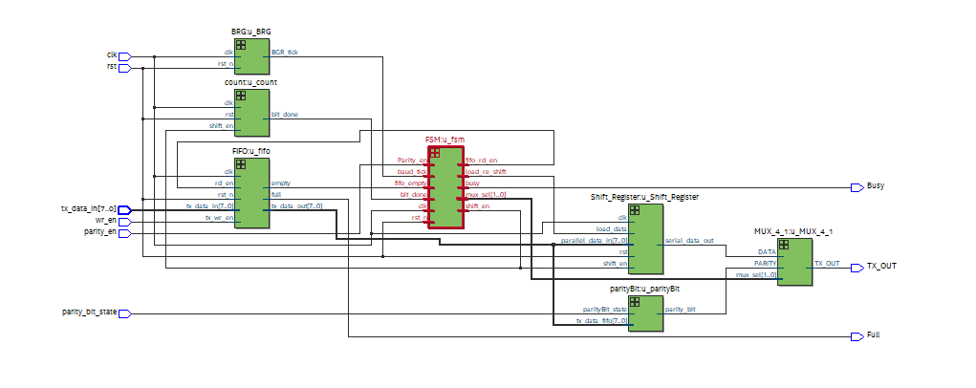
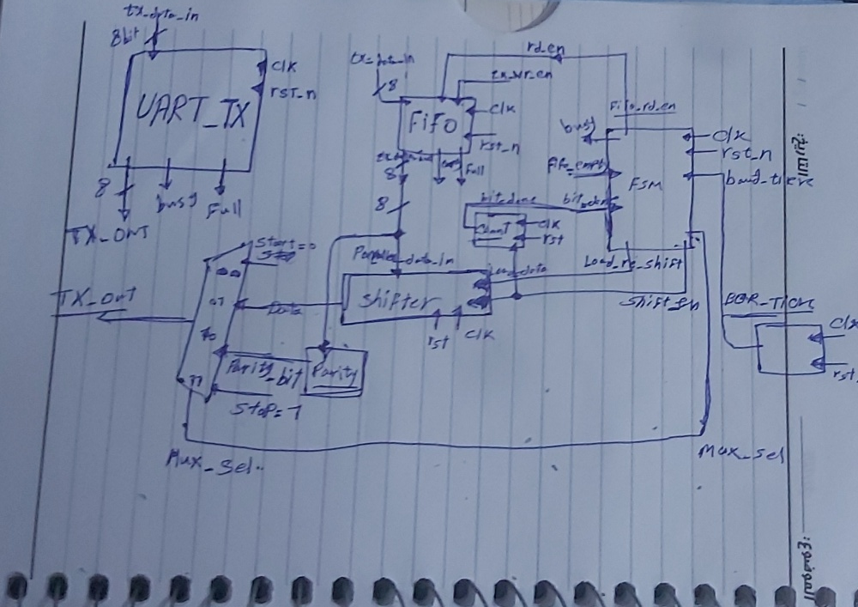
03
SYSTEM ARCHITECTURE
High-Level Architecture
1
Top Module (UART_TX)
2
Baud Rate Generator (BRG)
Parameterized by DATA_WIDTH
Instantiates & wires all sub-blocks
Divides system clock
Produces one bit-period tick
▦
<< INSERT IMAGE HERE >>
Quartus Top-Level RTL Schematic / Block Diagram
(uart_tx_top.v elaborated view)
3
FSM (Main Controller)
4
Datapath
Sequences the 5-state protocol
Drives datapath control signals
Serializer, Parity Calc., Bit Counter
4-to-1 output MUX
SYSTEM ARCHITECTURE
UART_TX IP Core | 03 / 24
Notes:
This is the elaborated top-level view straight from Quartus — swap in your RTL Viewer screenshot here. Four blocks: the parameterized top wrapper, the baud generator that paces every bit, the FSM that sequences the protocol, and the datapath that actually assembles and shifts the frame out.

Slide 4
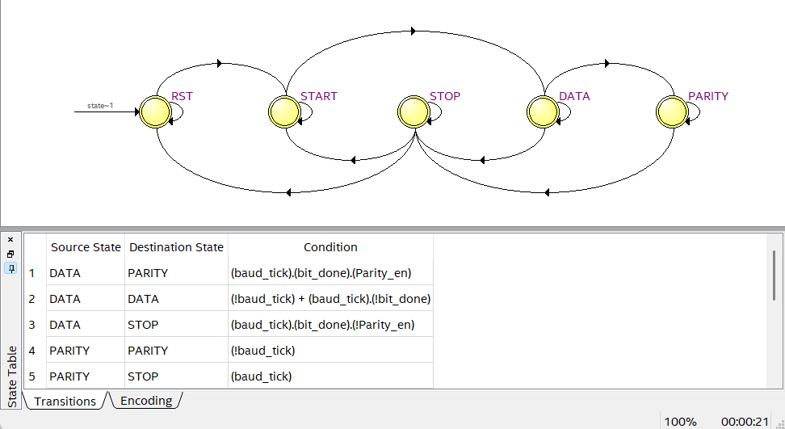
04
CONTROL LOGIC
The FSM Controller
RST
TX_OUTPUT held high; waits for we_en while BUSY = 0
START
Drives TX_OUTPUT low for one full bit period
▦
DATA
Serializes DATA_WIDTH bits LSB-first; bit counter advances each baud tick
<< INSERT IMAGE HERE >>
FSM State Diagram
IDLE → START → DATA → PARITY → STOP
PARITY
Transmits computed parity bit (entered only if parity_en is asserted)
STOP
Drives TX_OUTPUT high, deasserts BUSY, returns to IDLE
CONTROL LOGIC
UART_TX IP Core | 04 / 24
Notes:
Five states, Moore-style outputs gated by state. Point out DATA is highlighted in amber because that's exactly where one of our debug case studies happened — a timing bug that stalled the FSM here. PARITY is conditionally entered only when P_EN is high; otherwise DATA transitions straight to STOP.

Slide 5
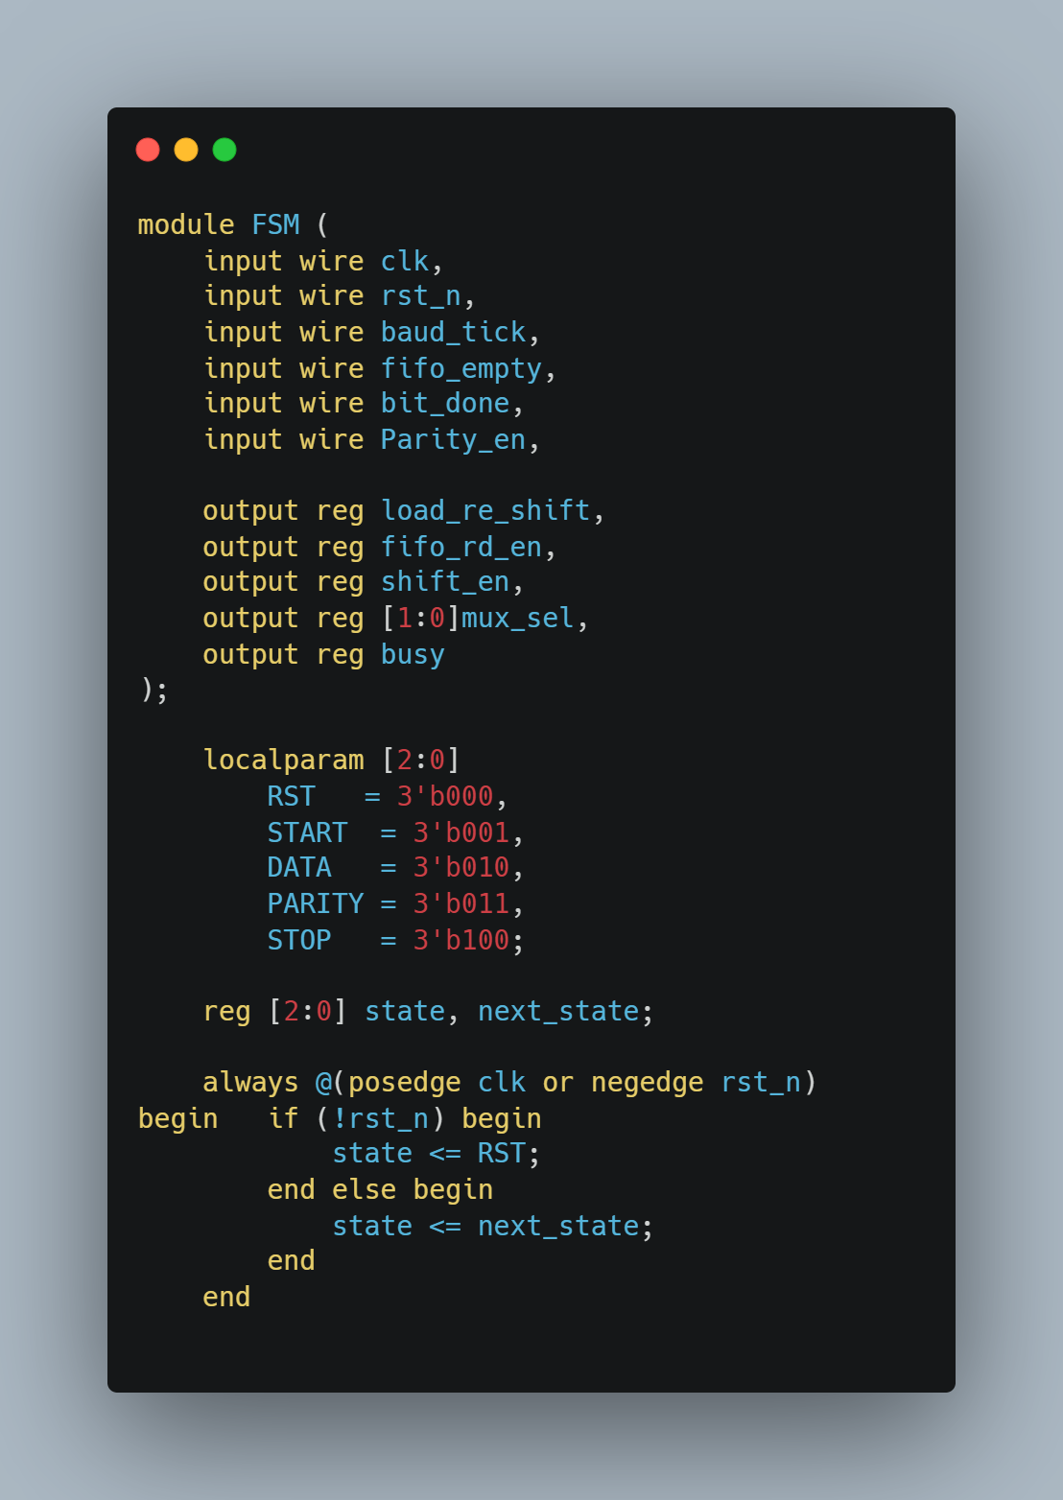
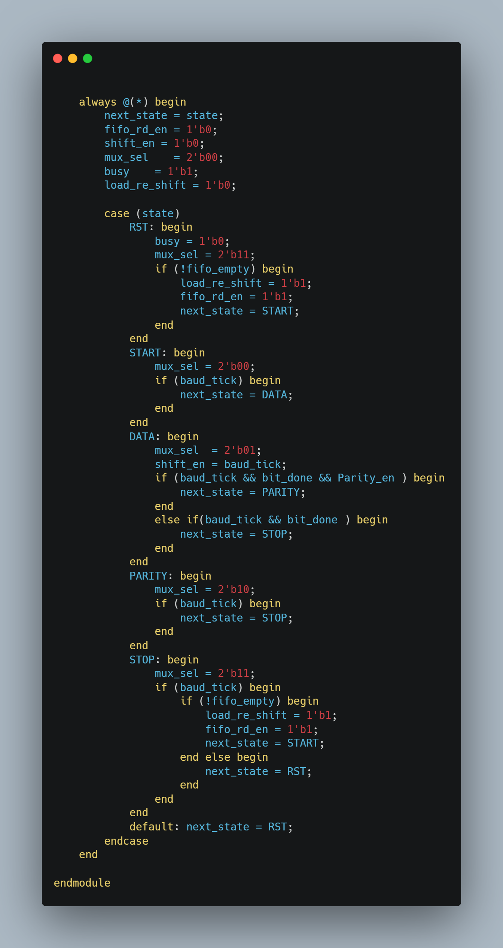
05
RTL IMPLEMENTATION
FSM RTL Code Snippet
uart_tx_fsm.v
Two-process style: sequential state register + combinational next-state / output logic
State register updates only on clk; rst forces RST synchronously
Next-state logic is a pure case statement on the current state and control inputs
bit_done (from the datapath) gates the DATA → PARITY/STOP transition
Parity_en sampled at START to decide whether PARITY is visited
RTL IMPLEMENTATION
UART_TX IP Core | 05 / 24
Notes:
Drop the real case statement into this code panel before presenting. Walk the committee through the two-always-block style: registered state, combinational next-state. Flag that bit_done is an input to this FSM generated by the datapath — its timing is exactly what bug #2 in the debugging section was about.

Slide 6
06
DATAPATH
The Datapath & Serializer
1
4-to-1 Output MUX
2
Serializer (Shift Register)
Selects Start / Data-bit / Parity / Stop onto TX_OUTPUT
Select lines driven directly by FSM current state
Parallel-loads P_INPUT on the V_INPUT pulse
Shifts LSB-first, one bit per baud tick
3
Parity Calculator
4
3-bit Bit Counter
Combinational XOR-tree over tx_data_out from FIFO
Even/odd sense selected by parity_bit_en
Tracks position 0–7 within the data byte
Feeds bit_done to the FSM (combinational)
DATAPATH
UART_TX IP Core | 06 / 24
Notes:
Four blocks make up the datapath. The MUX is purely a function of FSM state — it never generates control decisions itself, only routes bits. The parity calculator is a plain XOR tree, so it settles well within one clock period. The bit counter is the block at the center of debug case study #2.

Slide 7
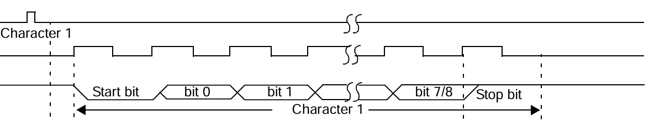
07
RTL IMPLEMENTATION
Datapath RTL Code Snippet
Bit ordering convention: LSB-first, matching the UART standard
Frame fields are logically concatenated as {STOP, PARITY, DATA[7:0], START}
MUX select logic uses blocking (=) assignments inside always @(*) — see Debug Case Study #1
Counter terminal count exposed combinationally as bit_done — see Debug Case Study #2
RTL IMPLEMENTATION
UART_TX IP Core | 07 / 24
Notes:
Same treatment as the FSM slide — paste the real datapath code into the panel. The two bullets at the bottom are deliberate callbacks: both point directly at the root causes covered in the debugging section, so the committee sees where in the code each fix actually lives.

Slide 8
08
SYNTHESIS
RTL Elaboration
▦
<< INSERT IMAGE HERE >>
State Machine Viewer
▦
<< INSERT IMAGE HERE >>
Quartus RTL Viewer — full elaborated schematic
ELABORATION CHECKS
Synthesized netlist matches RTL design intent
No inferred latches on any datapath or FSM signal
SYNTHESIS
UART_TX IP Core | 08 / 24
Notes:
This is the proof that the RTL synthesizes cleanly into real hardware. Confirm no unintended latches were inferred — a common way FSM or MUX bugs like the ones we hit would otherwise hide until the gate level. Fill in the LE/register counts from your own Compilation Report before presenting.

Slide 9
09
VERIFICATION
Verification Environment
1
Stimulus Driver
2
Clock / Reset Gen
3
Self-Checking Monitor
Drives tx_data_in, we_en, parity_en, parity_bit_en
Generates directed + randomized byte sequences
Respects the Busy handshake when queuing new frames
Free-running clk generation
Synchronous rst pulse at start of test
Parameterizable clock period
Samples TX_OUTPUT at each bit period
Reconstructs frame: start/data/parity/stop
Checks BUSY asserts/deasserts at correct edges
Parametrization Strategy: Baud counter parameterized (e.g. N=4 ) to compress simulation runtime while preserving protocol timing relationships — fast QuestaSim iteration during debug.
VERIFICATION
UART_TX IP Core | 09 / 24
Notes:
Three pieces: a driver that respects the same handshake contract real hardware must respect, a simple clock/reset generator, and a self-checking monitor that reconstructs the transmitted frame bit-by-bit rather than just eyeballing waveforms. The parametrized baud divider is what let us iterate on waveform debug in seconds instead of minutes per run.

Slide 10
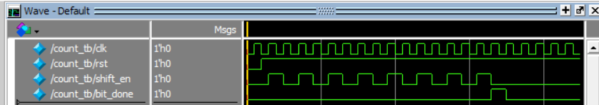
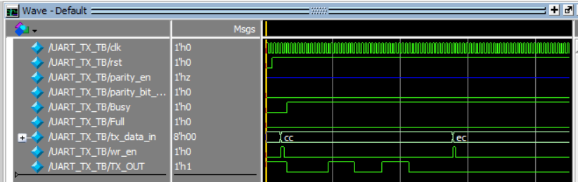
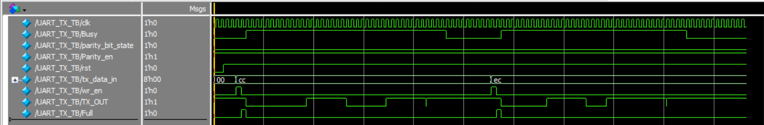
10
VERIFICATION
Simulation Results
WHAT TO VERIFY
Start bit: TX_OUTPUT low for exactly one baud period
Data bits: 8 bits, LSB-first, match driven P_INPUT
Parity bit: correct value for asserted parity_en sense
Stop bit: TX_OUTPUT returns high for one baud period
BUSY: high for the entire frame, deasserts exactly at frame end
VERIFICATION
UART_TX IP Core | 10 / 24
Notes:
Walk the waveform left to right against this checklist. This is the same checklist the monitor enforces automatically in regression — showing it manually here builds committee confidence that the self-checking testbench isn't missing anything a human would catch by eye.

Slide 11
11
DEBUG & ROOT-CAUSE ANALYSIS
Debugging Case Studies
BUG #1 — MISSING STOP BIT
BUG #2 — FSM STUCK IN DATA
Symptom: Stop bit missing from TX_OUTPUT in simulation. Root Cause: Non-blocking (<=) assignments used inside the combinational MUX select block (always @(*)) created a scheduling race — the select logic evaluated against a stale value. Fix: Changed the assignments inside the combinational always @(*) block from non-blocking (<=) to blocking (=). Lesson: Use blocking (=) in combinational always @(*) blocks; reserve non-blocking (<=) for sequential always @(posedge CLK) blocks.
Symptom: FSM never left the DATA state; bit counter appeared to count correctly. Root Cause: bit_done was a registered (sequential) signal, adding a 1-cycle lag that desynchronized it from the counter's true terminal count — the FSM missed the transition window. Fix: Made bit_done purely combinational: assign bit_done = (counter == 3'b111); Lesson: Control signals that gate FSM transitions should be combinational functions of state unless timing explicitly requires a registered stage.
DEBUG & ROOT-CAUSE ANALYSIS
UART_TX IP Core | 11 / 24
Notes:
These are the two bugs worth walking through carefully because they represent two different classes of RTL mistakes: bug #1 is a simulation semantics issue (blocking vs. non-blocking in combinational logic) that could also bias synthesis results if left uncorrected; bug #2 is an architectural timing mismatch between a control signal and the state it's meant to gate. Both were found by tracing the QuestaSim waveform back to the exact clock edge where behavior diverged from expectation.

Slide 12
12
CLOSING
Conclusion & Future Scalability
ACHIEVEMENTS
▪ Fully verified UART_TX RTL IP core — 5-state FSM, parameterized datapath, direct handshake ▪ Two significant RTL bugs identified and resolved via waveform-level root-cause analysis ▪ Clean Quartus Prime synthesis with schematic matching design intent, no inferred latches
Ready for integration review and sign-off.
UART_TX IP Core | 12 / 24
Notes:
Close by reinforcing that this is a signed-off, working IP block, not a proof of concept — verified against a self-checking testbench and clean through synthesis. Then pivot forward: FIFO and AXI-Stream wrappers are the natural next integration steps if this block is adopted into a larger SoC, and a UART_RX counterpart completes the link. Invite questions.

Slide 13
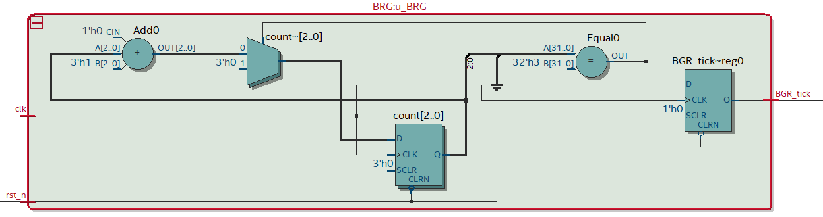
13
SUB-MODULE DEEP DIVE
Baud Rate Generator (BRG) – RTL Design
Parameterized counter: divides the system clock by N =4 (count_width = 3)
Free-running counter increments on every clock cycle
baud_tick pulses high for exactly one cycle when the counter reaches N−1, then resets
BRG.v
module BRG #(
parameter N = 4,
parameter count_width =3
)(
input wire clk,
input wire rst_n,
output reg BGR_tick
);
reg [count_width-1:0] count;
always @(posedge clk or negedge rst_n) begin
if (!rst_n) begin
count <= 0;
BGR_tick <= 0;
end
else if (count == N - 1) begin
count <= 0;
BGR_tick <= 1;
end
else begin
count <= count + 1'b1;
BGR_tick <= 0;
end
end
endmodule
▦
SUB-MODULE DEEP DIVE
UART_TX IP Core | 13 / 24
Notes:
Open the deep-dive section by framing why the BRG matters: every other block in the design is paced off baud_tick, so its correctness is foundational. Point out this is a pure divide-by-N counter with no surprises — the interesting engineering is entirely in how cleanly it's parameterized for reuse at any baud rate.

Slide 14
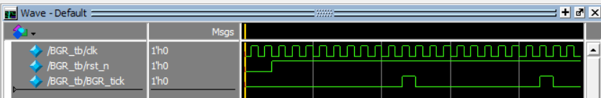
14
SUB-MODULE DEEP DIVE
Baud Rate Generator (BRG) – Unit Testing
Standalone testbench instantiates the BRG in isolation with a small N for fast simulation
Drives CLK and RST_N, monitors baud_tick
Self-checking assertion: baud_tick must assert exactly N clock cycles after each reset / prior tick
BRG_tb.v
/`timescale 1ns/1ps
module BGR_tb;
parameter N = 10;
parameter count_width = 4;
reg clk;
reg rst_n;
wire BGR_tick;
BRG #(
.N(N),
.count_width(count_width)
) UT (
.clk(clk),
.rst_n(rst_n),
.BGR_tick(BGR_tick)
);
always #5 clk = ~clk;
initial begin
clk = 0;
rst_n = 0;
#20;
rst_n = 1;
#200;
#50;
$finish;
end
endmodule
▦
SUB-MODULE DEEP DIVE
UART_TX IP Core | 14 / 24
Notes:
This is the same unit-level testbench style shown earlier for the full design, applied at the block level: isolate, drive, self-check. The N-cycle assertion here is what gives confidence the top-level timing is correct without having to eyeball every waveform by hand.

Slide 15
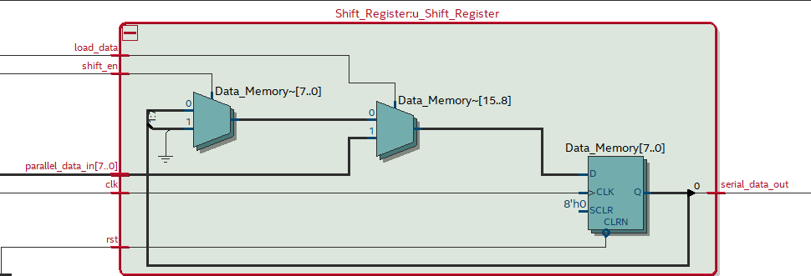
15
SUB-MODULE DEEP DIVE
Shift Register – RTL Design
Parallel-loads P_INPUT synchronously when load_re_shift is high
Shifts right one bit per baud tick when shift_en is high — LSB output first, matching UART bit order
Holds its current value when neither control signal is asserted
shift_reg.v
module Shift_Register #(parameter Data_Width = 8)
(
input wire clk,
input wire rst,
input wire load_data,
input wire shift_en,
input wire [Data_Width-1:0]parallel_data_in,
output wire serial_data_out
);
reg [Data_Width-1:0] Data_Memory;
always@(posedge clk or negedge rst) begin
if(~rst) begin
Data_Memory <= {Data_Width{1'b0}};
end
else if(load_data) begin
Data_Memory <= parallel_data_in;
end
else if(shift_en) begin
Data_Memory <= {1'b0 , Data_Memory[Data_Width-1:1]};
end
end
assign serial_data_out = Data_Memory[0];
endmodule
▦
SUB-MODULE DEEP DIVE
UART_TX IP Core | 15 / 24
Notes:
This is the serializer at the heart of the datapath. The key design decision to call out is the load vs. shift priority encoded in the always block — load_re_shift and shift_en should never need to be asserted in the same cycle given the FSM's control discipline, but the RTL still defines a clear priority for robustness.

Slide 16
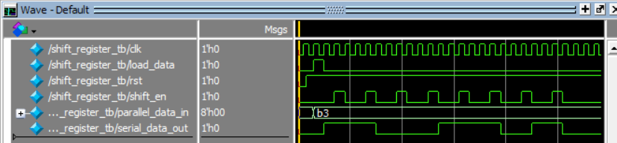
16
SUB-MODULE DEEP DIVE
Shift Register – Unit Testing
TB drives load_re_shift with a known byte pattern, then pulses shift_en repeatedly
Checks the loaded value matches the driven P_INPUT exactly after load
Checks the serial output bit order matches the expected LSB-first sequence across all 8 shifts
shift_reg_tb.v
always #10 clk = ~clk;
initial begin
clk = 0;
rst = 0;
load_data = 0;
shift_en = 0;
parallel_data_in = 8'b00000000;
#15;
rst = 1;
@(posedge clk);
parallel_data_in = 8'b10110011;
load_data = 1;
@(posedge clk);
load_data = 0;
#20;
repeat (8) begin
@(posedge clk);
shift_en = 1;
@(posedge clk);
shift_en = 0;
#30;
end
#50;
$finish;
end
▦
SUB-MODULE DEEP DIVE
UART_TX IP Core | 16 / 24
Notes:
Walk through the waveform bit-by-bit against the driven byte to show the LSB-first convention explicitly — this is exactly the kind of detail a committee will want confirmed rather than assumed.

Slide 17
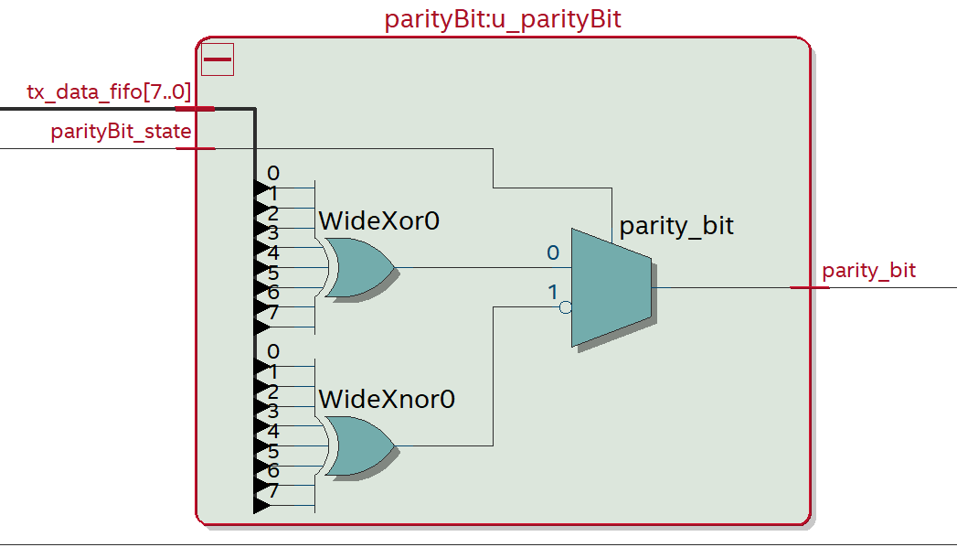
17
SUB-MODULE DEEP DIVE
Parity Calculator – RTL Design
Pure combinational XOR-reduction tree over all P_INPUT bits (^P_INPUT)
P_BIT selects even (P_BIT = 0) or odd (P_BIT = 1) parity by inverting the XOR result
Zero-latency — settles within one combinational delay, no clock involved
parity_calc.v
module parityBit #(parameter Data_Path = 8 )
(
input wire [Data_Path-1:0] tx_data_fifo ,
input wire parityBit_state,
output wire parity_bit
);
assign parity_bit = (parityBit_state) ? (~^tx_data_fifo) : (^tx_data_fifo);
endmodule
SUB-MODULE DEEP DIVE
UART_TX IP Core | 17 / 24
Notes:
Simple block, but worth a full slide because parity errors are a classic UART integration bug. Emphasize it's purely combinational — no registered stage — so it's always valid the same cycle P_INPUT is stable.

Slide 18
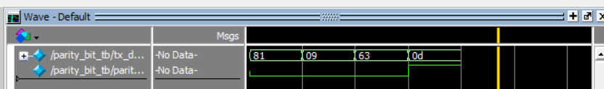
18
SUB-MODULE DEEP DIVE
Parity Calculator – Unit Testing
TB sweeps data patterns (all-zero, all-one, alternating, randomized) against both P_BIT settings
A reference model inside the testbench computes expected parity independently of the DUT
Self-checking comparison confirms both even and odd cases match for every pattern
parity_bit_tb.v
module parity_bit_tb;
parameter Data_Path = 8;
reg [Data_Path-1:0]tx_data_fifo;
wire parity_bit;
parityBit #(.Data_Path(Data_Path) ) UT (
.tx_data_fifo(tx_data_fifo),
.parity_bit(parity_bit)
);
initial begin
tx_data_fifo = $random ;
tx_data_fifo = $random;
#10;
tx_data_fifo = $random;
#10;
tx_data_fifo = $random;
#10;
tx_data_fifo = $random;
#10;
$finish;
end
endmodule
SUB-MODULE DEEP DIVE
UART_TX IP Core | 18 / 24
Notes:
The reference-model-in-the-testbench pattern is worth calling out explicitly — it's a scalable verification technique that generalizes well beyond this one block, and shows verification maturity beyond just directed test vectors.

Slide 19
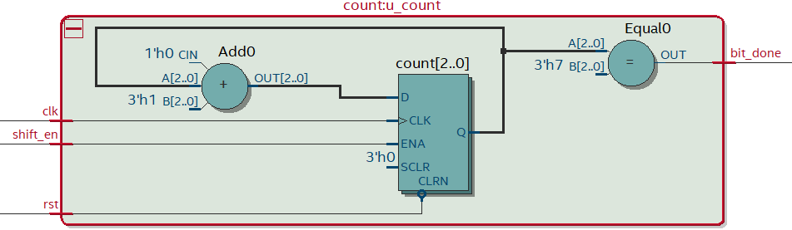
19
SUB-MODULE DEEP DIVE
3-bit Counter – RTL Design
Synchronous 3-bit up-counter, increments on every shift_en pulse during DATA
bit_done asserted purely combinationally: assign bit_done = (counter == 3'b111);
Resets on RST or when the FSM re-enters DATA for the next frame
bit_counter.v
module count (
input wire clk,
input wire rst,
input wire shift_en,
output wire bit_done
);
reg [2:0] count;
always @(posedge clk or negedge rst) begin
if (!rst) begin
count <= 3'b000;
end else begin
if (shift_en) begin
count <= count + 1'b1;
end
end
end
assign bit_done = (count == 3'b111);
endmodule
SUB-MODULE DEEP DIVE
UART_TX IP Core | 19 / 24
Notes:
This block is the direct subject of Debug Case Study #2 from the main deck — flag that connection explicitly. The combinational assign statement for bit_done is the fix; showing it here alongside the counter itself makes the root-cause story concrete rather than abstract.

Slide 20
20
SUB-MODULE DEEP DIVE
3-bit Counter – Unit Testing
TB pulses shift_en eight times, recording the counter value every cycle
Checks bit_done stays low for counts 0–6 and asserts on the exact cycle counter = 3'b111
This exact timing was the root cause in Debug Case Study #2 — regression confirms the fix holds
bit_counter_tb.v
always #5 clk = ~clk;
task pulse_shift_en();
begin
@(posedge clk);
shift_en = 1'b1;
@(posedge clk);
shift_en = 1'b0;
end
endtask
initial begin
clk = 0;
rst = 0;
shift_en = 0;
#10 rst = 1;
repeat(8) begin
pulse_shift_en();
#10;
end
#50 $finish;
end
▦
SUB-MODULE DEEP DIVE
UART_TX IP Core | 20 / 24
Notes:
This is the regression test that would have caught the original bug automatically — worth noting that it was added as a direct result of the debug process, not written speculatively beforehand.

Slide 21
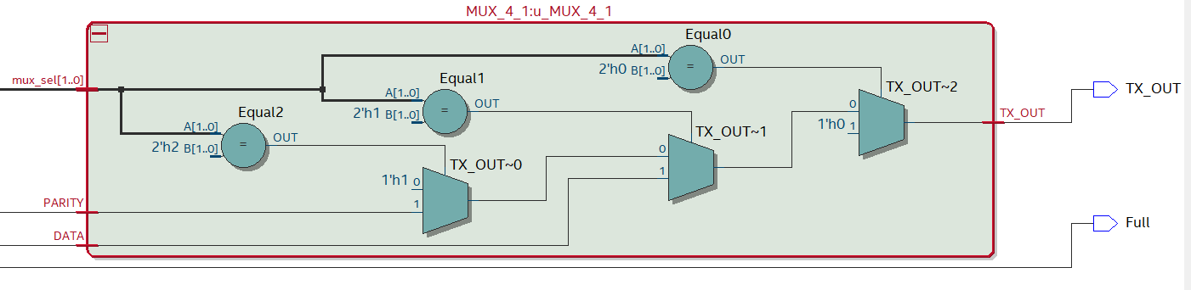
21
SUB-MODULE DEEP DIVE
4-to-1 MUX – RTL Design
Combinational routing block: selects Start bit (0), Data bit, Parity bit, or Stop/Idle bit (1) onto TX_OUTPUT
mux_sel is driven directly by the FSM's current state — a pure function of state, never latched
Implemented as a single always @(*) block using blocking (=) assignments
tx_mux.v
module MUX_4_1
(
input wire DATA,
input wire PARITY,
input wire [1:0]mux_sel,
output reg TX_OUT
);
always @(*) begin
if(mux_sel == 2'b00) TX_OUT = 1'b0;
else if(mux_sel == 2'b01) TX_OUT = DATA;
else if(mux_sel == 2'b10) TX_OUT = PARITY;
else if(mux_sel == 2'b11) TX_OUT = 1'b1;
else TX_OUT = 1'b1;
end
endmodule
SUB-MODULE DEEP DIVE
UART_TX IP Core | 21 / 24
Notes:
This is the other half of Debug Case Study #1. The blocking-assignment detail in the bullet list isn't incidental — it's the exact fix, stated here as a design rule rather than a war story.

Slide 22
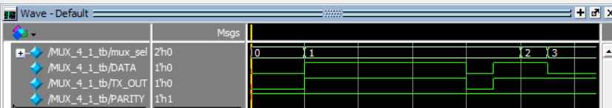
22
SUB-MODULE DEEP DIVE
4-to-1 MUX – Unit Testing
TB drives mux_sel through all 4 encodings while varying the three data inputs
Checks TX_OUTPUT reflects the correct source for every select value
This is the block from Debug Case Study #1 — regression confirms Stop-bit routing is correct every cycle
tx_mux_tb.v
task set_Data(input [1:0] Mux_Sel , input parity);
begin
DATA = $random;
PARITY = parity;
mux_sel = Mux_Sel ;
#10;
end
endtask
initial begin
set_Data(2'b00,1'b1);
#10;
repeat (8) begin
set_Data(2'b01,1'b1);
end
set_Data(2'b10,1'b1);
set_Data(2'b11,1'b1);
#20;
$finish;
end
▦
SUB-MODULE DEEP DIVE
UART_TX IP Core | 22 / 24
Notes:
Exhaustive testing of all 4 select values is deliberate here, not overkill — with only 4 states, full coverage is cheap and it's exactly this kind of exhaustive check that should catch a MUX scheduling bug like the one covered earlier, closing the loop on Debug Case Study #1.

Slide 23
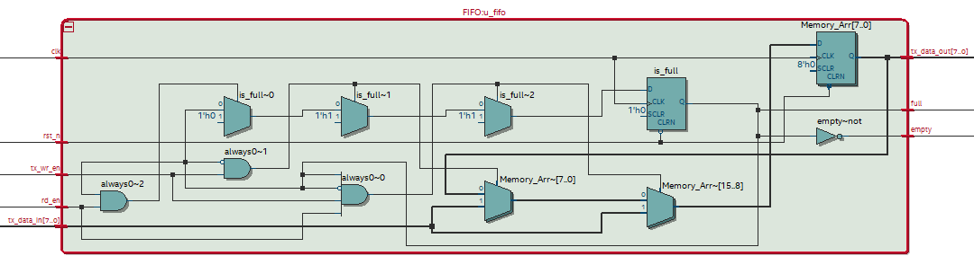
23
ADVANCED ARCHITECTURE
FIFO Buffert
A parameterizable First-Word-Fall-Through FIFO was also designed to demonstrate a production-grade decoupling strategy between a fast CPU/write-side and the comparatively slow UART bit rate.
FIFO.v
t
module FIFO #(parameter Data_Path = 8 , parameter Depth = 4 )
(
input wire clk,
input wire rst_n,
input wire [Data_Path-1:0]tx_data_in,
input wire tx_wr_en,
input wire rd_en,
output wire full, // if 4 byte is full by data
output wire [Data_Path-1:0]tx_data_out,
output wire empty // if empty = 0 this mean memory have data ;
);
reg [Data_Path-1:0] Memory_Arr;
reg is_full;
assign full =is_full;
assign empty = ~is_full;
assign tx_data_out = Memory_Arr;
always @(posedge clk or negedge rst_n) begin
if (~rst_n) begin
is_full <= 1'b0;
Memory_Arr <= 0;
end
else begin
if (rd_en && tx_wr_en && ~full && ~empty)begin
if (is_full) begin
Memory_Arr <= tx_data_in;
end else begin
Memory_Arr <= tx_data_in;
is_full <= 1'b1;
end
end
else if (tx_wr_en && ~is_full) begin
Memory_Arr <= tx_data_in;
is_full <= 1'b1;
end
else if (rd_en && is_full) begin
is_full <= 1'b0;
end
end
end
endmodule
ADVANCED ARCHITECTURE
UART_TX IP Core | 23 / 24
Notes:
This slide exists to show range — that the direct-handshake design was a deliberate choice against a specification, not the only architecture known. Be ready to explain FWFT specifically: unlike a standard synchronous FIFO where rd_data is only valid one cycle after rd_en, FWFT presents the next word immediately, which matters if a downstream consumer wants to peek before committing to a read.

Slide 24
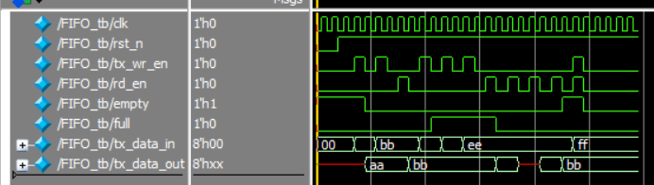
24
ADVANCED ARCHITECTURE
FIFO vs. Direct Handshake Architecture Trade-off
FIFO-BASED ARCHITECTURE (INDUSTRY STANDARD)
DIRECT HANDSHAKE (THIS PROJECT'S SPEC)
Decouples CPU write timing from the UART bit rate — the CPU never stalls waiting on BUSY
Absorbs bursty writes and smooths them onto the serial line at baud rate
tx_data_in pulses are intentionally ignored while BUSY is high — no buffering,
Forces the master to respect Busy explicitly — simplest possible core, smallest footprint
▦
ADVANCED ARCHITECTURE
UART_TX IP Core | 24 / 24
Notes:
Close the deep-dive section with the trade-off framed as a deliberate engineering choice, not a limitation. The direct-handshake spec was chosen specifically to exercise and verify data-drop behavior under back-pressure — a legitimate design requirement in its own right, distinct from ‘the FIFO version wasn't built.’ If asked why not just always use a FIFO: cost, latency, and verification surface are all lower without one, and some protocols specifically require the master to observe BUSY rather than have the slave paper over back-pressure.

