Slide 1


Slide 2
What is Docker?
Docker container image is a lightweight, standalone, executable package of software that includes everything needed to run an application: code, runtime, system tools, system libraries and settings.

Slide 3
Docker containers that run on Docker Engine:
Standard: Docker created the industry standard for containers, so they could be portable anywhere
Lightweight: Containers share the machine’s OS system kernel and therefore do not require an OS per application, driving higher server efficiencies and reducing server and licensing costs
Secure: Applications are safer in containers and Docker provides the strongest default isolation capabilities in the industry

Slide 4
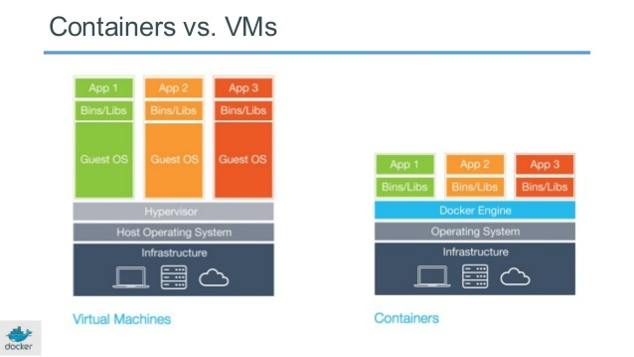

Slide 5
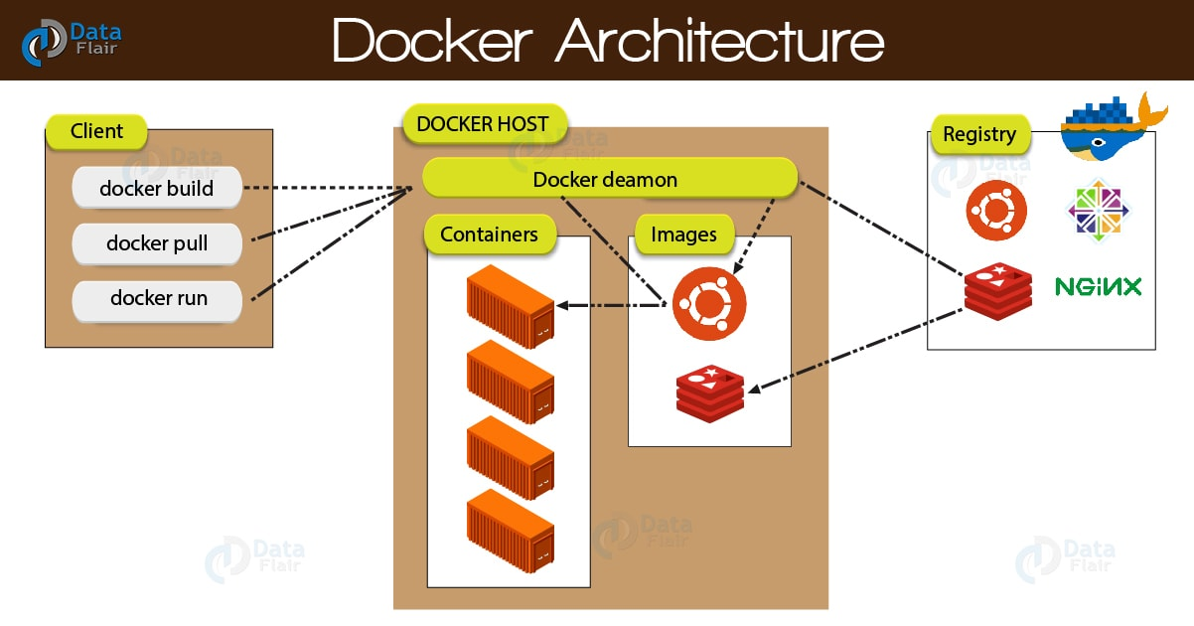

Slide 6
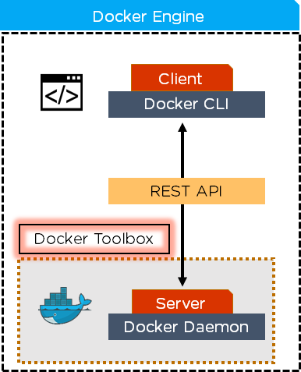
What is the difference between Docker daemon and docker engine?
Docker Daemon checks the client request and communicates with the Docker components in order to perform a service whereas, Docker Engine or Docker is the base engine installed on your host machine to build and run containers using Docker components and services

Slide 7
Top 10 Docker Features
Easily Scalable
Easy and Faster Configuration
Ability to Reduce the Size
Increase productivity
Reduced Infrastructure and Maintenance Costs
Application Isolation
Swarm
Routing Mesh
Services
Security Management

Slide 8
What is Dockerfile?
A Dockerfile is a text document that contains all the commands a user could call on the command line to assemble an image.
A Dockerfile is just a deployment script which packages software into a Docker image.

Slide 9
What is Docker Image?
A Docker image is a complete application package. It contains one application and all of its dependencies: the language runtime, the application host, and the underlying operating system.
Logically the image is a single file, and it's a portable unit – you can share your application by pushing your image to a Docker registry.
Anyone who has access can pull the image themselves and run your application in a container; it will behave in exactly the same way for them as it does for you.

Slide 10
Docker Commands
Command | Description
docker image build | Build an image from a Dockerfile
docker image history | Show the history of an image
docker image import | Import the contents from a tarball to create a filesystem image
docker image inspect | Display detailed information on one or more images
docker image load | Load an image from a tar archive or STDIN
docker image ls | List images
docker image prune | Remove unused images
docker image pull | Pull an image or a repository from a registry
docker image push | Push an image or a repository to a registry
docker image rm | Remove one or more images
docker image save | Save one or more images to a tar archive (streamed to STDOUT by default)
docker image tag | Create a tag TARGET_IMAGE that refers to SOURCE_IMAGE

Slide 11
Image registries
A registry is a storage server for Docker images. Registries can be public or private, and there are free public registries and commercial registry servers which allow fine-grained access control for images. Images are stored with a unique name within the registry. Anyone with access can upload an image by running docker image push, and download an image by running docker image pull.
The most popular registry is Docker Hub

Slide 12
Docker Containers
A container is an instance of an application created from an image. The image contains the whole application stack, and it also specifies the process to start the application, so Docker knows what to do when you run a container. You can run multiple containers from the same image, and you can run containers in different ways.

Slide 13
Docker Compose
Compose is a tool for defining and running multi-container Docker applications. With Compose, you use a YAML file to configure your application’s services. Then, with a single command, you create and start all the services from your configuration.
docker-compose up
docker-compose down
docker-compose config

Slide 14
References
https://docs.docker.com/
https://data-flair.training/blogs/docker-features/
Docker on Windows (Book).

