Slide 1
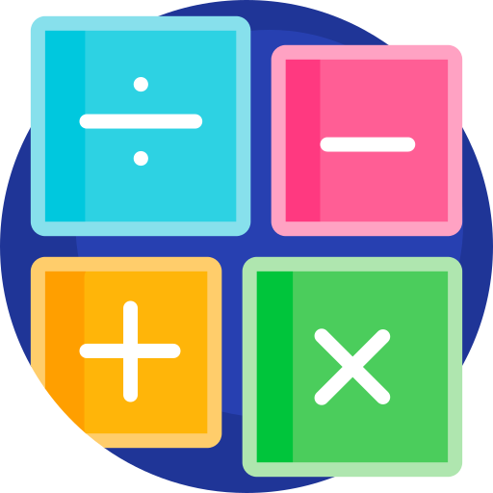
How to add two decimal numbers together
objectives:
1) How to add two decimal numbers together 1
2) How to add two decimal numbers together 2

Slide 2
School book page 89
booklet page 56

