Slide 1
TM471
Introduction

Slide 2
What the course provides is:
A chance to demonstrate a student’s individual
abilities by putting into practice the theory that
has been learned in the relevant level 3 course by:
Applying and extending the knowledge gained in relevant third level courses
Emphasising Process rather than Product
Emphasising Communication
Emphasising the Importance of Evidence Based Practice, keeping logs throughout process

Slide 3
What the course is not:
A taught project course
A prescribed project
A project management course
A technical skills development course
An integrating / capstone project

Slide 4
Assessments
Presentation part1 (defence in front of a Jury, 5%)
The Project Report-Part1 (25%)
  Planning, doing, reviewing and communicating.
Presentation part2 (defence in front of a Jury 10%)
Implementation (35%)
The Project Report (25%)
  Planning, doing, reviewing and communicating.

Slide 5
Tutor / Project
Initially, we work on scoping your project.
Then, we monitor your progress against schedule
We advise you on process, not technically and not on the product
We provide feedback

Slide 6
Accepting / Rejecting project titles
There must be an element of real-life application (potentially useful to someone)
It must be sufficiently complex (but not over-ambitious)
It must use / extend material from the relevant level 3 course

Slide 7
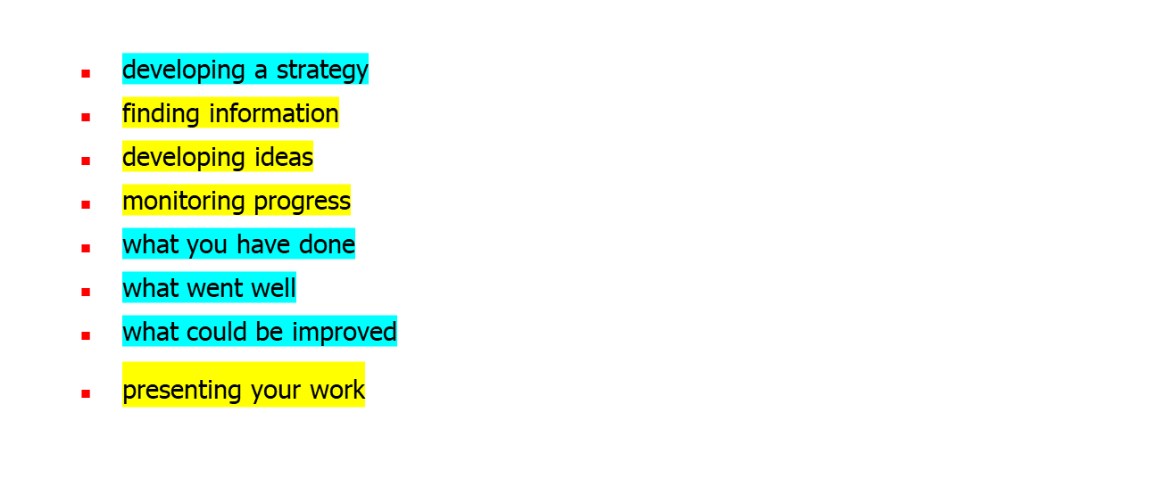
Emphasise the project life cycle through:

Slide 8
Monitoring progress and schedule
We will ask you to verify your work.
You will need to keep regular contact throughout the course so we can monitor your progress
We will advise you and guide you especially where you appear to be going off target or falling behind schedule

Slide 9
Marking and providing feedback
Emphasise requirements
Emphasise the planning of work schedules and the monitoring of progress against these, and to include risk assessment
Emphasise the use of evidence from personal logs to justify decisions taken

Slide 10
A good project report should:
Demonstrate that the learning outcomes have been achieved and skills extended.
Provide evidence of critical thought, discussing and justifying decisions taken
Provide evidence of the extent to which a real product has been developed and tested
Provide evidence of ability to communicate to an appropriate audience

Slide 11
Problems
Poor choice of project title / topic
Poor analysis of problem domain
Poor specification of requirements
Poor planning / scheduling / timekeeping
Poor coding
Poor documentation
Plagiarism
Etc

Slide 12
Problems
Getting started
Keeping going
Keeping on course
Keeping on schedule
Not reading the course documentation
Not doing enough background reading
Not keeping good records
Not allowing enough time for coding / debugging
Not allowing enough time for producing report

Slide 13
Types of Plagiarism to be avoided:
Copying of textual material from the Web or elsewhere.
Copying of source code from the Web or elsewhere.
Use of own material developed earlier / elsewhere / for another purpose
Use of material developed in collaboration with others.

Slide 14
Marking
You will be marked on
  WHAT you have done (description of product)
  WHEN you did it (description of process)
  HOW you did it (reflection on process)
  WHY you did it (reflection on purpose)

Slide 15
Problems with reports
The report must be written bearing in mind the existence of a second marker, hence must be totally self-contained and self-explanatory.
It should be written at a level of technical complexity that is understandable by someone who, whilst familiar with generic issues relating to software development, is not necessarily familiar with the application domain
An excellent technical project with excellent technical documentation cannot possibly be awarded a grade 1 when it contains virtually nothing about the process and no significant element of reflection

Slide 16
Review
Where do we go from here?
Questions / Discussion

