Slide 1

Data Mining and Machine Learning Project Presentation MoneyGuard
By:
Ahmed Salah Tawfik Ibrahim
Francesco Del Turco

Slide 2
Project Overview
Aim: determine whether a credit card transaction is fraudulent or not.
Tools:
Python 3
Python-weka-wrapper3
Matplotlib
Pandas

Slide 3
Dataset Description
Source: https://www.kaggle.com/kartik2112/fraud-detection?select=fraudTrain.csv
Description: The dataset contains information about simulated transactions carried out by credit cards. The attributes include credit card owner information (first name, last name, gender, job, address, date of birth) and transaction information (amount, category, merchant, merchant address, transaction time) in addition to the label (0 for safe and 1 for fraudulent)
Volume: 478.38MB

Slide 4
Data Preprocessing and Visualization
Irrelevant attributes & Checking for missing values.
Handling Date and String attributes
Kernel Density Estimation for continuous attributes
Discretization of continuous attributes
Histograms for nominal attributes
Class Distribution

Slide 5
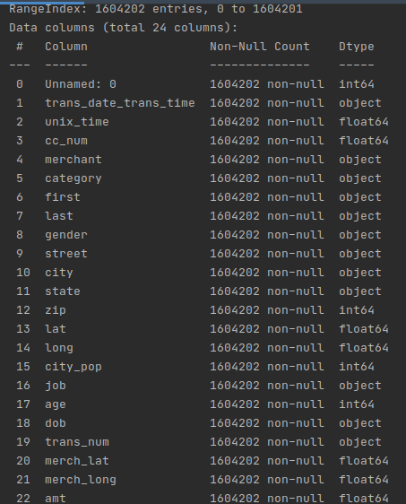
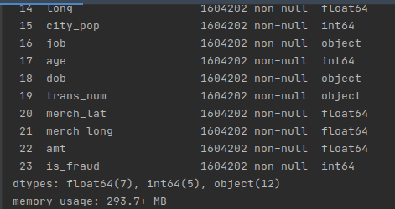
Data Preprocessing – Irrelevant Attributes & Missing Values
Irrelevant attributes in the dataset were eliminated:
These include ID and transaction number.
Fortunately, the dataset had no missing values.
+

Slide 6
Data Preprocessing – Handling Date and String Attributes
Date attributes were converted into numeric attributes:
Transaction time --> UNIX timestamp
Date of birth --> age at the time of the transaction
String attributes were converted into nominal attributes:
First name, last name, credit card number, street, city, state, zip and merchant.

Slide 7
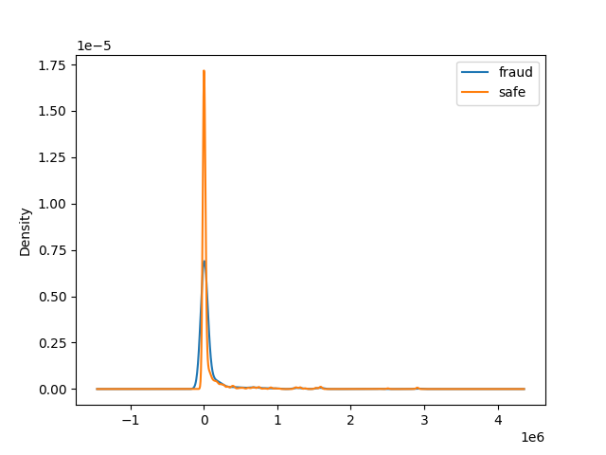
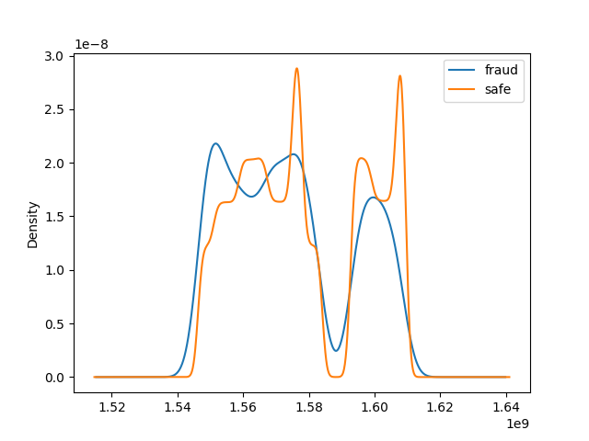
Data Visualization – Continuous Attributes
City Population & UNIX time
Distribution of values is the similar for both classes (fraud – safe)

Slide 8
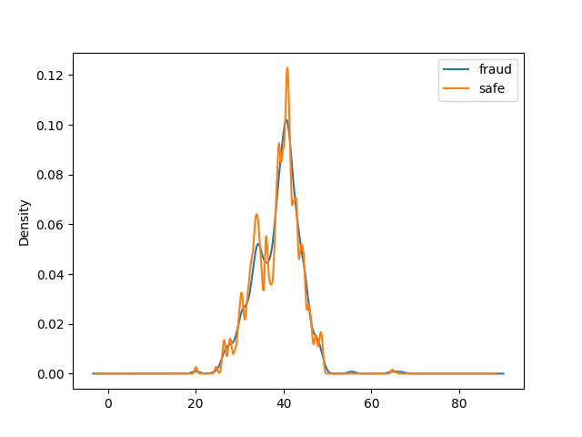
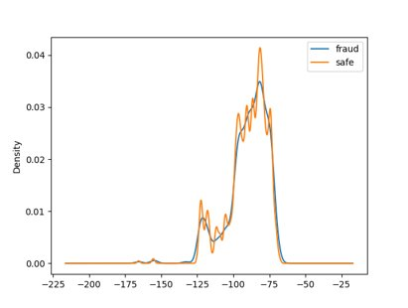
Data Visualization – Continuous Attributes
Kernel Density Estimation for numeric attributes: (lat, long)
Distribution of values is the similar for both classes (fraud – safe)

Slide 9
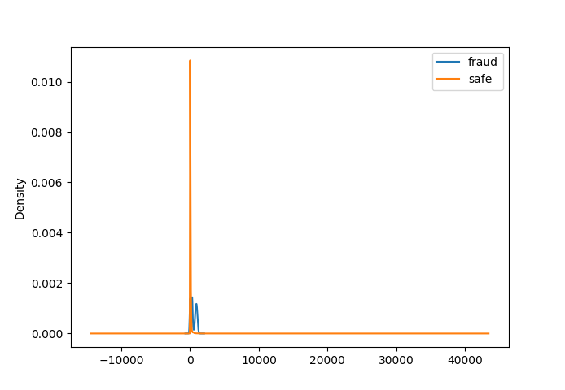
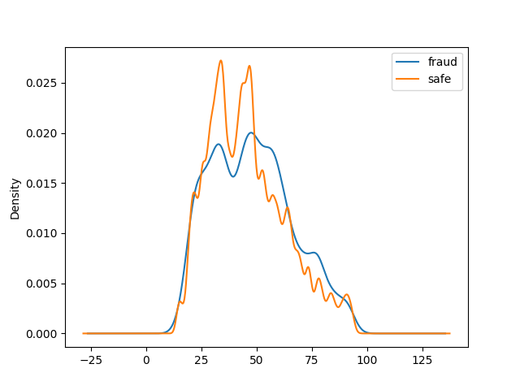
Data Visualization – Continuous Attributes
Kernel Density Estimation for numeric attributes: (amount, age)
Distribution of age values is the similar for both classes (fraud – safe)
.Different distribution of values for amount for both classes.

Slide 10
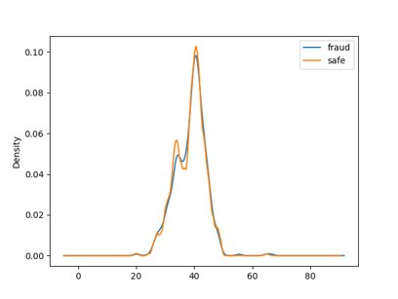
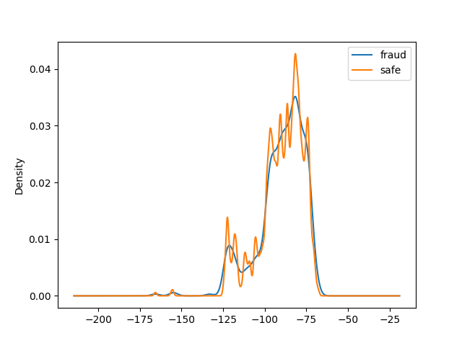
Data Visualization – Continuous Attributes
Kernel Density Estimation for numeric attributes: (merchLat, merchLong)
Distribution of values is the similar for both classes (fraud – safe)

Slide 11
Discretization of continuous attributes
Based on the kernel density estimation analysis, the attribute amount could give good results if it is discretized in a supervised way (Fayyad & Irani).

Slide 12
Nominal Attributes
Nominal attributes had a lot of values and it was nearly impossible to visualize them graphically.
Street, city, state and zip are expected to have a similar frequency to the attributes latitude and longitude, so it was useless to plot them.
First name, last name and
Attributes category and gender were easy to visualize using histograms.

Slide 13
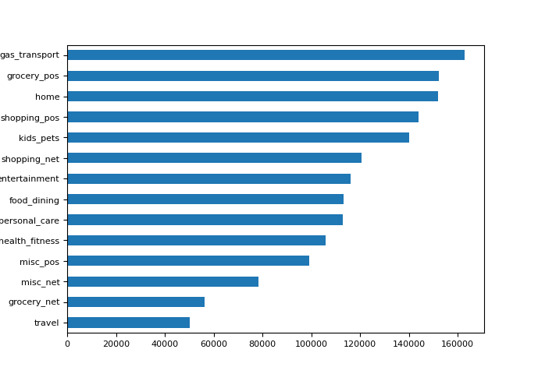
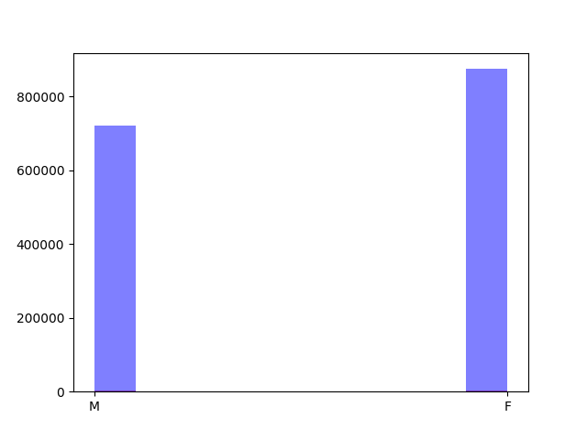
Histograms of nominal attributes

Slide 14
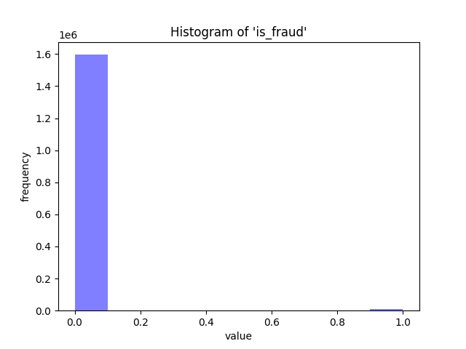


Data Visualization – Class Distribution
Huge Imbalance
Need to resample
SMOTE oversampling combined with undersampling

Slide 15
Classification
Attribute Selection:
CFS Subset Evaluation & Best First
InfoGain & Ranker
Models:
Unpruned Decision Tree
Prunded Decision Tree
Naïve Bayes
Bayesian Belief Networks
Random Forest
Hoeffding Tree (for streaming)
KNN

Slide 16
Attribute Selection
We tried two methods:
CFS Subset Evaluation + Best First Search --> age and amount
InfoGain + Ranker (choose best 4) --> (amount, merchant, UNIX time, latitude)
Best Accuracy was achieved by the second method.

Slide 17
Random Forest (Best Model)
Cross Validation Results (Runtime: 43 minutes):
Train-Test Split Results (Runtime: 3 minutes):
 | TP Rate | FP Rate | Precision | Recall | F-Measure | ROC Area | Class
- | 0.998 | 0.001 | 0.999 | 0.998 | 0.999 | 1.000 | 0
- | 0.999 | 0.002 | 0.998 | 0.999 | 0.999 | 1.000 | 1
Weighted Avg. | 0.999 | 0.001 | 0.999 | 0.999 | 0.999 | 1.000
Positive (0) | Negative (1) | Classified as
1,197,903 | 2,096 | Positive (0)
1,462 | 1,198,537 | Negative (1)
 | TP Rate | FP Rate | Precision | Recall | F-Measure | ROC Area | Class
- | 0.998 | 0.001 | 0.999 | 0.998 | 0.998 | 1.000 | 0
- | 0.999 | 0.002 | 0.998 | 0.999 | 0.998 | 1.000 | 1
Weighted Avg. | 0.998 | 0.002 | 0.998 | 0.998 | 0.998 | 1.000
Positive (0) | Negative (1) | Classified as
359,350 | 858 | Positive (0)
502 | 359.289 | Negative (1)

Slide 18
Hoeffding Tree (For Streaming)
Cross Validation Results (Runtime: 11 minutes):
Train-Test Split Results (Runtime: 1 minutes):
 | TP Rate | FP Rate | Precision | Recall | F-Measure | ROC Area | Class
- | 0.938 | 0.059 | 0.941 | 0.938 | 0.940 | 0.987 | 0
- | 0.941 | 0.062 | 0.938 | 0.941 | 0.940 | 0.987 | 1
Weighted Avg. | 0.940 | 0.060 | 0.940 | 0.940 | 0.940 | 0.987
Positive (0) | Negative (1) | Classified as
1,126,005,148 | 73,994 | Positive (0)
70,969 | 1,129,030 | Negative (1)
 | TP Rate | FP Rate | Precision | Recall | F-Measure | ROC Area | Class
- | 0.939 | 0.050 | 0.942 | 0.939 | 0.940 | 0.987 | 0
- | 0.942 | 0.061 | 0.939 | 0.942 | 0.940 | 0.987 | 1
Weighted Avg. | 0.940 | 0.060 | 0.940 | 0.940 | 0.940 | 0.987
Positive (0) | Negative (1) | Classified as
1,126,005,148 | 73,994 | Positive (0)
70,969 | 1,129,030 | Negative (1)

Slide 19
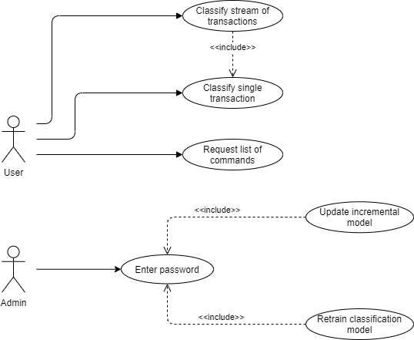
Application

Slide 20
Aim of our Application
It should be used as a notifier to the user in one of the following scenarios:
Banking application interacts with our application to notify users when a suspicious activity is detected.
Users use our application directly to analyze transactions.

Slide 21
Thank You!
Any Questions?

