Slide 1
Dagu-Dagu
Ahmed Ghazy
Ahmed Ibrahim
Osama Abdel Reheem

Slide 2
Baseline Functionality
Reading Distance
Communication with the mobile
Time Configuration
Mobile Application

Slide 3
Reading Distance
For this we use 3 ultrasonic sensors(one on the front and two for the sides)
We connect all of them on one trigger pin
Each sensor’s echo is connected to a separate pin
We set the trigger pin high and wait for the readings
The readings are received in Interrupts where each echo pin is an external interrupt on the rising and falling edge
We calculate the time between the rising and falling edge for each sensor and use this for calculating the distance

Slide 4
Communication with the Mobile
We use bluetooth module for the communication
The module is connected to the UART
We read from the UART when an interrupt is raised
The data is sent in packets of 5 bytes with a begin and end byte of 0xFF
0xFF | rotation_byte1 | rotation_byte2 | human_flag | 0xFFs

Slide 5
Time Configuration
We use a timer to gain the sense of time and distance
A timer with prescaler of 800 and period of 10000 to tick each second
An Enable Flag is used to enable/disable the timer
When the timer is enabled, a global variable called seconds is incremented whenever is ticked
Each tick is with an interrupt

Slide 6
Mobile App
We used processing to create an android app that does the following
Measures the rotation angle
Detect Faces (using KetaiFaces)
Send and receive data from/to the MC
Plays normal jokes
Plays interactive knock-knock jokes

Slide 7
General Methodology

Slide 8
Main Objectives
Travel the first corridor
Detect obstacles and avoid them
Detect humans and tell them a joke
Normal
Interactive(knock-knock)
Detect the ramp and go through it
Travel the second corridor

Slide 9
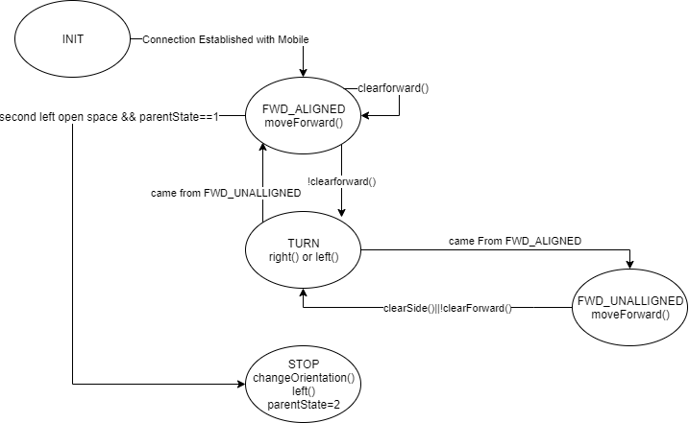
State Machine: Corridor 1 and Corridor 2
Parent State=1 or 3

Slide 10
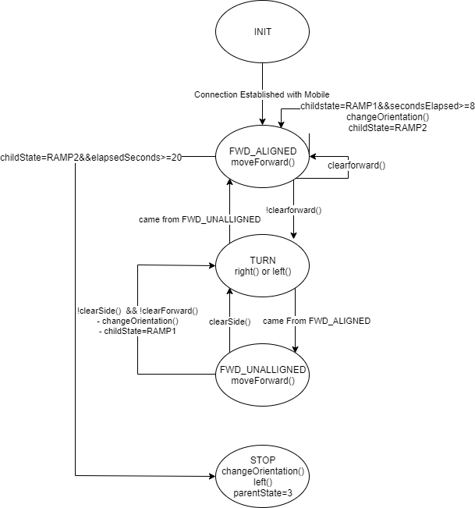
State Machine: Ramp
Parent State=2

Slide 11
Move Forward Function
For moving forward, we needed to adjust the speed of the car to match the given target angle
Change the speed of the right and left motors according to the error in the angle
If we detect a wall on the side of the car, we change the angle (increasing or decreasing) by one and move away from the wall

Slide 12
Obstacles and Human
When an obstacle is detected, the MicroController checks if the human_flag is one
If one: then the obstacle is a human, and the microcontroller goes into conversation mode
MC sends a rising flag to the mobile indicating there is an obstacle and blocks until the app finishes the conversation
The Mobile App plays a “knock knock” voice. Waits for the user to says “who’s there”. Then it says the next line such as “Doctor”. Waits for the user to says “Doctor who””. Then it says the punch line such as “Exactly”.
The Mobile resets the human flag indicating that the conversation is over
The Microcontroller resumes its normal logic avoiding obstacles
If zero: then the obstacle is not a human and it avoids the obstacle without waiting.

Slide 13
MicroController
App
“knock knock”
Inform App of the obstacle
Wait for the reset of human flag
Wait for user voice input
If no “who” in the command
Go Into Conversation Mode
Reset human_flag
Say next line
human_flag
If no “who” in the command
Obstacle Detected
Wait for user voice input
!human_flag
Avoid Obstacle
Line ended
Say punch line

Slide 14
Ramp Detection and Traversal
We use the fact that it is the second left open space.
For travelling the ramp, we detect that we have reached the corned and change our angle to face the other side
After 9 seconds of forward movement, we change the angle by 45 degrees
After 20 seconds of forward movement , we change the angle by 90 degrees to go through the second corrido

Slide 15
Thank You
GitHub Link:
https://github.com/osamahammad21/3ARABEYA

