Slide 1
Startup Failure Risk Predictor
Predicting Startup Failure Through Founder Burnout & Business Factors
Kyrellos Tharwat Lamaey
Mohammed Elsayed Elmorsy
Ahmed Hossam Matar
Mohammed Magdy Mahmoud
m

Slide 2
The Problem: Predicting Startup Failure Risk Through Founder Burnout
Startup failure is rarely just a financial story — it's deeply tied to the psychological and operational state of the founder. While most predictive models focus purely on funding and revenue metrics, they overlook a critical driver: founder burnout. Our project bridges this gap by building a machine learning model that predicts startup failure risk based on the human side of entrepreneurship.
Startup culture normalizes long working hours, investor pressure, and emotional exhaustion.
Most existing datasets and models ignore the psychological toll on founders, focusing only on funding and revenue.
Burnout, sleep deprivation, and decision fatigue directly correlate with rising failure risk.
Cofounder conflict and work-life imbalance are early warning signs that traditional metrics fail to capture.

Slide 3
Our Approach
Real-world data is rarely clean or straightforward. Building an effective ML solution requires confronting complexity head-on.
The Hidden Human Factor
Behavioral Signal Modeling
Startup failure prediction has long ignored founder mental health — burnout, stress, and sleep deprivation remain invisible in traditional financial-only models.
Our approach captures nonlinear relationships between founder psychology, operational pressure, and startup survival — turning overlooked human signals into predictive power.

Slide 4
Dataset Overview
Source
Records
Features
Startup Founder Burnout & Failure Risk Dataset (synthetic) — startup_founder_burnout_2026_final.csv Published on Kaggle
50,000 realistic synthetic founder records
29 carefully engineered features across 5 key domains
Target
startup_failure_flag
is a binary classification target indicating whether a startup has failed, shut down operations, or entered bankruptcy within a specified observation period.

Slide 5
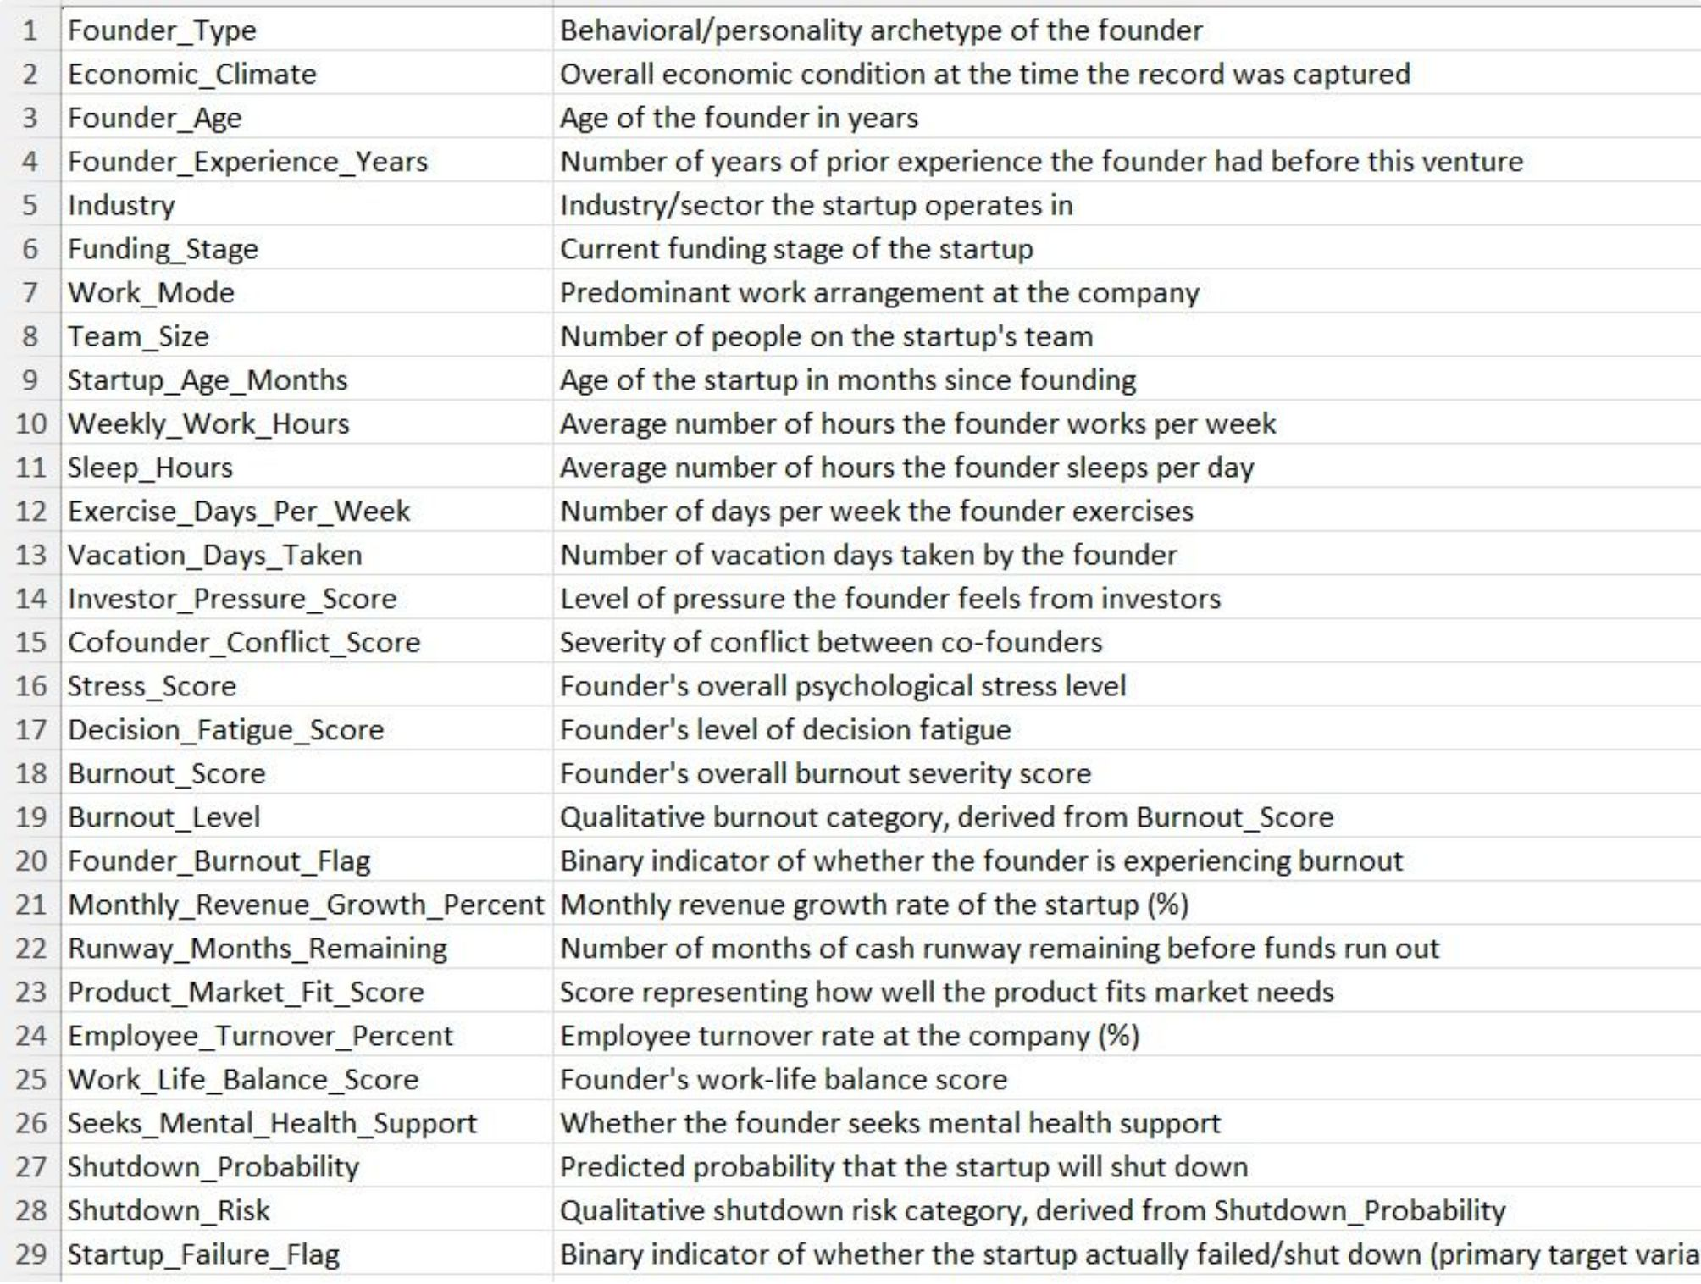
Columns Description

Slide 6
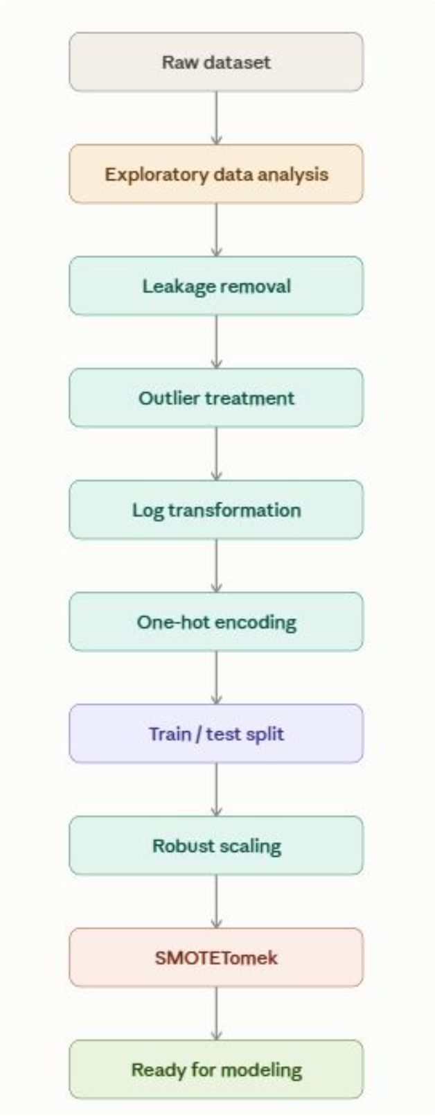
Full ML Pipeline
Raw data passes through a 10-stage pipeline before reaching the model:
exploratory analysis surfaces initial patterns,
leakage removal and outlier treatment clean the signal,
log transformation and one-hot encoding prepare features for learning, and after splitting the data,
robust scaling and SMOTETomek balance the classes — leaving a fully model-ready dataset.

Slide 7
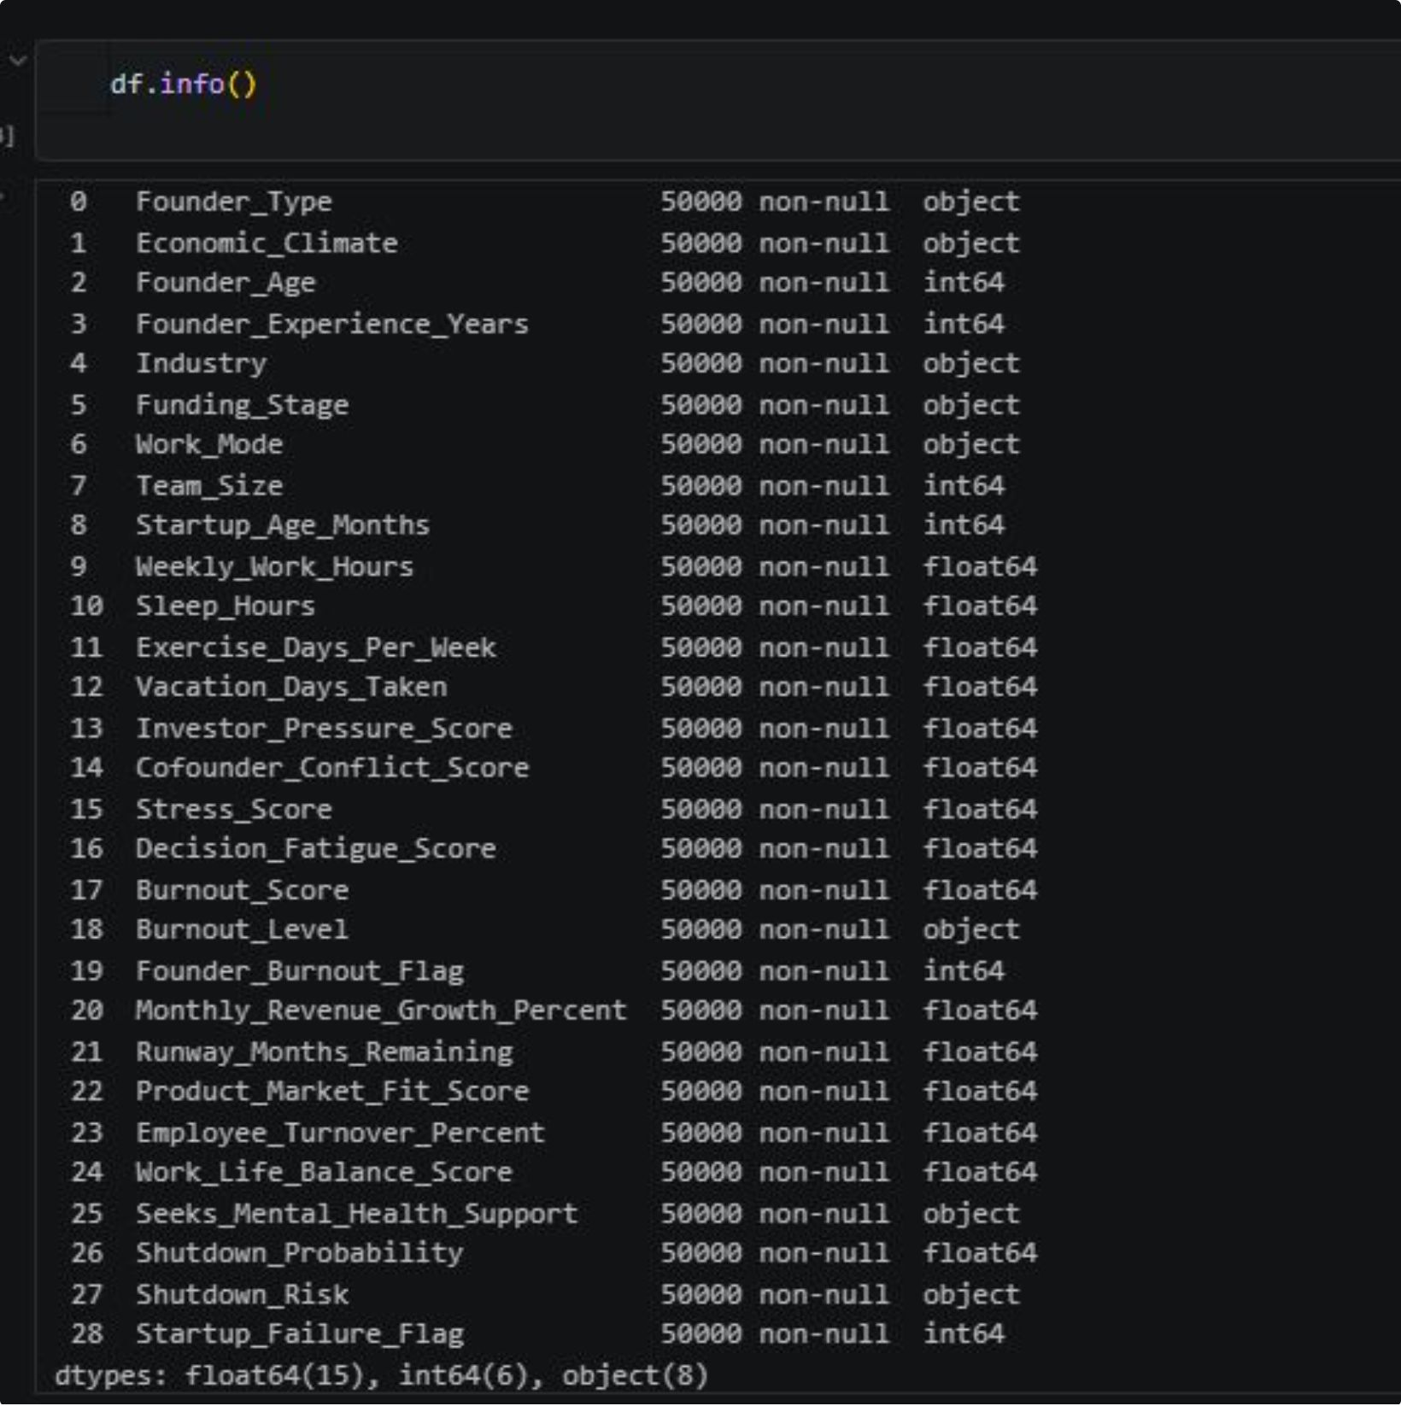
Exploratory Data Analysis
Understanding the Data Before Modeling
We explored the dataset to identify distributions, relationships, patterns, and potential factors associated with startup failure and founder burnout.
comments:
Zero Missing Values: Data is 100% complete across all 50,000 records; no null imputation required.
Feature Schema: Contains 21 numerical features (financial & psychological metrics) and 8 categorical features .
Preprocessing Need: Categorical variables must be encoded before model training.

Slide 8
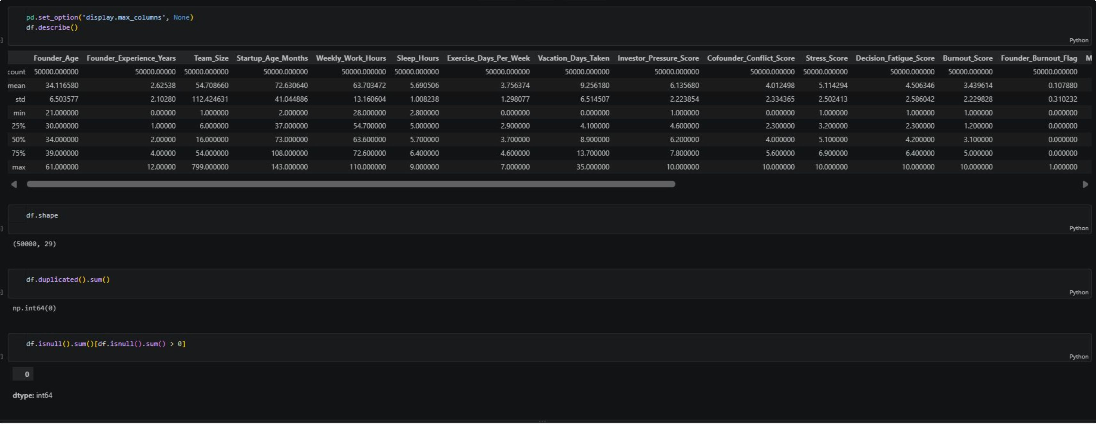
Data Distributions

Slide 9
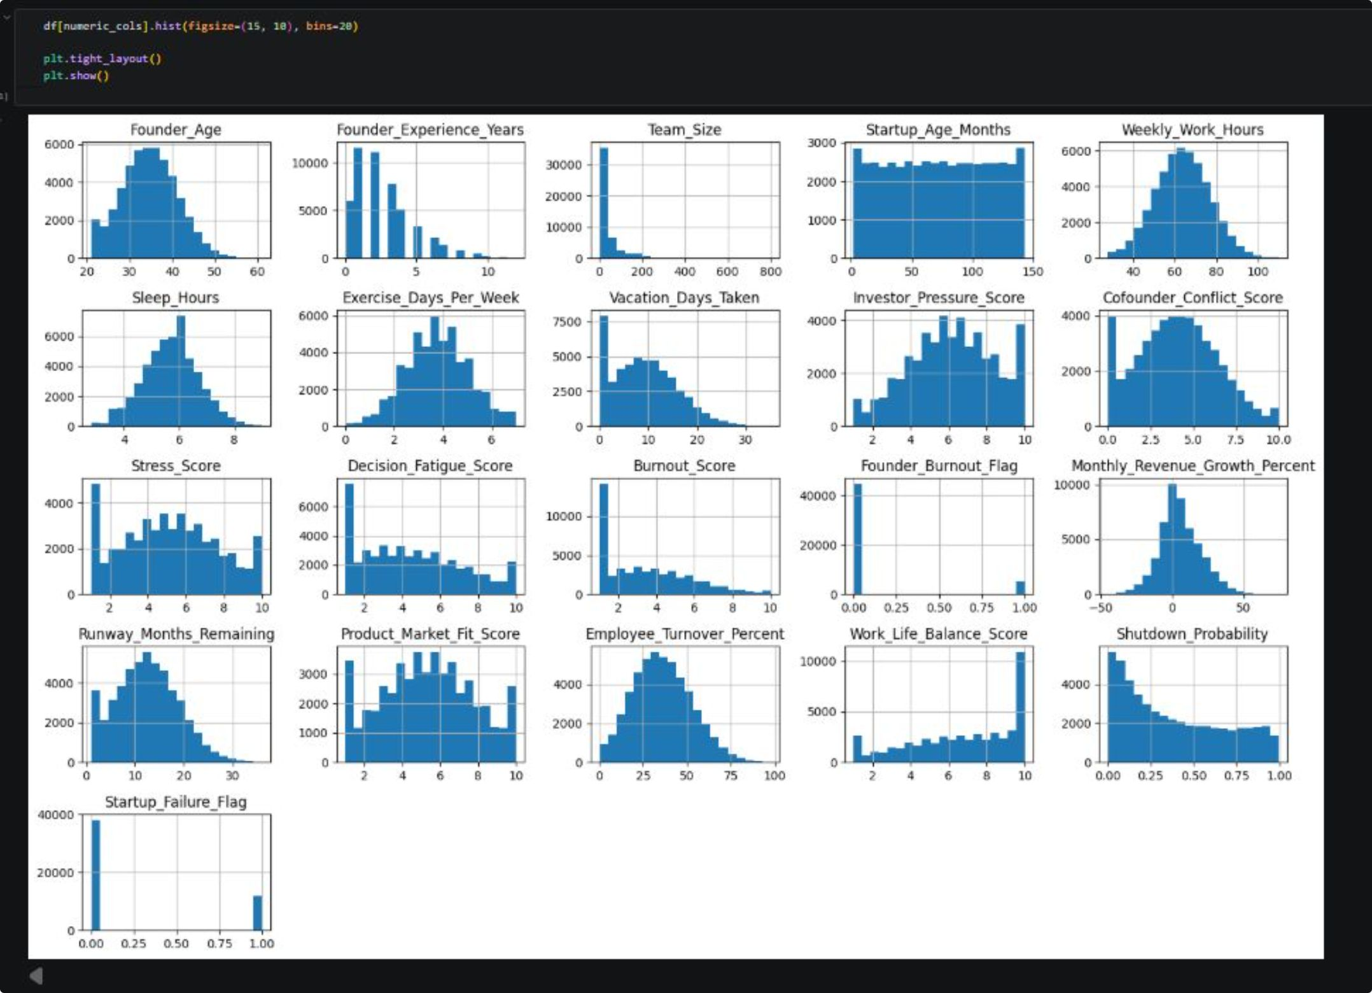
Description
Visual analysis of feature distributions revealing dataset imbalances, highly skewed variables, and critical mental health vs. business outcome patterns.

Slide 10
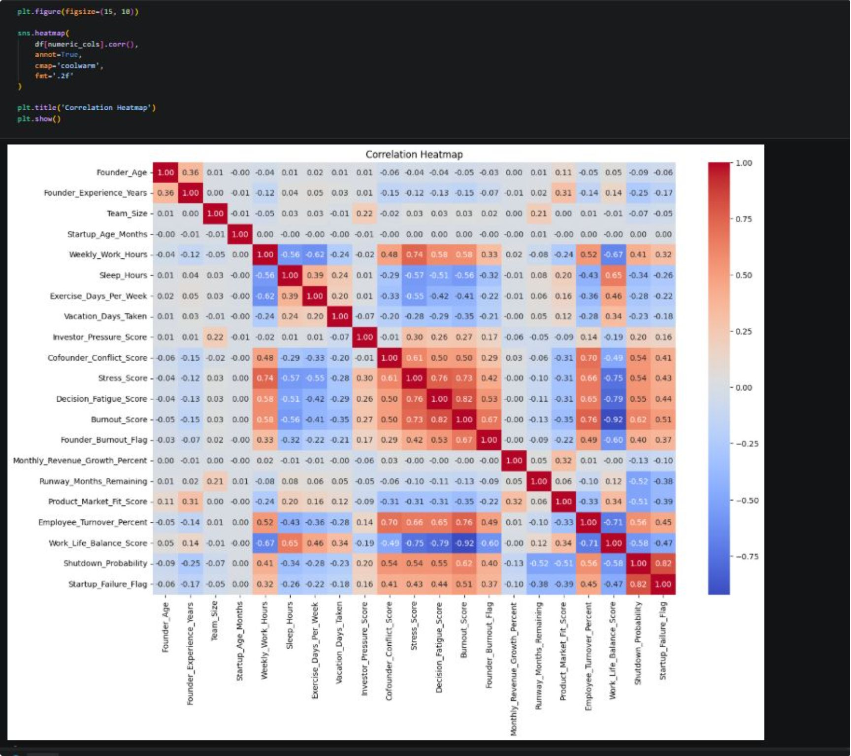
Description
Key Failure Drivers: Shutdown_Probability(+0.82), Burnout_Score (+0.51), and Employee_Turnover_Percent (+0.45) are the strongest indicators of startup collapse.
Founder Well-being Impact: Employee_Turnover_Percent (-0.92) is the primary buffer against burnout, while Stress_Score & Decision_Fatigue (+0.82) show high collinearity.
Risk Mitigators: Product_Market_Fit_Score (-0.39) and Runway_Months_Remaining (-0.38) serve as core financial and operational buffers against failure.

Slide 11
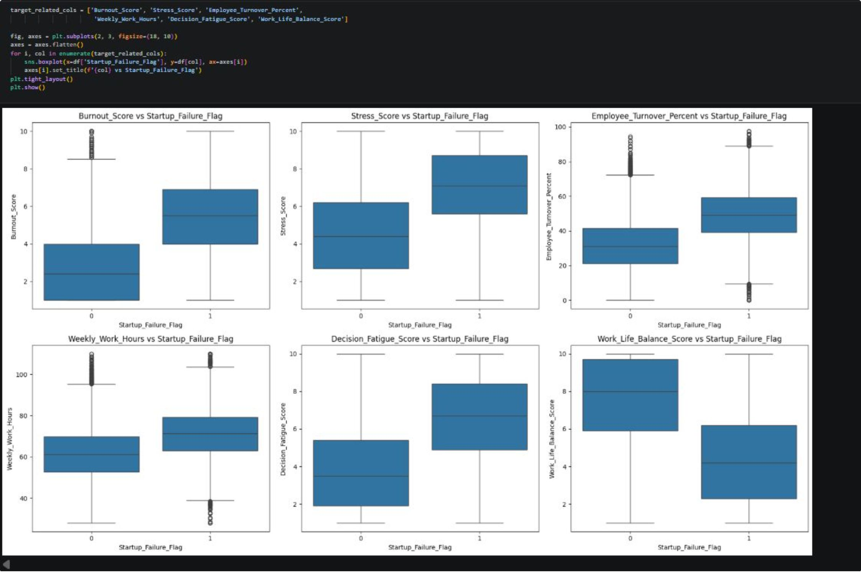
Description
Elevated Psychological Risk: Failed startups show significantly higher burnout, stress, and decision fatigue scores.
Operational Overload: Higher weekly work hours and employee turnover directly align with startup failure.
Key Protective Buffer: Stronger work-life balance is clearly linked to startup survival.

Slide 12
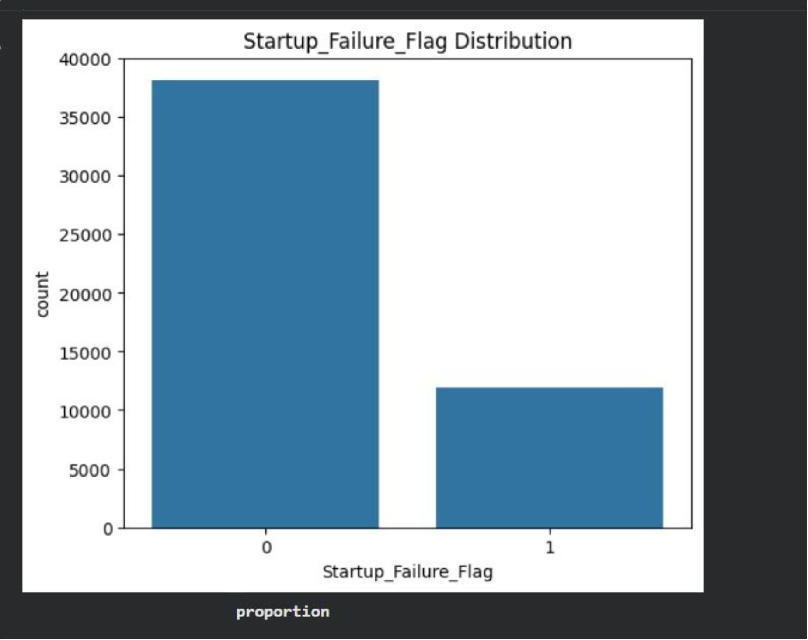
Target Variable Distribution
Target Variable Distribution
Description
Class Distribution
The target variable was analyzed to identify the distribution of successful and failed startups and assess whether class imbalance could affect model performance.

Slide 13
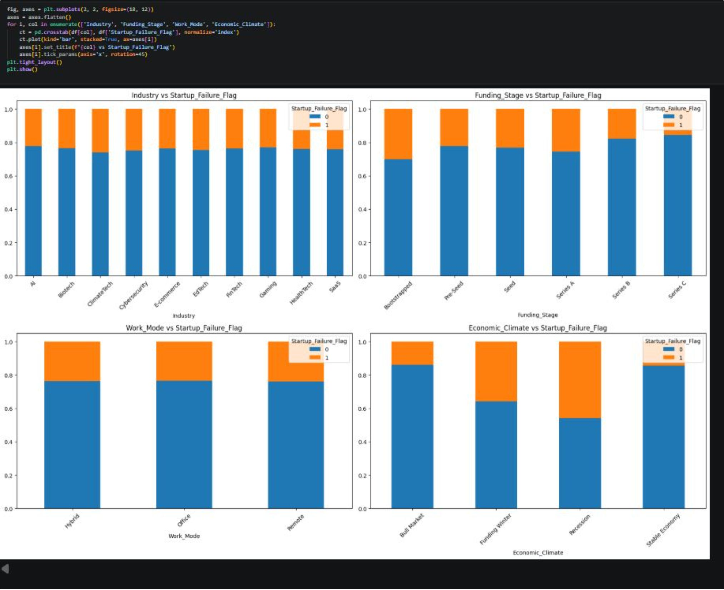
Categorical Features vs. Startup Failure
Description
Categorical features were analyzed against startup failure to identify differences in failure rates across industries, funding stages, work modes, and economic
conditions.

Slide 14
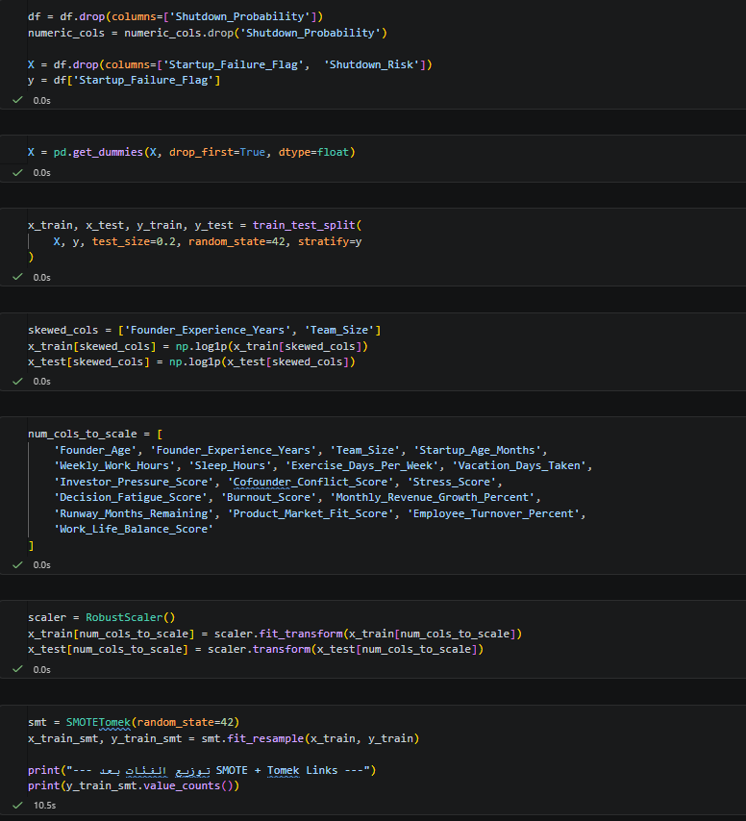
Data Preprocessing
Description
This slide shows the final data preparation stage before training, covering the following:
Dropping the leakage-causing columns (Shutdown_Probability and Shutdown_Risk), and separating the target from the rest of the features.
One-hot encoding the categorical columns into numeric form.
Splitting the data into training and test sets (80/20), stratified to preserve the same class distribution in both sets.
Log-transforming the skewed columns (Founder_Experience_Years and Team_Size) to reduce the effect of extreme values on their distribution shape.
Scaling the remaining numeric columns using RobustScaler, which relies on the median and IQR to reduce the influence of remaining outliers.
Handling class imbalance with a hybrid technique (SMOTETomek) that combines synthetic oversampling of the minority class with removal of overlapping samples between classes — applied only to the training data, not the test data, to avoid data leakage during evaluation.

Slide 15
Model Selection
Algorithm Evaluation
We evaluated multiple machine learning algorithms to identify the most suitable model for predicting startup failure risk.
Models Evaluated:
Logistic Regression
Decision Tree
Random Forest
Gradient Boosting
AdaBoost
XGBoost
K-Nearest Neighbors (KNN)
Neural Network (MLPEvaluation Strategy
Models will be compared based on:
Accuracy
Precision
Recall
F1-Score

Slide 16
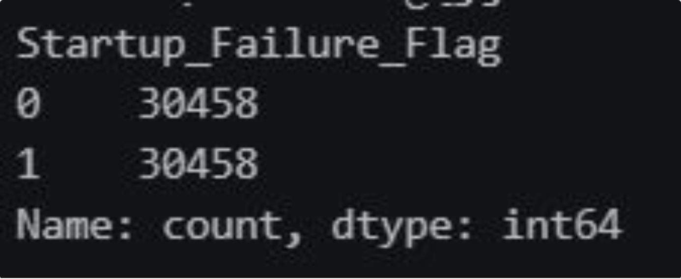
Initial Experiment
The Challenge:
The target variable was imbalanced, which could bias the models toward the majority class.
Our Approach
We applied SMOTE + Tomek Links (SMOTETomek) to the training data to balance the two classes before training the models.

Slide 17
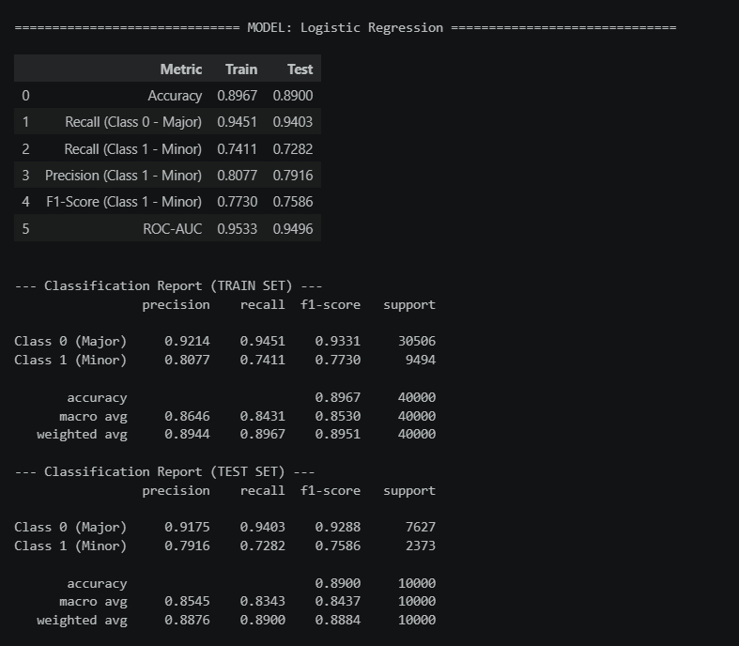
Model Evaluation
The model shows strong overall performance (89% test accuracy) but a noticeable gap between classes: precision on "No Failure" reaches 0.92, while "Failure" cases — the harder minority class — score lower at 0.8 precision and 0.75 F1-score. Train and test metrics are nearly identical, confirming the model generalizes well without overfitting.

Slide 18
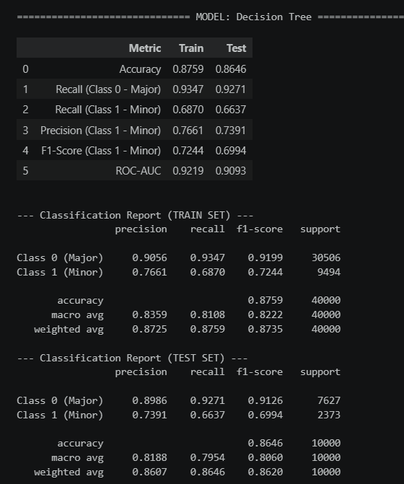
The Decision Tree scored 86% test accuracy, marginally lower than Logistic Regression. Failure-class precision dropped to 0.73, and the gap between train accuracy (87%) and test accuracy (86%) is slightly wider than the previous model — a sign of mild overfitting typical of single decision trees.

Slide 19
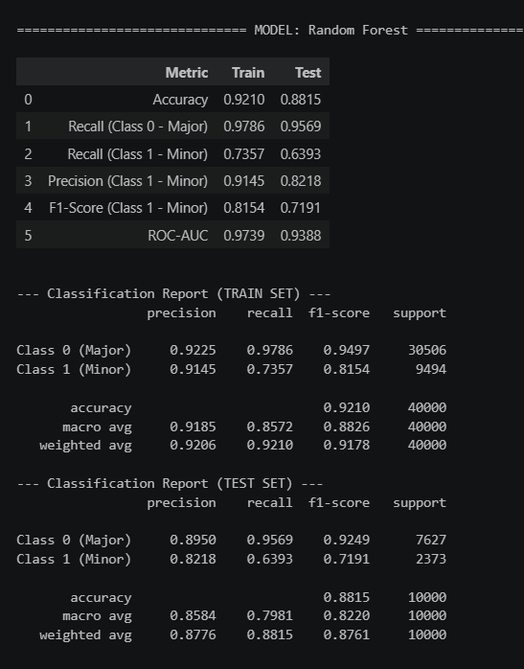
test performance drops to 88% accuracy and 0.71 F1-score on the Failure class. This large train-test gap is a textbook overfitting signal — the model fits the training data almost exactly but loses some generalization power on unseen data. Despite this, its test performance still slightly outperforms both Logistic Regression and Decision Tree on the minority class.

Slide 20
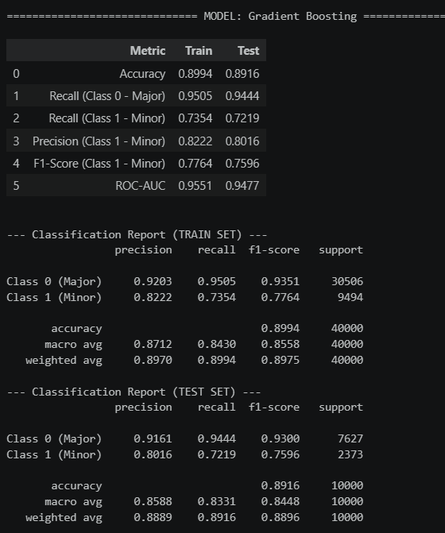
Gradient Boosting matches Random Forest's test accuracy (89%) but with far better generalization — train accuracy (89%) is nearly identical to test accuracy, showing no overfitting. It also achieves the best precision on the Failure class so far (0.8), making it one of the more balanced and reliable models in this comparison.

Slide 21
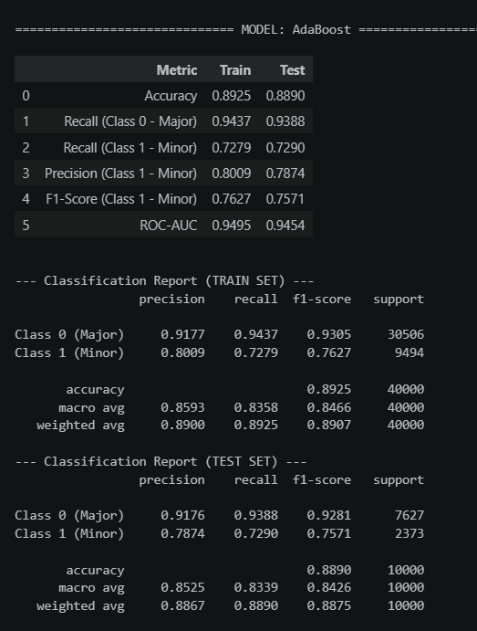
AdaBoost achieved 89% test accuracy with virtually no gap between train (89%) and test performance, confirming strong generalization. Its Failure-class F1-score of 0.75 is the highest recorded so far, driven by a solid 0.72 recall — meaning it catches more actual failure cases than any previous model.

Slide 22
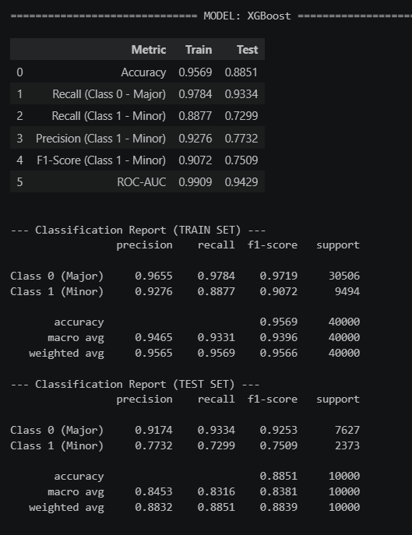
XGBoost shows a noticeable gap between train (95%) and test (88%) accuracy, indicating moderate overfitting — less severe than Random Forest's, but still present. On the test set, it achieves the highest Failure-class precision so far (0.76), though its recall (0.74) is slightly lower than AdaBoost and Gradient Boosting, resulting in a comparable F1-score of 0.75.

Slide 23
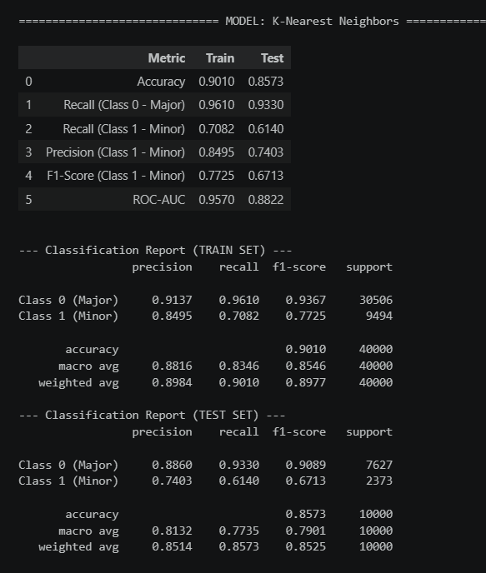
KNN shows the weakest overall performance, with test accuracy falling to 85%. While it catches most actual failure cases (0.61 recall), its precision on the Failure class drops sharply to 0.74 — meaning nearly half of its failure predictions are false positives.\

Slide 24
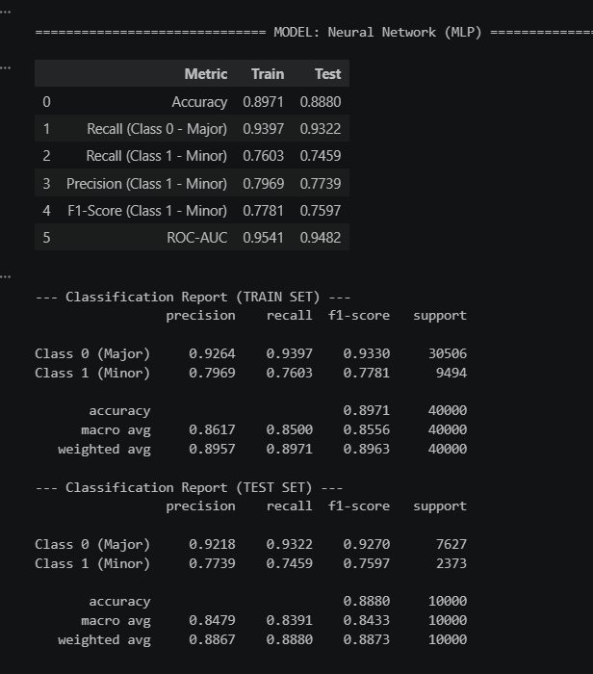
The MLP reached 89% test accuracy, indicating no serious overfitting. Its Failure-class recall (0.745) is solid, but precision (0.77) is lower than most tree-based models, resulting in an F1-score of 0.76 — respectable, but not the top performer in this comparison.

Slide 25
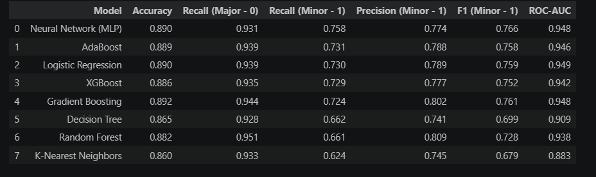
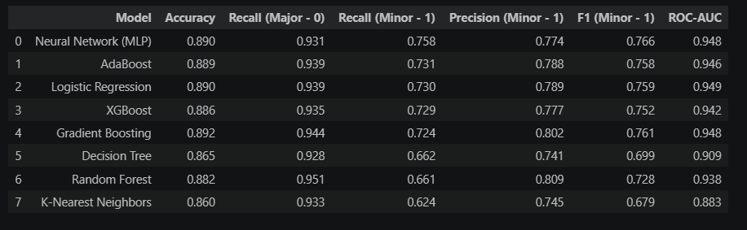
Model Comparison
AdaBoost, MLP, and Logistic Regression deliver the most consistent results, with test accuracy clustered around 87-89% and minimal gap from their training performance. Random Forest and XGBoost post competitive accuracy but show clear signs of overfitting, while KNN trails behind with the weakest generalization.

Slide 26
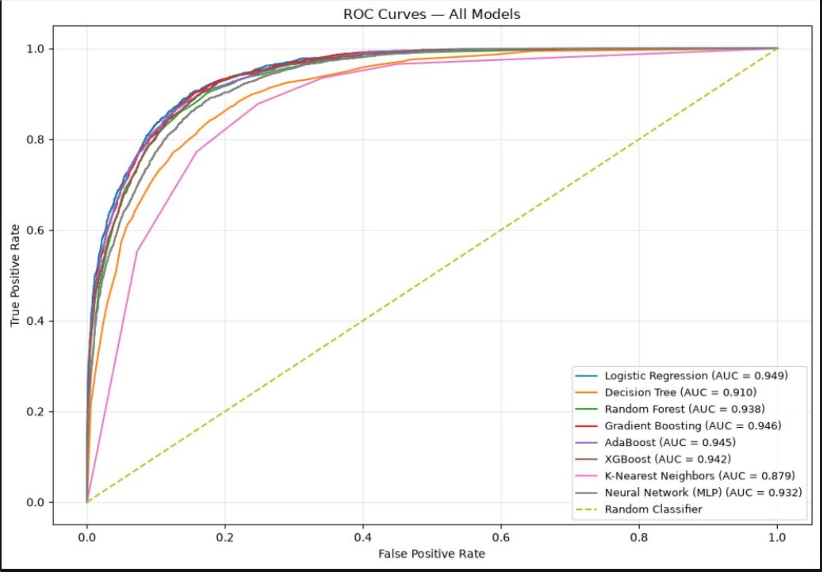
Models Performance

Slide 27
Summary
The ROC curves confirm the trend seen in the classification metrics: Logistic Regression (0.949), Gradient Boosting (0.946), and AdaBoost (0.945) cluster tightly at the top, showing the strongest ability to separate failing from surviving startups across all thresholds. Random Forest and XGBoost follow closely (0.938 and 0.942), while Decision Tree and KNN lag noticeably — KNN's curve sits furthest from the top-left corner, confirming it as the weakest performer overall.
EDA revealed important relationships between founder burnout, behavioral factors, and startup failure.
Preprocessing included leakage removal, log transformation, robust scaling, and SMOTETomek to handle class imbalance.
8 ML models were trained and evaluated using Accuracy, Precision, Recall, F1-Score, and ROC-AUC.
The experiments showed strong overall predictive performance, with ensemble models and Logistic Regression performing particularly well.
Logistic Regression achieved the highest ROC-AUC (0.949), while AdaBoost achieved the highest F1-Score (0.766) in the SMOTETomek experiment.
The results demonstrate that startup failure risk can be effectively predicted using founder, behavioral, and startup-related features.

Slide 28
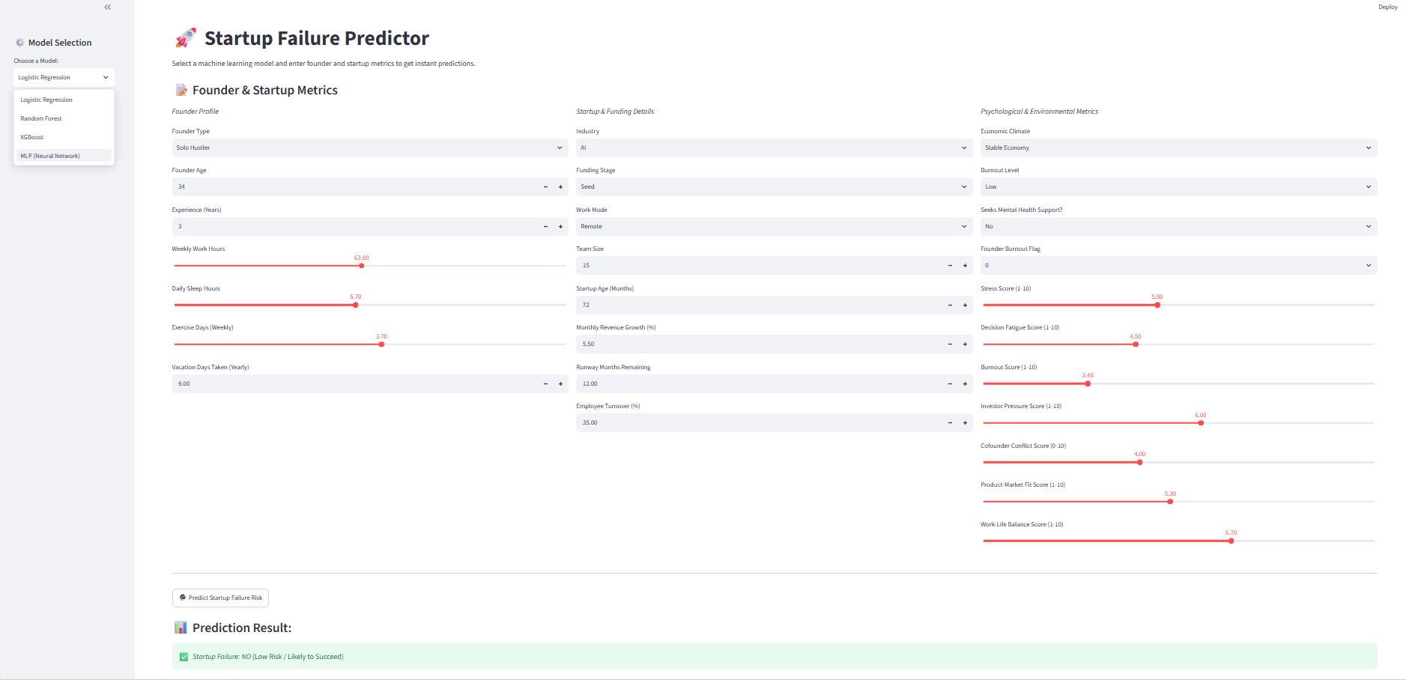
Live Prediction Demo

Slide 29
Thank You !
Questions?
Predicting risk today, to support better decisions tomorrow.

