Slide 1
KINGDOM TRAVEL SERVICES
Hotel Booking Data Analysis
Cleaning, Analysis & Key Findings — 119,207 Bookings (2015–2017)
Quality Assurance & Data Analytics | September 2026

Slide 2
Agenda
01
Data Cleaning & Methodology
How 119,390 raw rows became 119,207 clean records
02
Cancellation Drivers
What actually predicts a booking falling through
03
Revenue & Pricing
Where the money comes from, and the risk behind it
04
Guest Profile & Behavior
Who books, how long they stay, and if they return
05
Operations & Volume
Channel mix, seasonality, and booking reliability
06
Recommendations
Actions for the business

Slide 3
Executive Summary
Five findings, drawn from 119,207 cleaned bookings
119,207
82%
99.4%
57%
Clean bookings analyzed
of bookings via travel agents
cancellation on Non Refund
cancel rate at 180+ day lead time
Cancellation tracks commitment (lead time, special requests, changes) far more than price.
"Non Refund" deposits are cancelling almost universally — concentrated in agency Group bookings.
City Hotel drives more volume; Resort Hotel converts a higher share of bookings into real stays.
Repeat guests are only 3% of bookings but cancel at less than half the rate of first-timers.

Slide 4
1. Data Cleaning & Methodology

Slide 5
From Raw File to Clean Dataset
119,390 rows imported via LOAD DATA LOCAL INFILE, cleaned in MySQL
Issue | Rows Affected | Action
Exact duplicate row | 1 | Removed
Negative price (adr < 0) | 1 | Removed
Zero-guest bookings | 180 | Removed
Extreme price outlier (adr = 5,400) | 1 | Removed
Blank agent / company / country | 16,340 / 112,593 / 488 | Kept — genuinely missing
Result: 119,207 clean rows. No true NULLs, no literal "NULL" text, no spacing or casing inconsistencies found in any categorical column.

Slide 6
2. Cancellation Drivers

Slide 7
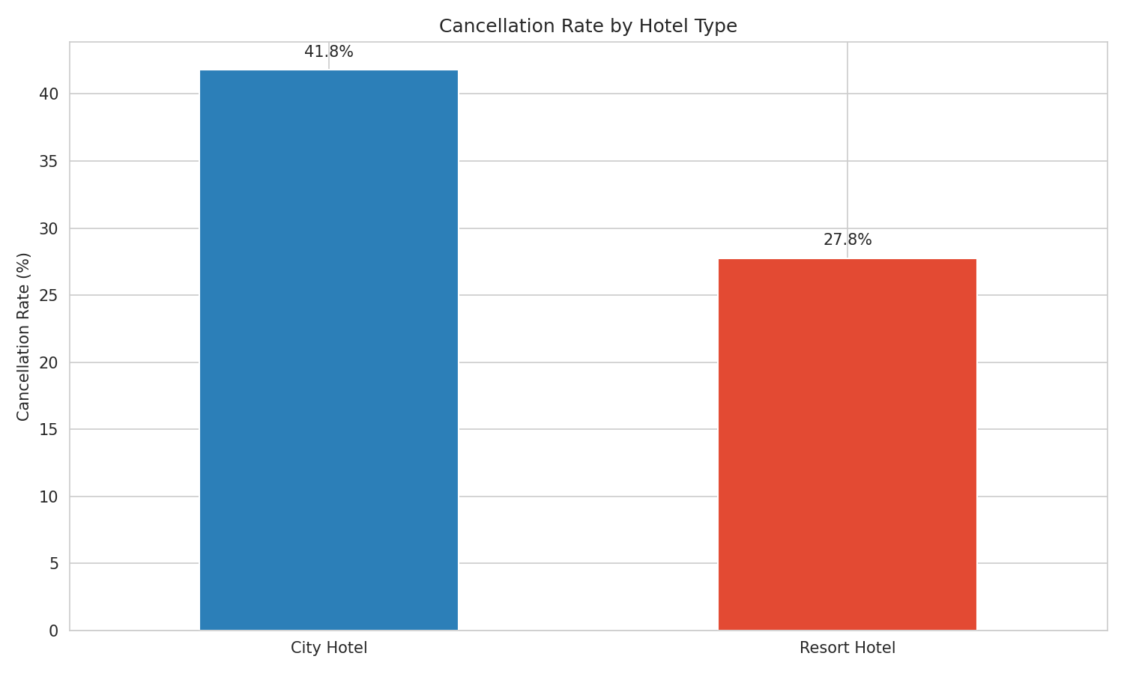
Cancellation Rate by Hotel Type
City Hotel cancels notably more often than Resort Hotel

Slide 8
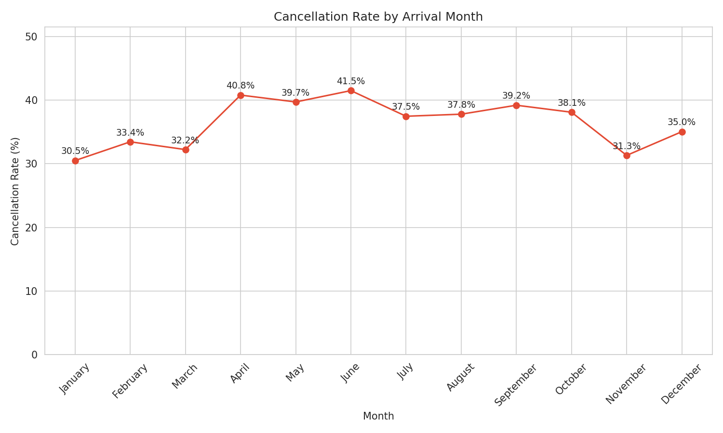
Cancellation Rate by Arrival Month
Peaks in spring and early summer arrivals

Slide 9
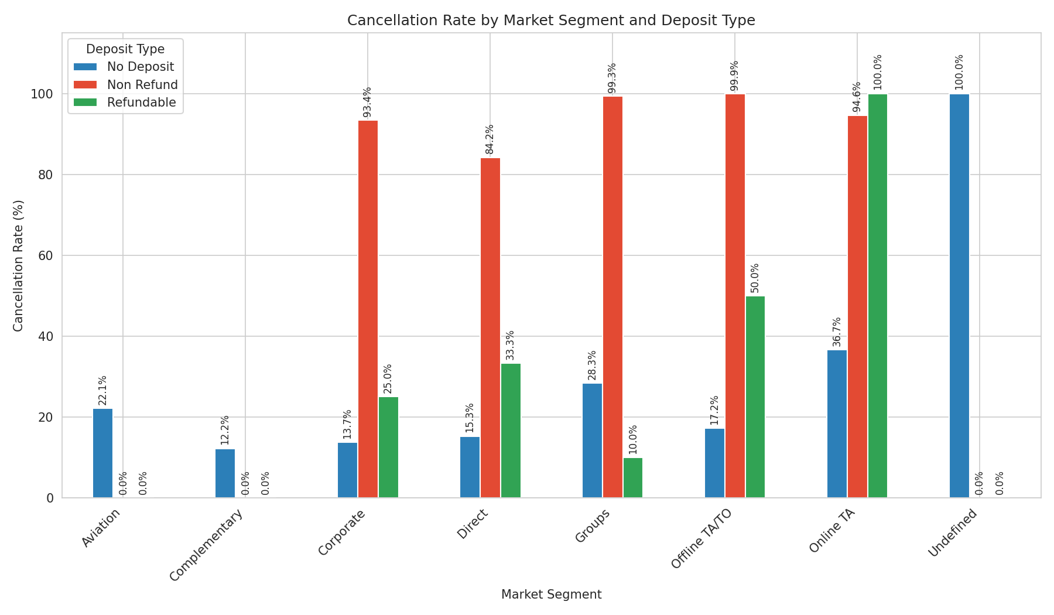
The Non Refund / Groups Anomaly
Non-refundable bookings cancel at 99.4% — the opposite of intended behavior
93.6% of Non Refund bookings arrive via the TA/TO channel — largely provisional agency
Group holds, not genuine non-cancellable guest commitments.

Slide 10
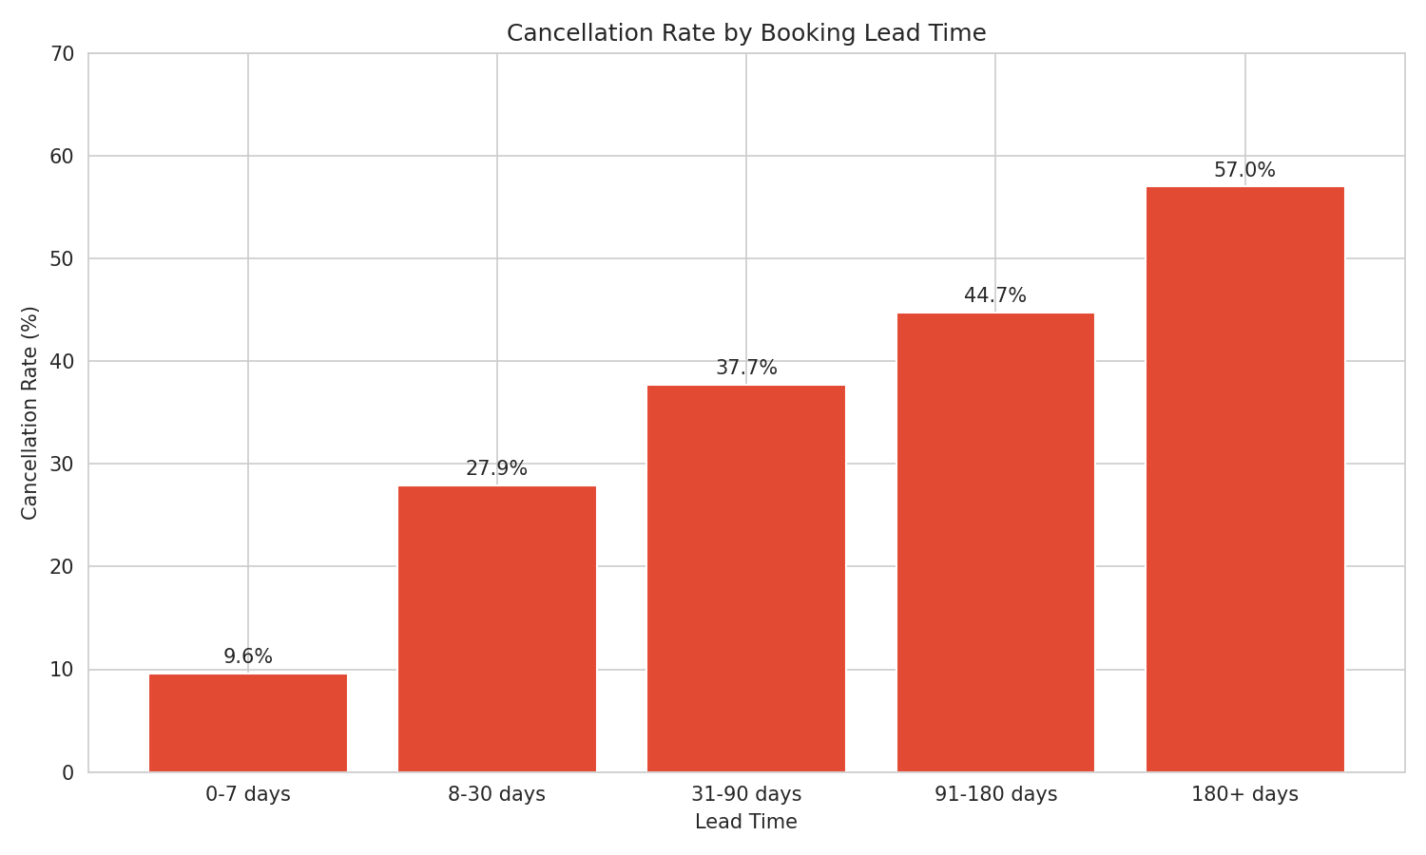
Cancellation Risk Rises With Lead Time
9.6% at 0-7 days climbs to 57.0% at 180+ days

Slide 11
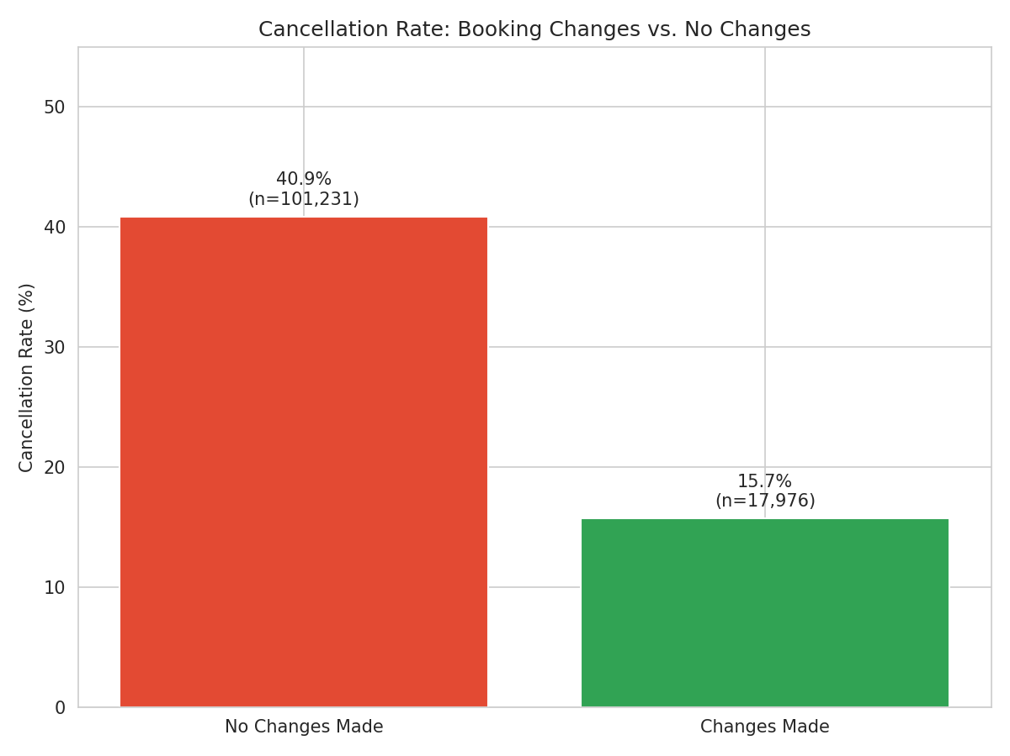
Booking Changes Signal Real Commitment
Modified bookings cancel at less than half the rate of untouched ones

Slide 12
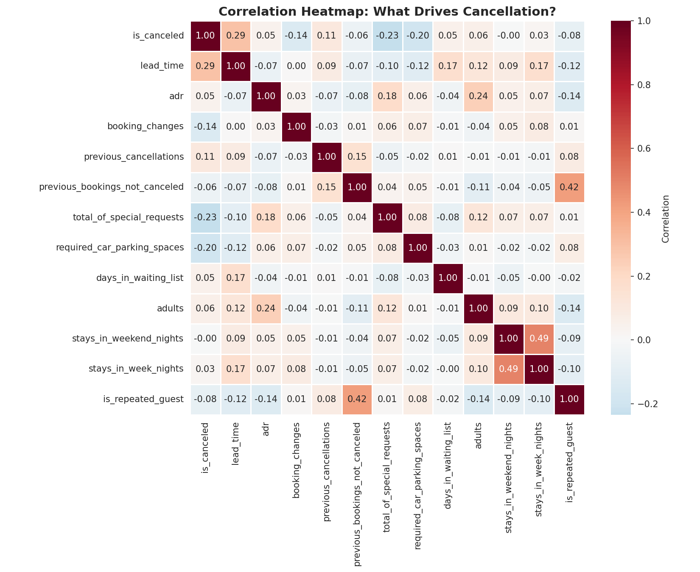
What Actually Drives Cancellation
Correlation across all numeric booking factors confirms the pattern
Strongest signals: lead time (+0.29), special requests (-0.23),
parking spaces (-0.20), booking changes (-0.14).

Slide 13
3. Revenue & Pricing

Slide 14
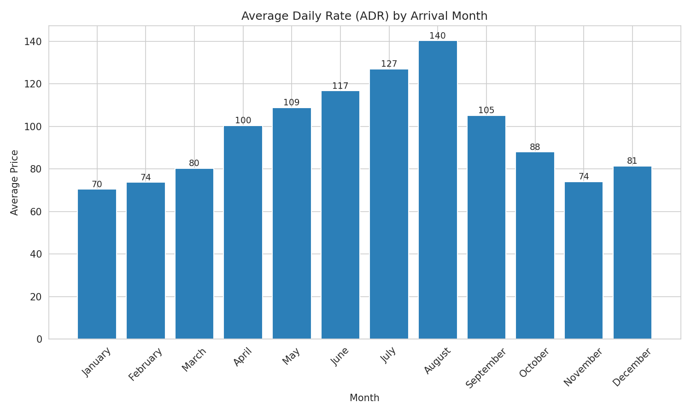
Average Daily Rate by Month
Pricing peaks align with the summer travel season

Slide 15
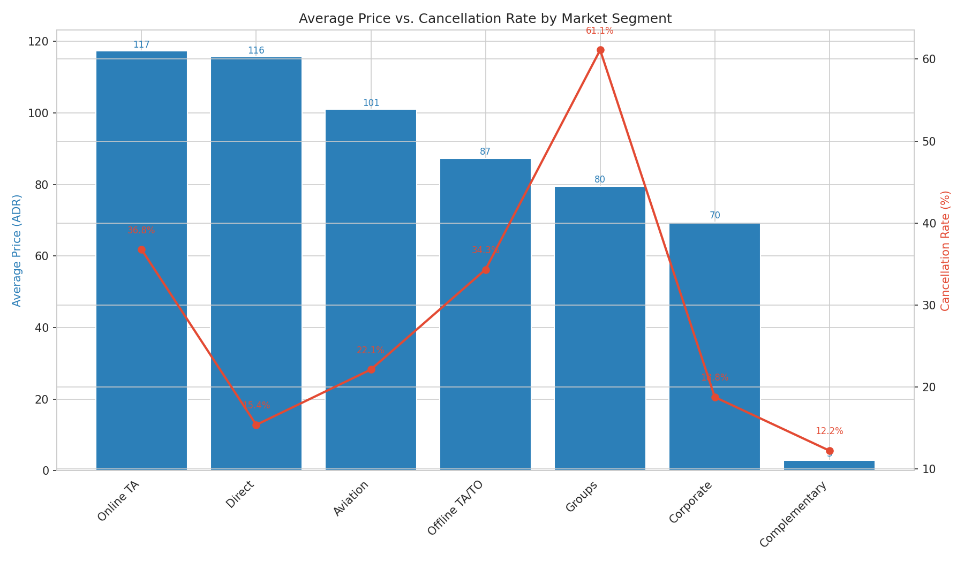
Price vs. Cancellation Risk by Segment
Direct bookings: strong price, lowest risk. Groups: lowest price, highest risk.

Slide 16
4. Guest Profile & Behavior

Slide 17
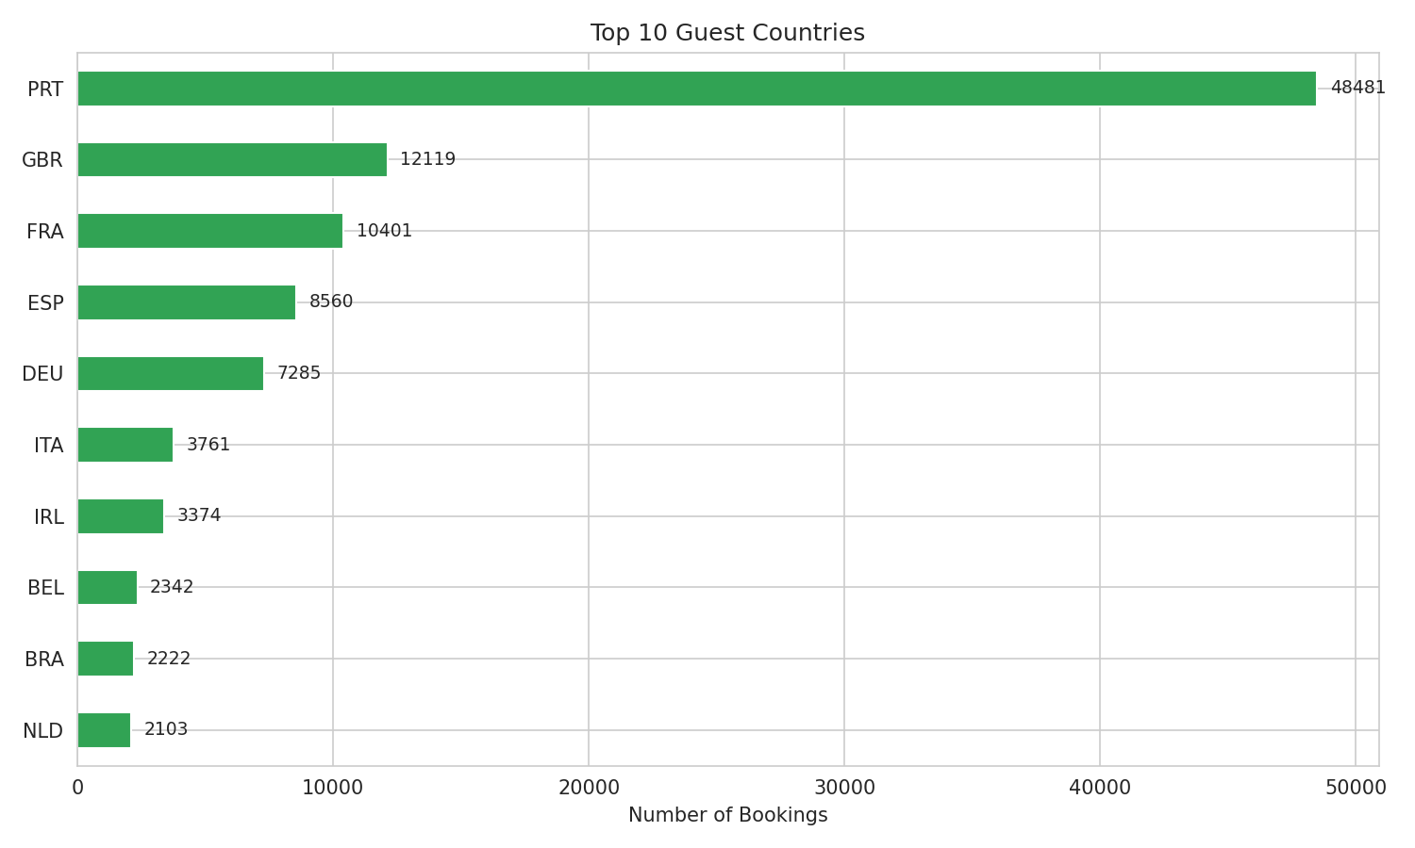
Top 10 Guest Countries
Guest origin by total booking volume

Slide 18
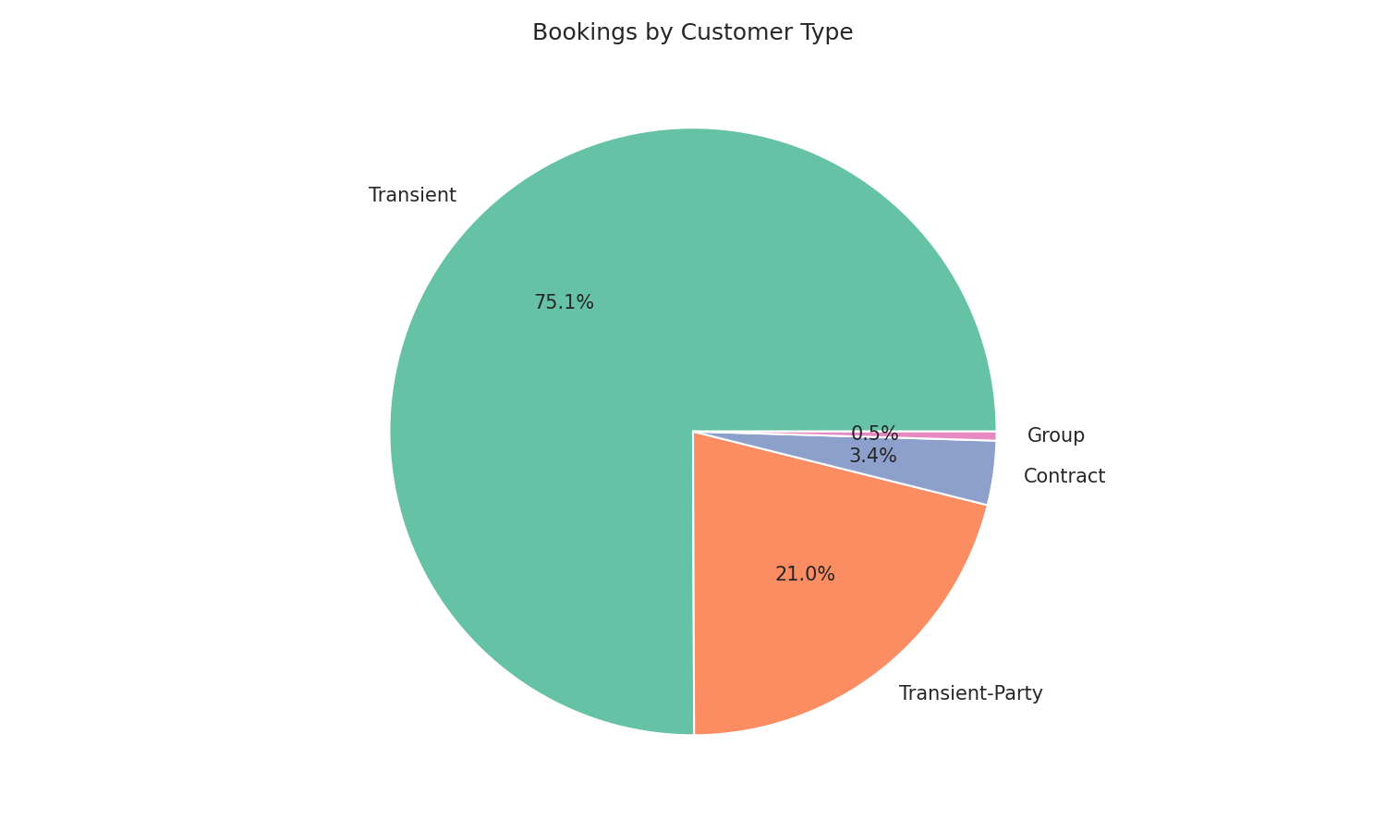
Bookings by Customer Type
Transient guests dominate the customer mix

Slide 19
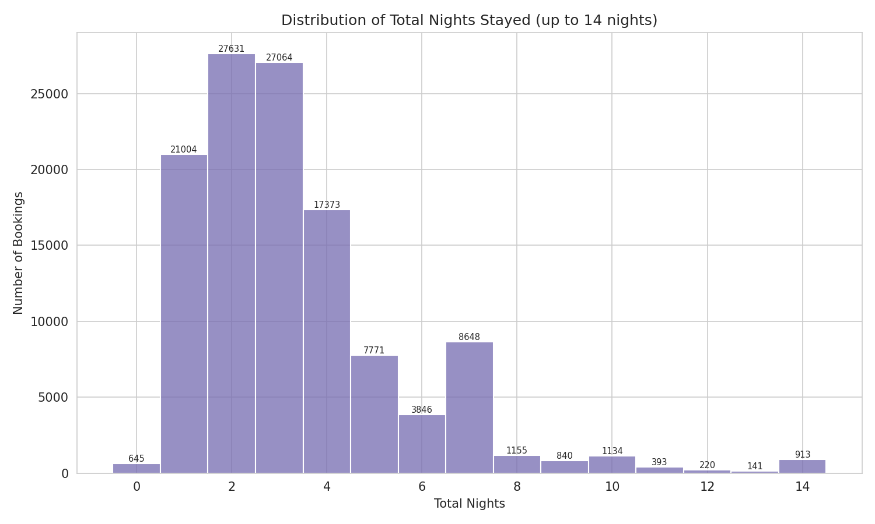
Length of Stay Distribution
Most stays cluster between 1 and 4 nights

Slide 20
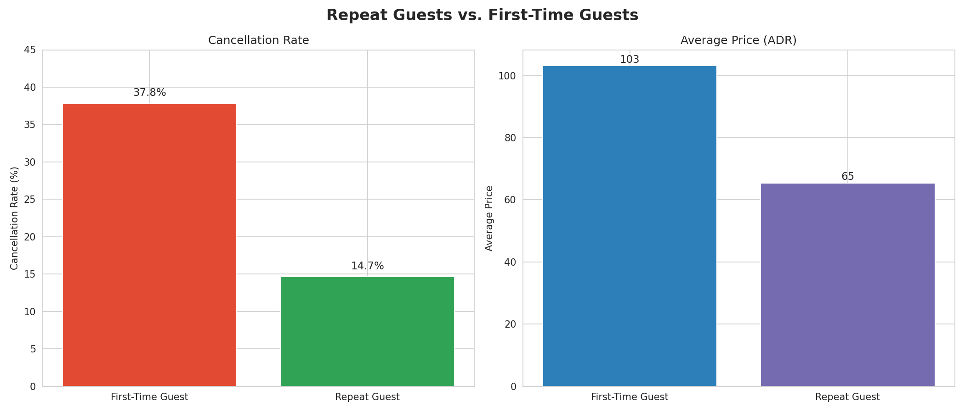
Repeat Guests: Rare but Reliable
Only 3.1% of bookings, yet far less likely to cancel

Slide 21
5. Operations & Booking Volume

Slide 22
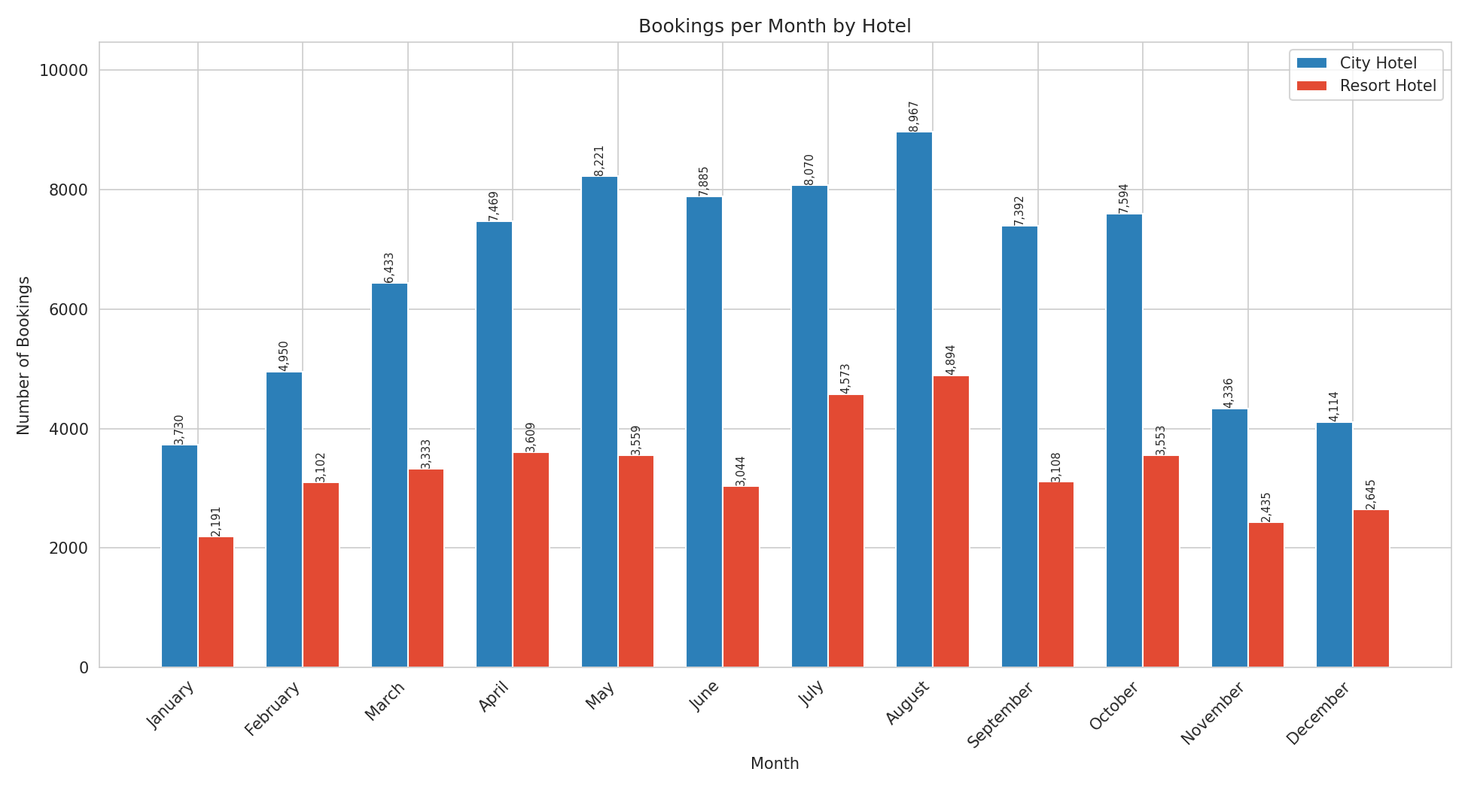
Bookings per Month by Hotel
Seasonal volume across both properties

Slide 23
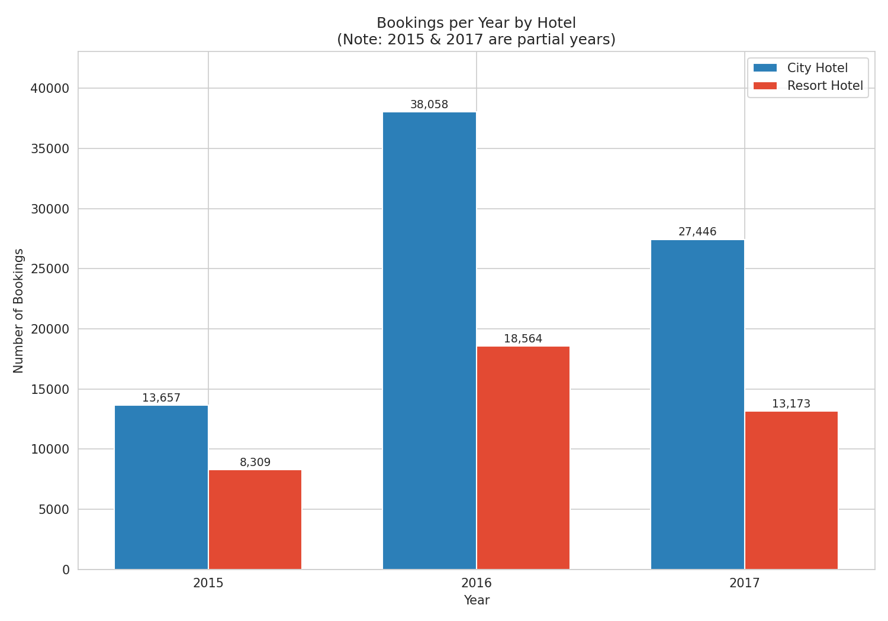
Bookings per Year by Hotel
2015 and 2017 are partial years; 2016 is the only full year

Slide 24
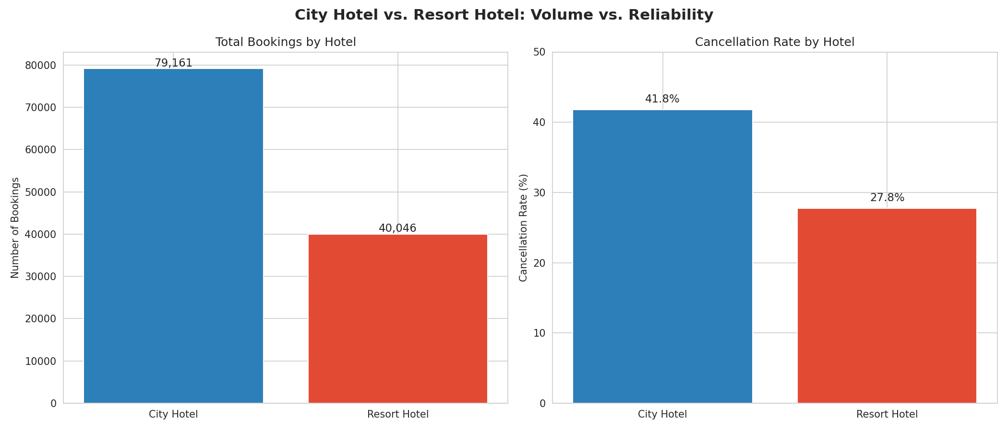
Volume vs. Reliability
City Hotel leads on volume; Resort Hotel leads on reliability

Slide 25
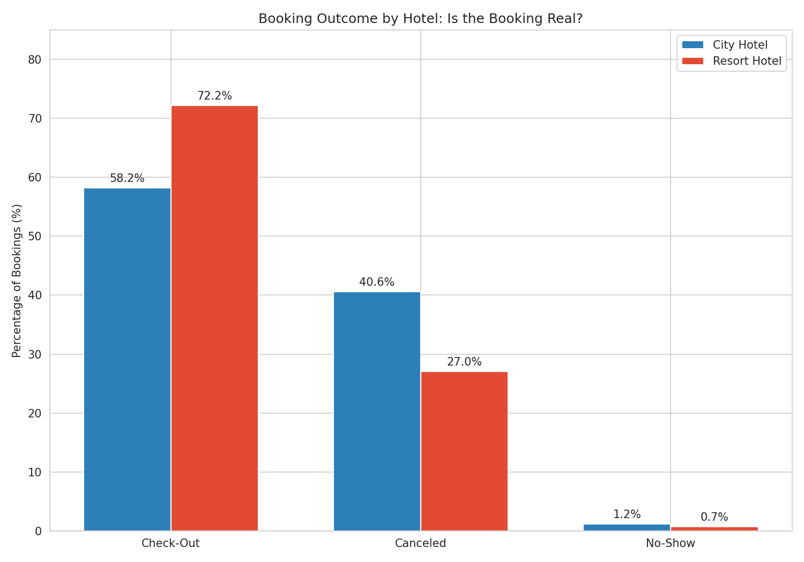
Booking Outcome by Hotel
Resort Hotel converts more bookings into real stays

Slide 26
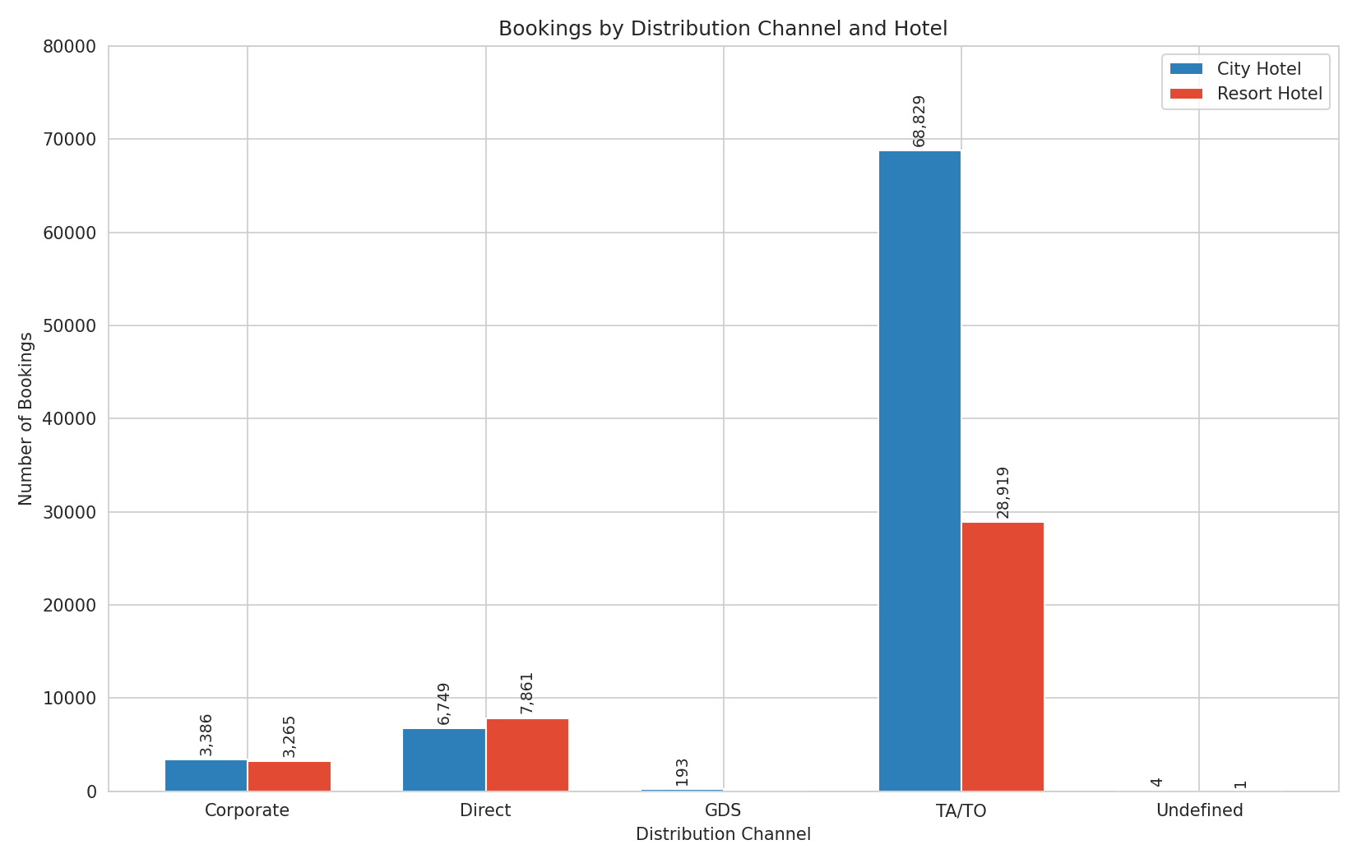
Bookings by Distribution Channel
TA/TO dominates both hotels — and drives most cancellation risk

Slide 27
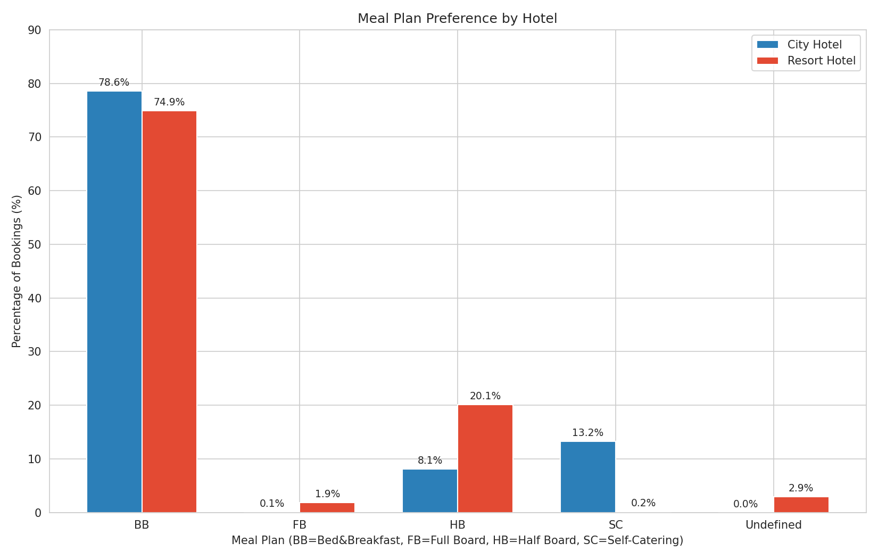
Meal Plan Preference by Hotel
Bed & Breakfast is the clear favorite at both properties

Slide 28
6. Recommendations

Slide 29
Recommended Actions
1
Review the deposit/cancellation policy for TA/TO Group bookings — "Non Refund" is not deterring cancellations.
2
Apply stricter confirmation or deposit requirements on bookings made 90+ days in advance.
3
Investigate why City Hotel converts fewer bookings into stays than Resort Hotel.
4
Build loyalty incentives to grow the repeat-guest base — small today, but highly reliable.
5
Use special requests, parking add-ons, and booking edits as early signals of real guest commitment.

Slide 30
Thank You
Kingdom Travel Services — Quality Assurance & Data Analytics

