Slide 1
WELCOME TO CLASS!

Slide 2
let’s introduce ourselves

Slide 3
what is a “Microprocessor”?

Slide 4
CLASS 1

Slide 5
what is a microprocessor?
The Microprocessor, also known as the Central Processing Unit (CPU), is the brain of all computers and many household and electronic devices

Slide 6
What is a microprocessor?
Multiple MPUs, working together, are the "hearts" of datacenters, super- computers, communications products, and other digital devices

Slide 7
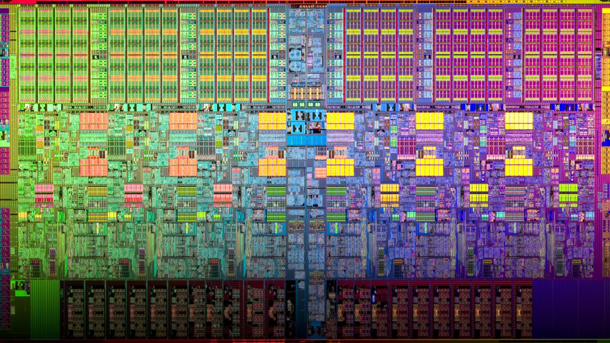
MPU ARCHITECTURE

Slide 8
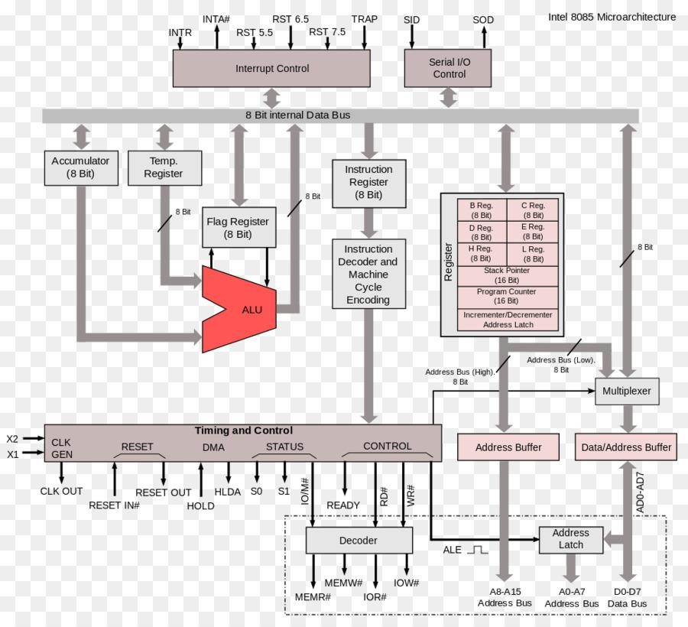
INTEL 8085 MPU ARCHITECTURE

Slide 9
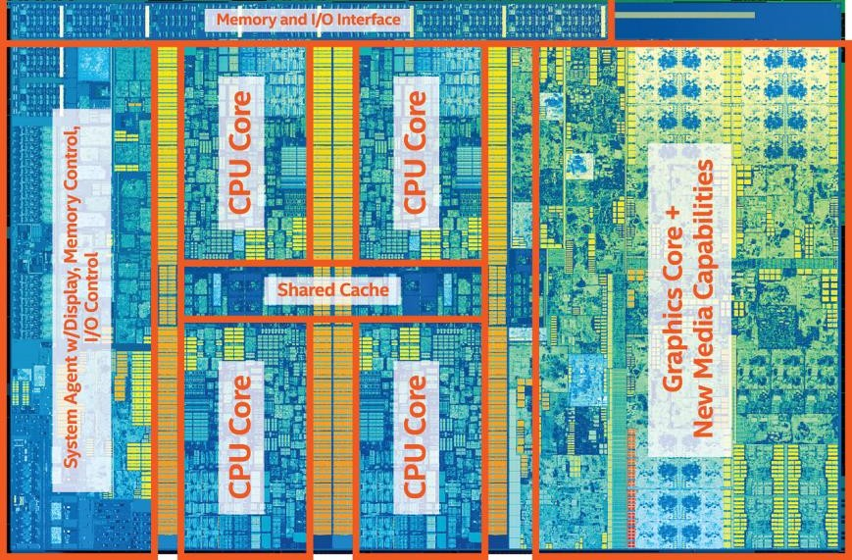

Slide 10
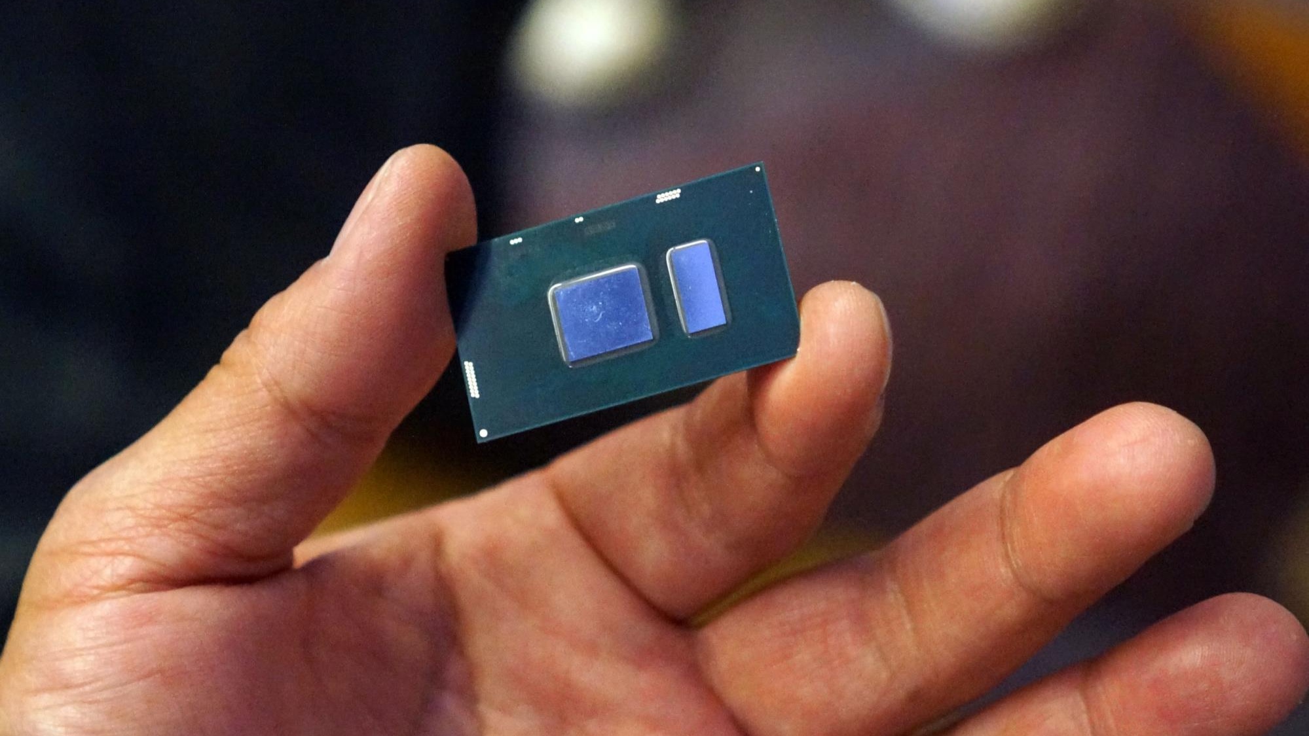

Slide 11
HISTORY
ENIAC (Electronic Numerical Integrator And Computer) was the world’s first general-purpose computer

Slide 12
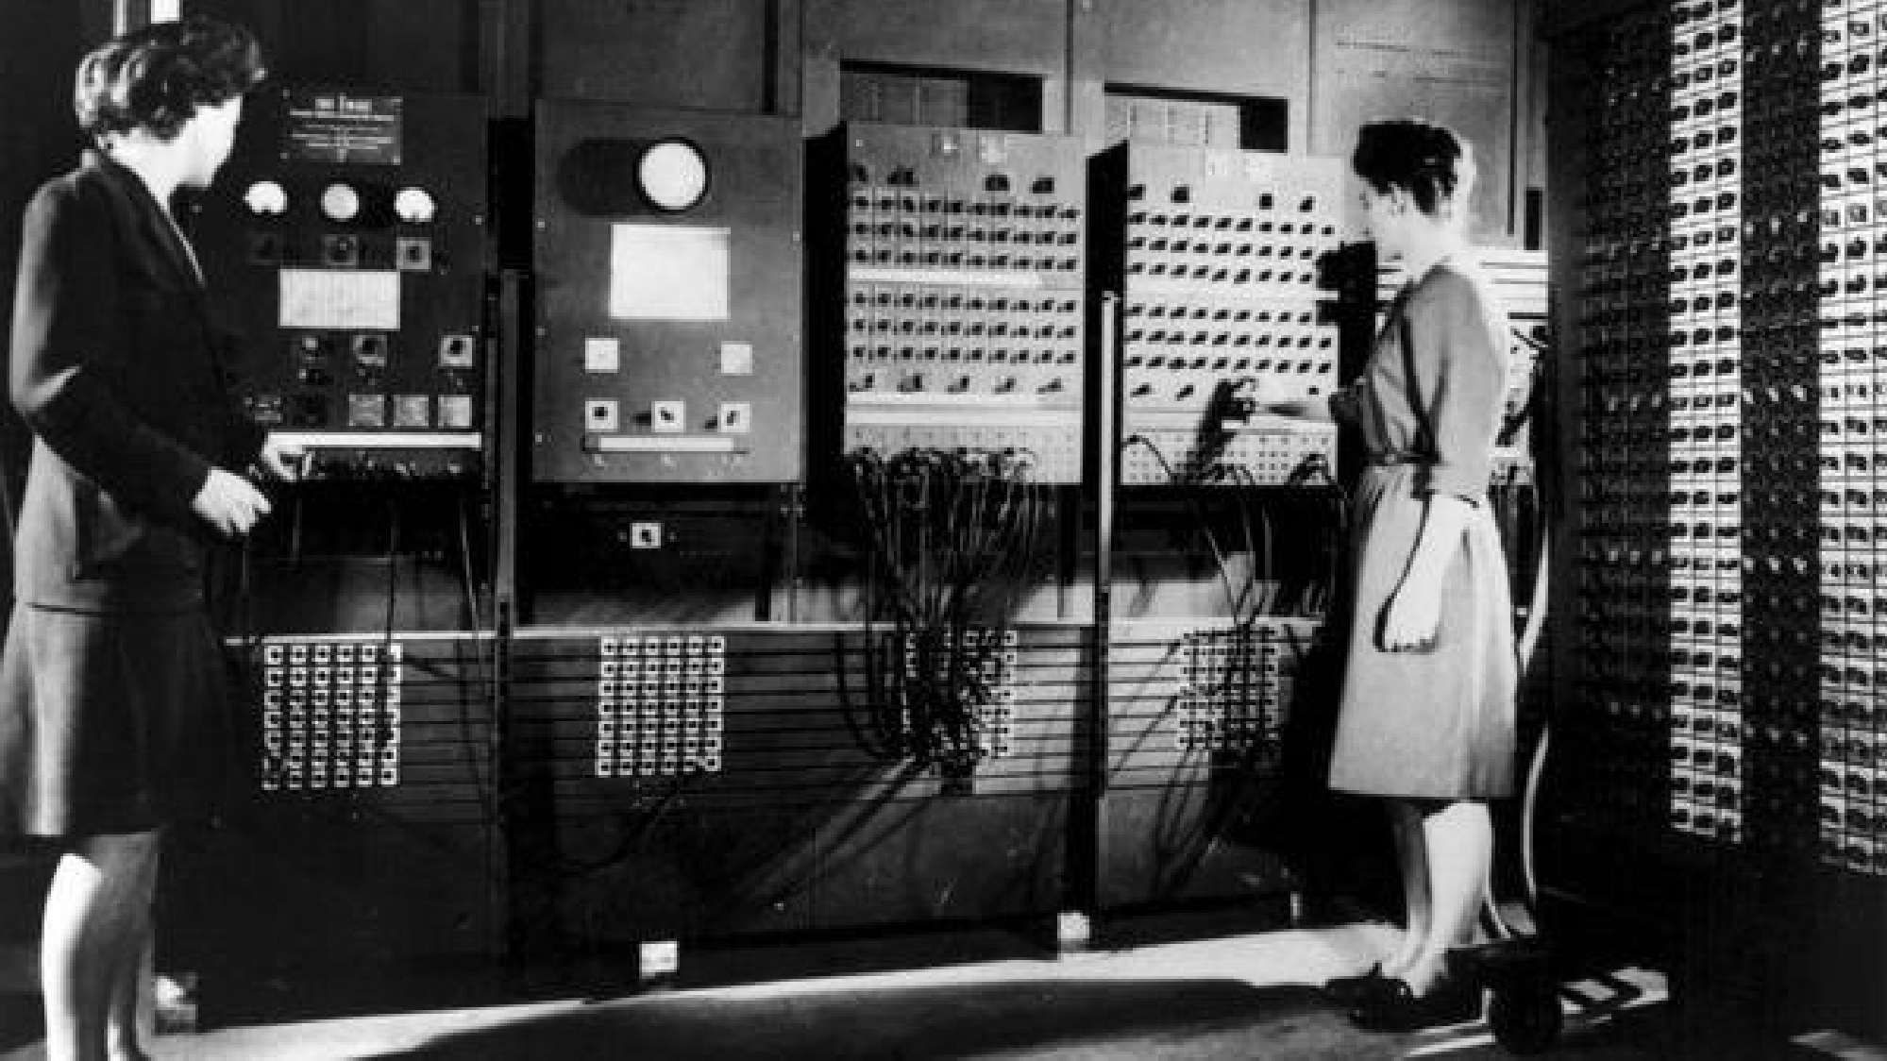
1946

Slide 13
HISTORY
The first microprocessor was the Intel 4004, introduced in 1971

Slide 14
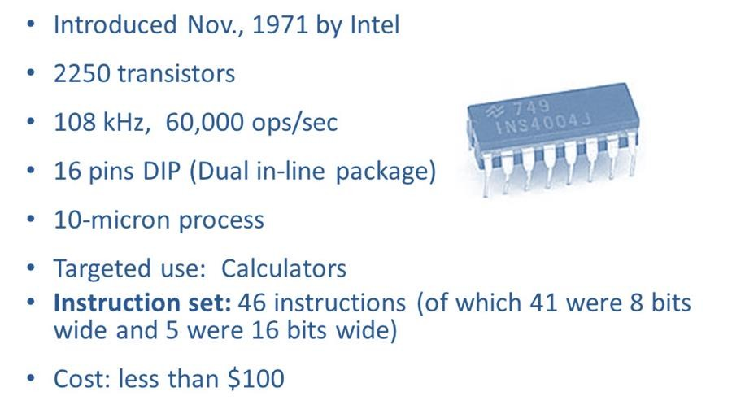
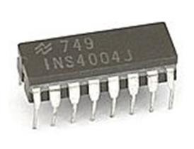
INTEL 4004

Slide 15
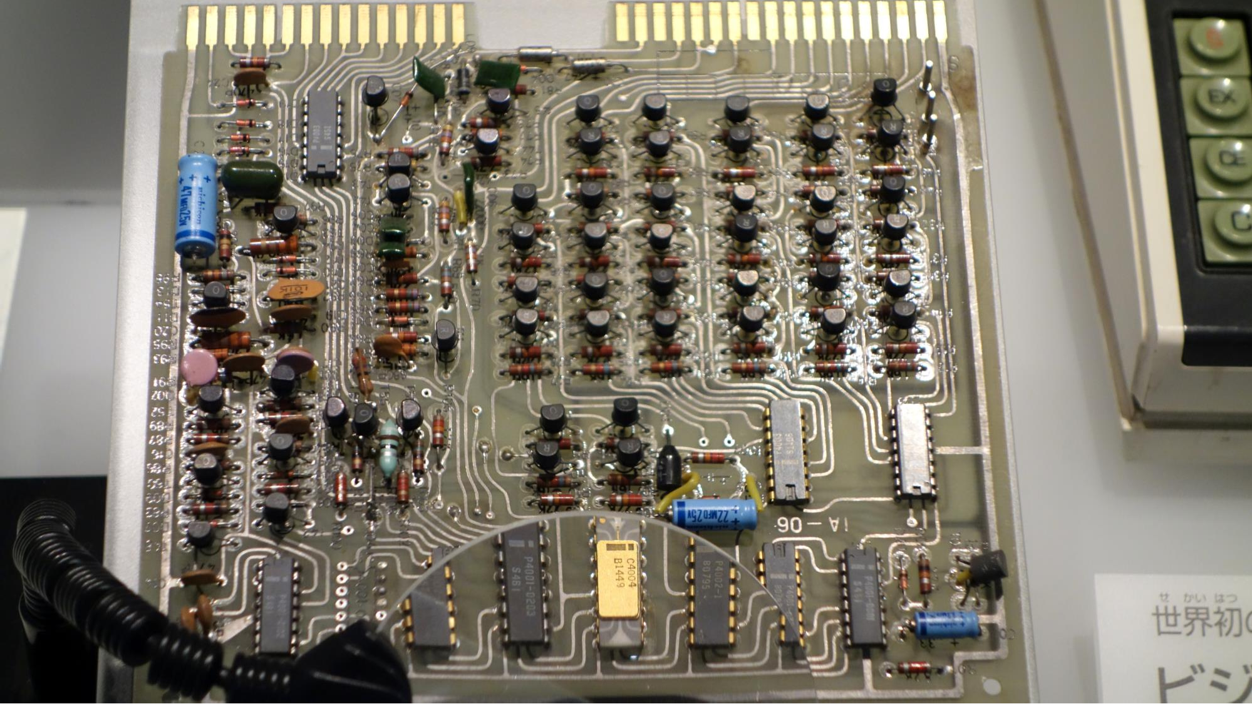

Slide 16
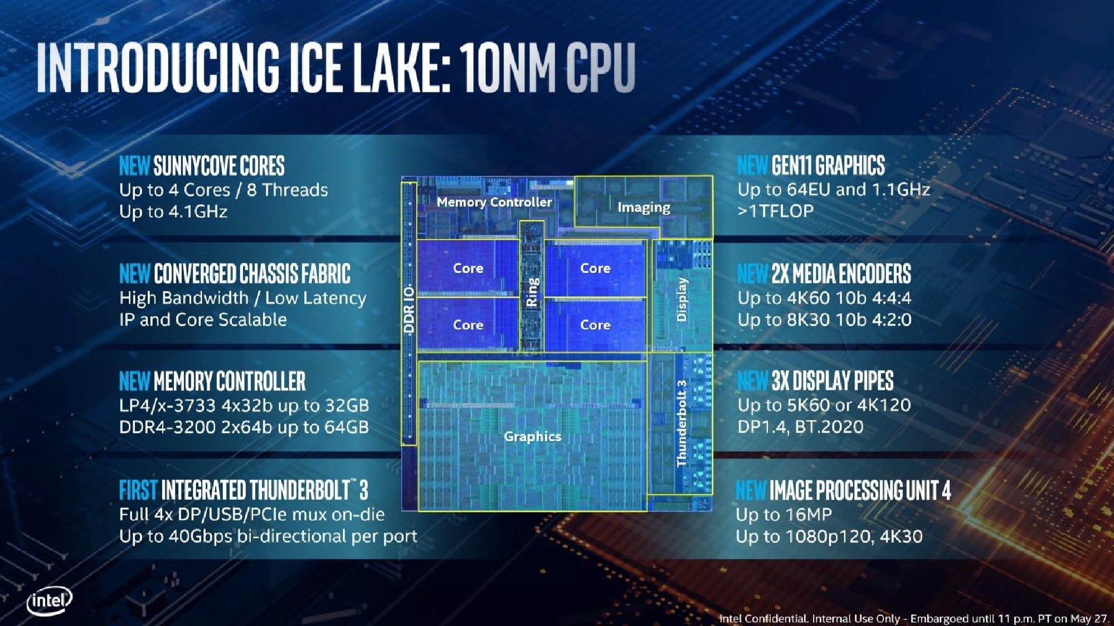
2019

Slide 17
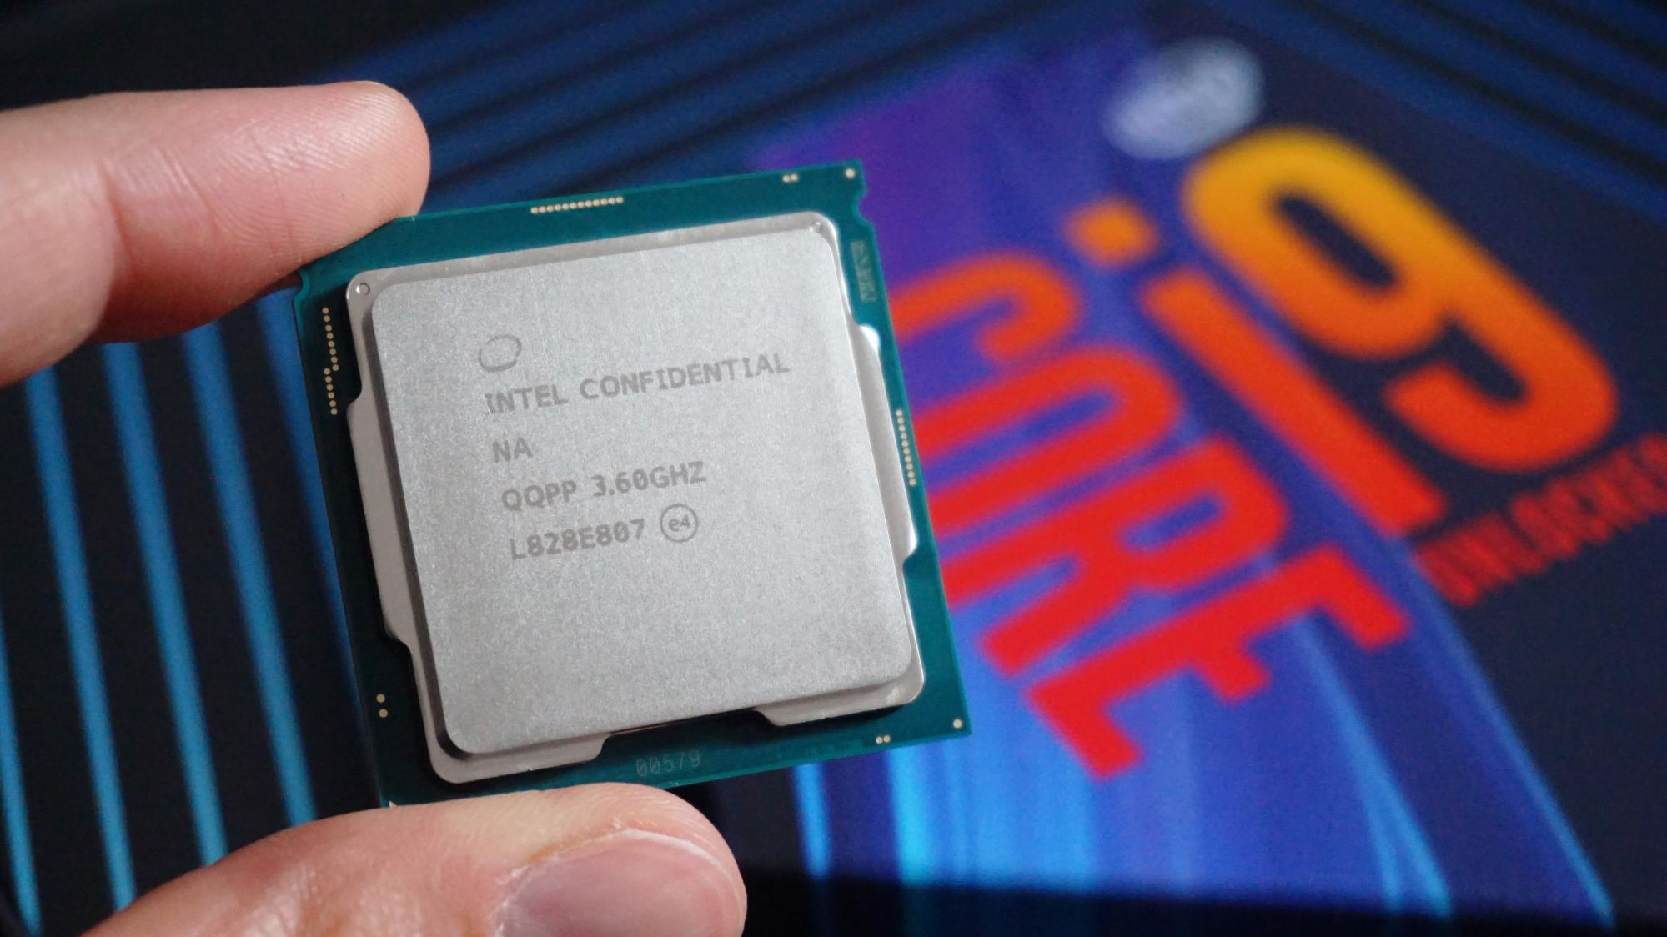
Intel Core i9-9900KS Processor 18 Billion Transistors

Slide 18







Slide 19
microprocessor vs CPU
A CPU (central processing unit) is the part of a computer that executes instructions. This can be implemented using a single IC, a number of ICs, discrete transistors or a room full of vacuum tubes

Slide 20
microprocessor vs CPU
A microprocessor is a single-chip implementation of a CPU

Slide 21
microprocessor vs CPU
Nowadays pretty much all CPUs for general use are microprocessors, causing the two terms to be practically synonymous

Slide 22
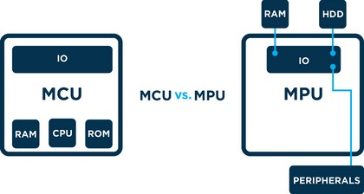
MPU vs MCU

Slide 23
what is a microcontroller?
A microcontroller is a computer present in a single integrated circuit which is dedicated to perform one task and execute one specific application

Slide 24
what is a microcontroller?
MCUs contain memory, programmable input/output peripherals as well a processor

Slide 25
what is a microcontroller?
MCUs are mostly designed for embedded applications and are heavily used in automatically controlled electronic devices such as cellphones, cameras, microwave ovens, washing machines, etc.

Slide 26
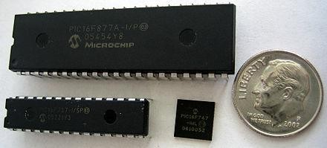
MCUs come in different shapes, sizes and _{coni}©️_{g}A_{u}er_{r}can_{a}Co_{t}lle_{i}ge_{o}of_{n}the _{s}

Slide 27
MICROCONTROLLERS CONTROL CIRCUITS

Slide 28
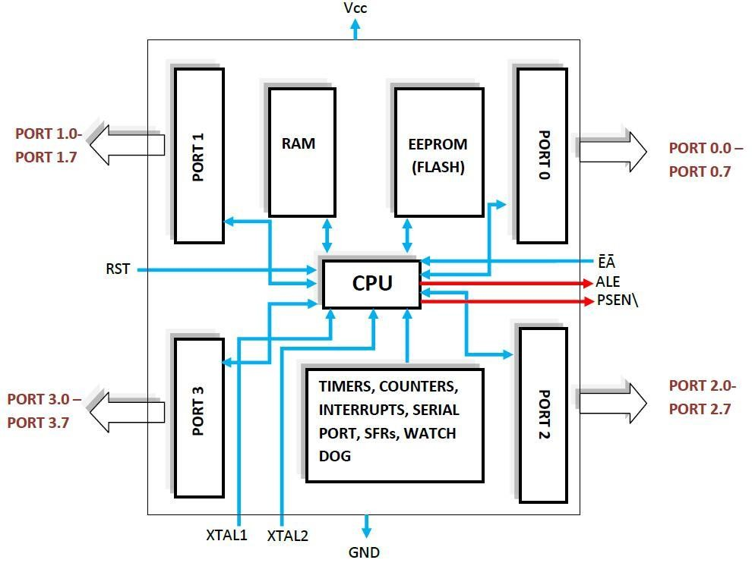

Slide 29
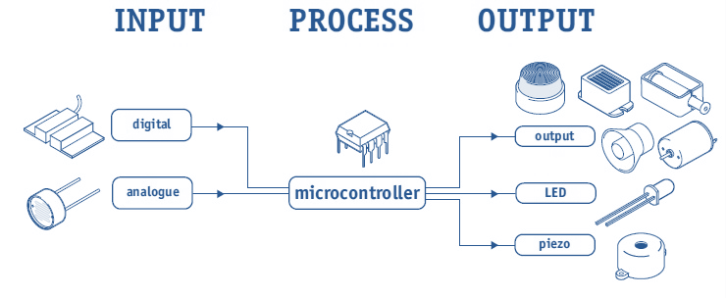

Slide 30
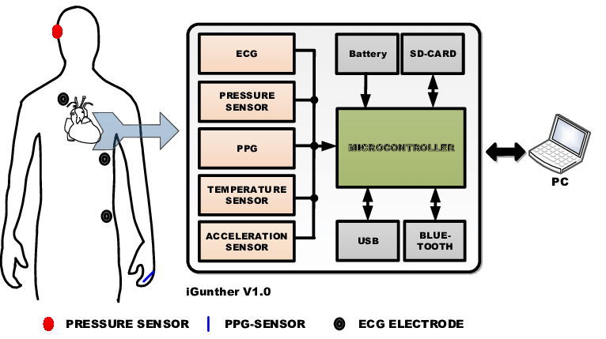
IN-EAR PULSE BIODATA ACQUISITION

Slide 31
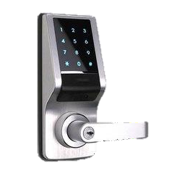
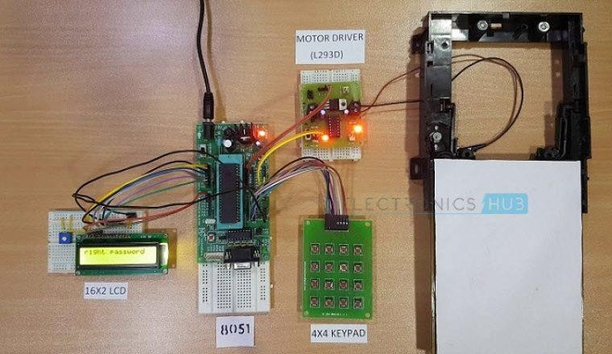
PASSWORD BASED DOOR LOCK SYSTEM

Slide 32
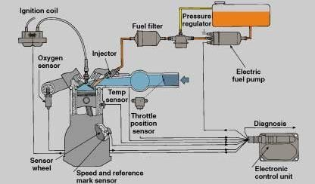
ENGINE CONTROL UNIT

Slide 33
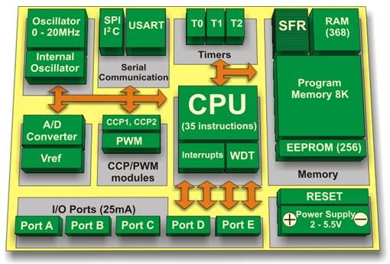
ARCHITECTURE OF A MICROCONTROLLER

Slide 34
in order to work, MCUs need:
Power
A program (code) to follow
Inputs and Outputs (HW & SW)

Slide 35


in order to work, MCUs need:
1.
Power
2. A program (code) to follow
3.
Inputs and Outputs (HW & SW)
DIGITAL COMPONENTS

Slide 36
in order to work, MCUs need:
1. Power
2.
A program (code) to follow
3. Inputs and Outputs (HW & SW)
DATA REPRESENTATION

Slide 37
DIGITAL COMPONENTS
basic electronic components
Ohm’s law Boolean logic
understand variables

Slide 38
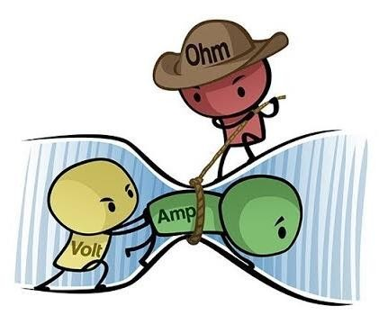
OHM’S LAW
V = I x R

Slide 39
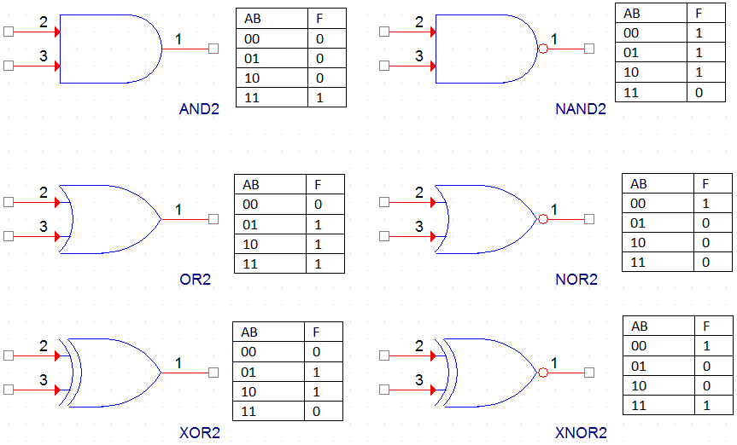
BOOLEAN LOGIC

Slide 40
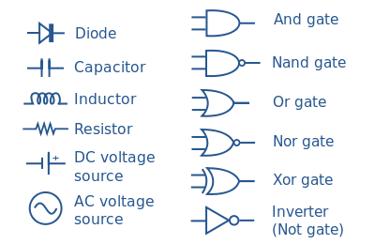
BASIC ELECTRONIC COMPONENTS

Slide 41
DATA REPRESENTATION
binary system
hexadecimal system decimal system
how to alternate between them

Slide 42
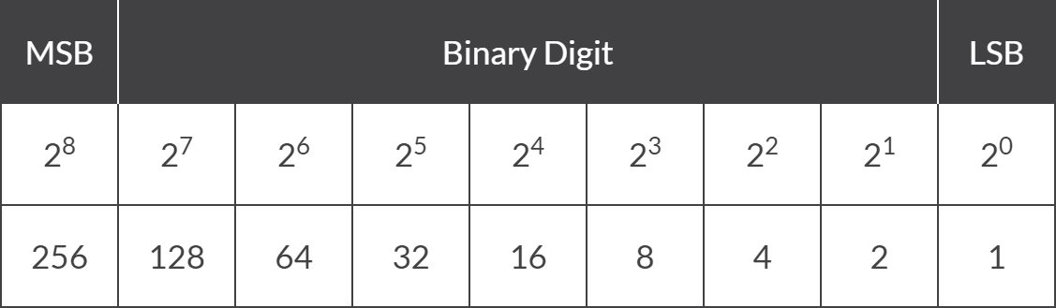
binary to decimal

Slide 43
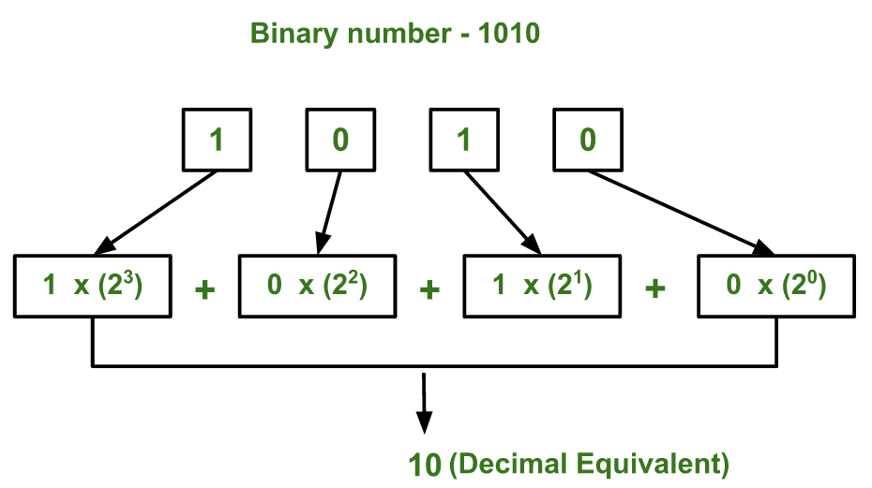
binary to decimal

Slide 44
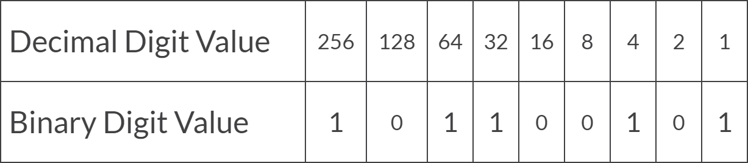
binary to decimal

Slide 45
binary to decimal
By adding together ALL the decimal number values from right to left at the positions that
are represented by a “1” gives us: (256) + (64) + (32) + (4) + (1) = 357₁₀
or three hundred and fifty seven as a decimal number.

Slide 46
binary to decimal

Slide 47
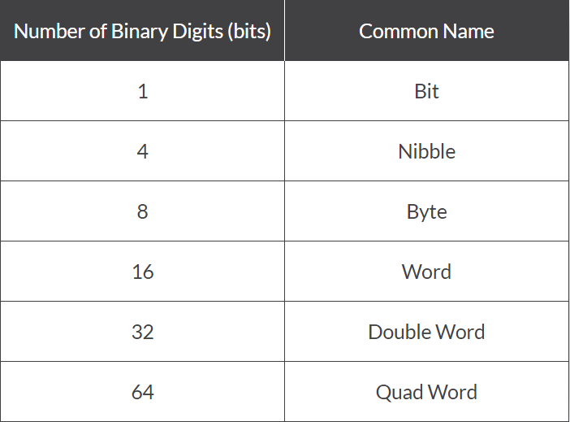
binary system units

Slide 48
Today, as micro-controller or microprocessor systems become increasingly larger, the individual binary digits (bits) are now grouped together into 8’s to form a single BYTE

Slide 49
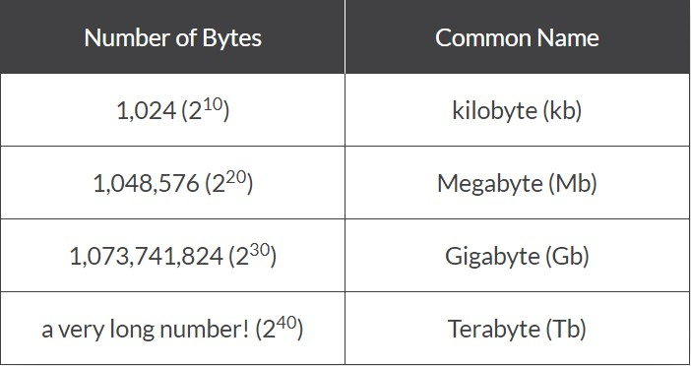
file system units

Slide 50
BINARY TO DECIMAL SUMMARY
_
A “BIT” is the abbreviated term derived from BInary digiT
A Binary system has only two states, Logic “0” and Logic “1”
giving a base of 2
A Decimal system uses 10 different digits, 0 to 9 giving it a
base of 10
A Binary number is a weighted number who’s weighted value increases from right to left
The weight of a binary digit doubles from right to left
A decimal number can be converted to a binary number by
using the sum-of-weights method
When we convert numbers from binary to decimal, or
decimal to binary, subscripts are used to avoid errors

Slide 51
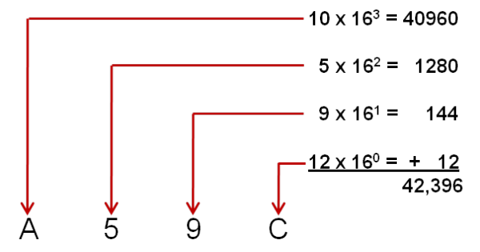
hexadecimal to decimal

Slide 52
THANK YOU

