Slide 1
CLASS 2

Slide 2
CLASS 1 REVIEW

Slide 3
what is a “Microprocessor”?

Slide 4
what is a microprocessor?
The Microprocessor, also known as the Central Processing Unit (CPU), is the brain of all computers and many household and electronic devices

Slide 5
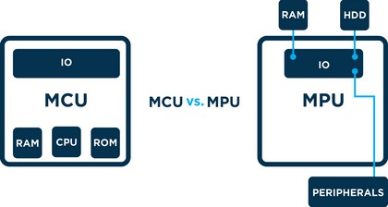
MPU vs MCU

Slide 6
what is a microcontroller?
A microcontroller is a computer present in a single integrated circuit which is dedicated to perform one task and execute one specific application

Slide 7
what is a microcontroller?
MCUs contain memory, programmable input/output peripherals as well a processor

Slide 8
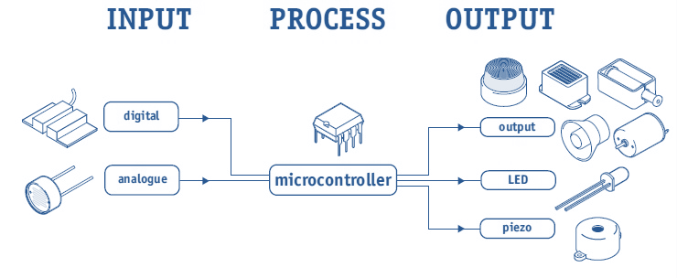

Slide 9
in order to work, MCUs need:
Power
A program (code) to follow
Inputs and Outputs (HW & SW)

Slide 10
DIGITAL COMPONENTS
basic electronic components
Ohm’s law Boolean logic
understand variables

Slide 11
DATA REPRESENTATION
binary system
hexadecimal system decimal system
how to alternate between them

Slide 12
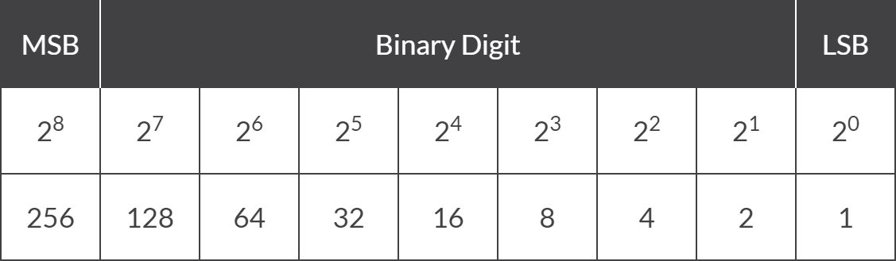
binary to decimal

Slide 13
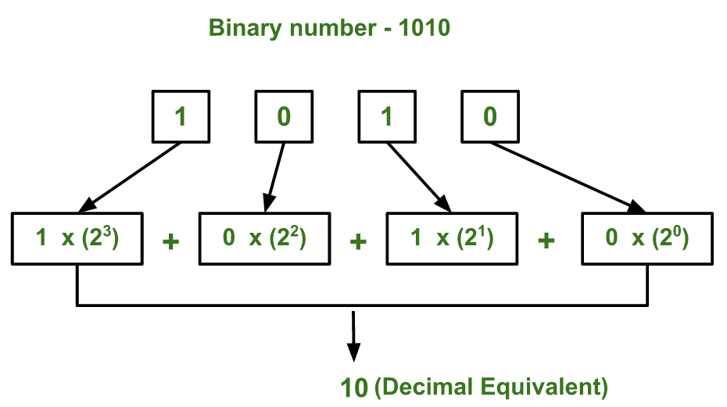
binary to decimal

Slide 14
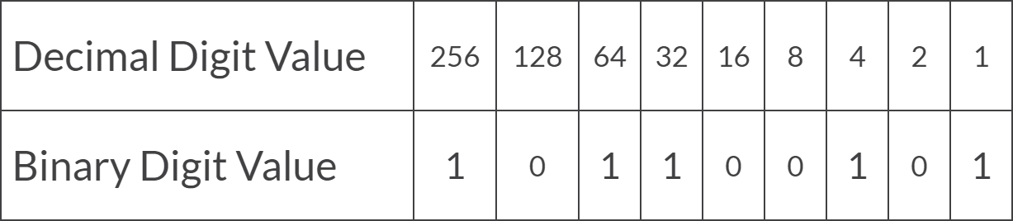
binary to decimal

Slide 15
CLASS 2
INTRODUCTION TO ASSEMBLY LANGUAGE
ADDING AND SUBSTRACTING VALUES
REGISTERS AND OPERATIONS
TRIS AND PORT REGISTERS
LED BLINK

Slide 16
what is a “Assembly Language”?

Slide 17
ASSEMBLY LANGUAGE IS AN EXTREMELY LOW-LEVEL PROGRAMMING LANGUAGE THAT HAS A 1-TO-1 CORRESPONDENCE TO MACHINE CODE — THE SERIES OF BINARY INSTRUCTIONS WHICH MOVE VALUES IN AND OUT OF REGISTERS IN A CPU

Slide 18
GENERAL OPERATIONS
MOVLW 0xFF MOVWF PORTA ADDLW b101 SUBLW 25
BCF RP1
BSF RP0

Slide 19
ADDING AND SUBSTRACTING

Slide 20
A
A + B
MOVLW A
w
A + B
ADDLW B
w

Slide 21
LET’S PRACTICE
10 + 20

Slide 22
LET’S PRACTICE
0xF0 + 0x01

Slide 23
A
A - B
MOVLW B
w
A - B
SUBLW A
w

Slide 24
LET’S PRACTICE
50 - 10

Slide 25
LET’S PRACTICE
0xFF - 0xAA

Slide 26
REGISTERS AND OPERATIONS

Slide 27
STATUS
To change from Bank 0 to Bank 1 we talk to the STATUS register. We do this by setting the RP0 and RP1 bits. In most cases we’ll be moving only between Bank 0 and Bank 1, thus we can just modify the value of the bit 5 of the STATUS register.

Slide 28
TRISD is in BANK 1
BSF STATUS, 5
PORTD is in BANK 0
BCF STATUS, 5

Slide 29
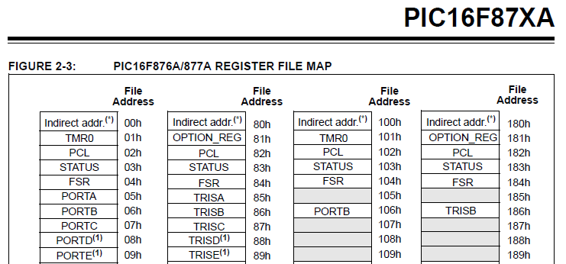
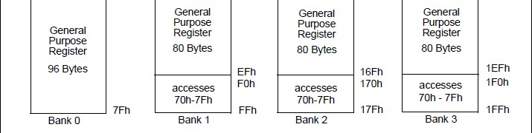
BANK SELECTION

Slide 30
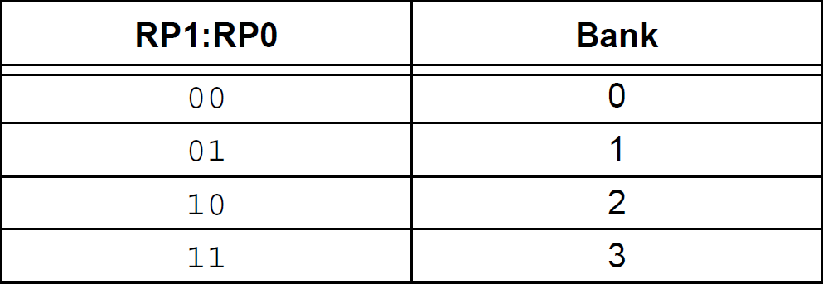
BANK SELECTION

Slide 31
TRISD is in BANK 1
BCF STATUS, RP1 BSF STATUS, RP0
PORTD is in BANK 0
BCF STATUS, RP1 BCF STATUS, RP0

Slide 32
W REGISTER
The W register is a general register in which you can put any value that you wish. Once you have assigned a value to W, you can add it to another value, or move.

Slide 33
MOVLW
The MOVLW command means ‘Move Literal Value Into W’, which in English means put the value that follows directly into the W register.
MOVLW 0xAA

Slide 34
MOVWF
This instruction means “Move The Contents Of W Into The Register Address That Follows”.
MOVWF TRISB

Slide 35
TRIS AND PORT REGISTERS

Slide 36
TRIS
We use the TRIS Register to program a pin to be an output or an input by simply sending a 0 (out) or a 1 (in) to the relevant bit in the register.
MOVLW 0xFF MOVWF TRISB

Slide 37
PORT
To send one of our output pins high, we simply send a ‘1’ to the corresponding bit in our PORTx register.
MOVLW 0xFF MOVWF PORTx

Slide 38

PORTB
PB7 PB6 PB5 PB4 PB3 PB2 PB1 PB0

Slide 39

PORTB
PB7 PB6 PB5 PB4 PB3 PB2 PB1 PB0

Slide 40
PORTB
PB7 PB6 PB5 PB4 PB3 PB2 PB1 PB0

Slide 41
TRISB
PORTB
PB7 PB6 PB5 PB4 PB3 PB2 PB1 PB0

Slide 42
TRISx
MCU
PBO
input 1
PC5
output 0

Slide 43
PORTB.0 = 1
BSF
TRISB, 0
PORTC.5 = 0
TRISC, 5
BCF

Slide 44
TRISx
MCU
PORTB
input
PORTC
output

Slide 45
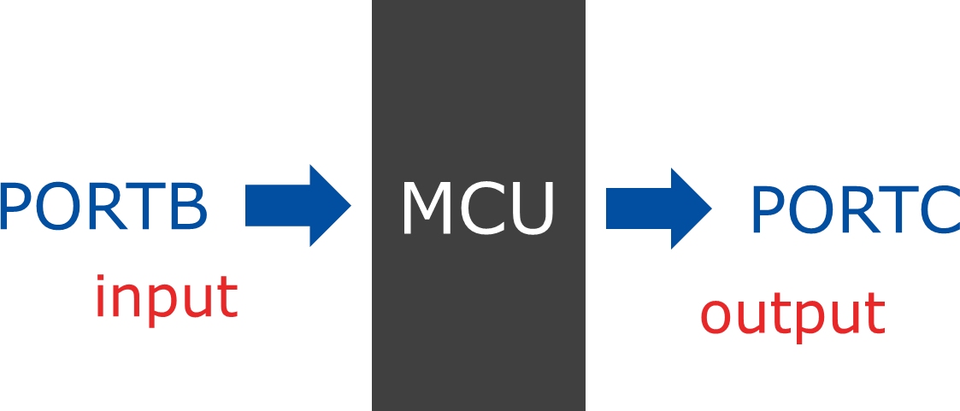
TRISx
0xFF -> TRISB
0x00 -> TRISC

Slide 46
TRISx
MOVLW 0xFF MOVWF TRISB CLRF TRISC

Slide 47
TURN LEDs ON AND OFF

Slide 48
PORTB
PB7 PB6 PB5 PB4 PB3 PB2 PB1 PB0

Slide 49
ORG 0x00
BSF STATUS, 5
CLRF TRISB MAIN
BCF STATUS, RP0 MOVLW 0xFF MOVWF PORTB
END

Slide 50
PORTB
PB7 PB6 PB5 PB4 PB3 PB2 PB1 PB0

Slide 51
ORG 0x00
BSF STATUS, 5
CLRF TRISB MAIN
BCF STATUS, 5 MOVLW 0xAA MOVWF PORTB END

Slide 52
PORTC
PC7 PC6 PC5 PC4 PC3 PC2 PC1 PC0

Slide 53
PORTD
PD7 PD6 PD5 PD4 PD3 PD2 PD1 PD0

Slide 54
THANK YOU

