Slide 1
CLASS 3

Slide 2
CLASS 3
Review INTRODUCTION TO ASSEMBLY LANGUAGE
ADDING AND SUBSTRACTING VALUES
REGISTERS AND OPERATIONS
TRIS AND PORT REGISTERS
LED BLINK

Slide 3
what is a “Assembly Language”?

Slide 4
ASSEMBLY LANGUAGE IS AN EXTREMELY LOW-LEVEL PROGRAMMING LANGUAGE THAT HAS A 1-TO-1 CORRESPONDENCE TO MACHINE CODE — THE SERIES OF BINARY INSTRUCTIONS WHICH MOVE VALUES IN AND OUT OF REGISTERS IN A CPU

Slide 5
GENERAL OPERATIONS
MOVLW 0xFF MOVWF PORTA ADDLW b101 SUBLW 25 BCF RP1
BSF RP0

Slide 6
ADDING AND SUBSTRACTING

Slide 7
A
A + B
MOVLW A
w
A + B
ADDLW B
w

Slide 8
LET’S PRACTICE
0xF0 + 0x01

Slide 9
A - B
MOVLW B
B
w
A - B
SUBLW A
w
SUBLW subtract W from Literal
Operation: k-(W)->W

Slide 10
LET’S PRACTICE
0xFF - 0xAA

Slide 11
REGISTERS AND OPERATIONS

Slide 12
STATUS
To change from Bank 0 to Bank 1 we talk to the STATUS register. We do this by setting the RP0 and RP1 bits. In most cases we’ll be moving only between Bank 0 and Bank 1, thus we can just modify the value of the bit 5 of the STATUS register.

Slide 13
TRISD is in BANK 1
BCF STATUS, RP1 BSF STATUS, RP0
PORTD is in BANK 0
BCF BCF
STATUS, RP1 STATUS, RP0

Slide 14
TRISD is in BANK 1
BCF STATUS, RP1
BSF STATUS, RP0
PORTD is in BANK 0
BCF BCF
STATUS, RP1 STATUS, RP0

Slide 15
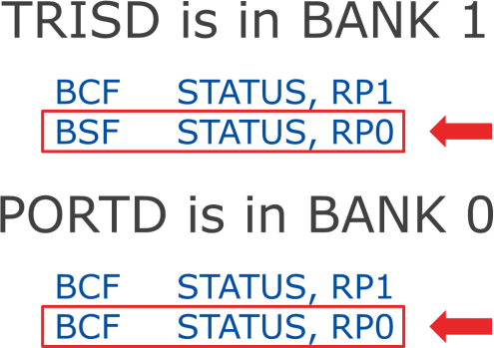
STATUS
IRP | RP1 | RP0 | TO | PD | Z | DC | C
7
6 5
4 3 2 1 0
0: BANK0 BANK1
1: BANK1
0: BANK0

Slide 16
STATUS, 5
IRP | RP1 | RP0 | TO | PD | Z | DC | C
7 6 |  | 5 | 4 3 2 1 0
0: BANK0 BANK1
1: BANK1
0: BANK0

Slide 17
TRISD is in BANK 1
BSF STATUS, 5
PORTD is in BANK 0
BCF STATUS, 5

Slide 18
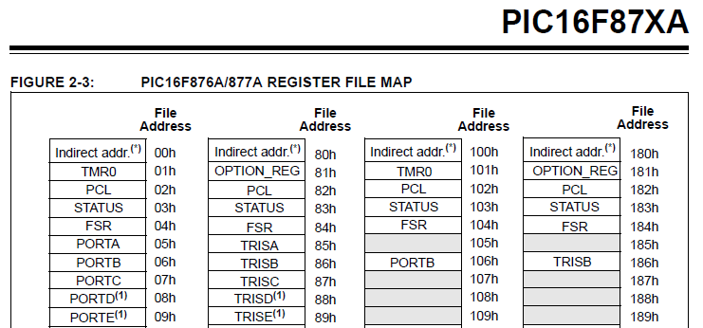
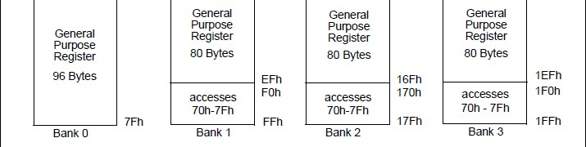
BANK SELECTION

Slide 19
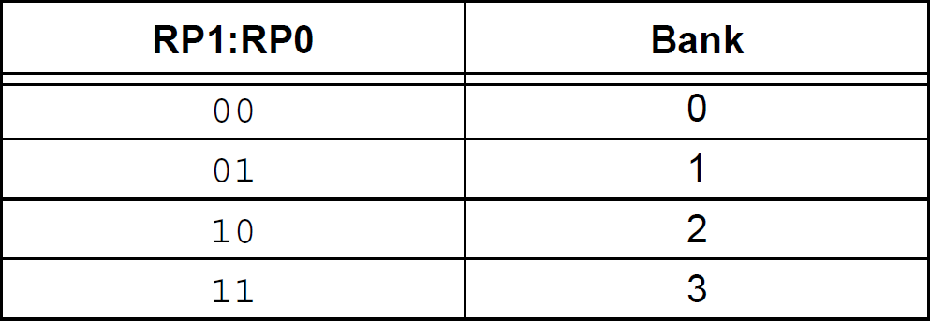
BANK SELECTION

Slide 20
BANK SELECTION

Slide 21
W REGISTER
The W register is a general register in which you can put any value that you wish. Once you have assigned a value to W, you can add it to another value, or move.

Slide 22
MOVLW
The MOVLW command means ‘Move Literal Value Into W’, which in English means put the value that follows directly into the W register.
MOVLW 0xAA

Slide 23
MOVWF
This instruction means “Move The Contents Of W Into The Register Address That Follows”.
MOVWF TRISB

Slide 24
TRIS AND PORT REGISTERS

Slide 25
TRIS
We use the TRIS Register to program a pin to be an output or an input by simply sending a 0 or a 1 to the relevant bit in the register.
MOVLW 0xFF MOVWF TRISB

Slide 26

TRIS
USE PORT TO WRITE
USE PORT TO READ

Slide 27
PORT
To send one of our output pins high, we simply send a ‘1’ to the corresponding bit in our PORTx register.
MOVLW 0xFF MOVWF PORTx

Slide 28

PORTB
PB7 PB6 PB5 PB4 PB3 PB2 PB1 PB0

Slide 29

PORTB
PB7 PB6 PB5 PB4 PB3 PB2 PB1 PB0

Slide 30
PORTB
PB7 PB6 PB5 PB4 PB3 PB2 PB1 PB0

Slide 31

TRISB
PORTB
PB7 PB6 PB5 PB4 PB3 PB2 PB1 PB0

Slide 32
TRISx
MCU
PBO
input 1
PC5
output 0

Slide 33
PORTB.0 = 1
BSF
TRISB, 0
PORTC.5 = 0
TRISC, 5
BCF

Slide 34
TRISx
MCU
PORTB
input
PORTC
output

Slide 35
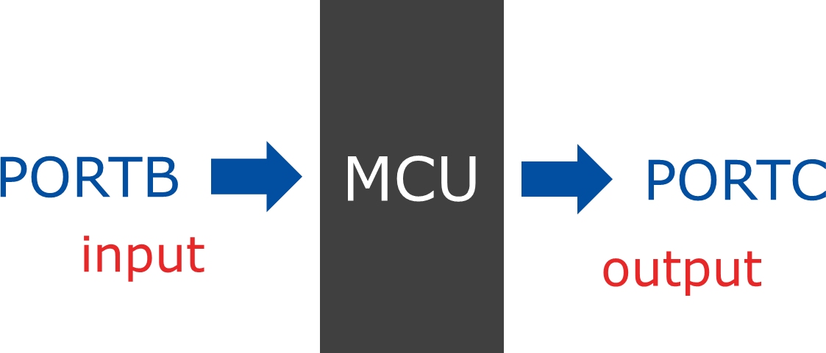
TRISx
0xFF -> TRISB
0x00 -> TRISC

Slide 36
TRISx
MOVLW 0xFF MOVWF TRISB CLRF TRISC

Slide 37
TURN LEDs ON AND OFF

Slide 38
PORTB
PB7 PB6 PB5 PB4 PB3 PB2 PB1 PB0

Slide 39
ORG 0x00
BSF STATUS, 5
CLRF TRISB MAIN
BCF STATUS, 5 MOVLW 0xFF MOVWF PORTB END

Slide 40
PORTB
PB7 PB6 PB5 PB4 PB3 PB2 PB1 PB0

Slide 41
ORG 0x00
BSF STATUS, 5
CLRF TRISB MAIN
BCF STATUS, 5 MOVLW 0xAA MOVWF PORTB END

Slide 42
PORTC
PC7 PC6 PC5 PC4 PC3 PC2 PC1 PC0

Slide 43
PORTA
PA7 PA6 PA5 PA4 PA3 PA2 PA1 PA0

Slide 44
PORTE
PE7 PE6 PE5 PE4 PE3 PE2 PE1 PE0

Slide 45
WRITE AN ASSEMBLY PROGRAM IN ORDER TO TURN ON ONLY
THE FIRST THREE LEDS OF PORTB

Slide 46
WRITE AN ASSEMBLY PROGRAM IN ORDER TO TURN ON
THE EVEN BITS OF PORTA

Slide 47
WRITE AN ASSEMBLY PROGRAM IN ORDER TO TURN ON
THE ODD BITS OF PORTD

Slide 48
WRITE AN ASSEMBLY PROGRAM IN ORDER TO TURN ON ONLY
THE LAST TWO LEDS OF PORTC

Slide 49
WRITE AN ASSEMBLY PROGRAM IN ORDER TO TURN ON
THE EVEN BITS OF PORTB AND THE ODD BITS OF PORTC

Slide 50
THANK YOU

