Slide 1
CLASS 4

Slide 2
CLASS 3 REVIEW

Slide 3


PORTB
PB7 PB6 PB5 PB4 PB3 PB2 PB1 PB0

Slide 4
TURN LEDs ON AND OFF

Slide 5
PORTB
PB7 PB6 PB5 PB4 PB3 PB2 PB1 PB0

Slide 6
ORG 0x00
BSF STATUS, 5
CLRF TRISB MAIN
BCF STATUS, 5 MOVLW 0xFF MOVWF PORTB END

Slide 7
PORTB
PB7 PB6 PB5 PB4 PB3 PB2 PB1 PB0

Slide 8
ORG 0x00
BSF STATUS, 5
CLRF TRISB MAIN
BCF STATUS, 5 MOVLW 0xAA MOVWF PORTB END

Slide 9
PORTC
PC7 PC6 PC5 PC4 PC3 PC2 PC1 PC0

Slide 10
PORTA
PA7 PA6 PA5 PA4 PA3 PA2 PA1 PA0

Slide 11
PORTE
PE7 PE6 PE5 PE4 PE3 PE2 PE1 PE0

Slide 12
WRITE AN ASSEMBLY PROGRAM IN ORDER TO TURN ON ONLY
THE FIRST THREE LEDS OF PORTB

Slide 13
WRITE AN ASSEMBLY PROGRAM IN ORDER TO TURN ON
THE EVEN BITS OF PORTA

Slide 14
WRITE AN ASSEMBLY PROGRAM IN ORDER TO TURN ON
THE ODD BITS OF PORTD

Slide 15
WRITE AN ASSEMBLY PROGRAM IN ORDER TO TURN ON ONLY
THE LAST TWO LEDS OF PORTC

Slide 16
WRITE AN ASSEMBLY PROGRAM IN ORDER TO TURN ON
THE EVEN BITS OF PORTB AND THE ODD BITS OF PORTC

Slide 17
CLASS 4
TURN ON LEDs
7-SEGMENT DISPLAY
BASICS OF CENTRAL PROCESSING UNIT

Slide 18
TURN LEDS ON AND OFF

Slide 19
PORTA
PA7 PA6 PA5 PA4 PA3 PA2 PA1 PA0

Slide 20
ORG 0x00
BSF STATUS, 5
CLRF TRISA MAIN
BCF STATUS, 5 MOVLW 0x99 MOVWF PORTA END

Slide 21
7-SEGMENT DISPLAY

Slide 22
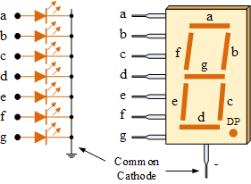
7-SEGMENT DISPLAY
COMMON CATHODE

Slide 23
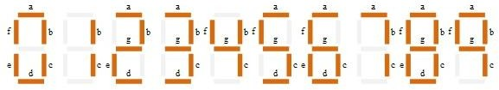
7-SEGMENT DISPLAY

Slide 24
7-SEGMENT DISPLAY
Decimal | DP | g | f | e | d | c | b | a | Hex
0 | 0 | 0 | 1 | 1 | 1 | 1 | 1 | 1 | 3F
1 | 0 | 0 | 0 | 0 | 0 | 1 | 1 | 0 | 06
2 | 0 | 1 | 0 | 1 | 1 | 0 | 1 | 1 | 5B
3 | 0 | 1 | 0 | 0 | 1 | 1 | 1 | 1 | 4F
4 | 0 | 1 | 1 | 0 | 0 | 1 | 1 | 0 | 66
5 | 0 | 1 | 1 | 0 | 1 | 1 | 0 | 1 | 6D
6 | 0 | 1 | 1 | 1 | 1 | 1 | 0 | 1 | 7D
7 | 0 | 0 | 0 | 0 | 0 | 1 | 1 | 1 | 07
8 | 0 | 1 | 1 | 1 | 1 | 1 | 1 | 1 | 7F
9 | 0 | 1 | 1 | 0 | 0 | 1 | 1 | 1 | 67

Slide 25

7-SEGMENT DISPLAY
SHOW NUMBER “0”
IN ALL THE 7-SEG DISPLAYS

Slide 26
7-SEGMENT DISPLAY
COMMON CATHODE

Slide 27
7-SEGMENT DISPLAY
Decimal | DP | g | f | e | d | c | b | a | Hex
0 | 0 | 0 | 1 | 1 | 1 | 1 | 1 | 1 | 3F
1 | 0 | 0 | 0 | 0 | 0 | 1 | 1 | 0 | 06
2 | 0 | 1 | 0 | 1 | 1 | 0 | 1 | 1 | 5B
3 | 0 | 1 | 0 | 0 | 1 | 1 | 1 | 1 | 4F
4 | 0 | 1 | 1 | 0 | 0 | 1 | 1 | 0 | 66
5 | 0 | 1 | 1 | 0 | 1 | 1 | 0 | 1 | 6D
6 | 0 | 1 | 1 | 1 | 1 | 1 | 0 | 1 | 7D
7 | 0 | 0 | 0 | 0 | 0 | 1 | 1 | 1 | 07
8 | 0 | 1 | 1 | 1 | 1 | 1 | 1 | 1 | 7F
9 | 0 | 1 | 1 | 0 | 0 | 1 | 1 | 1 | 67

Slide 28

ORG 0x00
BSF STATUS, 5 CLRF TRISA CLRF TRISD MAIN
BCF STATUS, 5 MOVLW 0xFF MOVWF PORTA MOVLW 0x3F MOVWF PORTD END

Slide 29
7-SEGMENT DISPLAY
SHOW NUMBER “5”
IN THE FIRST TWO 7-SEG DISPLAYS

Slide 30
7-SEGMENT DISPLAY
SHOW CHARACTER “H”
IN THE FIRST AND LAST 7-SEG DISPLAY

Slide 31
7-SEGMENT DISPLAY
SHOW CHARACTER “A”
IN THE SECOND AND THIRD 7-SEG DISPLAY

Slide 32
7-SEGMENT DISPLAY
SHOW THE 7-SEG DISPLAY OUTPUT IF PORTD=0xC9

Slide 33
CENTRAL PROCESSING UNIT

Slide 34
CPU
Also known as Microprocessor, handles all instructions it receives from hardware and software running on the computer

Slide 35
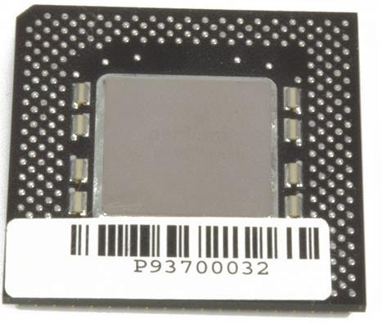
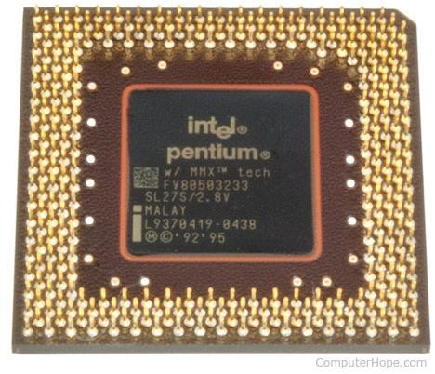
INTEL PENTIUM

Slide 36
CENTRAL PROCESSING UNIT
The processor is placed and secured into a compatible CPU socket found on the motherboard
Processors produce heat, so they are covered with a heat sink to keep them cool and running smoothly

Slide 37
WHAT DOES THE CPU DO?

Slide 38
WHAT DOES THE CPU DO?
Takes input from a peripheral (keyboard, mouse, printer, etc) or computer program
Interprets what it needs
Outputs information to your monitor, or perform the requested task

Slide 39






WHAT DOES THE CPU DO?
INPUTS
OUTPUTS

Slide 40
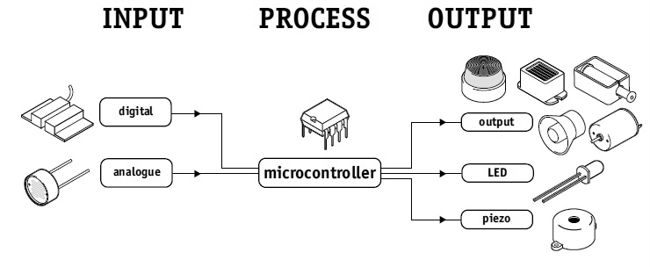

Slide 41
HISTORY
THE FIRST MICROPROCESSOR WAS THE INTEL 4004, INTRODUCED IN 1971

Slide 42
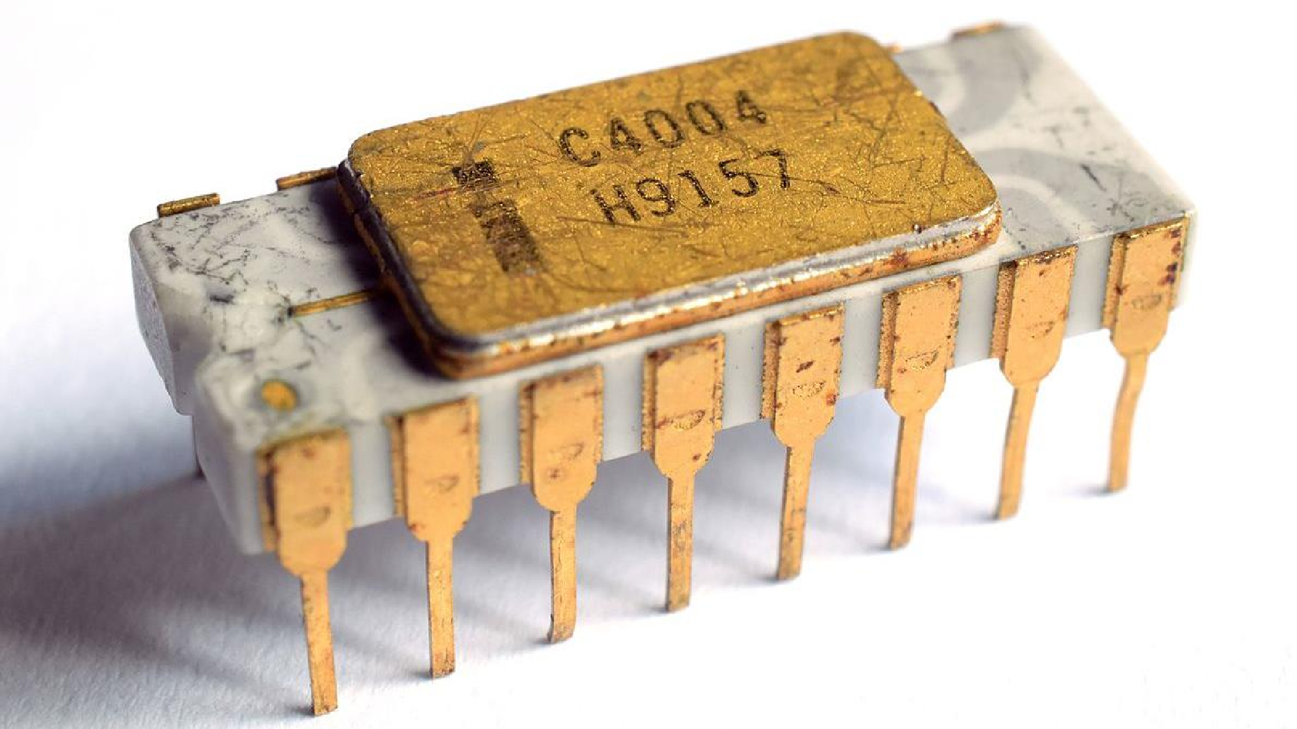
INTEL 4004
1971

Slide 43
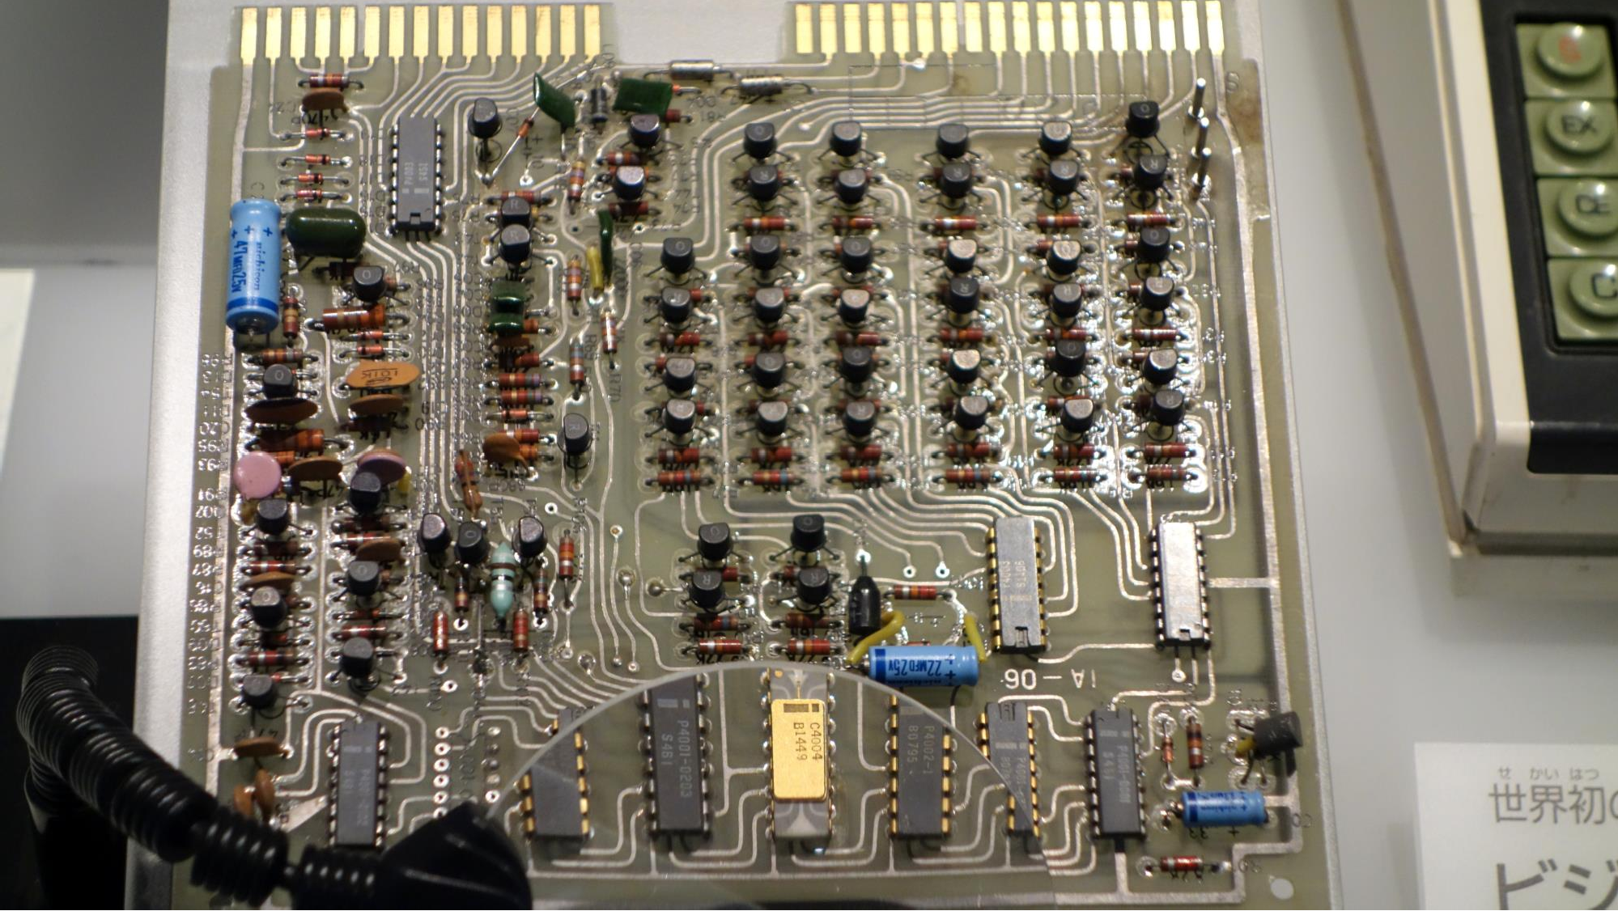

Slide 44
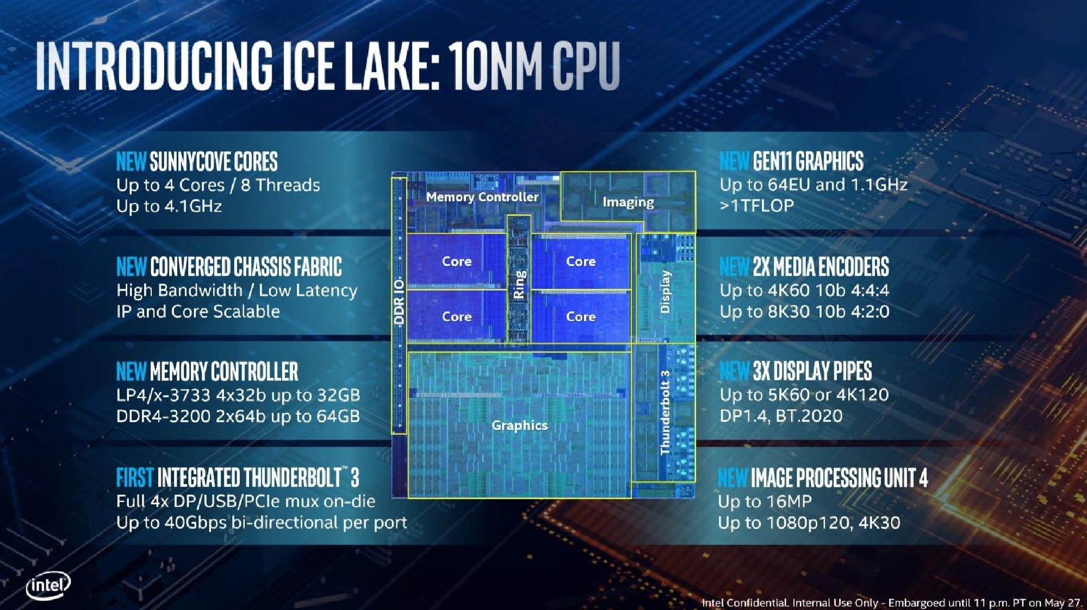
2019

Slide 45
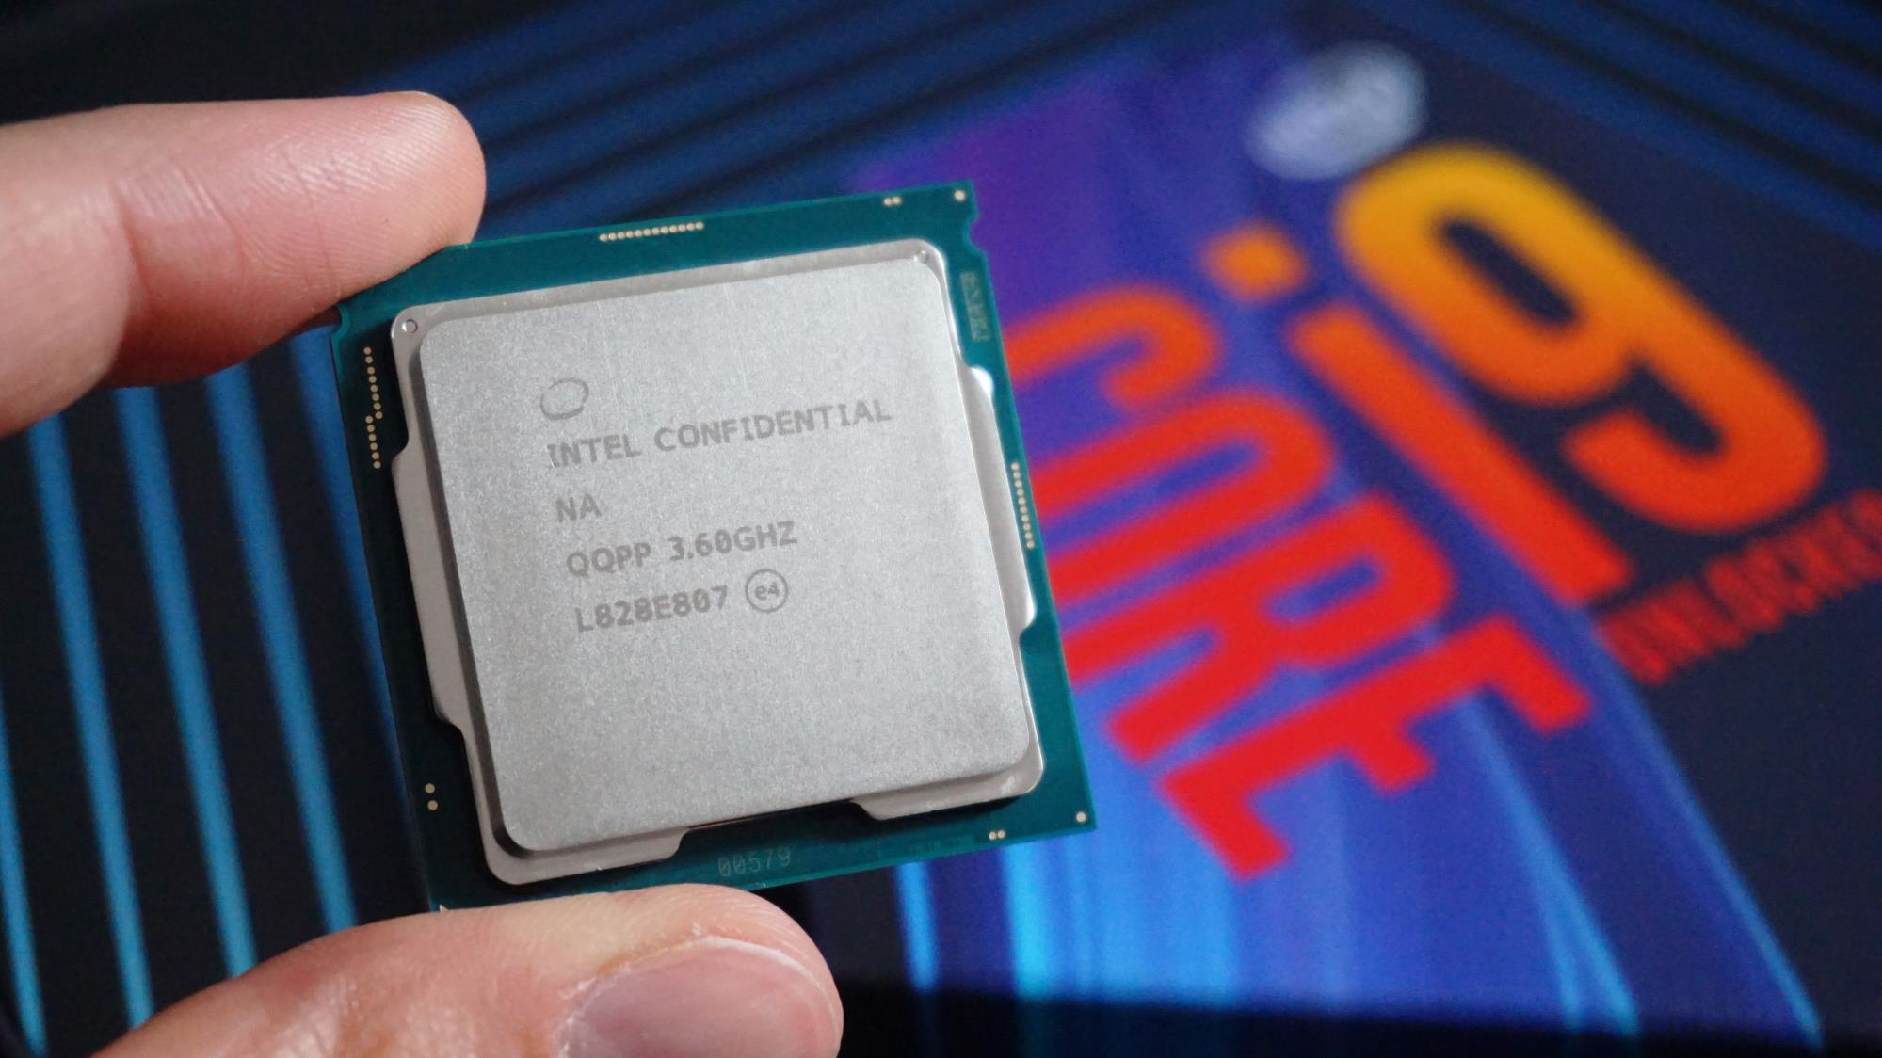
Intel Core i9-9900KS Processor 18 Billion Transistors

Slide 46







Slide 47
COMPONENTS OF THE CPU

Slide 48
COMPONENTS OF THE CPU
The primary components are:
The ALU (Arithmetic Logic Unit) that performs mathematical, logical, and decision operations and
The CU (Control Unit) that directs all of the processors operations.

Slide 49
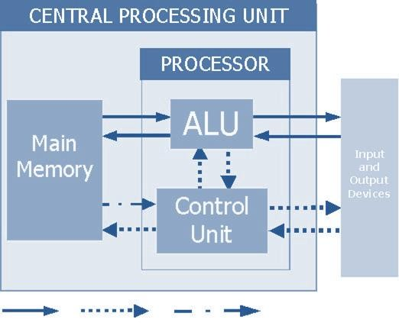
COMPONENTS OF THE CPU

Slide 50
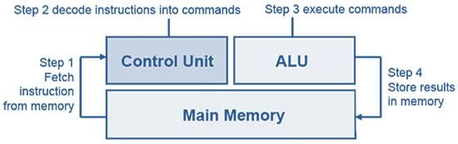
MACHINE CYCLE

Slide 51
CONTROL UNIT
The control unit has the task of decoding the instructions, interpreting them by generating the appropriate signals to be sent to the executing organs at the clock pulse rate

Slide 52
CONTROL UNIT
The control unit's activity is generally divided into three main phases:
Fetch
Decode
Execute

Slide 53
ARITHMETIC LOGIC UNIT
The arithmetic-logic unit is formed by a set of circuits capable of performing elementary arithmetic operations such as addition, subtraction, increment, decay, multiplication, division, data exchange between registers and control operations

Slide 54
HOW FAST DOES
A CPU TRANSFER DATA?

Slide 55
CPU TRANSFER DATA SPEED
Like any device that utilizes electrical signals, the data travels very near the speed of light, which is approximately 300,000,000 m/s

Slide 56
CPU TRANSFER DATA SPEED
This speed depends on the medium (type of metal in the wire) through which the signal is traveling.
Most electrical signals are traveling at about 75 to 90% the speed of light.

Slide 57
CPU CLOCK SPEED
The clock speed of a CPU is the number of instructions it can process in any given second, measured in gigahertz (GHz)

Slide 58
CPU CLOCK SPEED
For example, a CPU has a clock speed of 1 Hz if it can process one piece of instruction every second. Extrapolating this to a more real-world example: a CPU with a clock speed of 3.0 GHz can process 3 billion instructions each second

Slide 59
CPU CORES
Some devices have a single-core processor while others may have a dual-core (or quad- core, etc.) processor. As might already be apparent, having two processor units working side by side means that the CPU can simultaneously manage twice the instructions every second, drastically improving performance

Slide 60
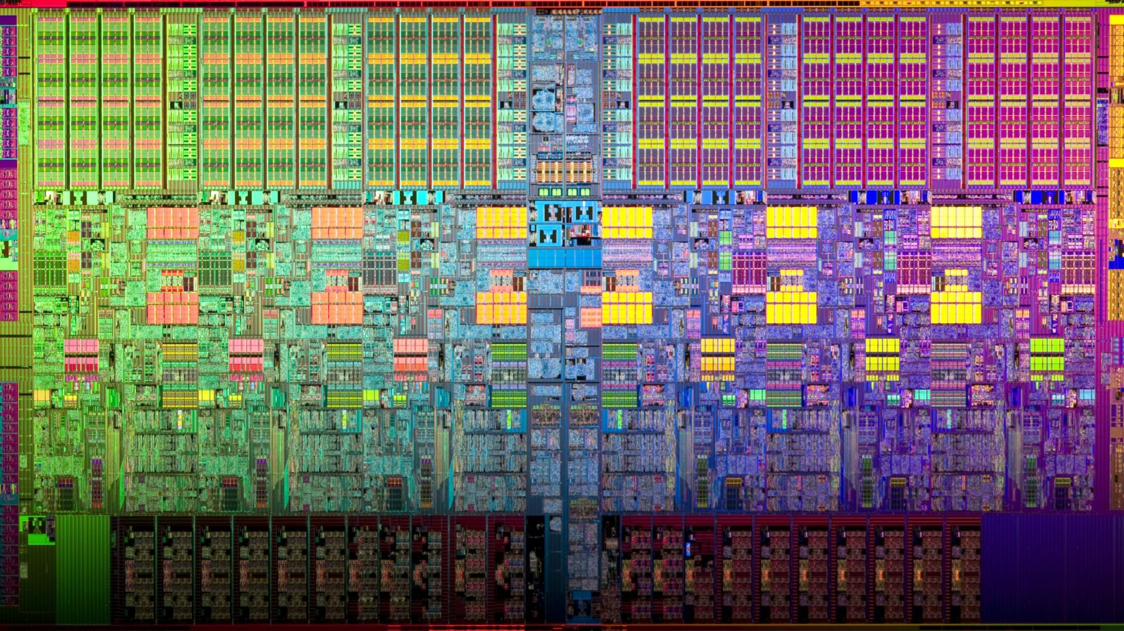
MPU ARCHITECTURE

Slide 61
1

Slide 62
THANK YOU

