Slide 1
CLASS 5

Slide 2
Quiz review

Slide 4
CLASS – WEEK 4
ASSEMBLY LANGUAGE
IF STATEMENT
READ INPUTS

Slide 5
IF STATEMENT

Slide 6
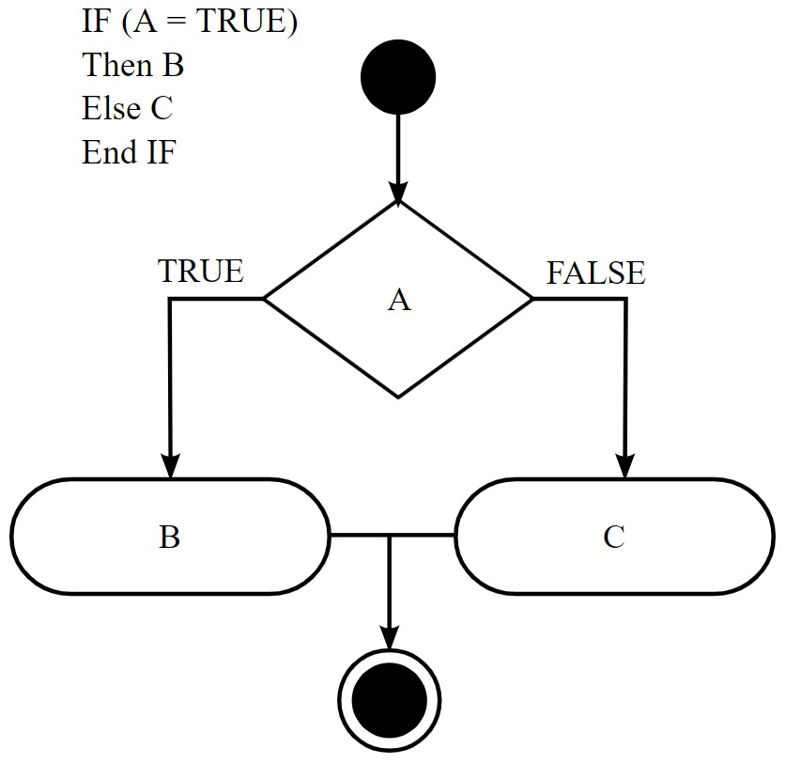
IF STATEMENT

Slide 7

IF STATEMENT

Slide 8

IF STATEMENT

Slide 9
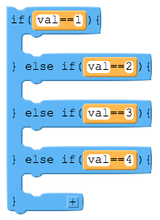
IF STATEMENT

Slide 10
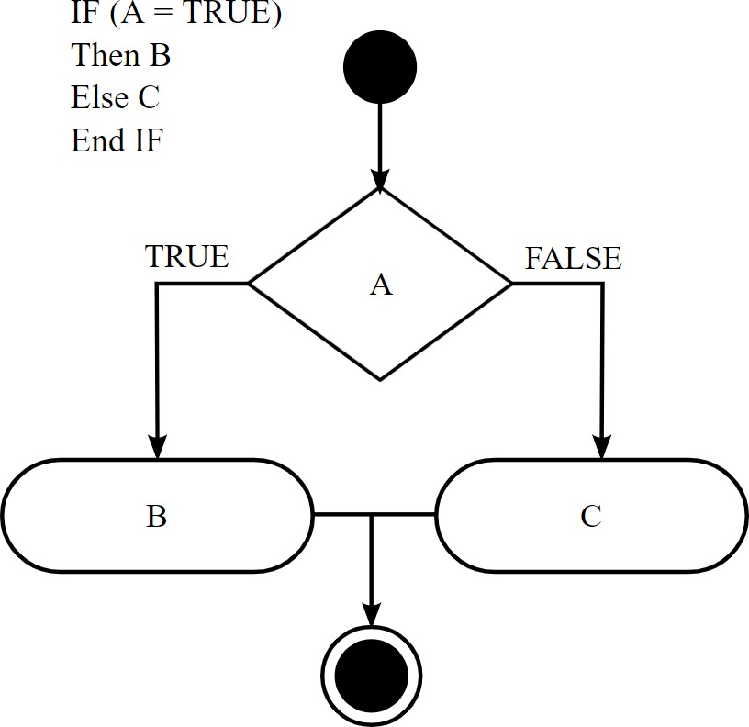
IF STATEMENT IN ASSEMBLY

Slide 11
IF STATEMENT IN ASSEMBLY
BTFSC (Bit Test File Skip if Clear) BTFSS (Bit Test File Skip if Set)

Slide 12
BTFSC (Bit Test File Skip if Clear)
IF THE LOGIC AT LOCATION F IS HIGH (1), THEN THE BTFSC FUNCTION WILL NOT SKIP THE NEXT LINE OF CODING

Slide 13
BTFSS (Bit Test File Skip if Set)
IF THE LOGIC AT LOCATION F IS HIGH (1), THEN THE BTFSS FUNCTION WILL SKIP THE NEXT LINE OF CODING

Slide 14
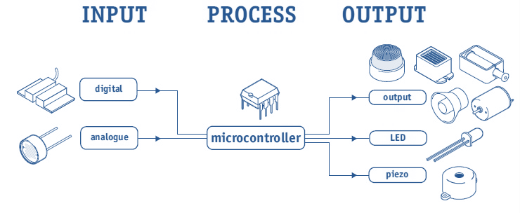
MCU SYSTEM
LED
PD5
PUSH BUTTON
PB5

Slide 15
ORG 0x00
BSF STATUS, 5
BSF TRISB, 5 CLRF TRISD MAIN
BCF STATUS, 5
BTFSC PORTB,5
GOTO LEDON
GOTO LEDOFF
LEDON
BSF PORTD,5 GOTO MAIN
LEDOFF
BCF PORTD, 5 GOTO MAIN END

Slide 16
ORG 0x00
BSF STATUS, 5
BSF TRISB, 5 CLRF TRISD MAIN
BCF STATUS, 5
BTFSS PORTB, 5
GOTO LEDOFF
GOTO LEDON
LEDON
BSF PORTD, 5 GOTO MAIN
LEDOFF
BCF PORTD, 5 GOTO MAIN END

Slide 17



MCU SYSTEM
7-SEGMENT
DISPLAY
PUSH BUTTON
PB7

Slide 18
IF STATEMENT IN ASSEMBLY
NO
YES
IF PB7 ==1
SHOW “0” IN ALL 7-SEG DISP
SHOW “H” IN
ALL 7-SEG DISP

Slide 19
SHOWH
MOVLW 0x3C MOVWF PORTA MOVLW 0x76 MOVWF PORTD
GOTO MAIN
SHOWZ
MOVLW 0x3C MOVWF PORTA MOVLW 0x3F MOVWF PORTD
ORG 0x00
BSF STATUS, 5
BSF TRISB, 7 CLRF TRISA CLRF TRISD MAIN
BCF STATUS, 5
BTFSC PORTB, 7
GOTO SHOWH
GOTO SHOWZ
GOTO MAIN
END

Slide 20
MCU SYSTEM
LEDS ON
PUSH BUTTON
PA0
PORTD

Slide 21
IF STATEMENT IN ASSEMBLY
NO
YES
IF PA0 ==1
ODD BITS OF PORTD
EVEN BITS
OF PORTD

Slide 22
THANK YOU

