Slide 1
CLASS 6

Slide 2
CLASS 5 REVIEW

Slide 3
7-SEGMENT DISPLAY

Slide 4
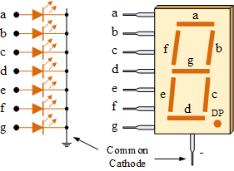
7-SEGMENT DISPLAY
COMMON CATHODE

Slide 5
7-SEGMENT DISPLAY
SHOW CHARACTER “C”
IN THE FOURTH AND SECOND 7-SEG DISPLAYS

Slide 6
7-SEGMENT DISPLAY
SHOW THE 7-SEG DISPLAY OUTPUT IF PORTA=0x09 AND PORTD=0x6B
4

Slide 7
CLASS – WEEK 6
ASSEMBLY LANGUAGE
IF STATEMENT
READ INPUTS
FUNCTIONS

Slide 8
IF STATEMENT

Slide 9
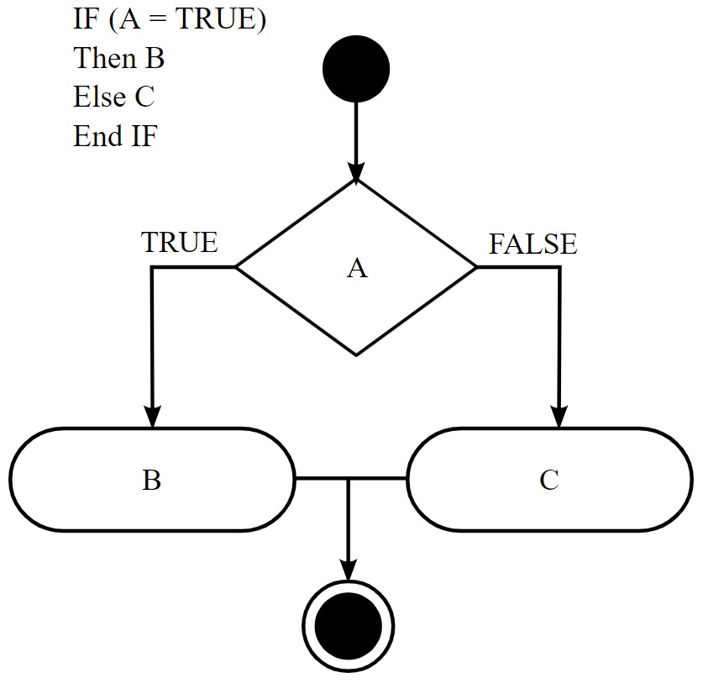
IF STATEMENT

Slide 10

IF STATEMENT

Slide 11

IF STATEMENT

Slide 12
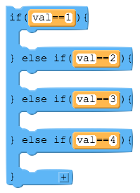
IF STATEMENT

Slide 13
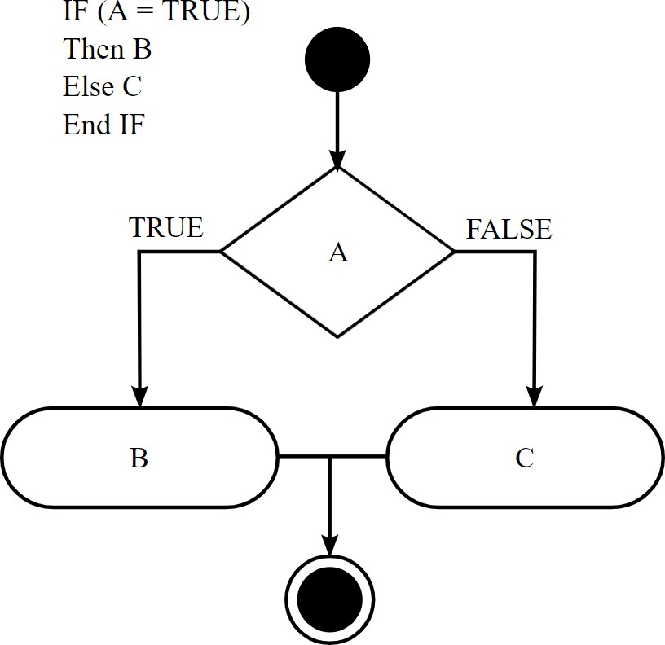
IF STATEMENT IN ASSEMBLY

Slide 14
IF STATEMENT IN ASSEMBLY
BTFSC (Bit Test File Skip if Clear) BTFSS (Bit Test File Skip if Set)

Slide 15
BTFSC (Bit Test File Skip if Clear)
IF THE LOGIC AT LOCATION F IS HIGH (1), THEN THE BTFSC FUNCTION WILL NOT SKIP THE NEXT LINE OF CODING

Slide 16
BTFSS (Bit Test File Skip if Set)
IF THE LOGIC AT LOCATION F IS HIGH (1), THEN THE BTFSS FUNCTION WILL SKIP THE NEXT LINE OF CODING

Slide 17
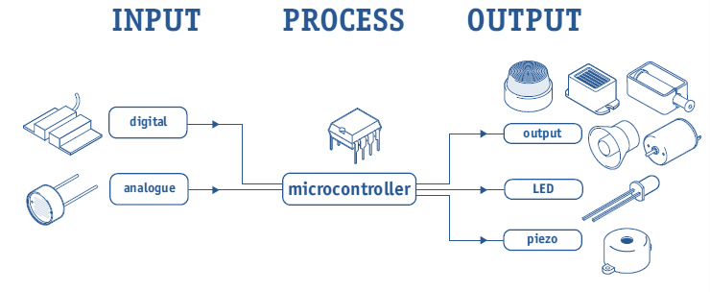
MCU SYSTEM
LED
PD5
PUSH BUTTON
PB5

Slide 18
ORG 0x00
BSF STATUS, 5
BSF TRISB, 5 CLRF TRISD MAIN
BCF STATUS, 5
BTFSC PORTB, 5 GOTO LEDON
GOTO LEDOFF
LEDON
BSF PORTD, 5 GOTO MAIN
LEDOFF
BCF PORTD, 5 GOTO MAIN END

Slide 19
ORG 0x00
BSF STATUS, 5
BSF TRISB, 5 CLRF TRISD MAIN
BCF STATUS, 5
BTFSS PORTB, 5 GOTO LEDOFF
GOTO LEDON
LEDON
BSF PORTD, 5 GOTO MAIN
LEDOFF
BCF PORTD, 5 GOTO MAIN END

Slide 20


MCU SYSTEM
7-SEGMENT DISPLAY
PUSH BUTTON
PB7

Slide 21
IF STATEMENT IN ASSEMBLY
NO
YES
IF PB7 ==1
SHOW “0” IN
ALL 7-SEG DISP
SHOW “H” IN ALL 7-SEG DISP

Slide 22
SHOWH
MOVLW 0x0F MOVWF PORTA MOVLW 0x76 MOVWF PORTD
GOTO MAIN SHOWZ
MOVLW 0x0F MOVWF PORTA MOVLW 0x3F MOVWF PORTD
ORG 0x00
BSF STATUS, 5
BSF TRISB, 7 CLRF TRISA CLRF TRISD MAIN
BCF STATUS, 5
BTFSC PORTB, 7 GOTO SHOWH
GOTO SHOWZ
GOTO MAIN
END

Slide 23
MCU SYSTEM
LEDS ON
PUSH BUTTON
PA0
PORTD

Slide 24
IF STATEMENT IN ASSEMBLY
NO
YES
IF PA0 ==1
ODD BITS
OF PORTD
EVEN BITS OF PORTD

Slide 25
MCU SYSTEM
7-SEGMENT DISPLAY
PUSH BUTTON
PE1

Slide 26
IF STATEMENT IN ASSEMBLY
NO
YES
IF PE1 ==1
SHOW “8” IN THE
1ST AND 4TH
7-SEG DISP
SHOW “o” IN THE 2ND AND 3RD
7-SEG DISP

Slide 27
MCU SYSTEM
LEDS ON
PUSH BUTTON
PORTC
PORTD
PB5

Slide 28
IF STATEMENT IN ASSEMBLY
NO
YES
IF PB5 ==1
PORTC = 0xC3
PORTD = 0x0F
OPPOSITE

Slide 29
CLASS 6
ASSEMBLY LANGUAGE
Delays

Slide 30
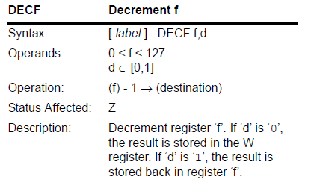
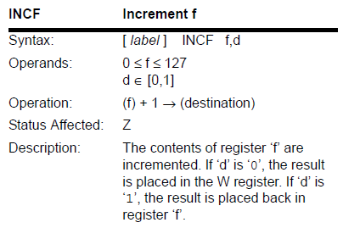
Instruction Descriptions

Slide 31
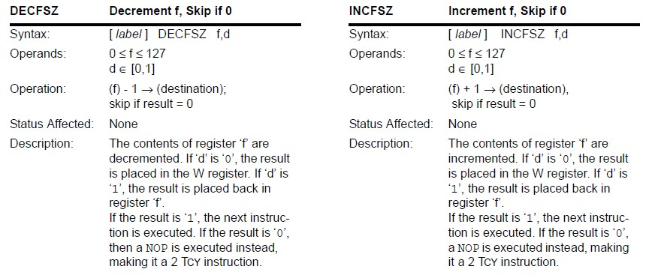
Instruction Descriptions

Slide 32
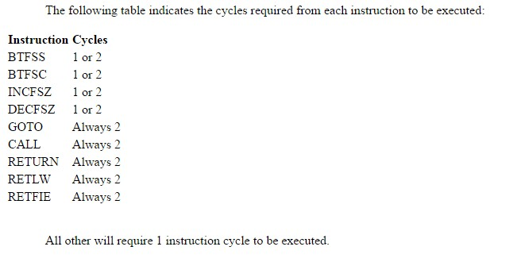

Slide 33
EX1: Calculate the delay created by the below code segment if oscillator of 4 MHz. (Assume the number 5 is loaded into Counter)
LOOP DECFSZ GOTO
Counter,F LOOP
Solution:
No. of cycles = 5 X(1 +2) = 15
Delay by this code= No. of cycles X Instruction cycle
= No. of cycles X 4 / F
= 15 X (4 X 0.25uS)
= 15 us

Slide 34
EX2: Calculate the delay created by the below code segment if oscillator of 8 MHz. (Assume the number 5 is loaded into Counter)
LOOP DECFSZ GOTO
Counter , F LOOP
Solution:
No. of cycles = 5 X(1 +2) = 15
Delay by this code = No. of cycles X Instruction cycle
= No. of cycles X 4/ F
= 15 X (0.5uS)
= 7.5 us

Slide 35
EX3: Calculate the delay created by the Loop in the below code segment oscillator of 4 MHz:
Counter1 EQU 35H
START
Solution:
MOVLW MOVWF
0F2H
Counter1
No. of cycles in Loop = No. of cycles in code =
[ 242 X (1 +2)] = 726
1 + 1 + 726= 728
LOOP DECFSZ GOTO
Counter1,F LOOP
Delay by this code= No. of cycles X Instruction cycle
= 728 X (4 X 0.25uS) = 728 us
END

Slide 36
EX 2: Calculate the delay created by the Loop in the below code segment oscillator of 8 MHz:
Counter1 EQU 70H
START
Solution:
MOVLW MOVWF
0F2H
Counter1
No. of cycles in Loop = No. of cycles in code =
[ 242 X (1 +2)] = 726
1 + 1 + 726= 728
LOOP DECFSZ GOTO
Counter1,F LOOP
Delay by this code= No. of cycles X Instruction cycle
= 728 X (0.5 us) = 364 us
END

Slide 37
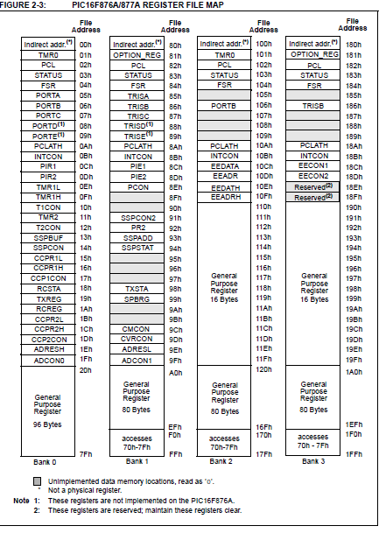

Slide 38
CLASS 6
ASSEMBLY LANGUAGE
CONDITIONAL STATEMENT: BTFSC, BTFSS
READ MULTIPLE INPUTS
FUNCTIONS

Slide 39
MCU SYSTEM
LEDS
PORTD
PUSH BUTTONS:
PE0 PE1
4

Slide 40
PSEUDOCODE
IF PE0 IS PRESSED THEN
TURN ON ODD BITS OF PORTD ELSE IF PE1 IS PRESSED THEN
TURN ON EVEN BITS OF PORTD ELSE
TURN OFF ALL BITS OF PORTD END IF
4

Slide 41
FLOWCHAR T
?
4

Slide 42
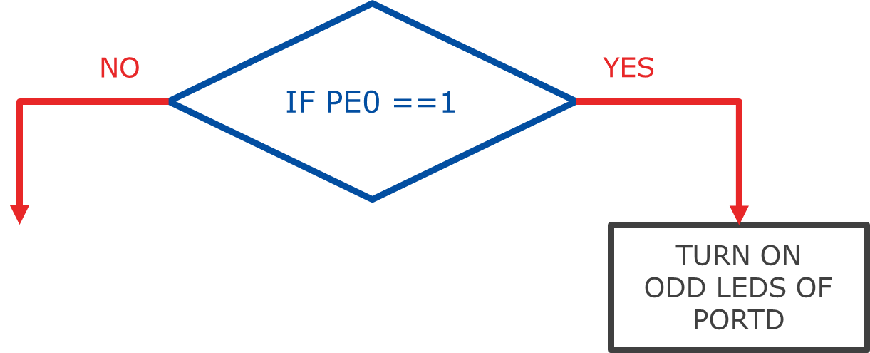
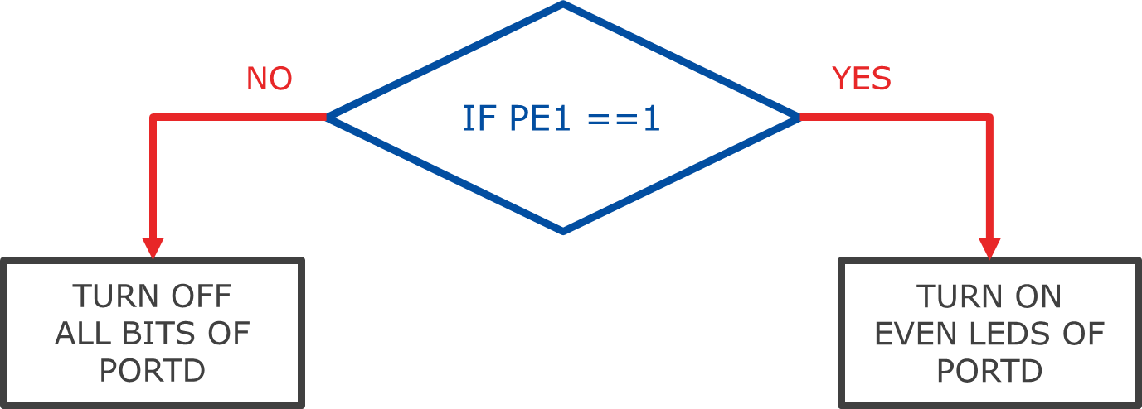
FLOWCHAR T
4

Slide 44
MCU SYSTEM
7-SEGMENT DISPLAY
PUSH BUTTONS:
PA3
PA4
5

Slide 45
FLOWCHAR T
NO
YES
IF PA3 ==1
SHOW “3” ON THE
FIRST TWO 7-SEG DISP
NO
YES
IF PA4 ==1
SHOW “ - ” ON ALL THE 7-SEG DISP
SHOW “E” ON THE LAST TWO
7-SEG DISP
5

Slide 47
MCU SYSTEM
LEDS PORTC
7-SEGMENT
DISPLAY
BUTTONS:
PB7
PB6
6

Slide 48
FLOWCHAR T
NO
YES
IF PB7 ==1
SHOW “P” ON THE 2ND AND 3RD
7-SEG DISP
PORTC = 0x0F
NO
YES
IF PB6 ==1
TURN OFF EVERYTHING
SHOW “d” ON THE 4TH AND 1ST
7-SEG DISP
PORTC = 0xF0
6

Slide 50
THANK YOU

