Slide 1

Operating system
Sec 1

Slide 2
What is an Operating System
OS = Interface between Hardware & Software
Manages all resources (CPU, Memory, I/O devices)
Without OS → No program can run

Slide 3
Functions of an OS
Process Management
  Creates, schedules, and terminates processes
  Example: Music + Browser running together
Memory Management
  Allocates & frees RAM
  Prevents processes from interfering
File System Management
  Organizes data into files & directories
  Controls access permissions
Device Management
  Coordinates I/O devices (keyboard, mouse, printer)
  Provides drivers for communication

Slide 4
Types of Operating Systems
Single-tasking vs. Multi-tasking
Single-user vs. Multi-user
Examples:
  Windows → User-friendly
  Linux → Open-source, widely used in servers
  MacOS → Apple devices
  Android / iOS → Mobile systems

Slide 5
Why Linux
Open-source → Learn from real code
Lightweight & efficient
Used in servers, supercomputers, cloud systems
Perfect for learning OS concepts

Slide 6
Steps to install VM & Linux

Slide 7
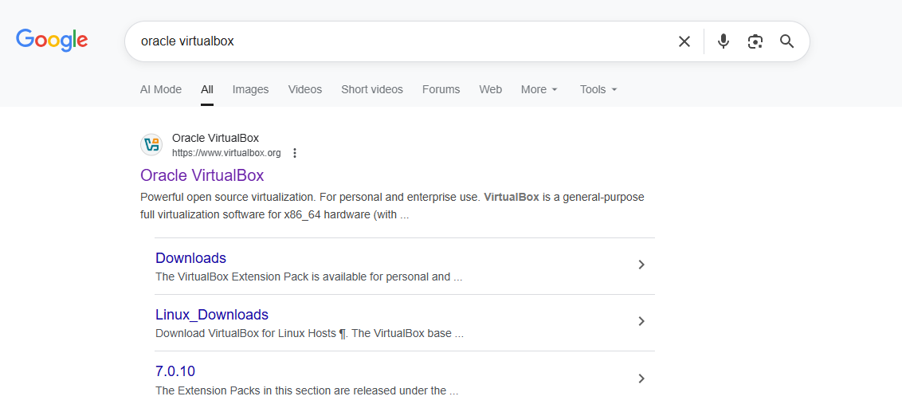

Slide 8
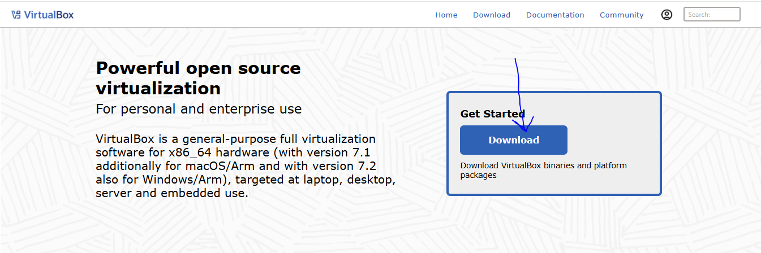

Slide 9
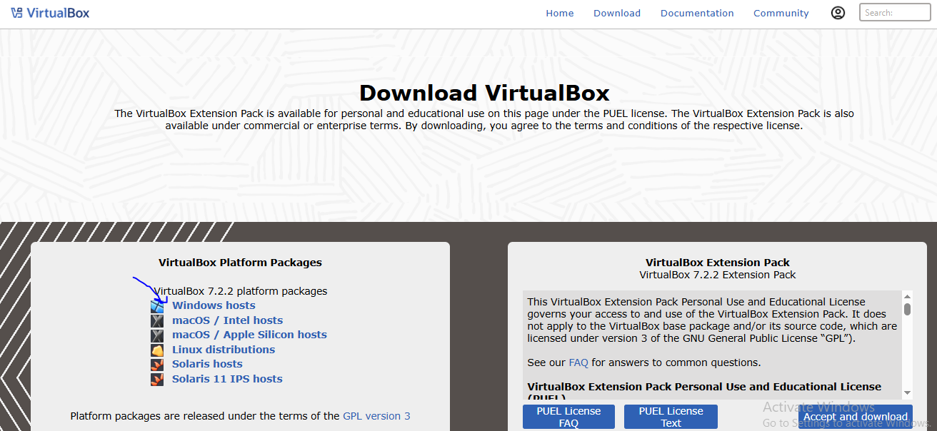

Slide 10
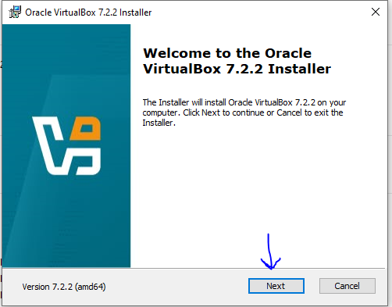

Slide 11
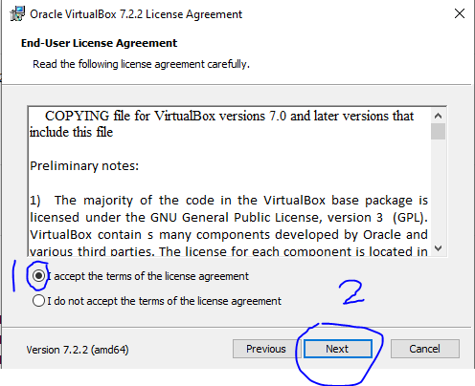
1

Slide 12
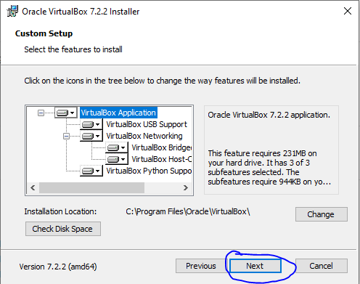

Slide 13
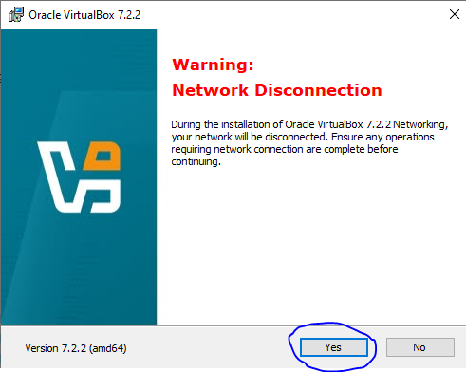
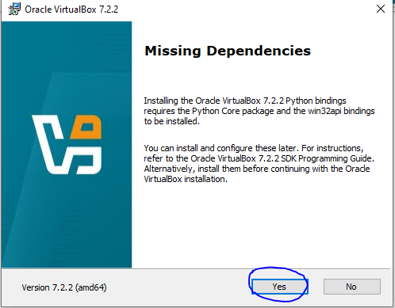
1
2

Slide 14
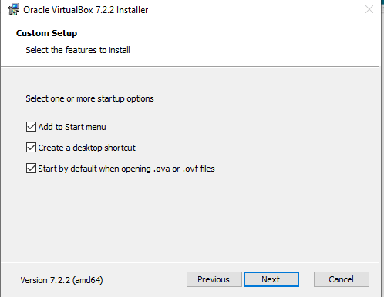
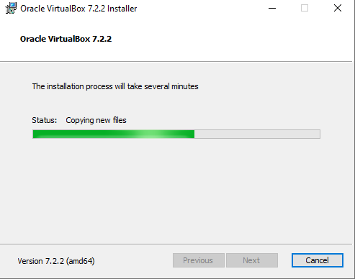
1
2

Slide 15
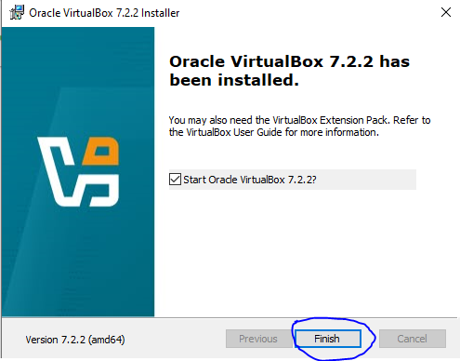

Slide 16
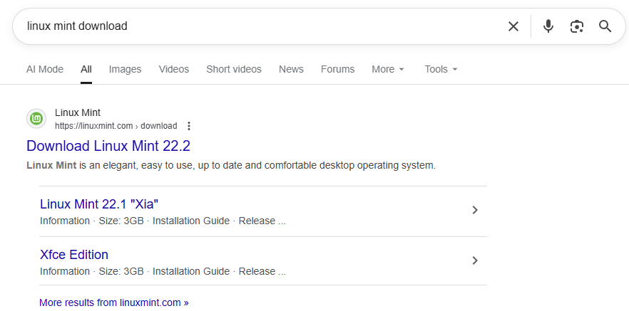

Slide 17
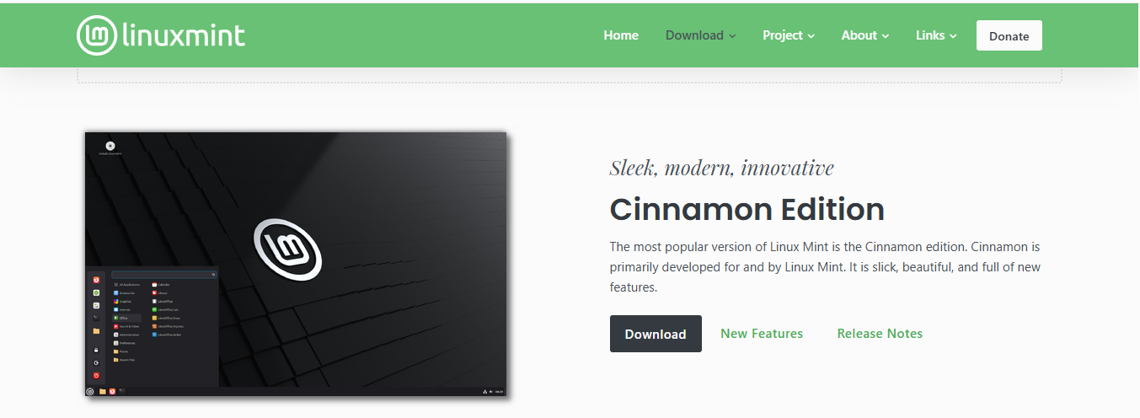

Slide 18
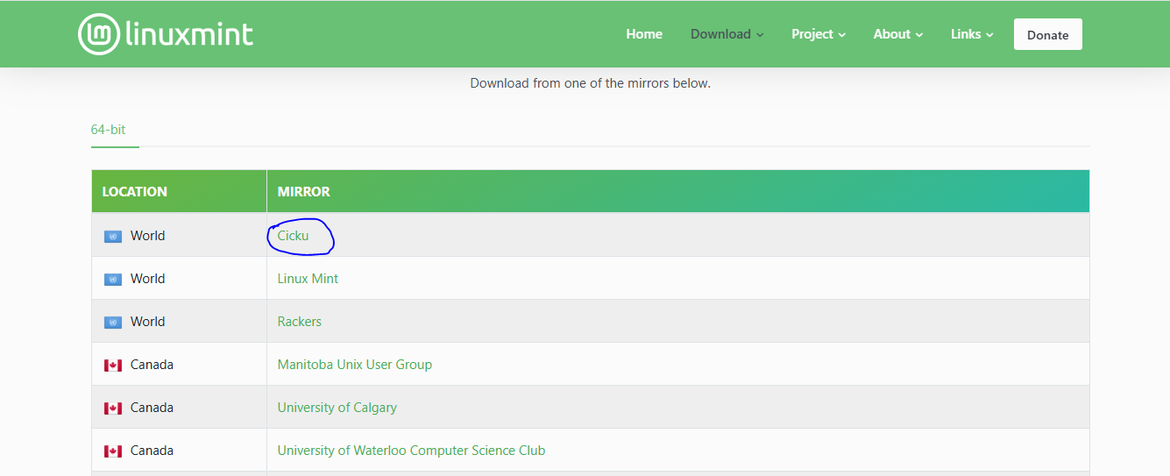

Slide 19
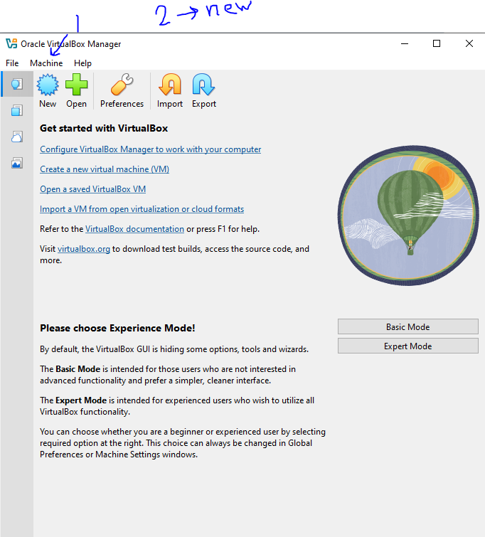
1
2

Slide 20
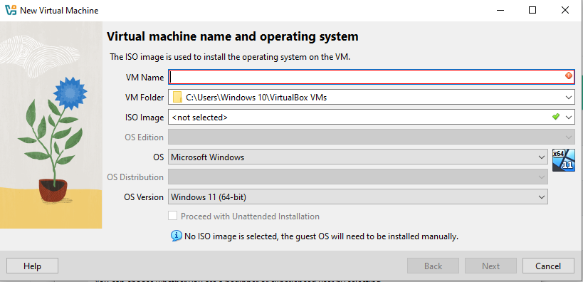

Slide 21
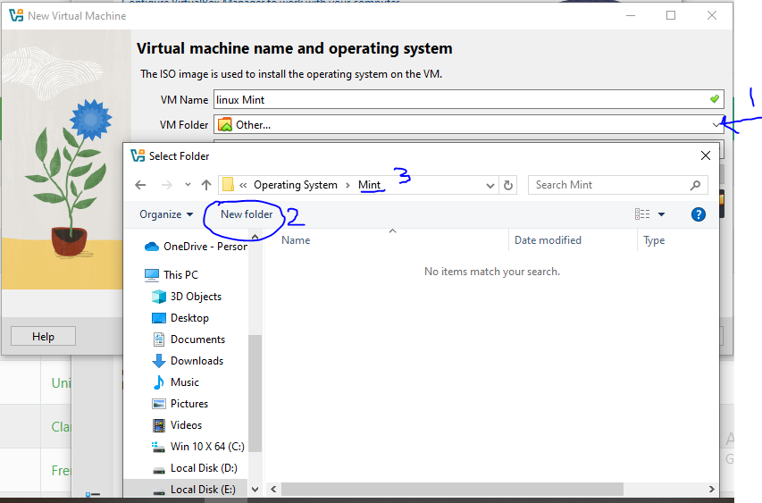

Slide 22
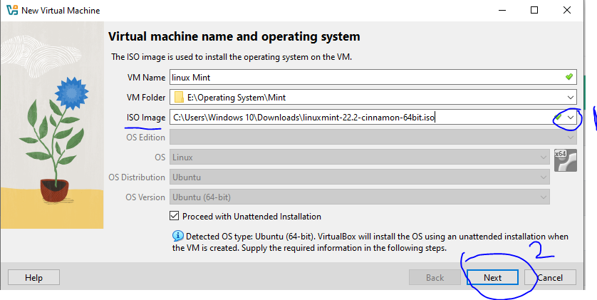

Slide 23
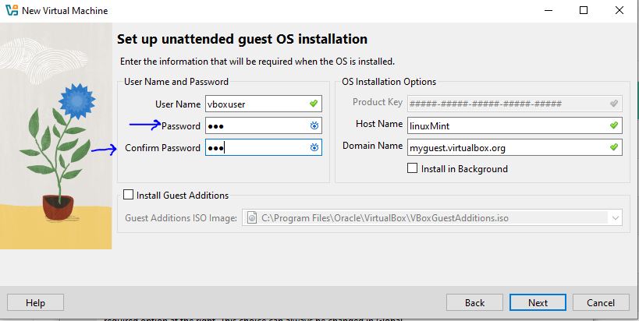

Slide 24
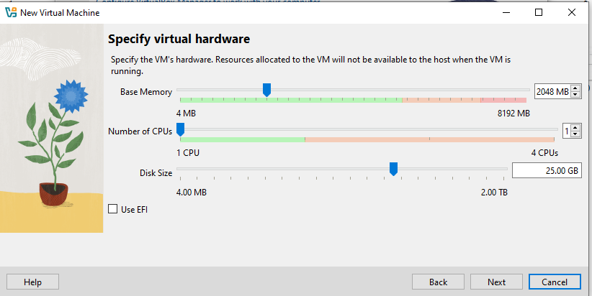

Slide 25
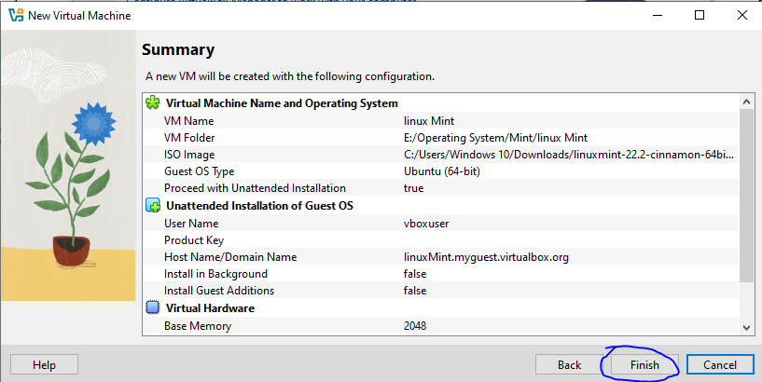

Slide 26
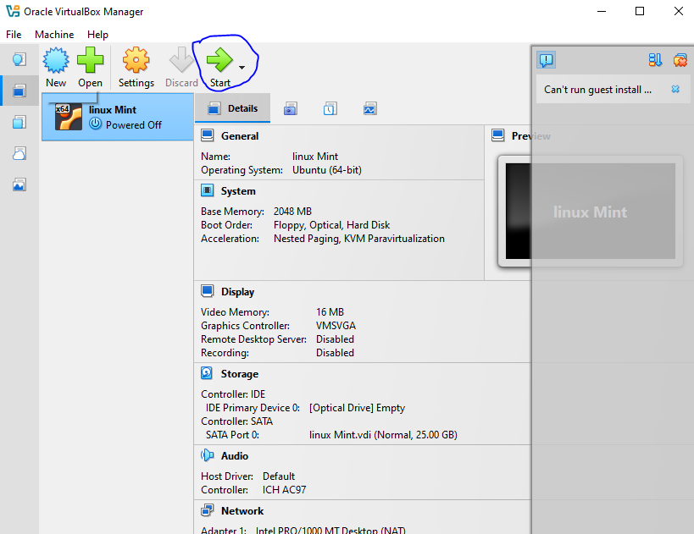

Slide 27
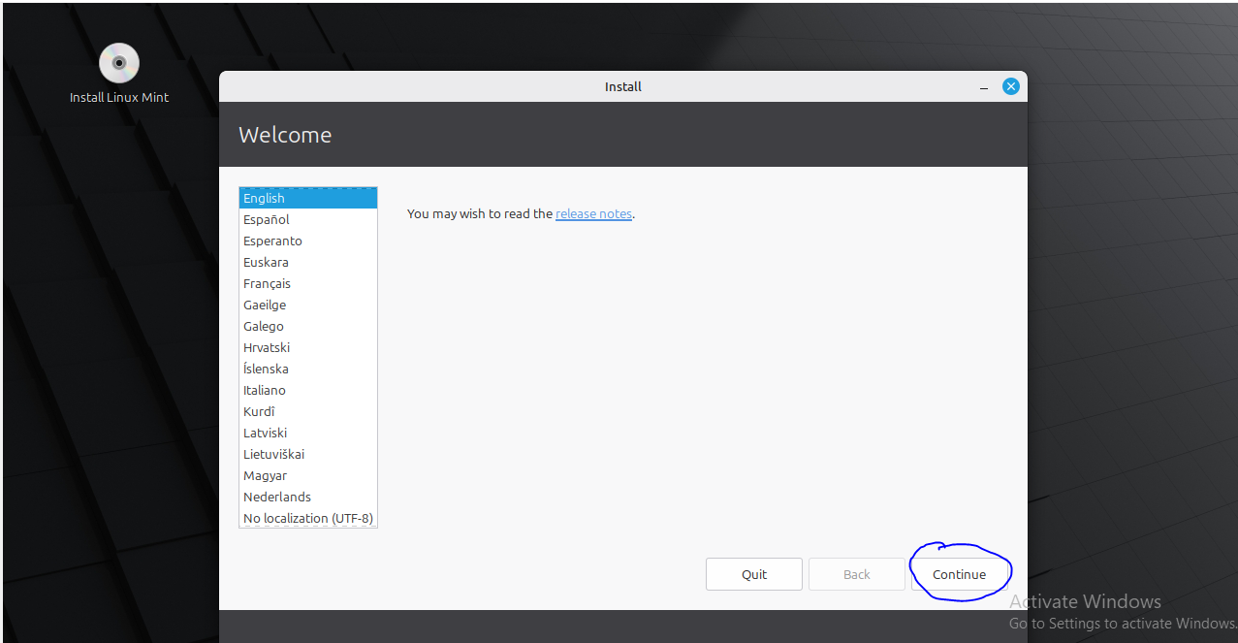
1
2

Slide 28
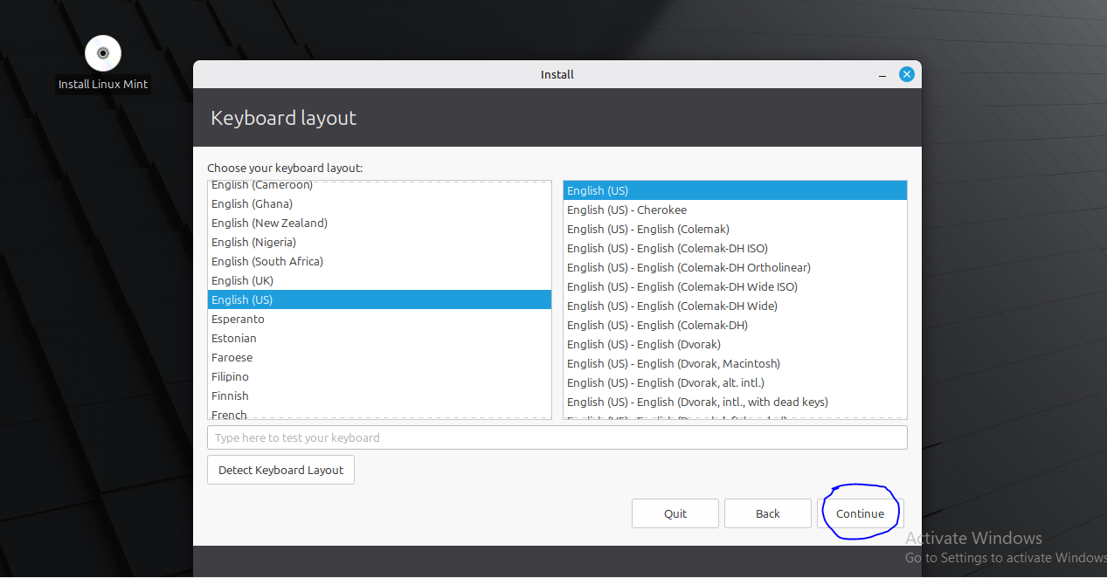

Slide 29
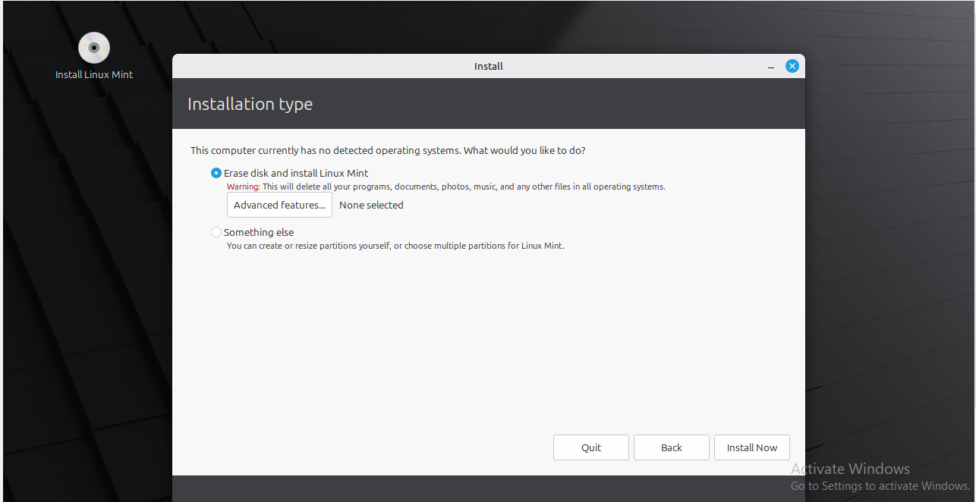

Slide 30
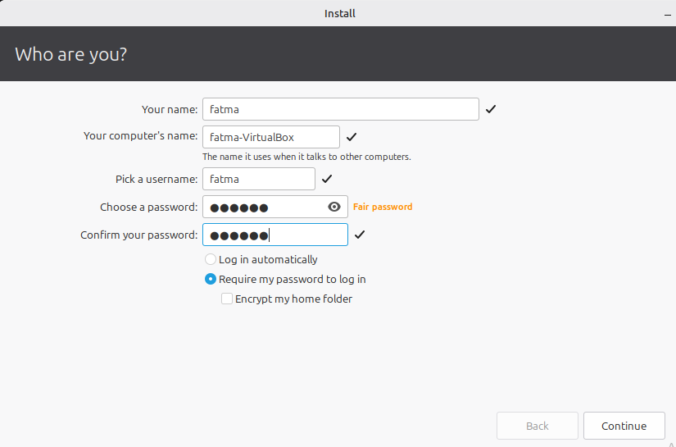

Slide 31

Thank You

