Slide 1
Algorithms
Section 1

Slide 2
Definition
Algorithm is a sequence of unambiguous instructions for solving a problem. Each step must be clear, precise, and executable.
Key Philosophy
"Think before coding" - Always emphasize algorithm design and planning before jumping into implementation. Strategy first, code second.
Academic & Professional Importance
Essential foundation for CS students and crucial for technical interviews in most technology companies.

Slide 3

Dual Focus
Algorithm analysis concentrates on two main aspects:
Analysis should be independent of hardware, language, or compiler. We measure algorithmic efficiency in a way that transcends specific computing environments.

Slide 4
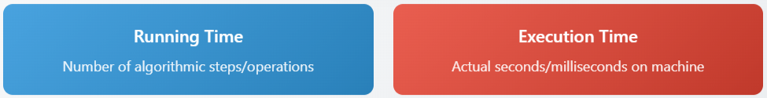
Running Time vs Execution Time

Slide 5
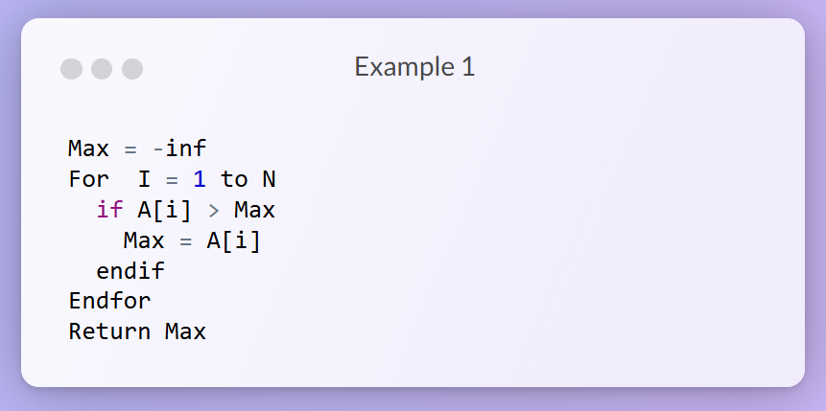
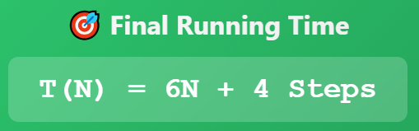
Compute the Running Time for those algorithms:

Slide 6
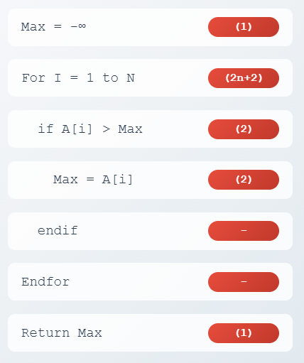
Loop Analysis (2n+2):
• Initialization: 1 step
• Increments: n steps
• Comparisons: n+1 steps
Inside Loop (per iteration):
• Condition check: 2 steps
- Access A[i]: 1 step
- Compare A[i] > Max: 1 step
• Assignment: 2 steps
- Access A[i]: 1 step
- Store in Max: 1 step
• Total per iteration: 4 steps
• Executed n times = 4n steps
Final Calculation:
• Loop overhead: 2n+2 steps
• Inside loop operations: 4n steps
• Constants: 1+1 = 2 steps
• Total: (2n+2) + 4n + 2 = 6n+4

Slide 7
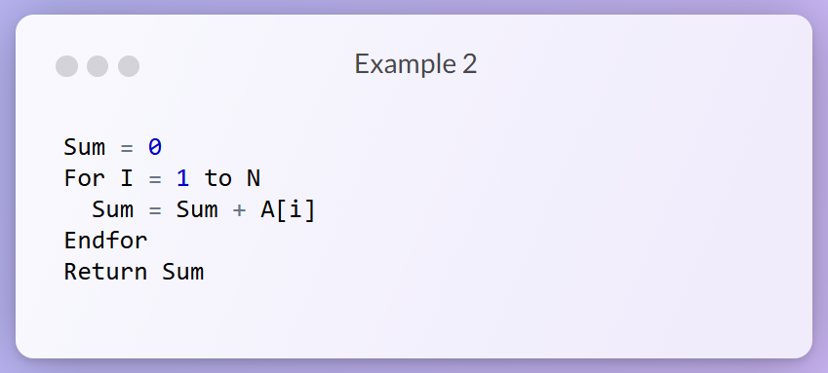
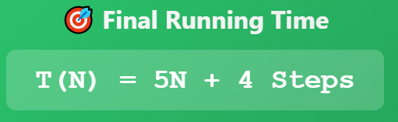

Slide 8
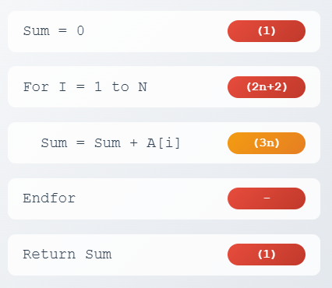
Loop Analysis (2n+2):
• Initialization: 1 step
• Increments: n steps
• Comparisons: n+1 steps
Inside Loop (per iteration):
• Access Sum: 1 step
• Access A[i]: 1 step
• Addition: 1 step
• Total per iteration: 3 steps
• Executed n times = 3n steps
Final Calculation:
• Loop overhead: 2n+2 steps
• Inside loop operations: 3n steps
• Constants: 1+1 = 2 steps
• Total: (2n+2) + 3n + 2 = 5n+4

Slide 9
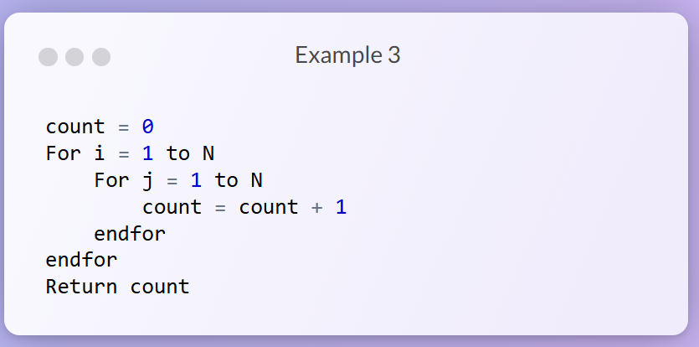

Slide 10
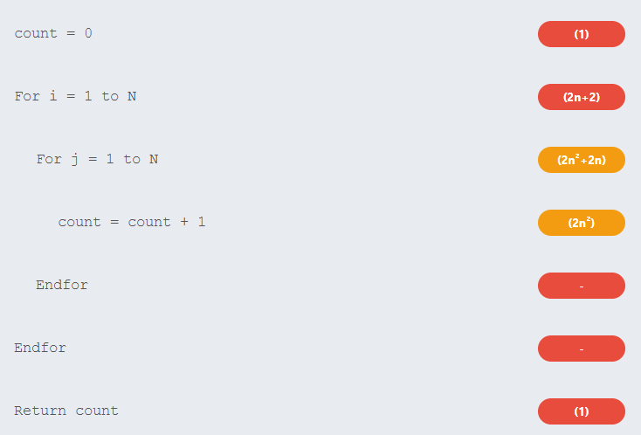
Loop Analysis (2n+2):
• Initialization: 1 step
• Increments: n steps
• Comparisons: n+1 steps
Inner Loop (per outer iteration):
Initialization: 1 step (j = 1)
Increments: n steps (j++)
Comparisons: n+1 steps (j ≤ N check)
Count increment: n steps (count = count + 1)
Total per outer iteration: 4n+2 steps
Executed n times = (4n+2)n = 4n²+2n steps
Final Calculation:
Outer loop overhead: 2n+2 steps
Inner loop operations: 4n²+2n steps
Constants: 1+1 = 2 steps (count initialization + return)
Total: (2n+2) + (4n²+2n) + 2 = 4n²+4n+4

Slide 11
Algorithm Analysis Must Care With Three Concepts:
Worst Case:
Analyze the maximum number of operations the algorithm will perform for any input of size n. This gives us the upper bound guarantee.
Large Input Size:
Focus on how the algorithm behaves as the input size grows very large (approaches infinity). Small input sizes don't reveal the true scalability.
Constants Are Not Important:
Ignore constant factors and lower-order terms. For example, 4n² + 4n + 4 simplifies to O(n²) because the n² term dominates for large n.

Slide 12
Algorithm analysis covers these key areas:
Statements, Conditions and Loops
Simple statements: O(1)
Conditional statements: analyze worst case branch
Single loops: O(n)
Nested loops: O(n²), O(n³), etc.
Sequential statements: sum the complexities
Recursion Functions
Analyze using recurrence relations
Master theorem for divide-and-conquer
Tree method for visualization
Examples: binary search O(log n), merge sort O(n log n)

