Slide 1
Section 2
Running time vs Order

Slide 2
Order is the dominant factor in the running time without constants
2n + 4 ➔ O(n)
5n^2 + 5 ➔ O(n^2)
5logn + n ➔ O(n)
!n + n^3 ➔ O(!n)
4n^3 + n + 10^6 ➔ O(n^3)
Growth rate of a function f(x) means how fast the value of f(x) increasing or decreasing as the value of x increases

Slide 3
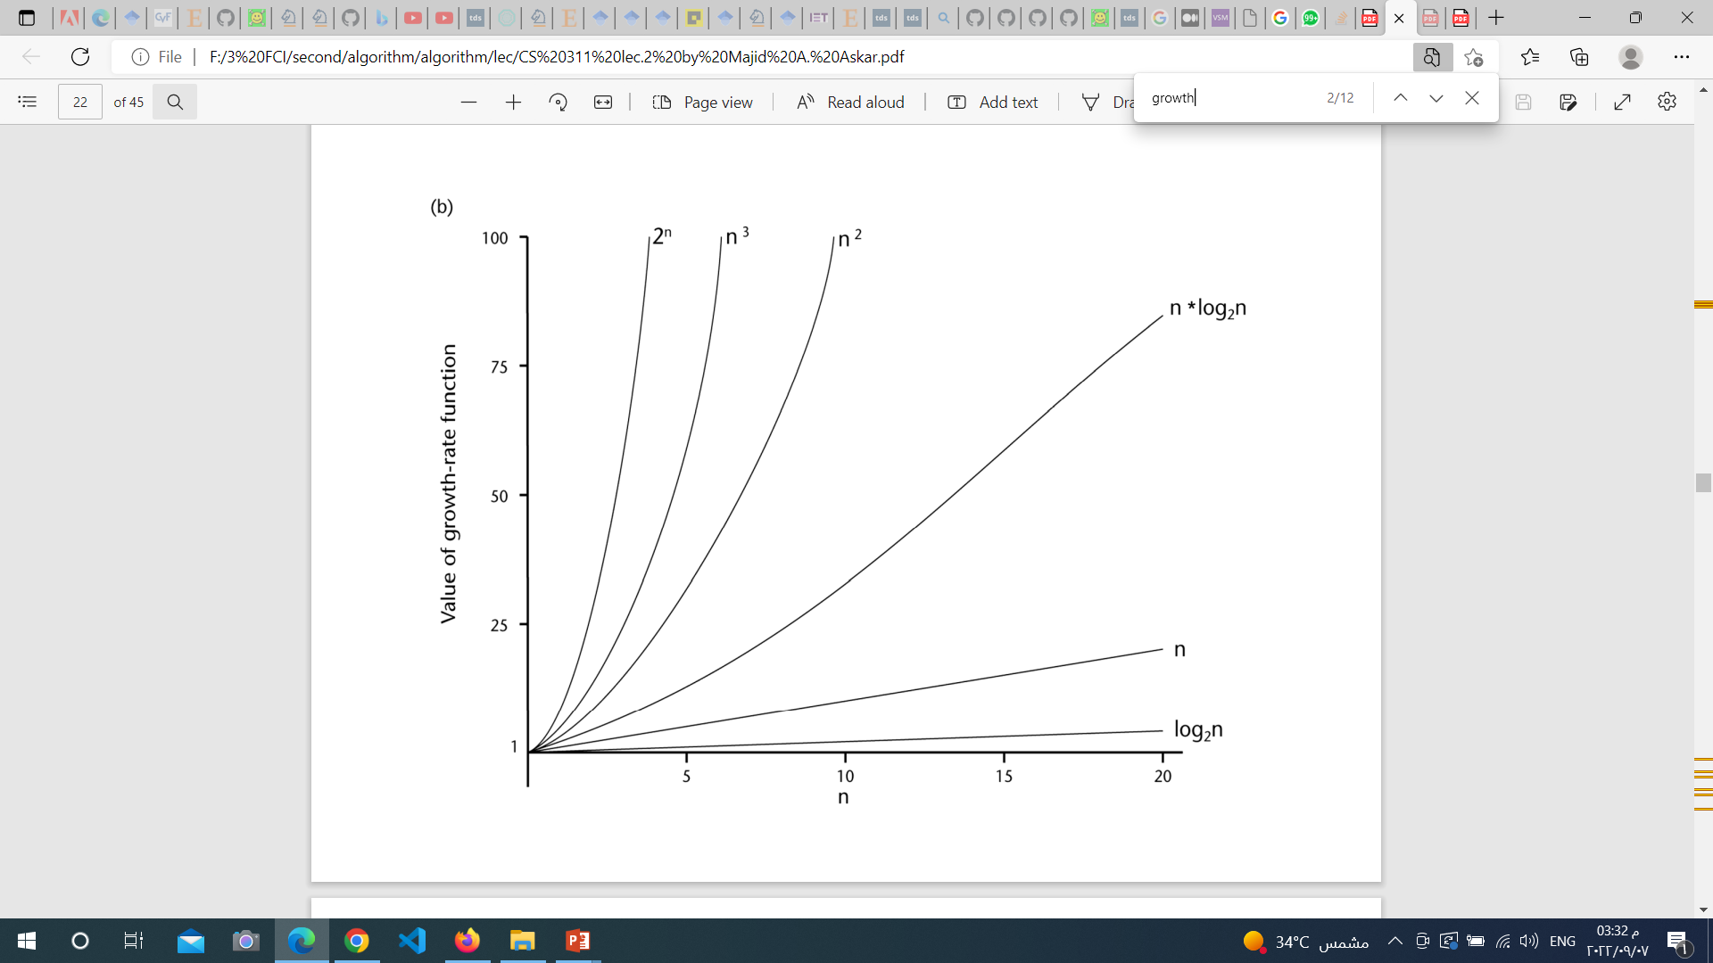

Slide 4
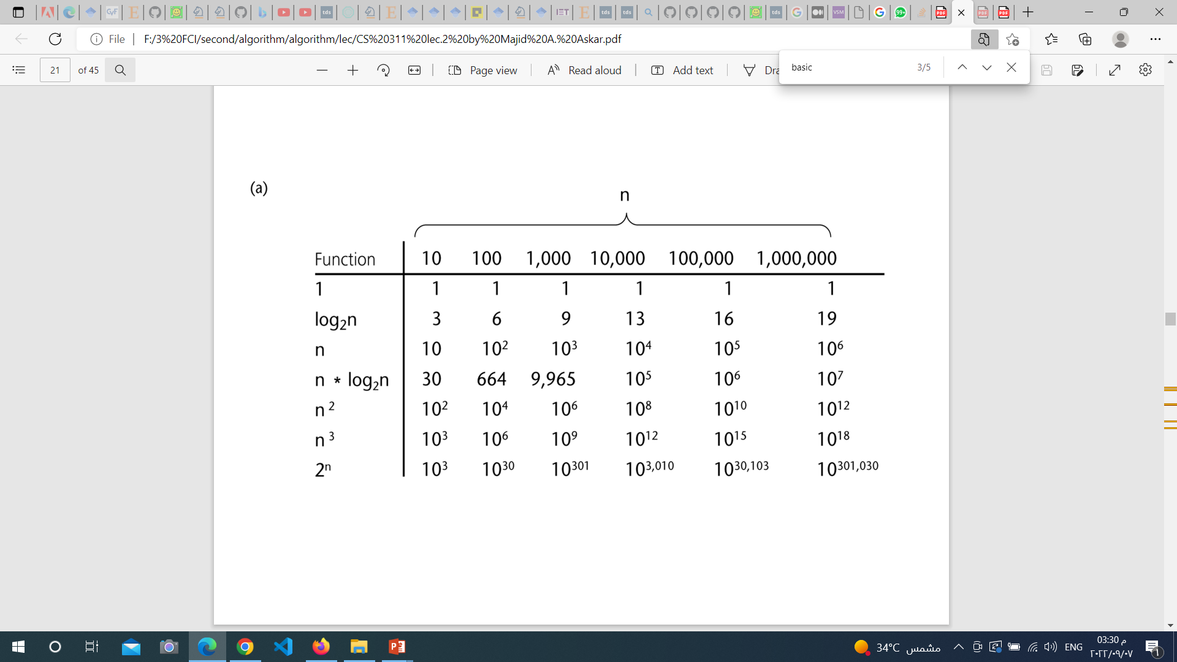

Slide 5
Why order ignore all constants ???
Order give us indication how algorithm do with large input size
Ex
10^6 N vs 20N^2

Slide 6
Order can computed from running time but it waste our time !!!
Order calculation is easier than running time
Order has different way for computing and it evaluated for
Statements, Conditions and loops
Recursion functions

Slide 7
Statements ➔ O(1)
Except let Max = getMax(A) ➔ O(?)
Conditions ➔ O(body)
Case of if statement with else statement or multiple elseif statements
O(?)
Loops ➔ O(body * number of iterations)
- In case of loop with constant number of iterations ➔ O(?)

Slide 8
Ex1
Max = -inf ➔ O(1)
For I = 1 to N
if A[i] > Max
Max = A[i]
endif
Endfor
Return Max ➔ O(1)
Order is O(N)
➔ O(1)
➔ O(n)

Slide 9
Ex2
Sum = 0 ➔ O(1)
For I = 1 to N
Sum = Sum + A[i]
Endfor
Return Sum ➔ O(1)
Order is O(N)
➔ O(n)

Slide 10
Ex3
Sum = 0 ➔ O(1)
For I = 1 to N
For J = 1 to I
Sum = Sum + 1
endfor
endfor
Return Sum ➔ O(1)
Order is O(N^2)
➔ O(n)
➔ O(n^2)

Slide 11
Ex4
Switch(choice)
case 1:
print N ➔ O(1)
case 2:
Max = GetMax(A, N) ➔ O(n)
print Max
case 3:
sum = 0
for I = 1 to N
if sum < GetMax(A,N)
sum += A[i]
endif
endfor
print sum
Endswitch
Order is O(N^2)
➔ O(n)
➔ O(n^2)

