Slide 1

Computer Organization & Architecture
Lab1 Introduction
    Nedaa Hussein Ahmed
    nh1179@fayoum.edu.eg

Slide 2
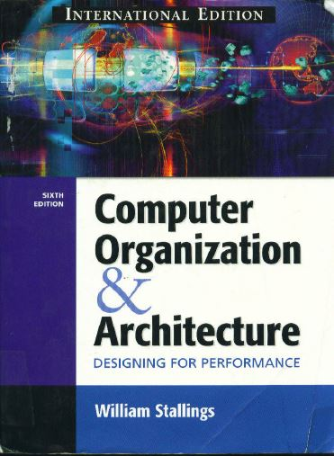
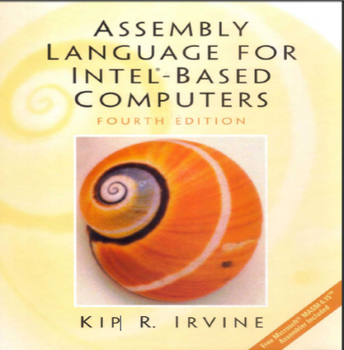
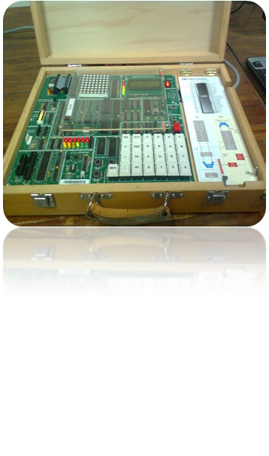
Course information
“Computer Organization And Architecture”, 6th edition, by William Stallings.
“Assembly language for INTEL-based computers”, 4th edition , by KIP R. I RV I N E
Emu8086 →8086 microprocessor emulator version 4.08.
MDA 8086 trainer kit.

Slide 3
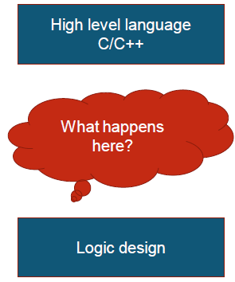
Introduction
A program written by a high level language is translated into an assembly language before it can be executed by the computer H/W.

Slide 4
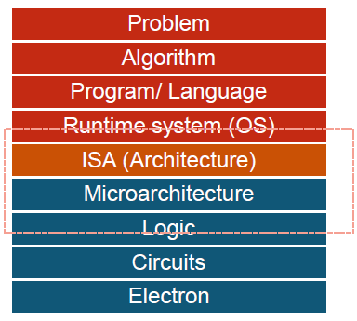
Introduction cont...

Slide 5
Machine Languages
In the earliest days of computers, the only programming languages available were machine languages.
It was made of streams of 0s and 1s.
The only language understood by a computer is machine language.
Example:
Let us see a machine language program that do the following steps:
  Read two integers,
  Add them and,
  Print the result.

Slide 6
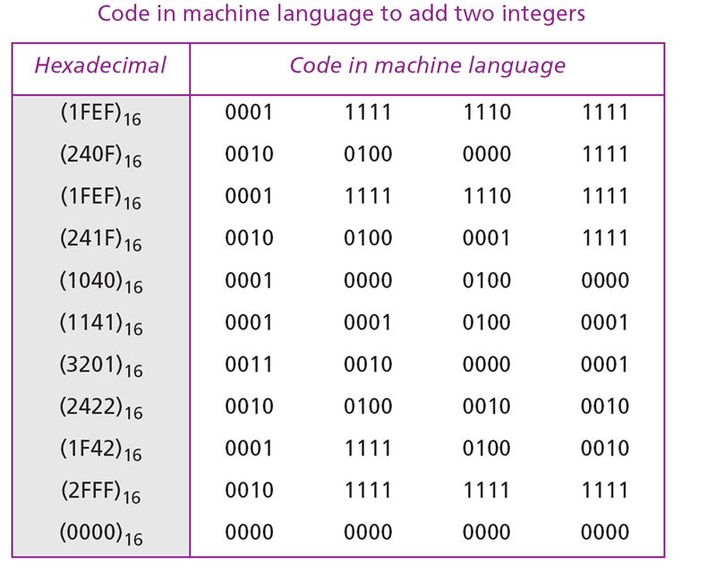
Machines Language cont...
Use eleven lines of code to do the required program, each line is 16 bits.

Slide 7

Assembly Languages
The next evolution in programming came with the idea of replacing binary code for instruction and addresses with symbols.
Because they used symbols, these languages were first known as symbolic languages.
The set of these symbolic languages were later referred to as assembly languages.
It provides direct access to a computer's hardware, making it necessary for you to understand a great deal about your computer's architecture and operating system.
This course focuses on programming Intel microprocessors by using Assembly language.
Let’s do the same example….

Slide 8
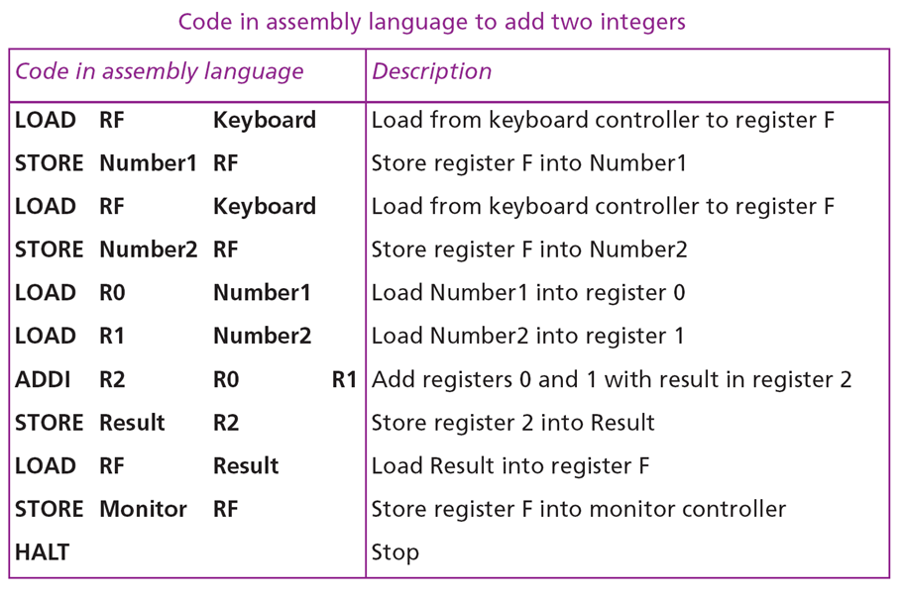
Assembly Languages cont...

Slide 9
High-Level Languages
Working with symbolic languages was also very tedious, because each machine instruction had to be individually coded.
The desire to improve programmer efficiency led to the development of high-level languages.
Over the years, various languages, most notably BASIC, Pascal, C, C++ and Java, were developed.
Let’s show the code for adding two integers as it would appear in the C++ language.

Slide 10
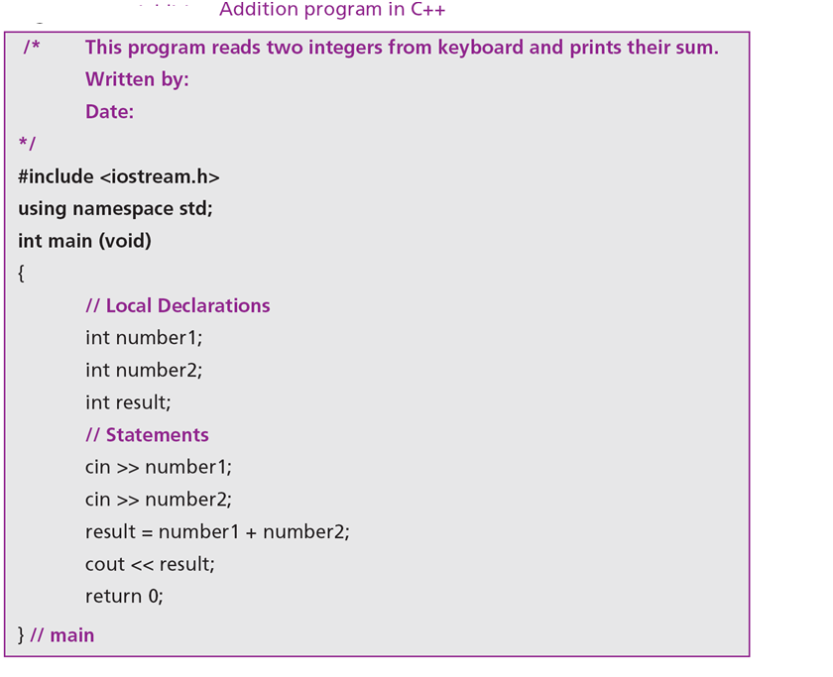
High-Level Languages cont...

Slide 11
Important Questions
What background should I have?
  You should have completed a single college course or its equivalent in computer programming.
  Like c/c++, C#, Java..
Why learn computer architecture & assembly language?
  Creating embedded system programs.
  For games programmers who wants to takes full advantage of specific hardware features in a target system.
  Gain an over all understanding of the interaction between the computer hardware, operating system, and application programs.
  Using fast libraries (DLL) made in Assembly.

Slide 12
Assembler & Linker
An assembler is a program that converts source-code programs from assembly language into machine language.
Two of the most popular assemblers for the Intel family are MASM (Microsoft Assembler) and TASM (Borland Turbo Assembler).
A linker combines individual files created by an assembler into a single executable program.
A third program, called a debugger provides a way for a programmer to trace the execution of a program and examine the contents of memory.

Slide 13
Needed H/W & S/W
Hardware:
  You need a computer with an Inte1386, Inte1486, or One of the Pentium processors.
Software:
  OS: Windows, MS-DOS, or even Linux with DOS emulator.
  Editor: To write assembly code.
  Assembler: Like MASM
  Linker.
  Debugger: MASM supplies a good 16-bit debugger named CodeView.
How do C++ and Java relate to assembly language?
  A single statement in C++ (Or Java) expands into multiple assembly language or machine instructions.

Slide 14
Numbering Systems
To understand machine language and then assembly language we must first have a quick review to the previous knowledge of Number Systems.
Number systems that we will work with are:
  Binary → Base 2
  Octal → Base 8
  Decimal → Base 10
  Hexadecimal → Base 16

Slide 15
Numbering Systems cont...
System | Base | Possible Digits
Binary | 2 | 01
Octal | 8 | 01234567
Decimal | 10 | 0123456789
Hexadecimal | 16 | 0 1 2 3 4 5 6 7 8 9 A BCDEF

Slide 16
1- Binary Numbers
MSB
LSB
0 | 0 | 1 | 1 | 0 | 0 | 1 | 0 | 0 | 1 | 1 | 1 | 1 | 0 | 1 | 0
15
0
2
. . . . . . . . . . . . . . .
2
Base 2 system.
Uses digits 0 &1.
2^{n} | Decimal Value
2⁰ | 1
2¹ | 2
2² ˸ | 4 ˸
2⁸ ˸ | 256 ˸
2¹⁵ | 32768

Slide 17
Translating unsigned binary integers to decimal:
1- Binary Numbers cont...
8- bit Binary 00001001
Decimal equivalence = 1*2⁰+1*2³ = 9
Translating unsigned decimal integers to binary:
Divide the decimal value by 2, saving each remainder as a binary digit. Binary of 37d = 100101b
Division | Quotient | Remainder
37/2 | 18 | 1
18/2 | 9 | 0
9/2 | 4 | 1
4/2 | 2 | 0
2/2 | 1 | 0
1/2 | 0 | 1
LSB
MSB
100101

Slide 18
1- Binary Numbers cont...
Convert 67 to its binary equivalent:
67₁₀ = x₂
Step 1: 67 / 2 = 33 R 1 Divide 67 by 2. Record quotient in next row
Step 2: 33 / 2 = 16 R 1 Again divide by 2; record quotient in next row
Step 3: 16 / 2 = 8 R 0 Repeat again
Step 4: 8 / 2 = 4 R 0 Repeat again
Step 5: 4 / 2 = 2 R 0 Repeat again
Step 6: 2 / 2 = 1 R 0 Repeat again
Step 7: 1 / 2 = 0 R 1 STOP when quotient equals 0
1 0 0 0 0 1 1₂

Slide 19
1- Binary Numbers cont...
Convert (10101101)₂ to its decimal equivalent:
Binary 1 0 1 0 1 1 0 1
Positional Values
x
x
x
x
x
x
x
x
2⁷
2⁶
2⁵
2⁴
2³
2²
2¹
2⁰
Products
128 + 0+32 +0+ 8 + 4 + 0+1
173₁₀

Slide 20
Binary Addition
Rules:
0 + 0 = 0
0 + 1 = 1
1 + 0 = 1
1 + 1 = 10 (0 and Carry 1)
Example: add 12+7 convert to binary and then add
1100
+ 0111
----------------
10011

Slide 21
Complementary Arithmetic
How do you represent a minus sign electronically in a computer?
How can you represent it such that arithmetic operations are manageable?
There are two types of compliments for each number base system.
  Have the r’s complement
  Have the (r-1)’s complement
For base 2 have 2’s complement and 1’s complement
1’s complement:
  Switch all 0’s to 1’s and 1’s to 0’s
  Binary # 10110011
  1’s complement 01001100

Slide 22
Complementary Arithmetic
2’s complement:
  Step 1: Find 1’s complement of the number
  Binary # 11000110
  1’s complement 00111001
  Step 2: Add 1 to the 1’s complement
  00111001
  + 00000001
  00111010

Slide 23
We can deal with the second number as it is negative so we must find the 2’s complement of it and convert the subtraction operation to summation.
Binary Subtraction
Now do the operation 4 – 6
4 0100 0100 0100
6 0110 1001+1=1010 +1010
1110 0001+1=- 0010
=-2

Slide 24
2- Octal Number System
Also known as the Base 8 System
Uses digits 0 - 7
Groups of three (binary) digits can be used to represent each octal digit
Also uses multiplication and division algorithms for conversion to and from base 10

Slide 25
Decimal to Octal Conversion
Convert 427₁₀ to its octal equivalent:
427 / 8 = 53 R= 3 Divide by 8; R is Reminder
53 / 8 = 6 R= 5 Divide Q by 8
6 / 8 = 0 R= 6 Repeat until Q = 0
653₈

Slide 26
Octal to Decimal Conversion
Convert 653₈ to its decimal equivalent:
Octal Digits
6 5 3
x
x
x
Positional Values
8² 8¹ 8⁰
Products
384 + 40 + 3
427₁₀

Slide 27
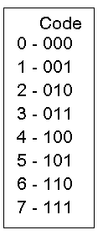
Octal to Binary Conversion
Each octal number converts to 3 binary digits
To convert 653₈ to binary, just substitute code:
6 5 3
110 101 011

Slide 28
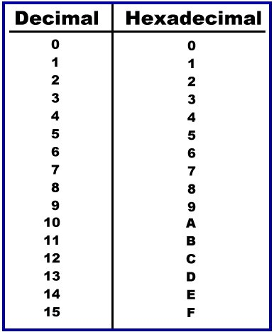
3. Hexadecimal Number System
Base 16 system.
Uses digits 0-9 & letters A,B,C,D,E,F.
Groups of four bits represent each base 16 digit.

Slide 29
Decimal to Hexadecimal Conversion
Convert 830₁₀ to its hexadecimal equivalent:
830 / 16 = 51 14
51 / 16 = 3 3
3 / 16 = 0 3
= E in Hex
33E₁₆

Slide 30
Hexadecimal to Decimal Conversion
Convert 3B4F16 to its decimal equivalent:
Hex Digits
3 B 4 F
x
x
x
x
Positional Values
16³ 16² 16¹ 16⁰
Products
12288 +2816 + 64 +15
15,183₁₀

Slide 31
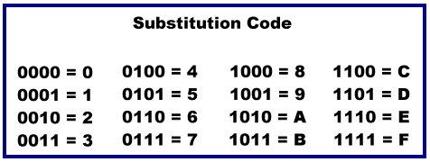
Binary to Hexadecimal Conversion
The easiest method for converting binary to hexadecimal is to use a substitution code
Each hex number converts to 4 binary digits

Slide 32

Binary to Hexadecimal Conversion cont...
Convert 0101 0110 1010 1110 0110 1010₂ to hex using the 4-bit substitution code :
0101 0110 1010 1110 0110 1010
5 6 A E 6 A
56AE6A₁₆

Slide 33


Binary to Octal Conversion
Substitution code can also be used to convert binary to octal by using 3-bit groupings:
010 101 101 010 111 001 101 010
2 5 5 2 7 1 5 2
25527152₈

Slide 34
Combinational Gates
Name Symbol Function Truth Table
A X = A • B
X or
B X = AB
A B X
AND
0 0 0
0 1 0
1 0 0
1 1 1
0 0 0
0 1 1
1 0 1
1 1 1
A
X X = A + B
B
A B X
OR
Not
A X
A X X = A`
0 1
1 0
Buffer A X X = A
A X
0 0
1 1
A B X
NAND
A
X X = (AB)’
B
0 0 1
0 1 1
1 0 1
1 1 0
A
X X = (A + B)’
B
A B X
NOR
0 0 1
0 1 0
1 0 0
1 1 0
XOR
Exclusive OR
A X = A ⊕ B
X or
B X = A’B + AB’
A B X
0 0 0
0 1 1
1 0 1
1 1 0
XNOR
A X = (A ⊕ B)’
X or
B X = A’B’+ AB
A B X
0 0 1
0 1 0
1 0 0
1 1 1
Exclusive NOR
or Equivalence

Slide 35
Assignment 1
From the book Solve:
  Section1.3.7 (Pages23-24-25):
    •Points:3,5,9,11,13,16,17,21
  Section1.4.2 (page29):
    •Points:6,9

Slide 36


