Slide 1
Structural Diagram

Slide 2
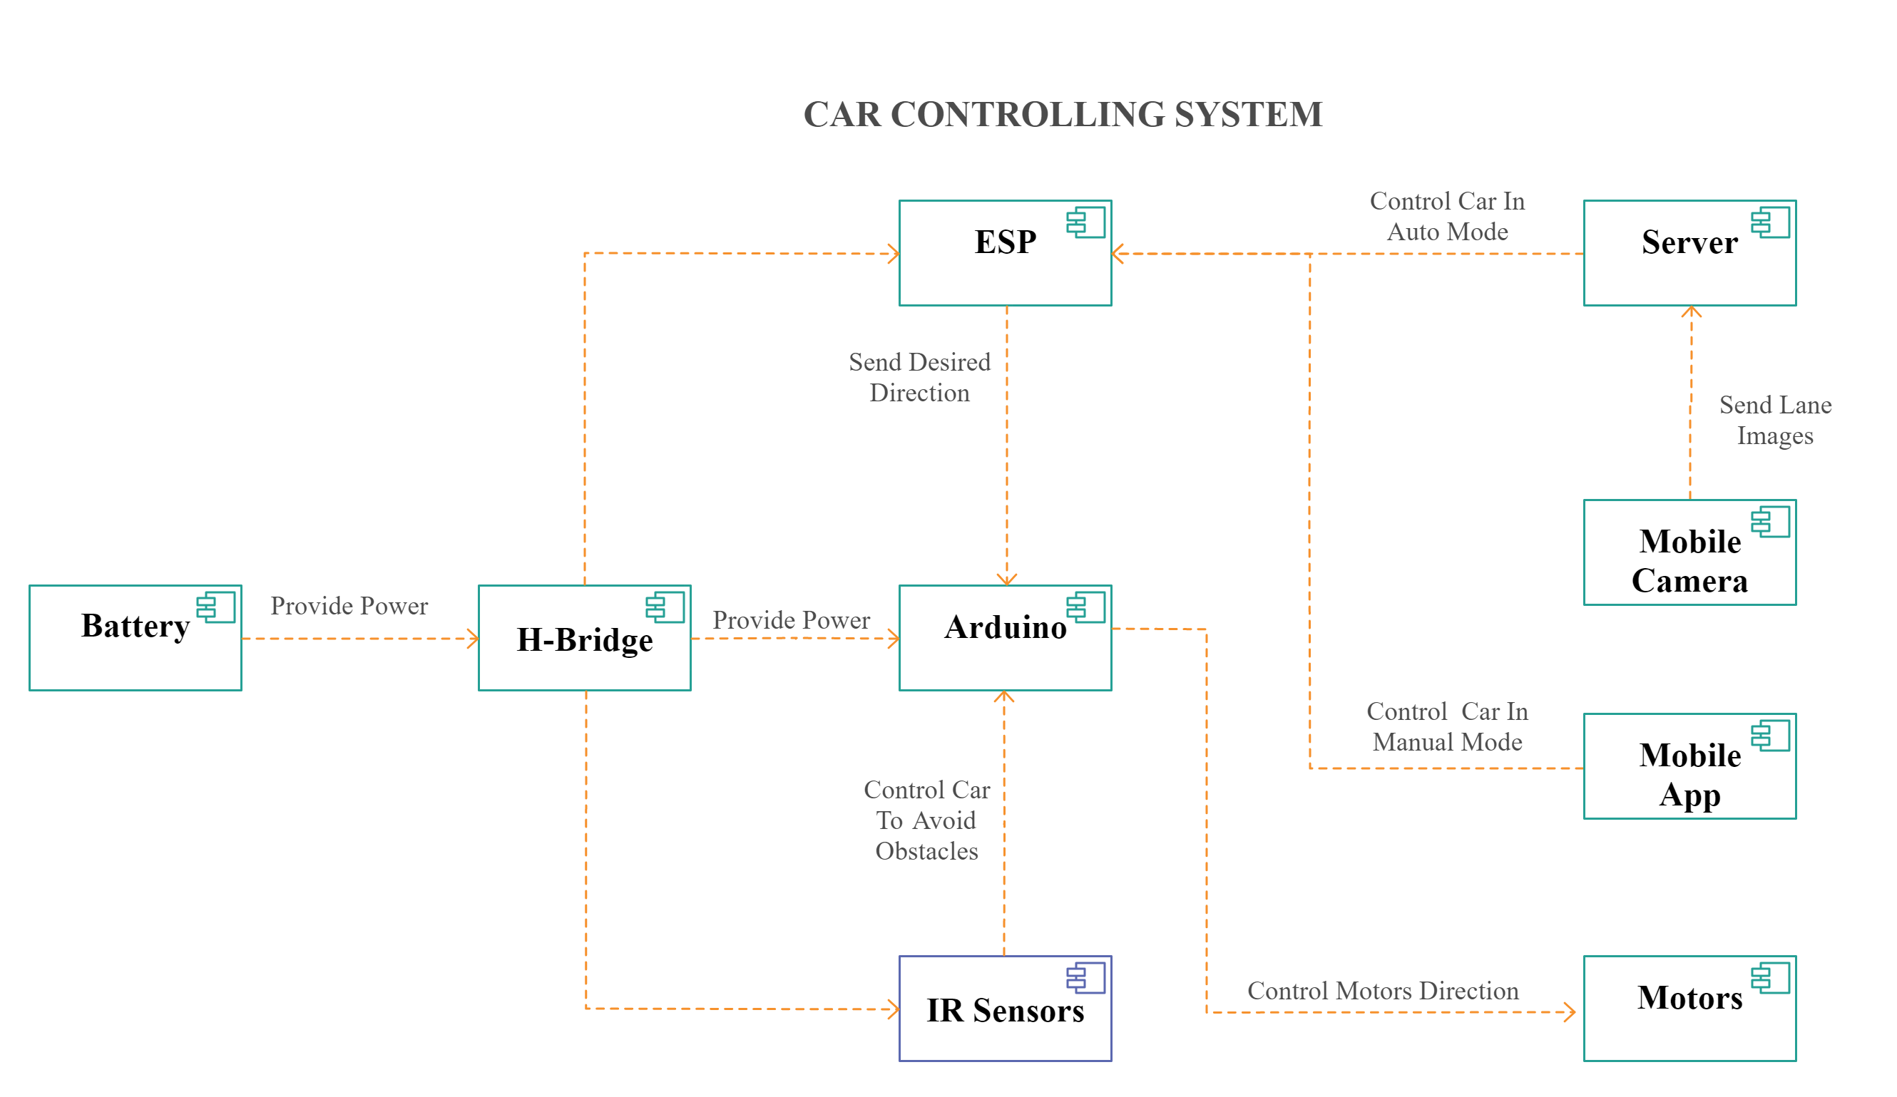
Component Diagram

Slide 3
Behavioural Diagram

Slide 4
Activity Diagram
Mobile App
Manual
Or
AUTO
Server Retrieves images from the mobile cam
AUTO
Manual
Lane Detection
Use mobile to control the car Movement
Obstacles Detection
RFID Tag Detected?
No
Taking decisions and send direction to ESP
Yes
Display RFID On Mobile Screen
ESP Control the movement of the car

