Slide 1

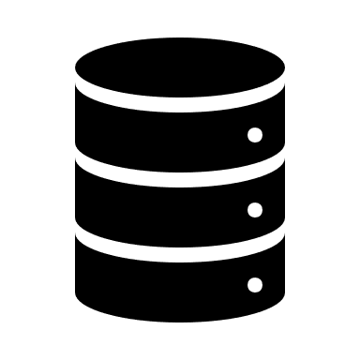

Architecture Overview
Procurement Data CSV
Data Loader
(PY Module)
Data Explorer
(PY Module)
Query
Vector DB Handler
(PY Module)
Conversation Handler
(PY Module)
Chroma-DB
Data Integrity
(PY Module)
Answer

