Slide 1
1749972825_Section 5

Slide 2
Class thresholding
K-means Clustering (Otsu Method) K-me Means Clustered (K-Means Method) Threshold t = 2 • ω₂(t) = probability of class 2
Erosion Erosions (Erosion)

Slide 3
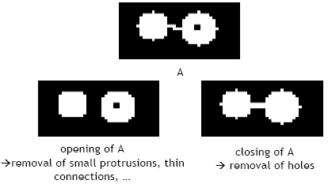
Class thresholding - Image 1

Slide 4
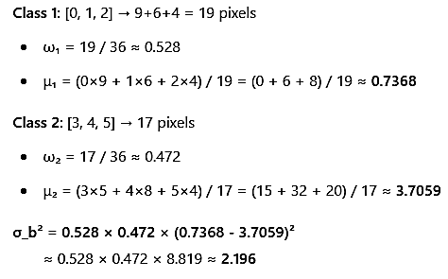
Class thresholding - Image 2

Slide 5

Class thresholding - Image 3

Slide 6
Object class thresholding
Thresholding (Otsu Method) Morphological operationsmorphological operations Closing
Closing
Clustering
K-means Clustered K-Means ClUSTering
Threshold t = 2

Slide 7
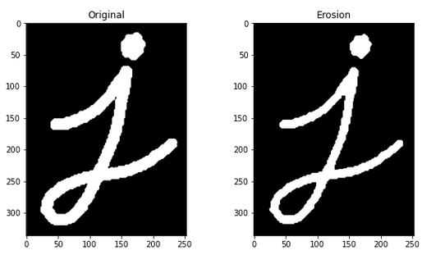
Object class thresholding - Image 1

Slide 8
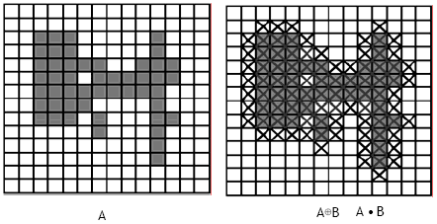
Object class thresholding - Image 2

Slide 9
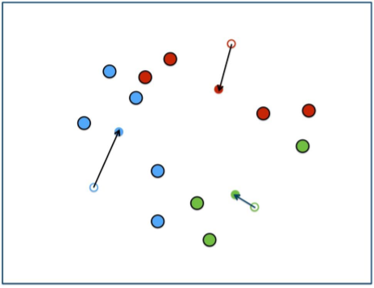
Object class thresholding - Image 3

Slide 10
Foreground thresholding otsu method
Thresholding (Otsu Method) Th threshold t = 2 K-means Clustering K- means ClUSTering K,means K-Means Clusterering K - Clustered K, Clusters K, K- Clusters K-Clustering
Threshold t = t
K-clustering k = 2
Clusterers K = 2
Clusters T = 1

Slide 11

Foreground thresholding otsu method - Image 1

Slide 12
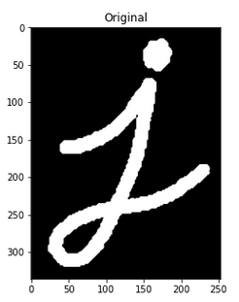
Foreground thresholding otsu method - Image 2

Slide 13
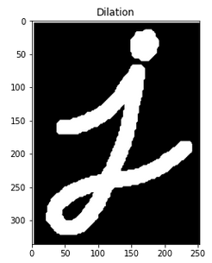
Foreground thresholding otsu method - Image 3

