Slide 1
1749973334_Section 5

Slide 2
Object class thresholding
K-means Clustering
Morphological operations
Thresholding (Otsu Method) K-mean Clustered
Morphology operations Morphological
operations Morphology

Slide 3
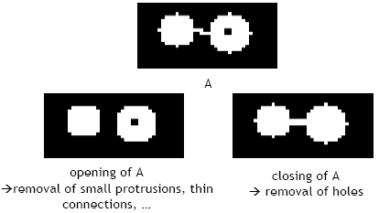
Object class thresholding - Image 1

Slide 4
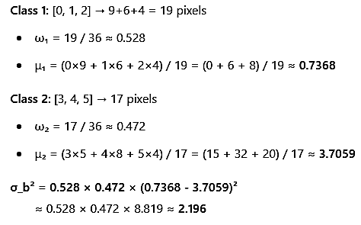
Object class thresholding - Image 2

Slide 5

Object class thresholding - Image 3

Slide 6
Mean class threshold thresholding
Thresholding (Otsu Method) Th thresholding ( Otsu method) Thresholded (OTSU Method) K-means Clustering (K-mean method) Clustered (Clustering method)

Slide 7
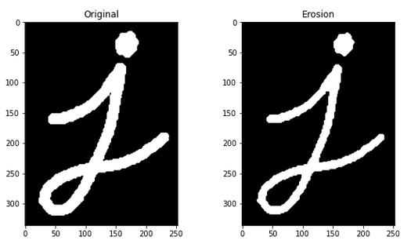
Mean class threshold thresholding - Image 1

Slide 8
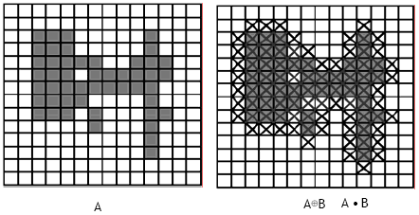
Mean class threshold thresholding - Image 2

Slide 9
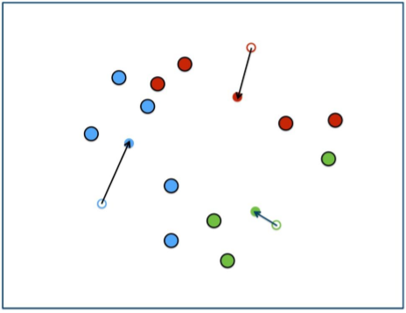
Mean class threshold thresholding - Image 3

Slide 10
new title
Thresholding (Otsu Method) Thresholding (Otsi Method) Thresholds (O tsu method) Th thresholding ( Otsi method) “We try every threshold t and compute: ₁(t) = probability of class 1 (≤ t)”
““”” ‘ ’”: ‘‘
‘
’: “
” : ”

Slide 11

new title - Image 1

Slide 12
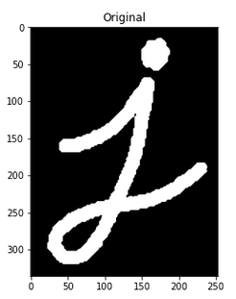
new title - Image 2

Slide 13
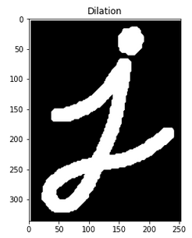
new title - Image 3

Slide 14
Class threshold thresholding otsu
Threshold t = 2 • ω₂(t) = probability of class 2 (> t) μ₁( t) = mean of class 1
ω (t), ω (t) = probability of class 2
μ ( t), (t, t) is the number of classes in a class
Thresholding (Otsu Method) K-means Clustering K-Means Cluster K- Means K- Means Clustered K- means Clusters K- Measures Clusters K-measures Clusterers K-miles Clusterer K-mean Cluster

Slide 15
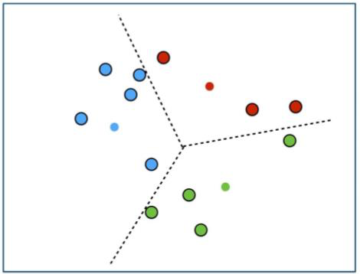
Class threshold thresholding otsu - Image 1

Slide 16
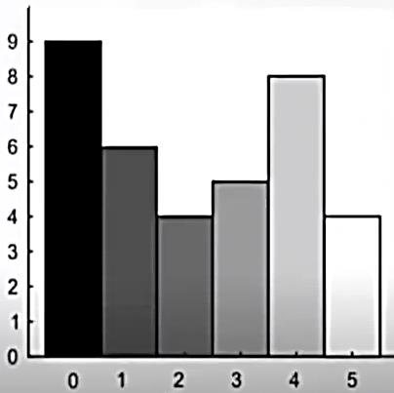
Class threshold thresholding otsu - Image 2

Slide 17
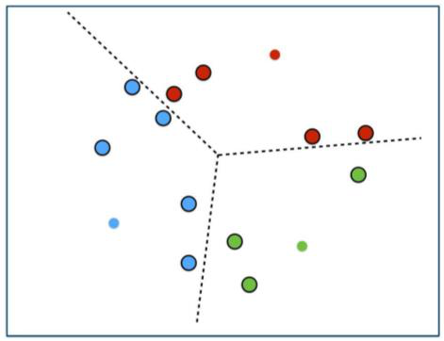
Class threshold thresholding otsu - Image 3

Slide 18
Foreground thresholding otsu
Thresholding (Otsu Method) Thresholding is a form of thresholding
Thresholds are used to determine whether a threshold has been achieved by a threshold test
The threshold test is similar to the one used in the Otsu threshold test for blood tests

Slide 19
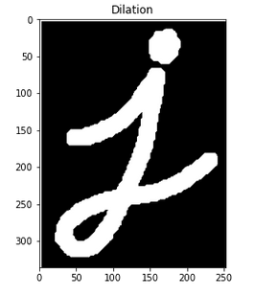
Foreground thresholding otsu - Image 1

Slide 20
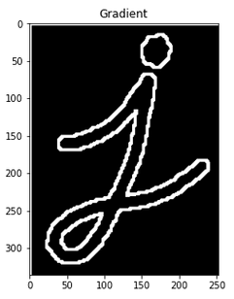
Foreground thresholding otsu - Image 2

Slide 21
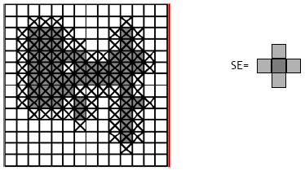
Foreground thresholding otsu - Image 3

Slide 22
Object class thresholding otsu
Morphological operations Morphological operationsmorphological operations Thanks Thanks Thanks Opening and Closing opening and closing
Closing and closing closing
Morphological operations morphological operation morphological operations

Slide 23
Object class thresholding otsu - Image 1

Slide 24
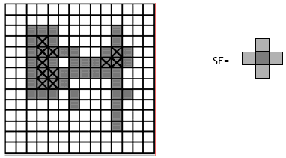
Object class thresholding otsu - Image 2

Slide 25
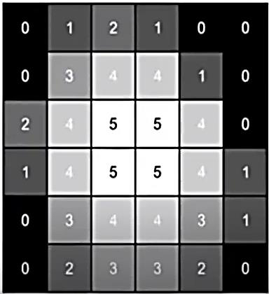
Object class thresholding otsu - Image 3

Slide 26
Foreground thresholding otsu method
Thresholding (Otsu Method) Th threshold t = 2 • ω₂(t) = probability of class 2 (> t) Morphological operations Morphological Operations Morphological operations = molecular probability

Slide 27
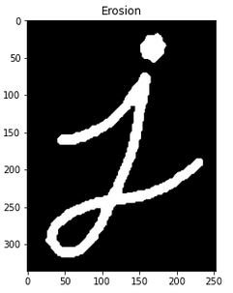
Foreground thresholding otsu method - Image 1

