Slide 1
1752989292_( Paper ) SciPostLayout

Slide 2
Scientific posters used efficiently
A well-designed scientific poster conveys the essential elements of the research and requires less time to read than a paper
Unfortunately, creating a scientific poster a graphical format
posters that can be utilized for these tasks would contribute significantly to the research on scientific poster generation

Slide 3
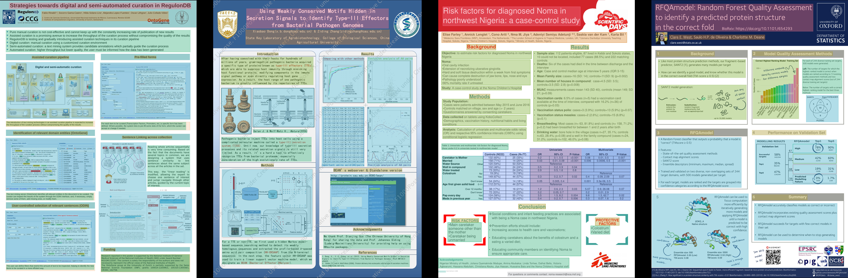
Scientific posters used efficiently - Image 1

Slide 4
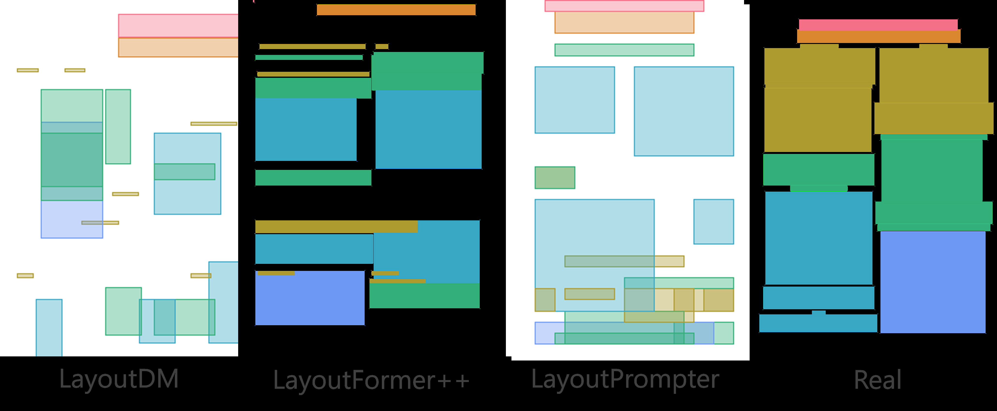
Scientific posters used efficiently - Image 2

Slide 5
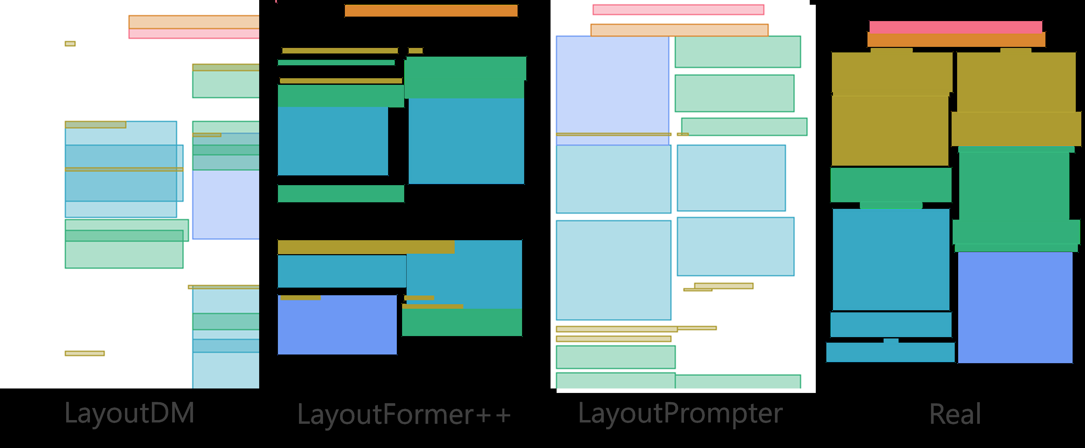
Scientific posters used efficiently - Image 3

Slide 6
Scipostlayout scientific poster generation
In this paper, we introduce SciPost layout, the first scientific poster layout dataset for scientific poster generation
A well-designed scientific poster conveys the essential elements of theresearch and requires less time to read than a paper
Unfortunately, creating a scientific poster a graphical format

Slide 7
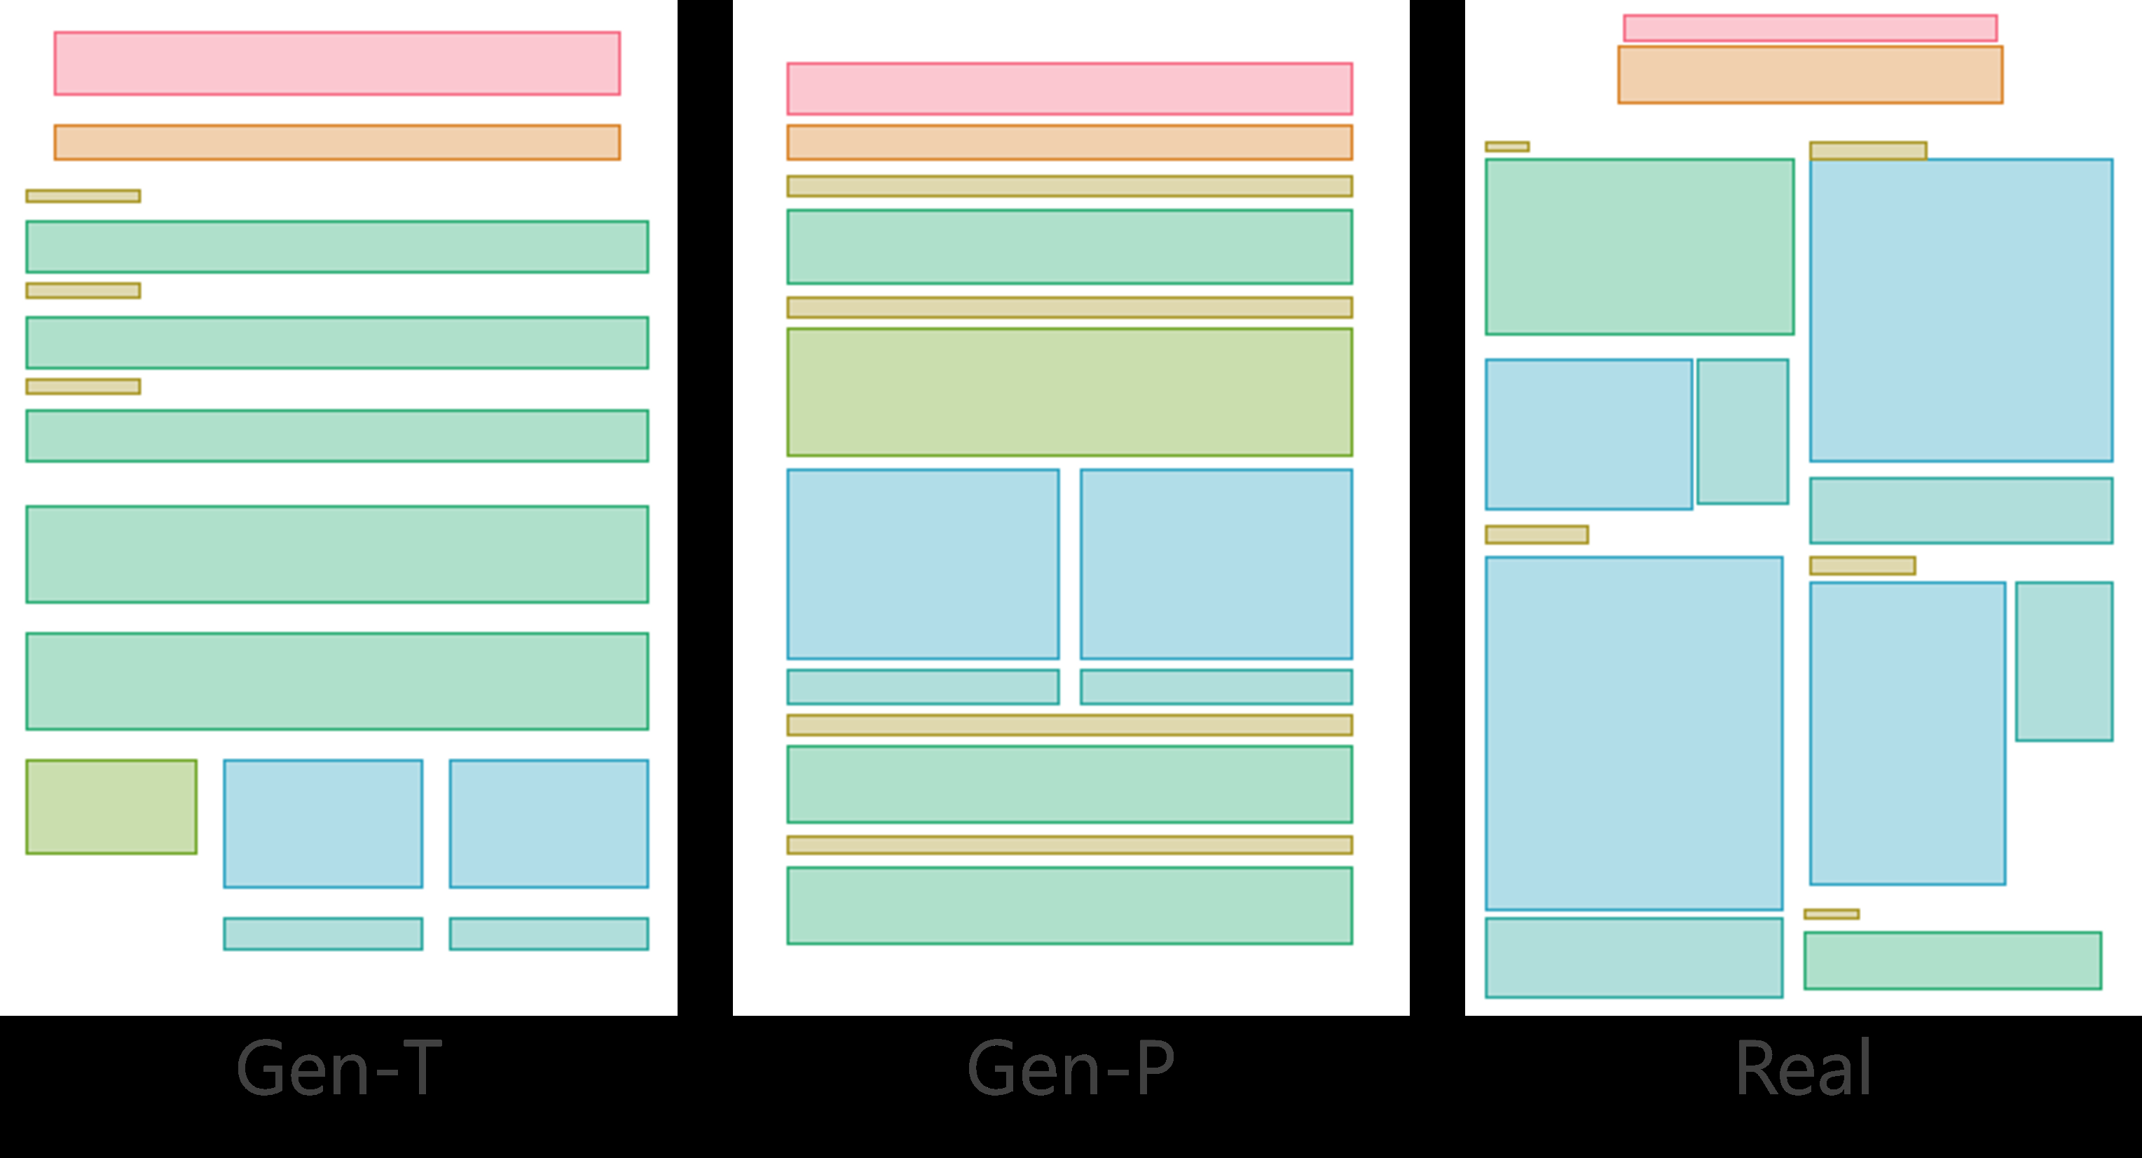
Scipostlayout scientific poster generation - Image 1

Slide 8
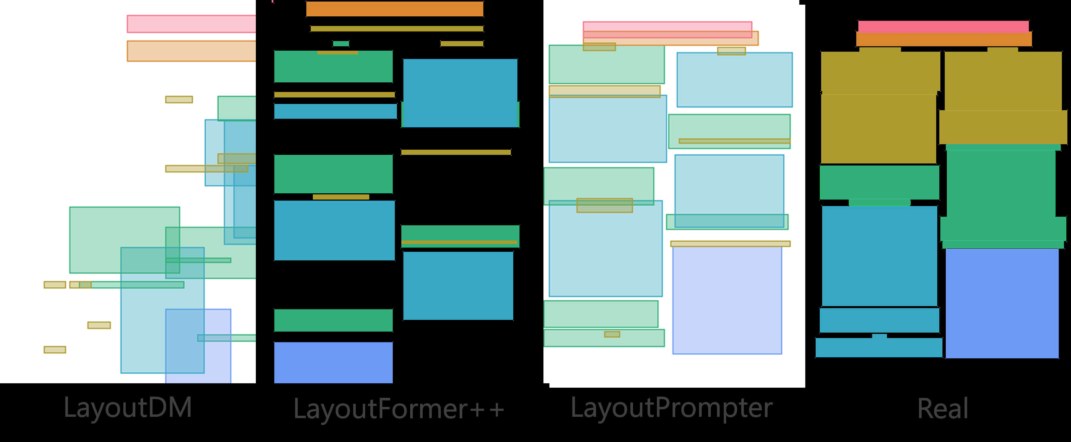
Scipostlayout scientific poster generation - Image 2

Slide 9
Scipostlayout scientific poster generation - Image 3

Slide 10
Generates poster scientific paper
scientific paper in PDF format
Your goal is to analyze the content and determine the layout generation constraints for a scientific poster
The poster should be summarizing the important information in a scientific paper
Research on scientific poster generation remains scarce due to its high summarizing

Slide 11
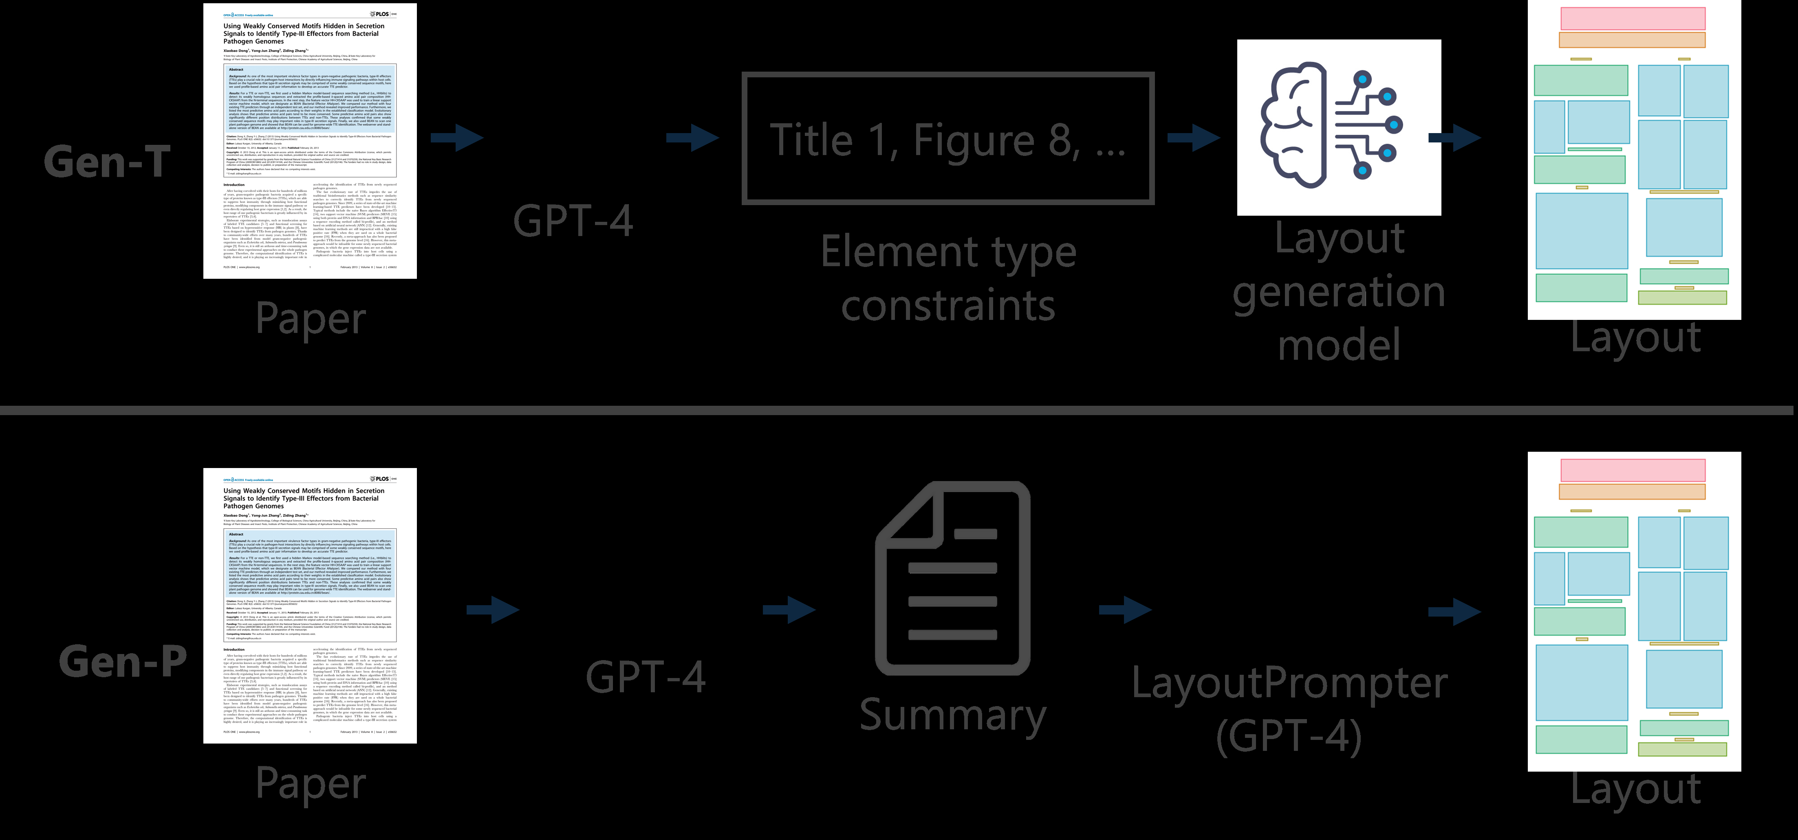
Generates poster scientific paper - Image 1

Slide 12
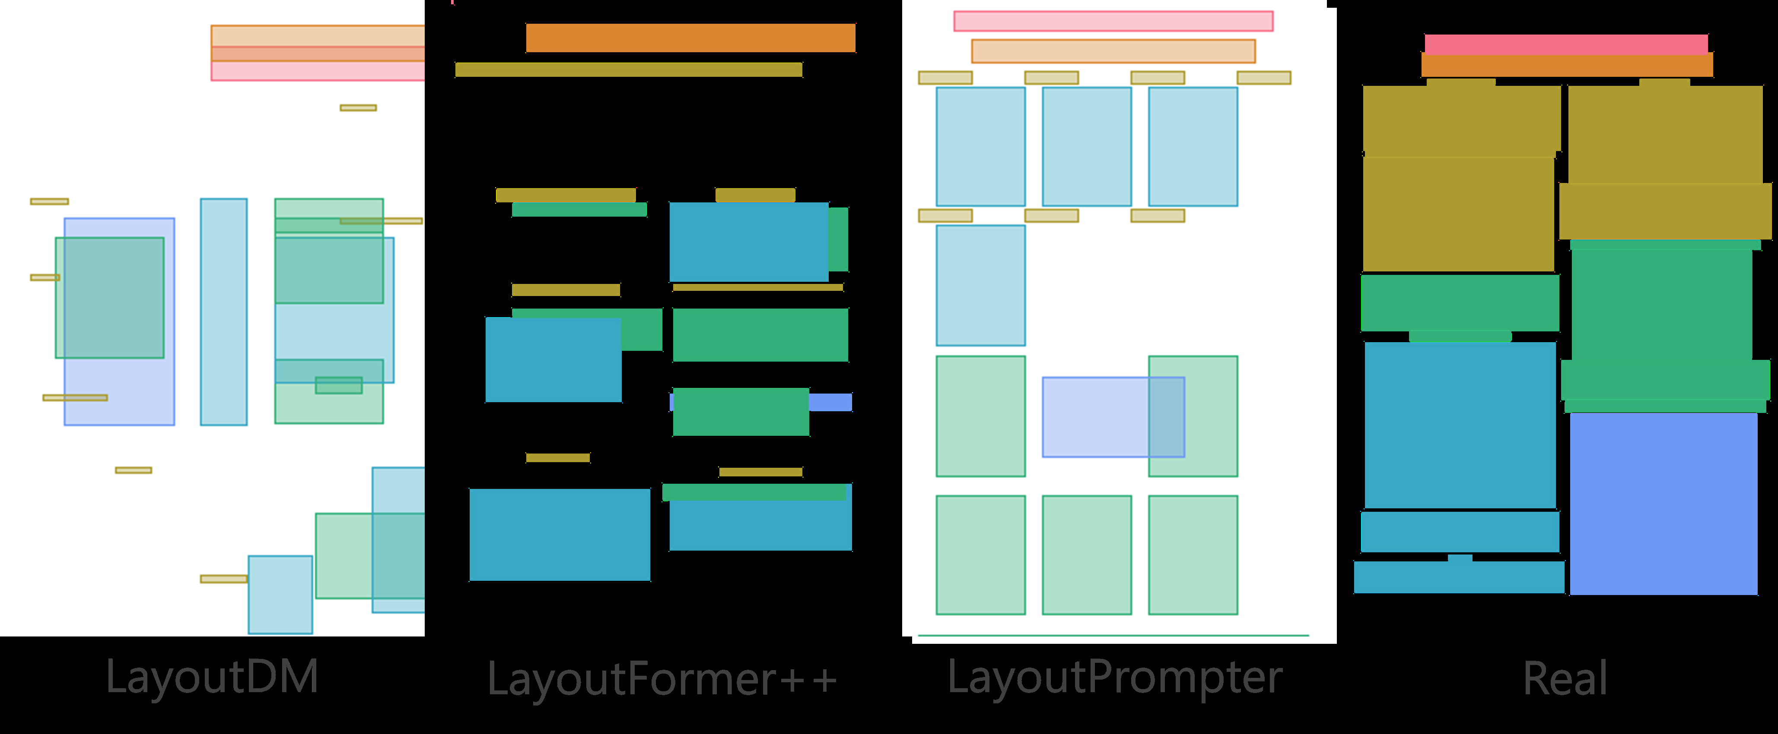
Generates poster scientific paper - Image 2

Slide 13
Scientific poster generation layout
In this paper, we introduce SciPost layout, the first scientific poster layout dataset for scientific poster generation
A well-designed scientific poster conveys the essential elements of the research and requires less time to read than a paper
Unfortunately, creating a scientific poster a graphical format is more challenging than that of scientific papers

Slide 14
Layout generation scientific poster
SciPost layout is the first scientific poster layout dataset for scientific poster generation
Analysis of scientific posters is more challenging than that of scientific papers because of the variety of fonts and positions of figures and tables

Slide 15
Layout analysis scientific posters
layout analysis of scientific posters is more challenging than that of scientific papers because of the variety of fonts and positions of figures and tables
Developing layout analysis models would be helpful in identifying layout patterns common to well-designed posters

Slide 16
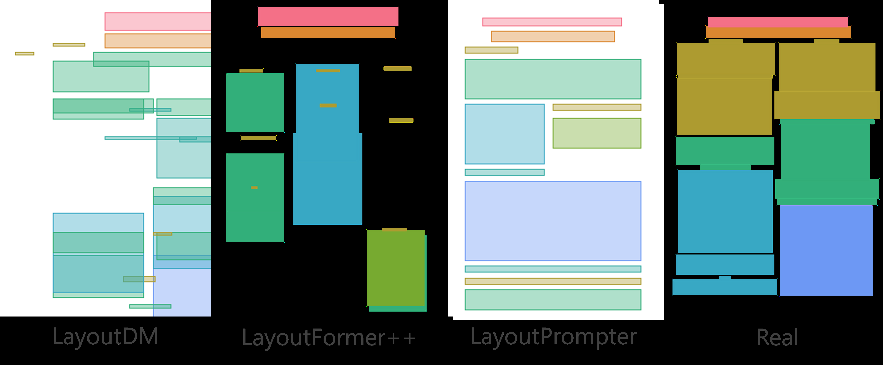
Layout analysis scientific posters - Image 1

Slide 17
Scientific posters layout analysis
2
2
layout analysis of scientific posters is more challenging than that of scientific papers because of the variety of fonts and positions of figures and tables
erating layouts forscientific posters is challenging, as are other layout generation tasks that require the positioning of figures

Slide 18
Poster generation systems scientific
In this paper, we introduce SciPost layout, the first scientific poster layout dataset for scientific poster generation
posters that can be utilized for these tasks would contribute significantly to the research on scientifically-based posters

Slide 19
Poster generation systems scien
In this paper, we introduce SciPost layout, the first scientific poster layout dataset for scientific poster generation
posters that can be utilized for these tasks would contribute significantly to the research on scientific postergeneration

Slide 20
Creating scientific poster efficiently
Research on scientific poster generation remains scarce due to its high summarizing the important information in a scientific paper
posters that can be utilized for these tasks would contribute significantly to the research on scientific poster generation
Your goal is to analyzethe content and determine the layout g

Slide 21
Generate designed posters scientific
The generated posters are composed lem
lem and developed a model to extract essential sentences from papers by classification and
fill them into templates to generate posters
posters that can be utilized for these tasks would contribute significantly to the research on
scientific poster generation

Slide 22
Poster layout generation scientific
In this paper, we introduce SciPost layout, the first scientific poster layout dataset for scientific poster generation
By developing layout generation models, we can generate layouts that follow the patterns of attractive posters
In other words, building a layout dataset of scientific

Slide 23
Poster generation scientific papers
Research on scientific poster generation remains scarce due to its high summarizing the important information in a scientific paper
posters that can be utilized for these tasks would contribute significantly to the research onscientific poster generation

Slide 24
Scientific poster generation dataset
In this paper, we introduce SciPost layout, the first scientific poster layout dataset for scientific poster generation
The first dataset that contains scientific paper-poster pairs with the CC-BY license, which can be utilized for evaluating scientific poster generations

Slide 25
Layout generation scientific posters
In this paper, we introduce SciPost layout, the first scientific poster layout dataset for scientific poster generation
The layouts of scientific posters are more diverse than the layouts of the papers in PubLayNet [38]

Slide 26
Scientific poster layout dataset
In this paper, we introduce SciPostLayout, the first scientific poster layout dataset for scientific poster generation
We ing existing computer vision models and found that both layout analysis and generationof posters using SciPost layout are more challenging than with scientific papers
We proposed a three-step framework to generate posters: section filter, content extraction, andipient composition

Slide 27
Scientific poster generation systems
In this paper, we introduce SciPost layout, the first scientific poster layout dataset for scientific poster generation
posters that can be utilized for these tasks would contribute significantly to the research on scientifically-based posters

Slide 28
Generate poster layouts scientific
By developing layout generation models, we can generate layouts that follow the patterns of attractive posters
In other words, building a layout dataset of scientific
However, the generated posters are composed lem and developed a model to extract essential sentences from papers

Slide 29
Generate posters scientific papers
scientific paper in PDF format
Your goal is to analyze the content and determine the layout generation constraints for a scientific poster
The poster should be summarizing the important information in a scientific paper
Research on scientific poster generation remains scarce due to its high summarizing

Slide 30
Layout dataset scientific posters
In this paper, we introduce SciPost layout, the first scientific poster layout dataset for scientific poster generation
This dataset includes 7,855 scientific posters with manuallayout annotations
All posters included in the dataset are under the CC-BY license 1

