Slide 1
1752990243_( Paper ) SciPostLayout

Slide 2
Scientific posters used efficiently
A well-designed scientific poster conveys the essential elements of the research and requires less time to read than a paper
posters that can be utilized for these tasks would contribute significantly to the research on scientific poster generation
Unfortunately, creating a scientific poster a graphical format

Slide 3
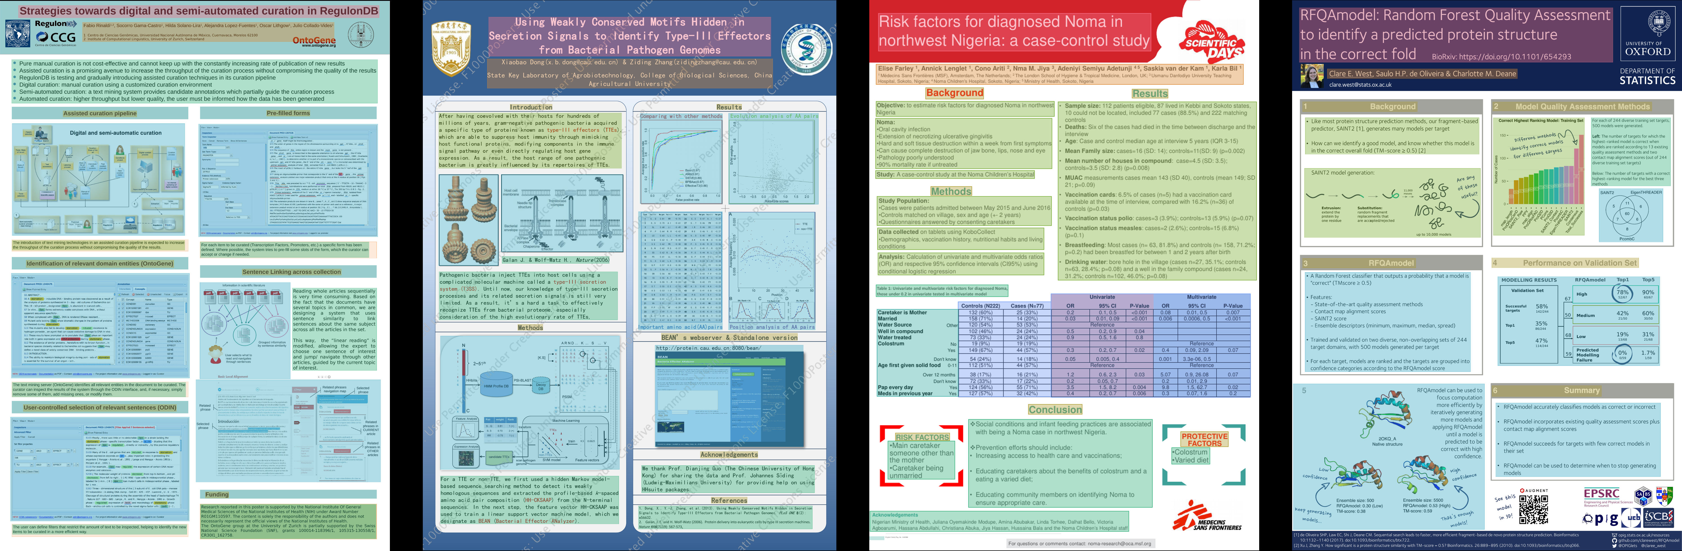
Scientific posters used efficiently - Image 1

Slide 4
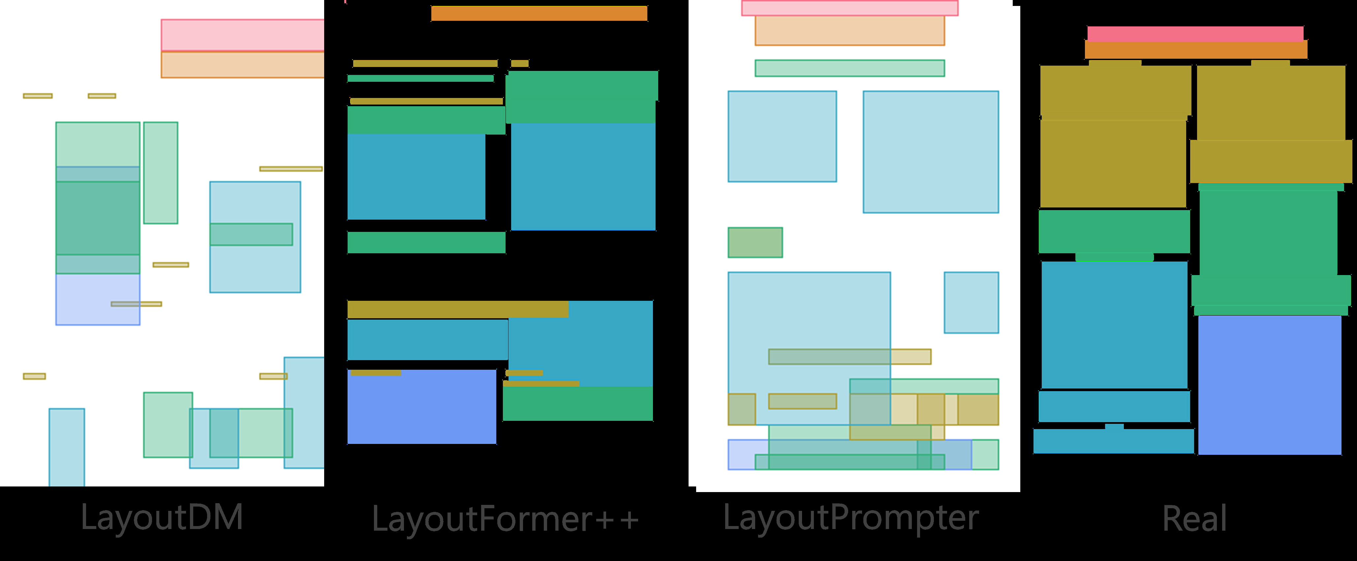
Scientific posters used efficiently - Image 2

Slide 5
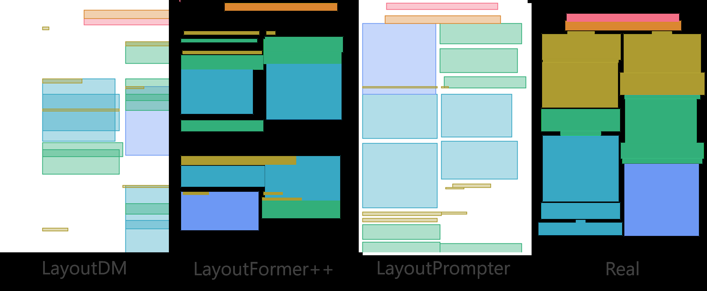
Scientific posters used efficiently - Image 3

Slide 6
Scipostlayout scientific poster generation
In this paper, we introduce SciPost layout, the first scientific poster layout dataset for scientific poster generation
A well-designed scientific poster conveys the essential elements of the research and requires less time to read than a paper

Slide 7
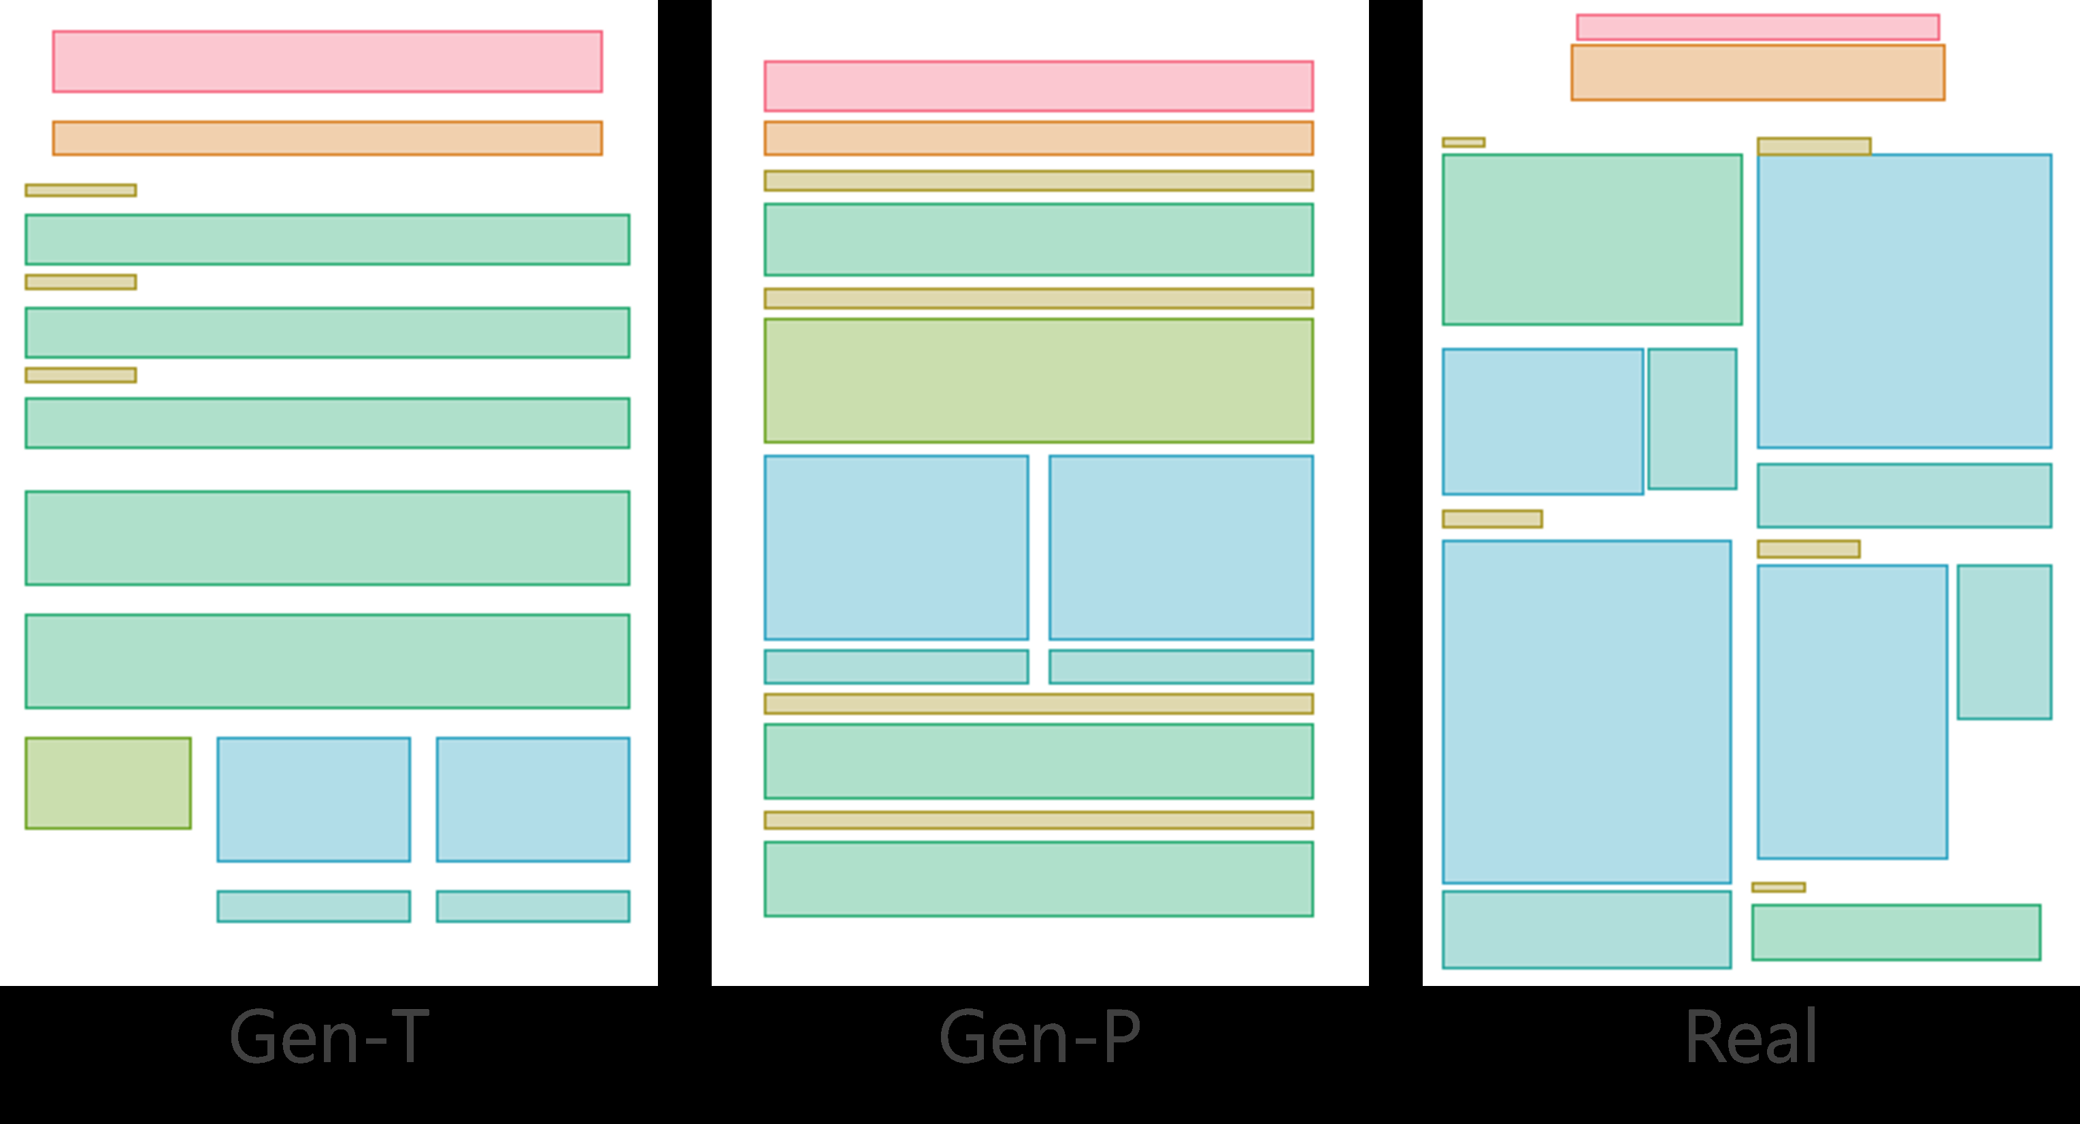
Scipostlayout scientific poster generation - Image 1

Slide 8
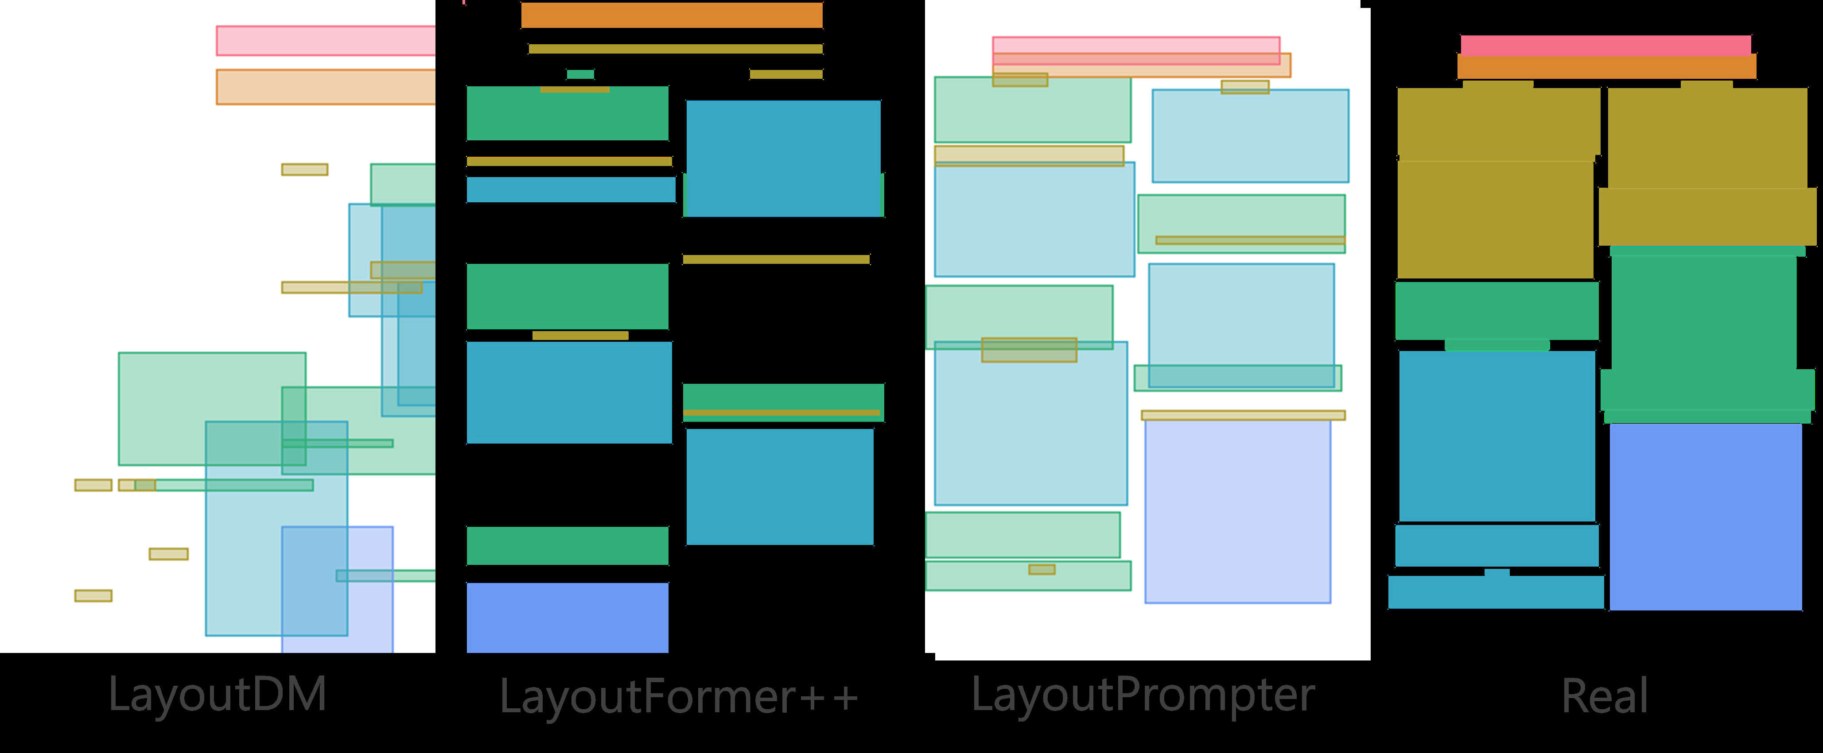
Scipostlayout scientific poster generation - Image 2

Slide 9
Scipostlayout scientific poster generation - Image 3

Slide 10
Generates poster scientific paper
scientific paper in PDF format
Your goal is to analyze the content and determine the layout generation constraints for a scientific poster
The poster should be summarizing the important information in a scientific paper
Research on scientific poster generation remains scarce due to its high summarizing of important information

Slide 11
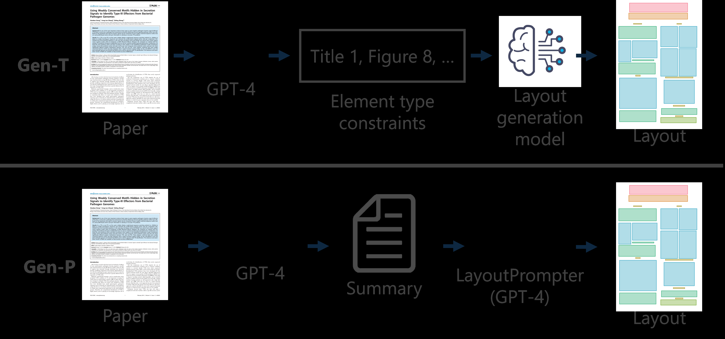
Generates poster scientific paper - Image 1

Slide 12
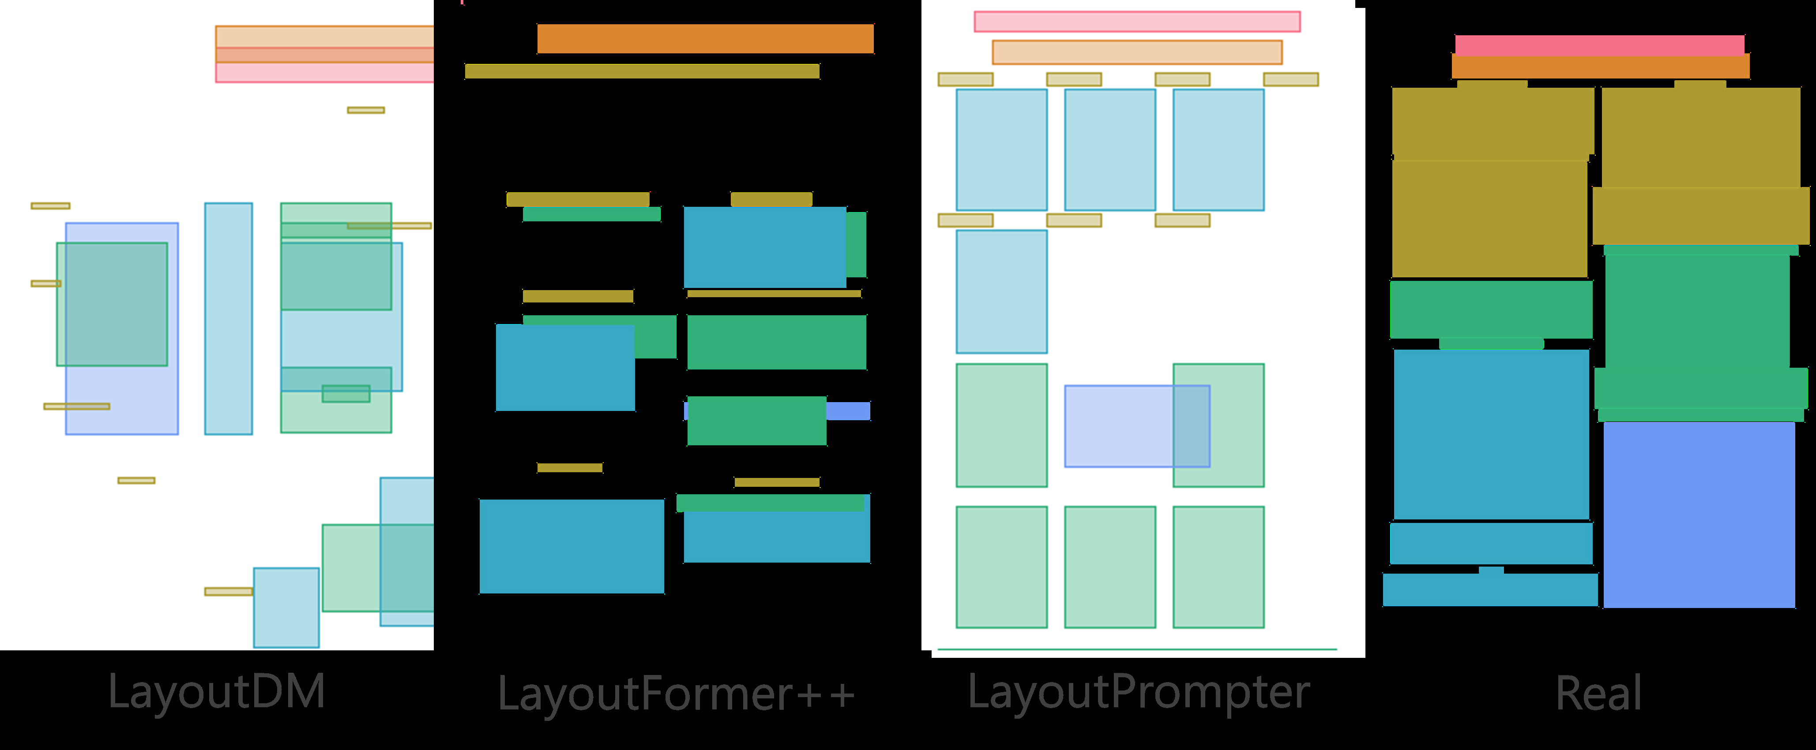
Generates poster scientific paper - Image 2

Slide 13
Scientific poster generation layout
In this paper, we introduce SciPost layout, the first scientific poster layout dataset for scientific poster generation
A well-designed scientific poster conveys the essential elements of the research and requires less time to read than a paper

Slide 14
Layout generation scientific poster
SciPost layout is the first scientific poster layout dataset for scientific poster generation
Analysis of scientific posters is more challenging than that of scientific papers because of the variety of fonts and positions of figures and tables

Slide 15
Layout analysis scientific posters
layout analysis of scientific posters is more challenging than that of scientific papers because of the variety of fonts and positions of figures and tables
Developing layout analysis models would be helpful in terms of identifying layout patterns common to well-designed posters

Slide 16
Scientific posters layout analysis
layout analysis of scientific posters is more challenging than that of scientific papers because of the variety of fonts and positions of figures and tables
erating layouts for scientific poster is challenging, as are other layout generation tasks that require the positioning of Figures and Tables

Slide 17
Poster generation systems scientific
In this paper, we introduce SciPost layout, the first scientific poster layout dataset for scientific poster generation
posters that can be utilized for these tasks would contribute significantly to the research on scientific postergeneration

Slide 18
Poster generation systems scien
In this paper, we introduce SciPost layout, the first scientific poster layout dataset for scientific poster generation
posters that can be utilized for these tasks would contribute significantly to the research on scientific postergeneration

Slide 19
Creating scientific poster efficiently
Research on scientific poster generation remains scarce due to its high summarizing the important information in a scientific paper
posters that can be utilized for these tasks would contribute significantly to the research on scientific poster generation

Slide 20
Generate designed posters scientific
The generated posters are composed lem
lem and developed a model to extract essential sentences from papers by classification and fill them into templates to generate posters
posters that can be utilized for these tasks would contribute significantly to the research onscientific poster generation

Slide 21
Poster layout generation scientific
In this paper, we introduce SciPostLayout, the first scientific poster layout dataset for scientific poster generation
posters that can be utilized for these tasks would contribute significantly to the research on
scientific postergeneration

Slide 22
Poster generation scientific papers
Research on scientific poster generation remains scarce due to its high summarizing the important information in a scientific paper
posters that can be utilized for these tasks would contribute significantly to the research on neurological poster generation

Slide 23
Scientific poster generation dataset
In this paper, we introduce SciPost layout, the first scientific poster layout dataset for scientific poster generation
This is the first dataset that contains scientific paper-poster pairs with the CC-BY license, which can be utilized for evaluating poster generation systems

Slide 24
Layout generation scientific posters
SciPost layout is the first scientific poster layout dataset for scientific poster generation
Analysis of scientific posters is more challenging than that of scientific papers because of the variety of fonts and positions of figures and tables

Slide 25
Scientific poster layout dataset
In this paper, we introduce SciPost layout, the first scientific poster layout dataset for scientific poster generation
We ing existing computer vision models and found that both layout analysis and generationof posters using SciPostLayout are more challenging than with scientific papers

Slide 26
Scientific poster generation systems
In this paper, we introduce SciPost layout, the first scientific poster layout dataset for scientific poster generation
posters that can be utilized for these tasks would contribute significantly to the research on scientific postergeneration

Slide 27
Generate poster layouts scientific
The generated posters are composed lem and developed a model to extract essential sentences from papers by classificat
In addition, by developing layout generation models, we can generate layouts that follow the revealed patterns of attractive posters

Slide 28
Generate posters scientific papers
scientific paper in PDF format
Your goal is to analyze the content and determine the layout generation constraints for a scientific poster
The poster should be summarizing the important information in a scientific paper
Research on scientific poster generation remains scarce due to its high summarizing of important information

Slide 29
Layout dataset scientific posters
In this paper, we introduce SciPost layout, the first scientific poster layout dataset for scientific poster generation
This dataset includes 7,855 scientific posters with manuallayout annotations
All posters included in the dataset are under the CC-BY license 1

