Slide 1
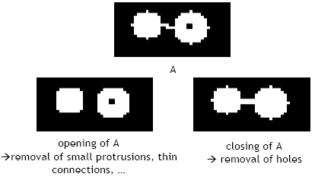
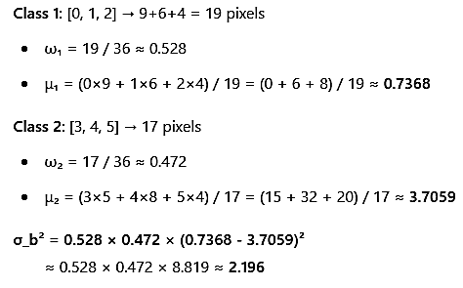

Class thresholding
• K-means Clustering (Otsu Method) K-me Means Clustered (K-Means Method) Threshold t = 2 • ω₂(t) = probability of class 2
• Erosion Erosions (Erosion)

Slide 2
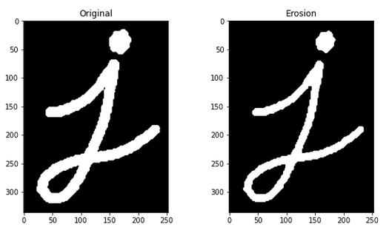
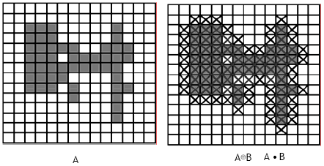
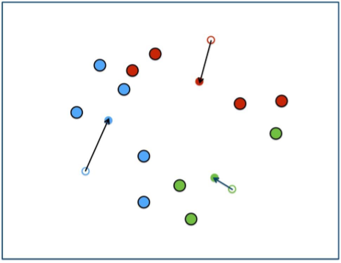
Object class thresholding
• Thresholding (Otsu Method) Morphological operationsmorphological operations Closing
• Closing
• Clustering
• K-means Clustered K-Means ClUSTering
• Threshold t = 2

Slide 3

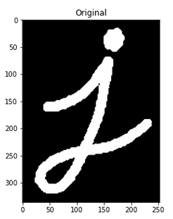
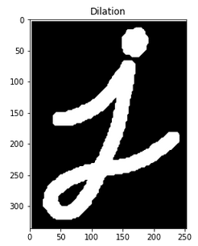
Foreground thresholding otsu method
• Thresholding (Otsu Method) Th threshold t = 2 K-means Clustering K- means ClUSTering K,means K-Means Clusterering K - Clustered K, Clusters K, K- Clusters K-Clustering
• Threshold t = t
• K-clustering k = 2
• Clusterers K = 2
• Clusters T = 1

