Slide 1
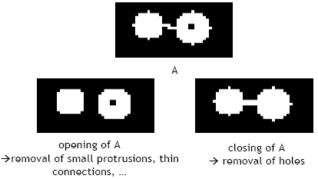
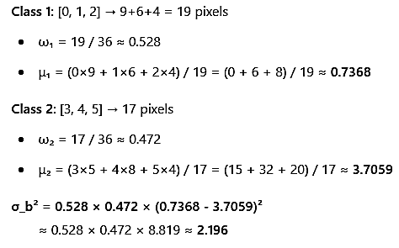

Object class thresholding
• K-means Clustering
• Morphological operations
• Thresholding (Otsu Method) K-mean Clustered
• Morphology operations Morphological
• operations Morphology

Slide 2
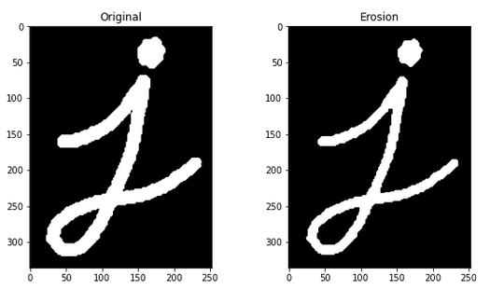
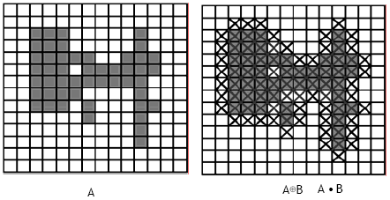
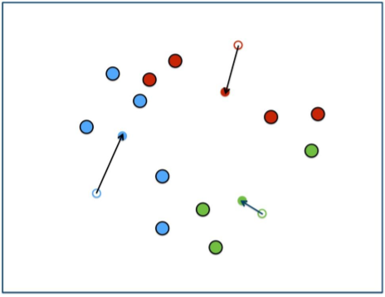
Mean class threshold thresholding
• Thresholding (Otsu Method) Th thresholding ( Otsu method) Thresholded (OTSU Method) K-means Clustering (K-mean method) Clustered (Clustering method)

Slide 3

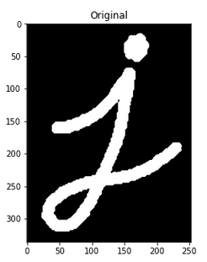
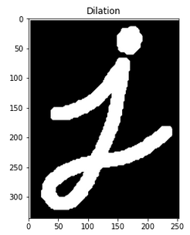
new title
• Thresholding (Otsu Method) Thresholding (Otsi Method) Thresholds (O tsu method) Th thresholding ( Otsi method) “We try every threshold t and compute: ₁(t) = probability of class 1 (≤ t)”
• ““”” ‘ ’”: ‘‘
• ‘
• ’: “
• ” : ”

Slide 4
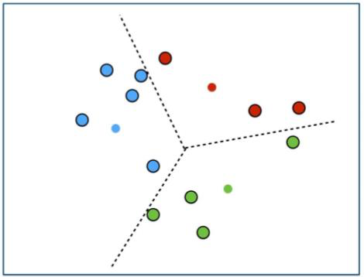
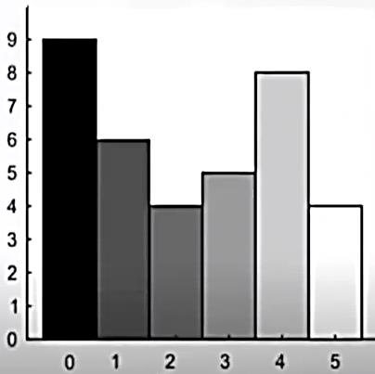
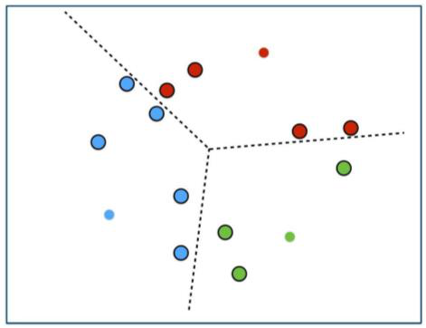
Class threshold thresholding otsu
• Threshold t = 2 • ω₂(t) = probability of class 2 (> t) μ₁( t) = mean of class 1
• ω (t), ω (t) = probability of class 2
• μ ( t), (t, t) is the number of classes in a class
• Thresholding (Otsu Method) K-means Clustering K-Means Cluster K- Means K- Means Clustered K- means Clusters K- Measures Clusters K-measures Clusterers K-miles Clusterer K-mean Cluster

Slide 5
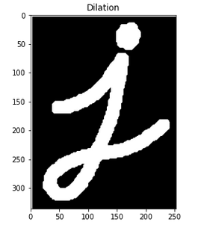
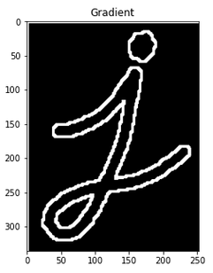
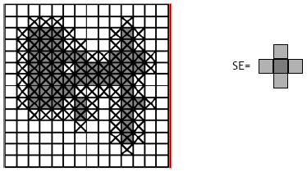
Foreground thresholding otsu
• Thresholding (Otsu Method) Thresholding is a form of thresholding
• Thresholds are used to determine whether a threshold has been achieved by a threshold test
• The threshold test is similar to the one used in the Otsu threshold test for blood tests

Slide 6
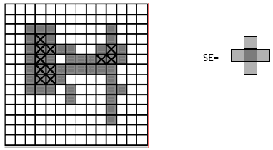
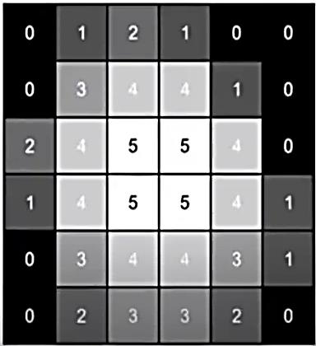
Object class thresholding otsu
• Morphological operations Morphological operationsmorphological operations Thanks Thanks Thanks Opening and Closing opening and closing
• Closing and closing closing
• Morphological operations morphological operation morphological operations

Slide 7
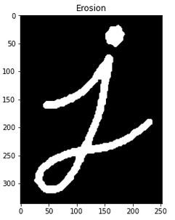
Foreground thresholding otsu method
• Thresholding (Otsu Method) Th threshold t = 2 • ω₂(t) = probability of class 2 (> t) Morphological operations Morphological Operations Morphological operations = molecular probability

