Slide 1
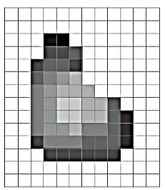
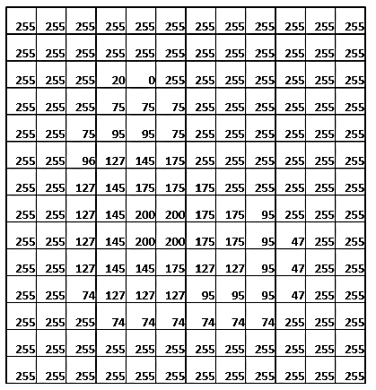
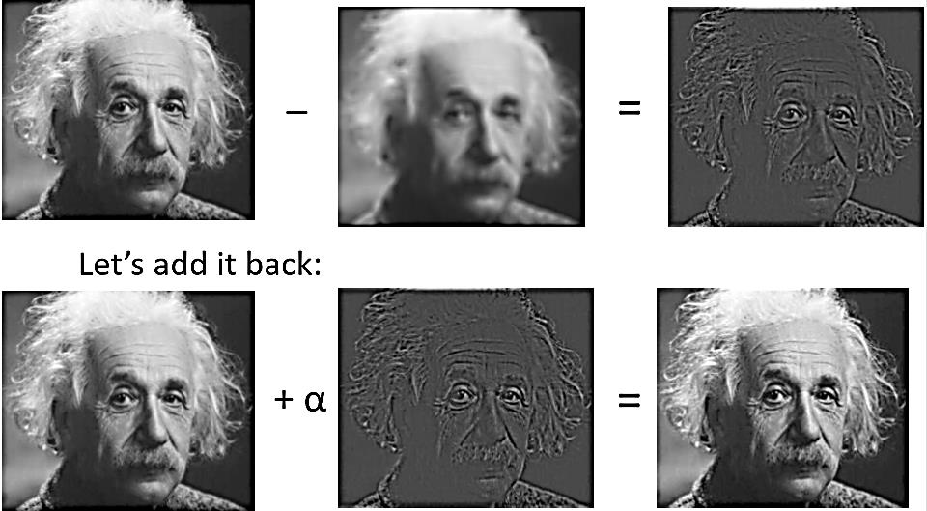
Images image grid
• Image is a grid (matrix) of intensity values: 1 color or 3 colors
• Black and white (0 or 1 for 1-bit images) Grayscale (0–255 for 8- bit images)

Slide 2
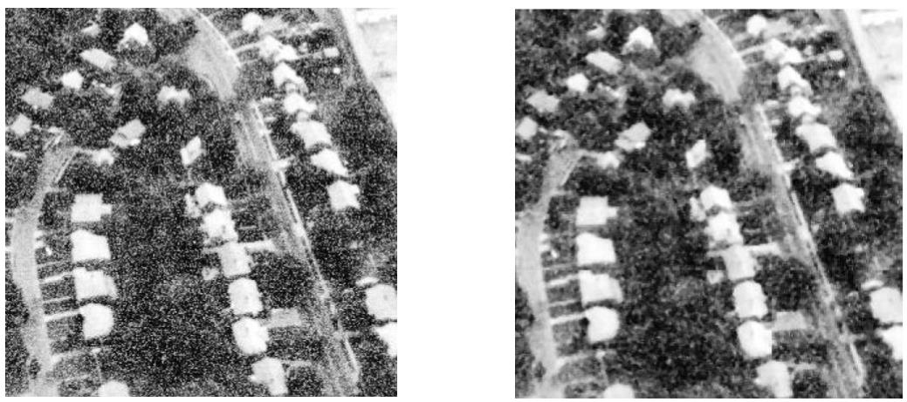
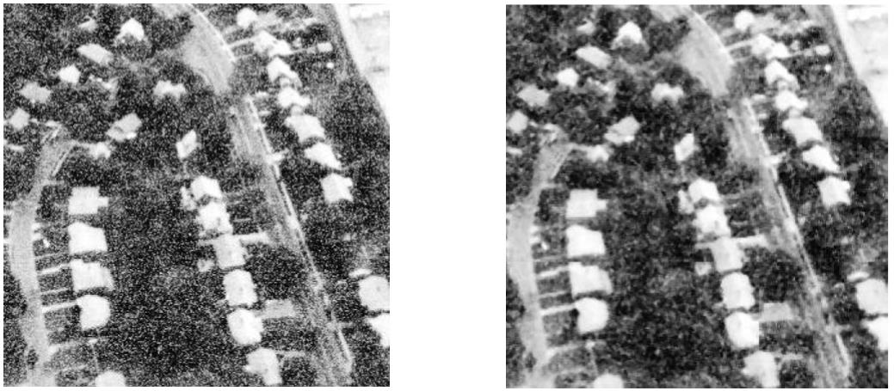
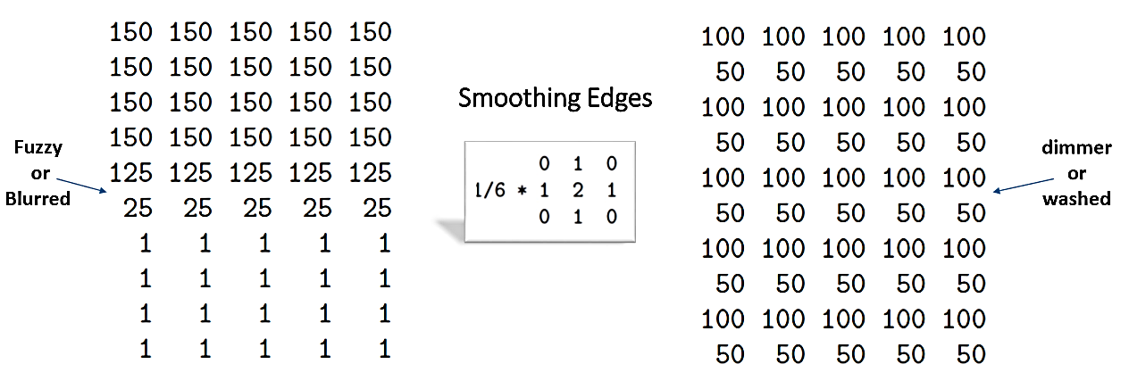
Operation image processing
• Convolution is a fundamental mathematical operation in image processing used for filtering
• operations
• In spatial filtering, operations are performed directly on the pixel values of the image
• In non-Linear Filtering, filters do not use convolution but apply other mathematical operations

Slide 3
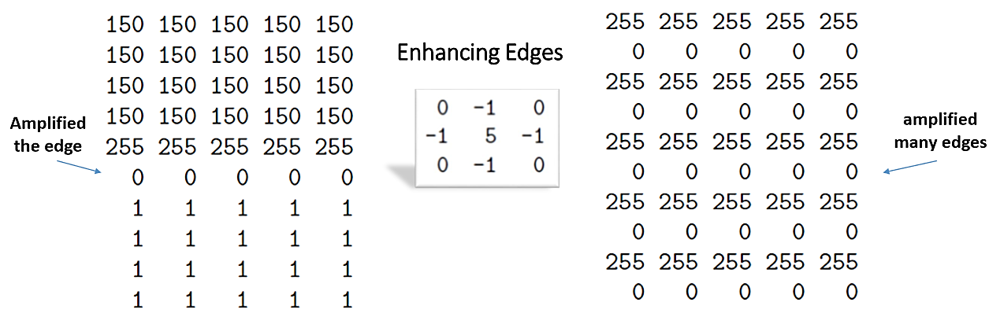
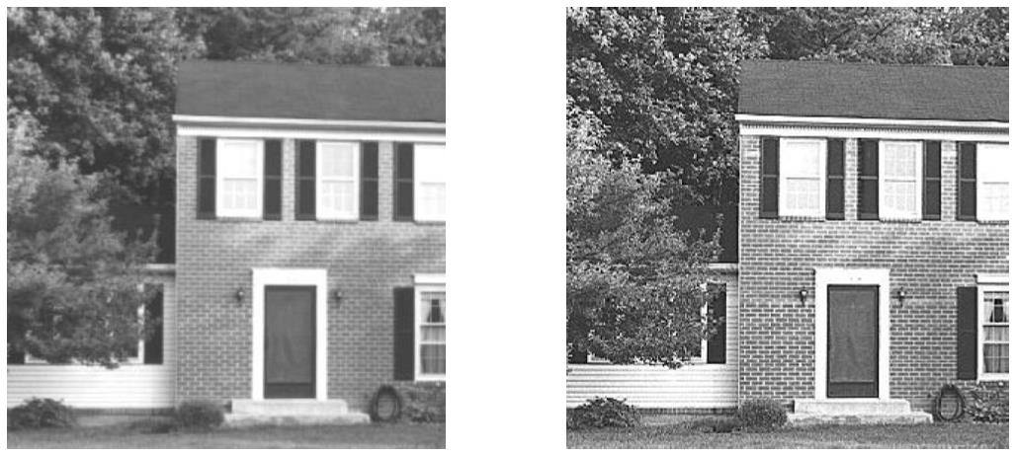
Image applying mathematical operations
• Cross-correlation is a mathematical operation used to measure the similarity between two signals or images
• Sharpening Filters (High-pass filters) – Used to enhance edges and details
• Non-Linear Filtering – These filters do not use convolution but apply other mathematical operations

Slide 4
Mathematical operations pixel values
• The center pixel is typically replaced by the average value of its neighboring pixels, resulting in a smoother image
• Cross-correlation is a mathematical operation used to measure the similarity between two signals or images

Slide 5
Grayscale cross correlation
• Filtering is a technique used to modify or enhance an image by applying mathematical operations to pixel values
• Filtering is widely used for: Noise reduction, Edge detection and feature extraction
• In spatial filtering, operations are performed directly on the pixel values of the image

