Slide 1
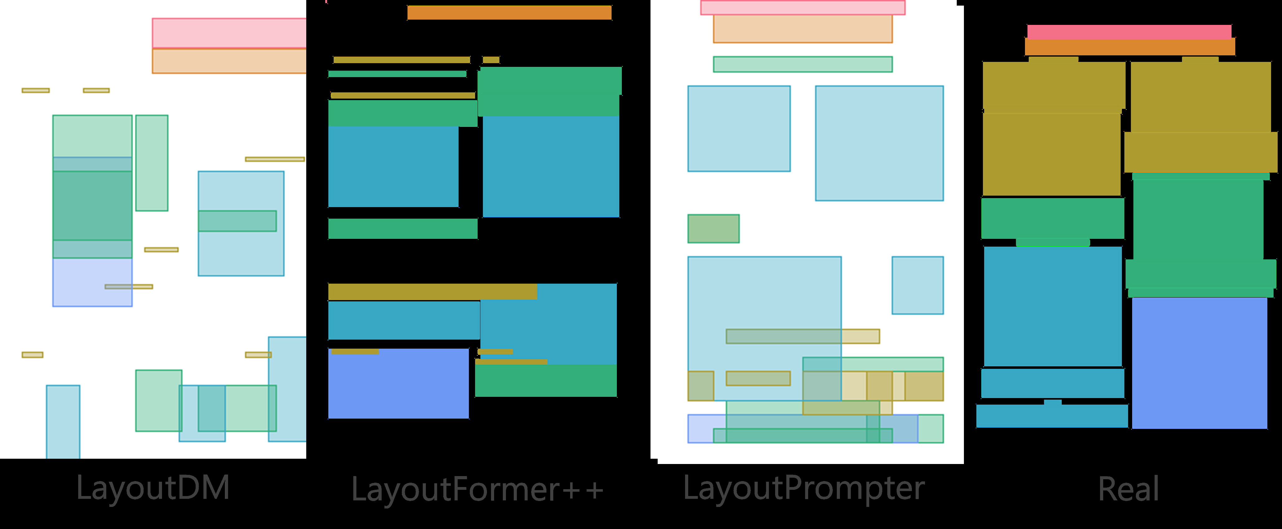
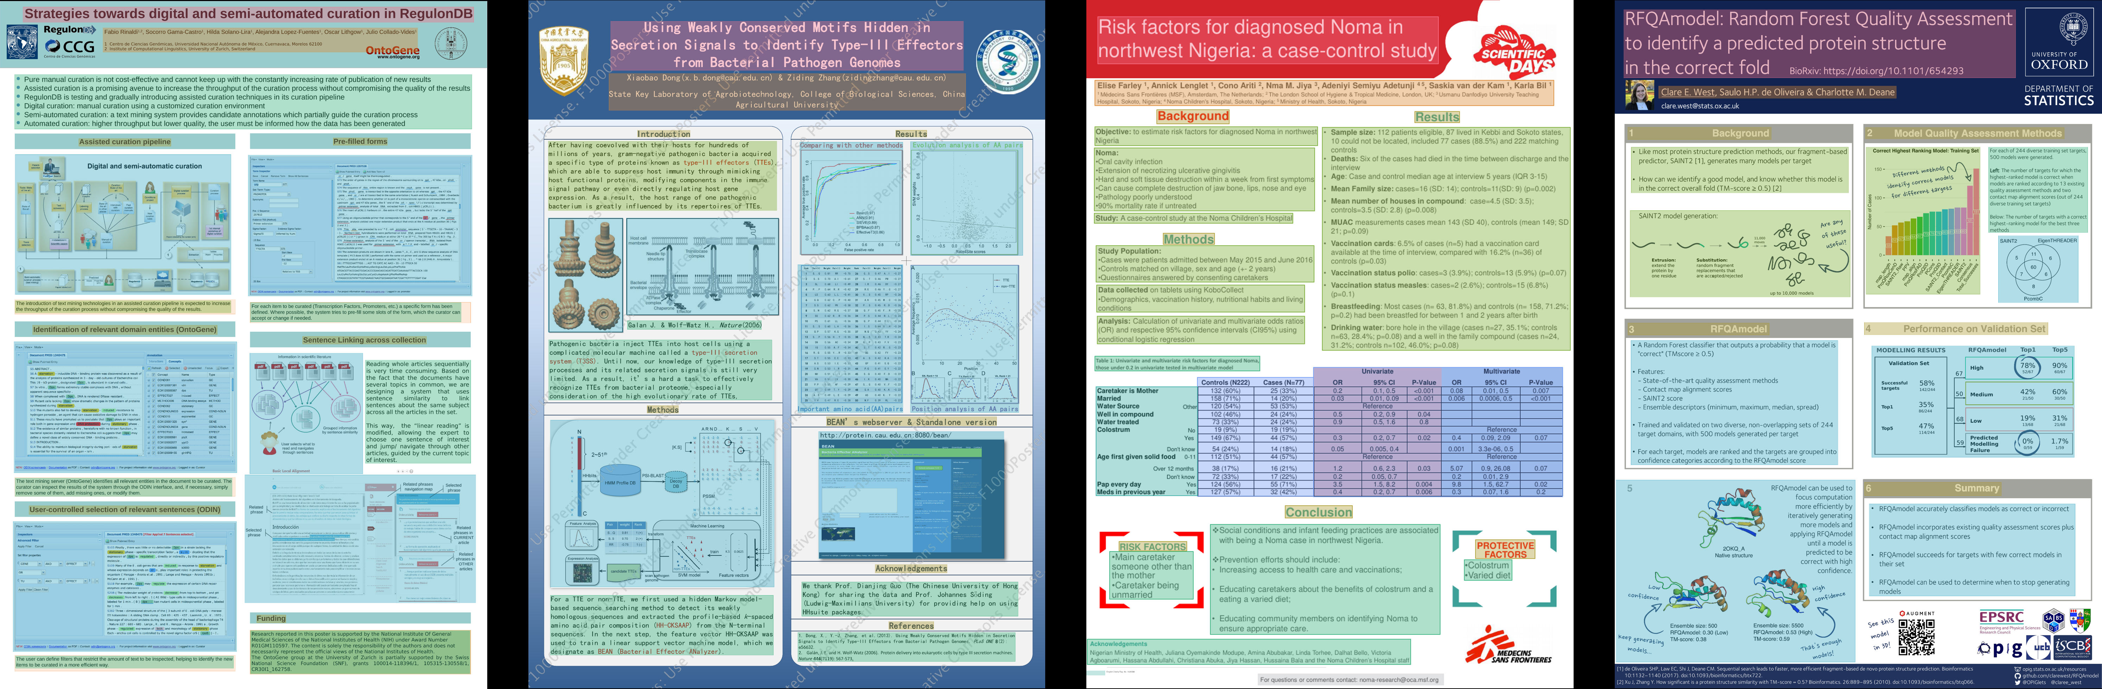
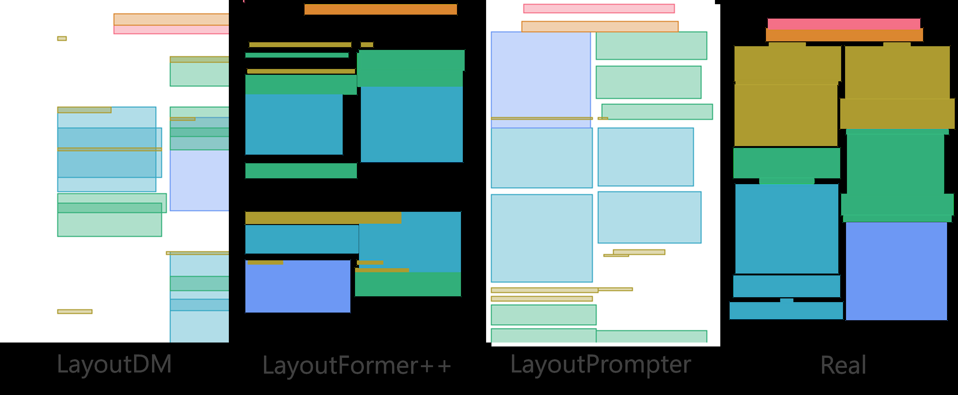
Scientific posters used efficiently
• A well-designed scientific poster conveys the essential elements of the research and requires less time to read than a paper
• Unfortunately, creating a scientific poster a graphical format
• posters that can be utilized for these tasks would contribute significantly to the research on scientific poster generation

Slide 2
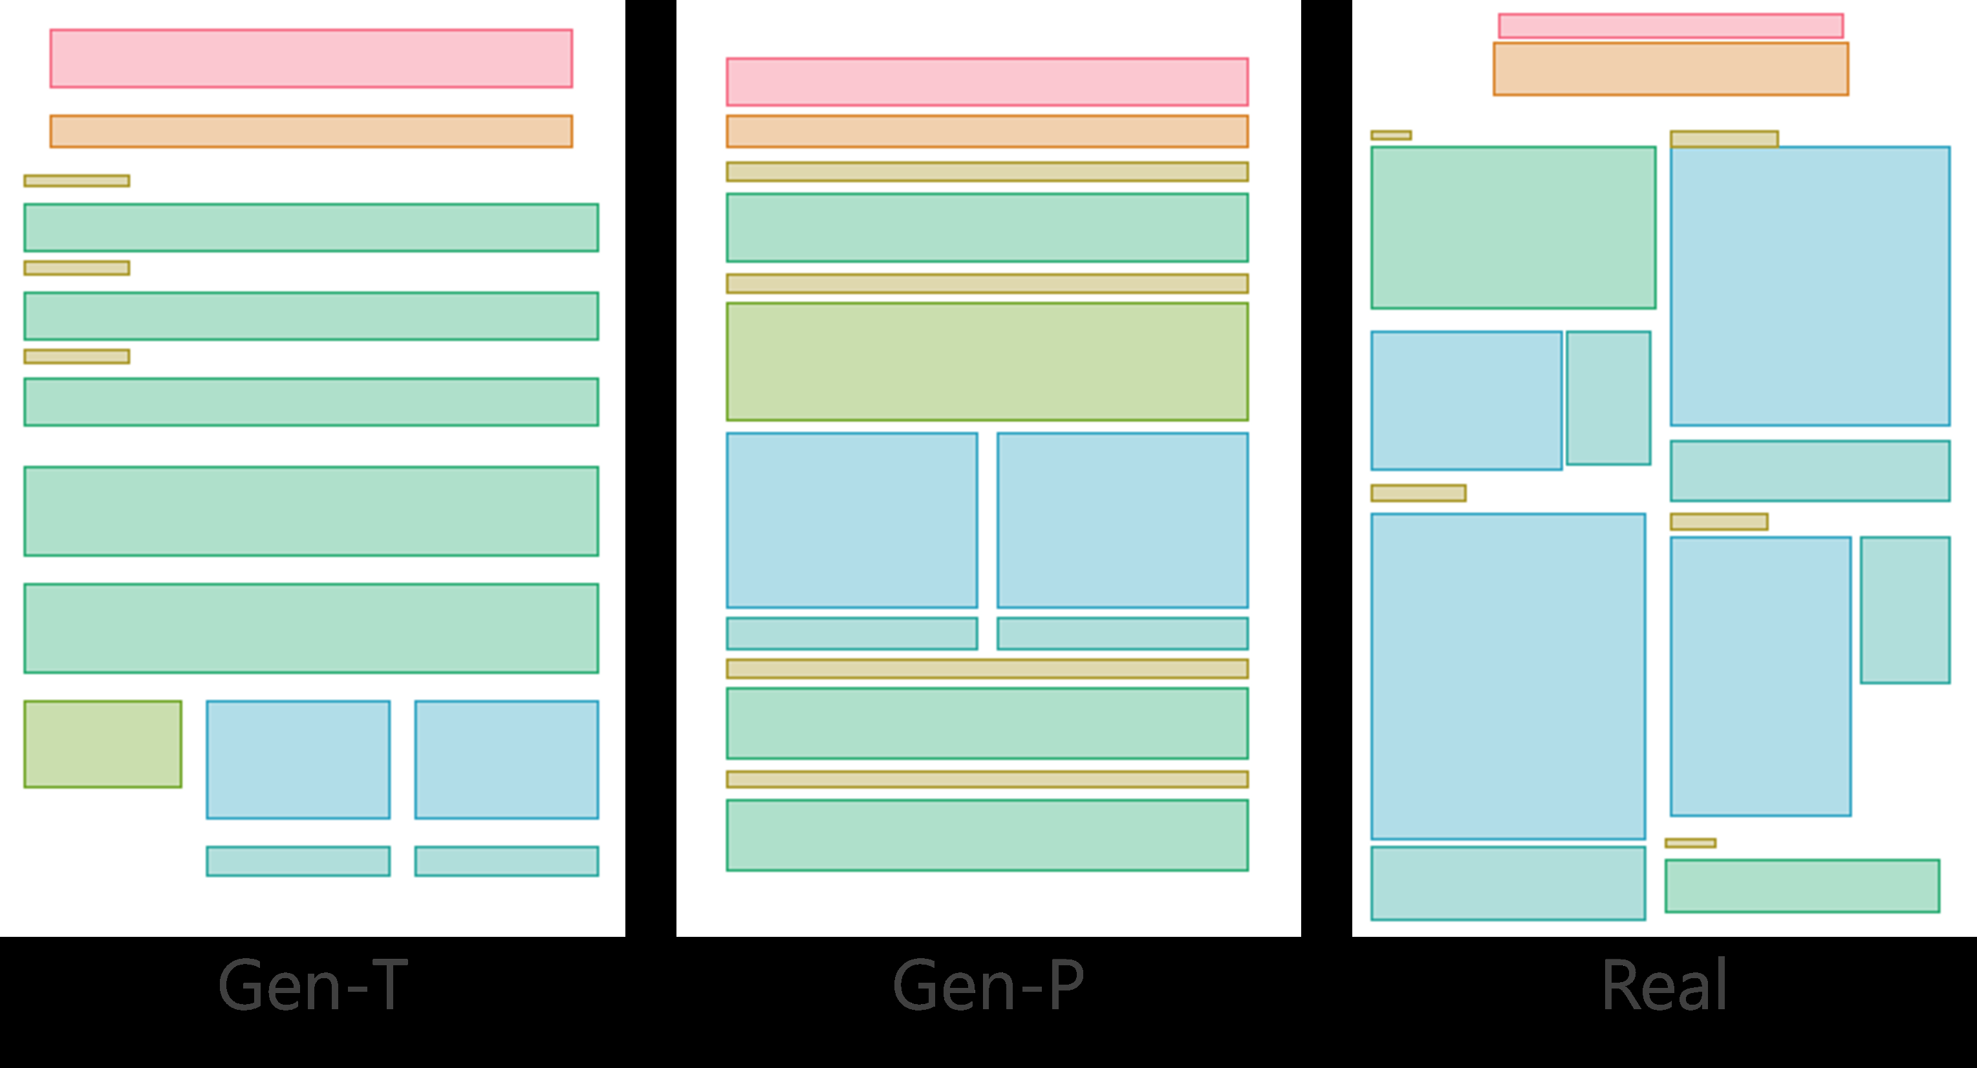
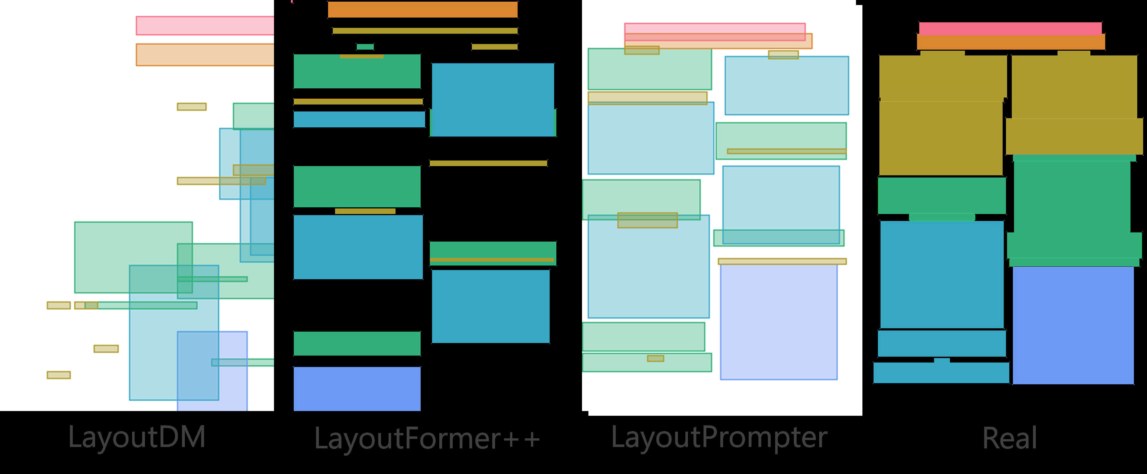
Scipostlayout scientific poster generation
• In this paper, we introduce SciPost layout, the first scientific poster layout dataset for scientific poster generation
• A well-designed scientific poster conveys the essential elements of theresearch and requires less time to read than a paper
• Unfortunately, creating a scientific poster a graphical format

Slide 3
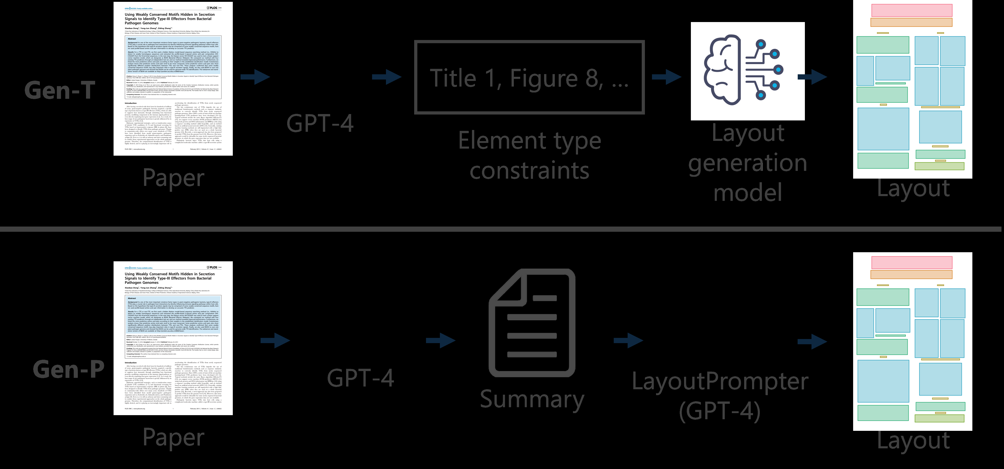
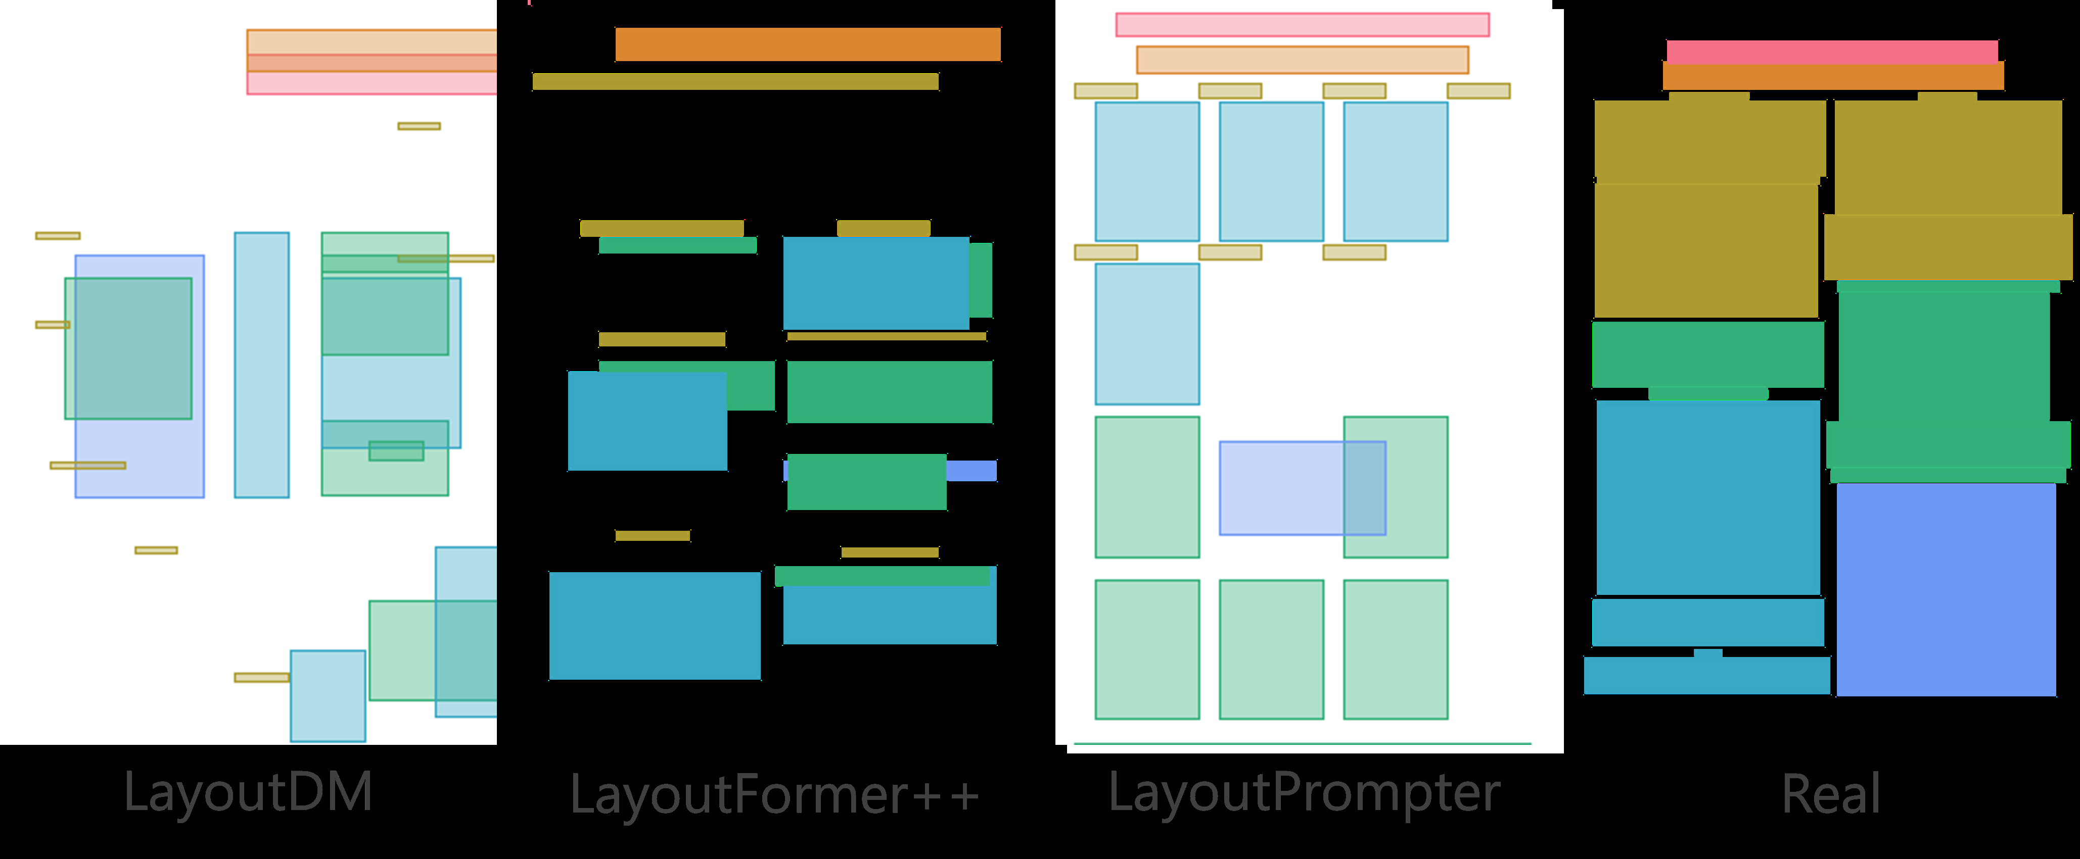
Generates poster scientific paper
• scientific paper in PDF format
• Your goal is to analyze the content and determine the layout generation constraints for a scientific poster
• The poster should be summarizing the important information in a scientific paper
• Research on scientific poster generation remains scarce due to its high summarizing

Slide 4
Scientific poster generation layout
• In this paper, we introduce SciPost layout, the first scientific poster layout dataset for scientific poster generation
• A well-designed scientific poster conveys the essential elements of the research and requires less time to read than a paper
• Unfortunately, creating a scientific poster a graphical format is more challenging than that of scientific papers

Slide 5
Layout generation scientific poster
• SciPost layout is the first scientific poster layout dataset for scientific poster generation
• Analysis of scientific posters is more challenging than that of scientific papers because of the variety of fonts and positions of figures and tables

Slide 6
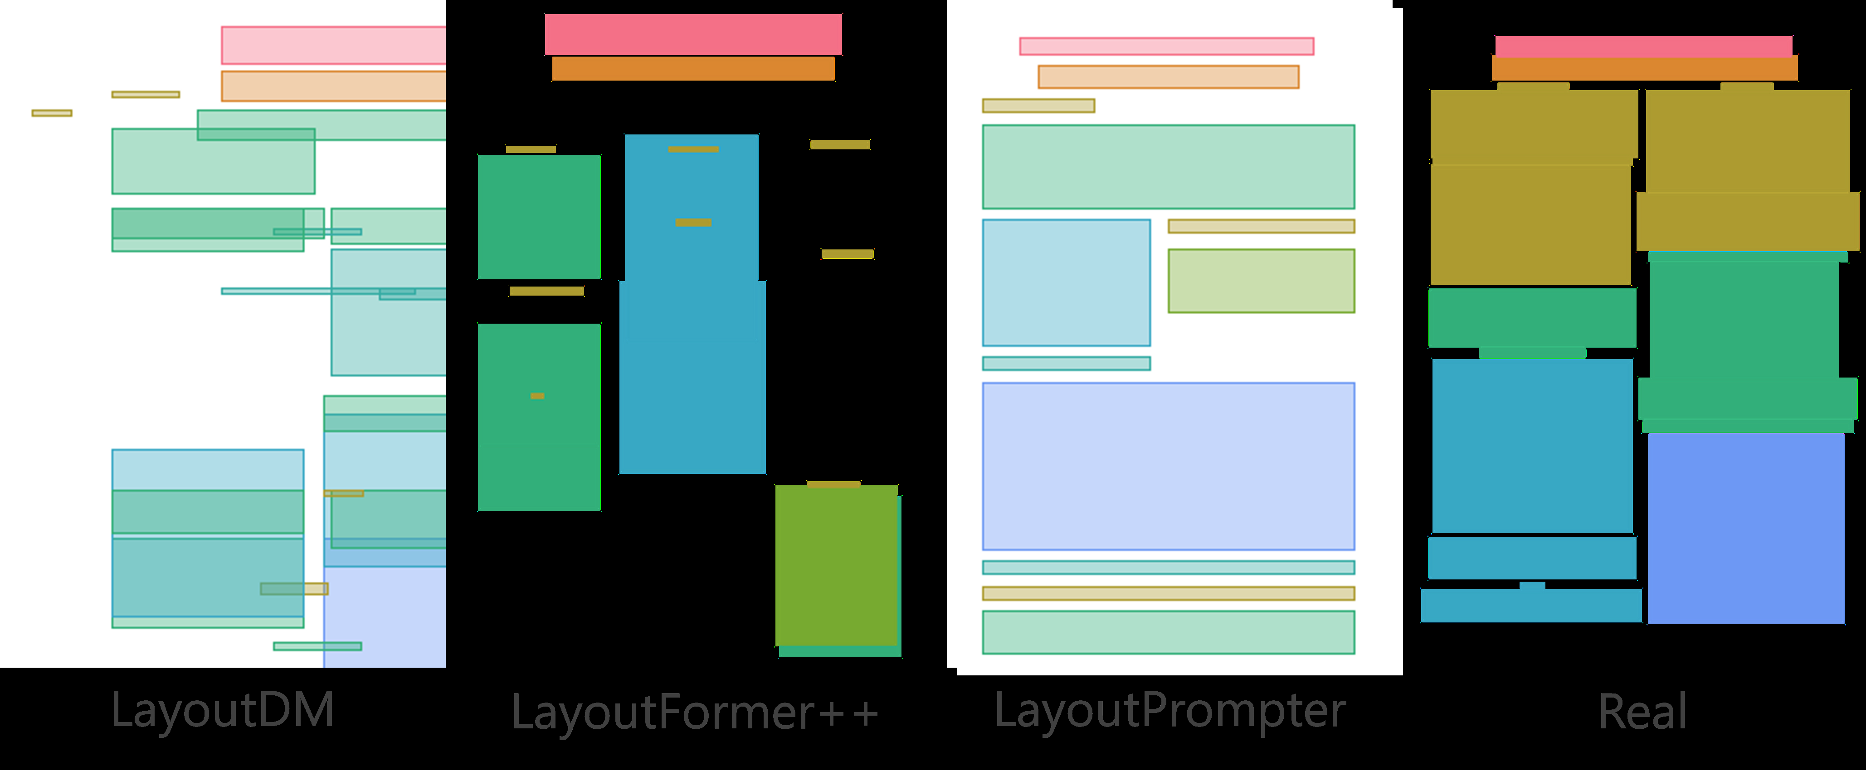
Layout analysis scientific posters
• layout analysis of scientific posters is more challenging than that of scientific papers because of the variety of fonts and positions of figures and tables
• Developing layout analysis models would be helpful in identifying layout patterns common to well-designed posters

Slide 7
Scientific posters layout analysis
• 2
• 2
• layout analysis of scientific posters is more challenging than that of scientific papers because of the variety of fonts and positions of figures and tables
• erating layouts forscientific posters is challenging, as are other layout generation tasks that require the positioning of figures

Slide 8
Poster generation systems scientific
• In this paper, we introduce SciPost layout, the first scientific poster layout dataset for scientific poster generation
• posters that can be utilized for these tasks would contribute significantly to the research on scientifically-based posters

Slide 9
Poster generation systems scien
• In this paper, we introduce SciPost layout, the first scientific poster layout dataset for scientific poster generation
• posters that can be utilized for these tasks would contribute significantly to the research on scientific postergeneration

Slide 10
Creating scientific poster efficiently
• Research on scientific poster generation remains scarce due to its high summarizing the important information in a scientific paper
• posters that can be utilized for these tasks would contribute significantly to the research on scientific poster generation
• Your goal is to analyzethe content and determine the layout g

Slide 11
Generate designed posters scientific
• The generated posters are composed lem
• lem and developed a model to extract essential sentences from papers by classification and
• fill them into templates to generate posters
• posters that can be utilized for these tasks would contribute significantly to the research on
• scientific poster generation

Slide 12
Poster layout generation scientific
• In this paper, we introduce SciPost layout, the first scientific poster layout dataset for scientific poster generation
• By developing layout generation models, we can generate layouts that follow the patterns of attractive posters
• In other words, building a layout dataset of scientific

Slide 13
Poster generation scientific papers
• Research on scientific poster generation remains scarce due to its high summarizing the important information in a scientific paper
• posters that can be utilized for these tasks would contribute significantly to the research onscientific poster generation

Slide 14
Scientific poster generation dataset
• In this paper, we introduce SciPost layout, the first scientific poster layout dataset for scientific poster generation
• The first dataset that contains scientific paper-poster pairs with the CC-BY license, which can be utilized for evaluating scientific poster generations

Slide 15
Layout generation scientific posters
• In this paper, we introduce SciPost layout, the first scientific poster layout dataset for scientific poster generation
• The layouts of scientific posters are more diverse than the layouts of the papers in PubLayNet [38]

Slide 16
Scientific poster layout dataset
• In this paper, we introduce SciPostLayout, the first scientific poster layout dataset for scientific poster generation
• We ing existing computer vision models and found that both layout analysis and generationof posters using SciPost layout are more challenging than with scientific papers
• We proposed a three-step framework to generate posters: section filter, content extraction, andipient composition

Slide 17
Scientific poster generation systems
• In this paper, we introduce SciPost layout, the first scientific poster layout dataset for scientific poster generation
• posters that can be utilized for these tasks would contribute significantly to the research on scientifically-based posters

Slide 18
Generate poster layouts scientific
• By developing layout generation models, we can generate layouts that follow the patterns of attractive posters
• In other words, building a layout dataset of scientific
• However, the generated posters are composed lem and developed a model to extract essential sentences from papers

Slide 19
Generate posters scientific papers
• scientific paper in PDF format
• Your goal is to analyze the content and determine the layout generation constraints for a scientific poster
• The poster should be summarizing the important information in a scientific paper
• Research on scientific poster generation remains scarce due to its high summarizing

Slide 20
Layout dataset scientific posters
• In this paper, we introduce SciPost layout, the first scientific poster layout dataset for scientific poster generation
• This dataset includes 7,855 scientific posters with manuallayout annotations
• All posters included in the dataset are under the CC-BY license 1

