Slide 1

Foodie
Ahmed Mohamed Khedr

Slide 2

What is the problem ?
Some people can not afford to own a restaurant or work at a restaurant as a cook.
Some new immigrants have a language barrier and can not open a restaurant
Some older people are not able to work in a restaurant
Some people are good at cooking and have secret recipes and can not share it with other people.

Slide 3
The Solution
Foodie is an application that lets home cook sign up with their health certificates to cook at home and deliver the food to the users who request the food.
Easy to use and allows users to try different good food from all over the world
Home cooks can make money and share their skills with others.

Slide 4
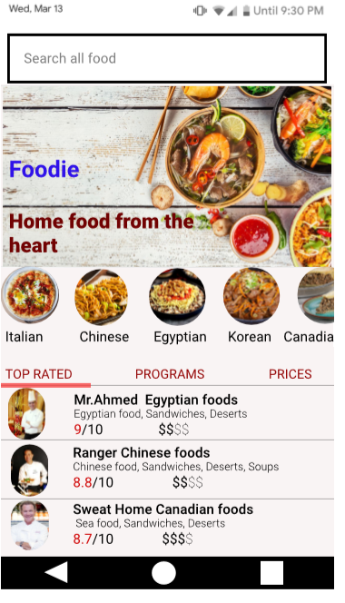
Foodie

Slide 5
Foodie
The users can choose the food they want and request it.
They can contact the cook
They can try out different food and they the food will be delivered at their homes

Slide 6
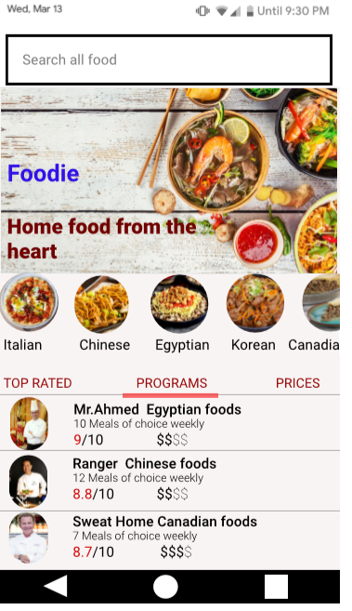
Foodie

Slide 7
Foodie
The users can sign up for a program and receive meals weekly for cheap.

Slide 8
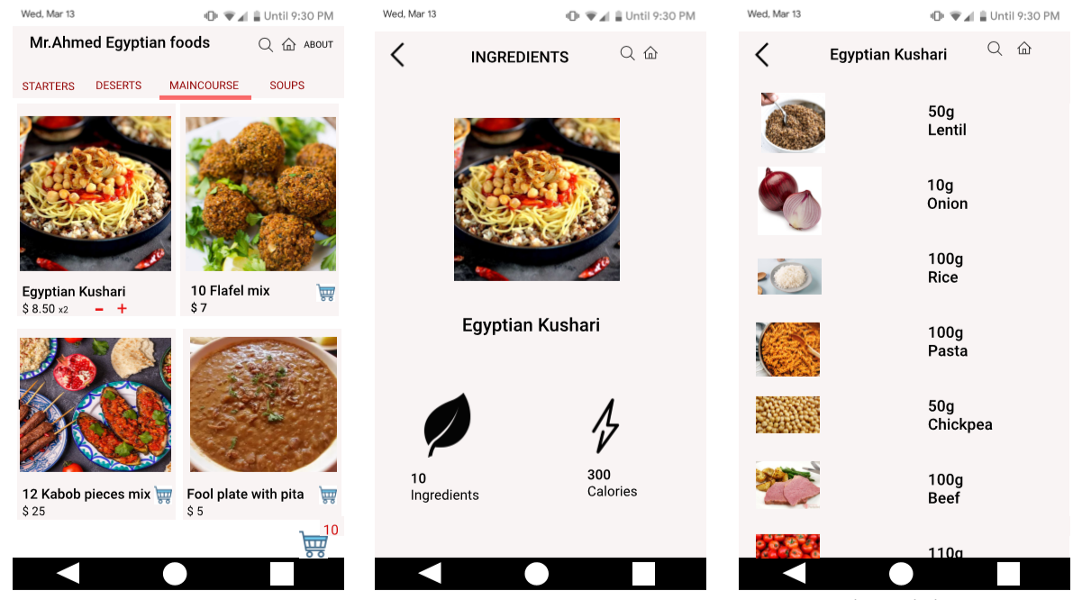
Foodie

Slide 9
Foodie
The users can check their ingredients and tell the cook about any diet restriction or any problem they face.

Slide 10
Foodie
The users will be able to check the cook’s information, check the prices, the reviews and finally sign up for programs using different pay methods.

