Slide 1
Algonauts 2021
Simple pooling and encoding of multi-layer CNN features for predicting brain response to videos
Michal Nahlik
(nahlik.michal@seznam.cz)

Slide 2
Solution overview – team michaln
Results:
  Full Track: score 0.3117 (5th place)
  Mini Track: score 0.5710 (9th place)
Source code: https://github.com/michal-nahlik/algonauts-vid2fmri-2021
Ensemble of 2 models
  Pool features from pretrained frozen CNN model ^{[1]}
  Encode features using linear layer into smaller space
  Calculate features over sequence of frames
  Linear layer to predict voxel activity
Secret sauce
  Weight normalization of linear layers ^{[2]}
  Use all combinations of repetitions for training
  FPS of video as feature
  Weighted mean square error

Slide 3
Data preprocessing
Resize to 224 x 224 pixels
Skip random number of frames
Resample videos to 5 FPS
Augmentations:
  Shift Scale Rotate, Random Perspective change,
  Coarse Dropout, Random Brightness

Slide 4
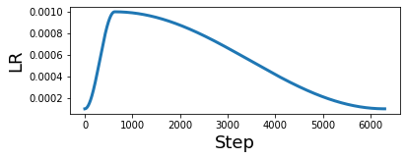
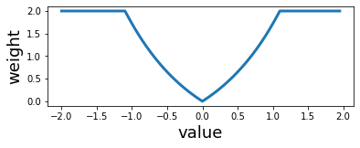
Training
Split data: First 900 videos for training, Last 100 for validation
3 repetitions -> 7 combinations
4 epochs
Optimizers: Adam, AdamW
OneCycleLR scheduler
Loss function: Weighted mean square error
Weight calculated for each target
based on it’s absolute value

Slide 5
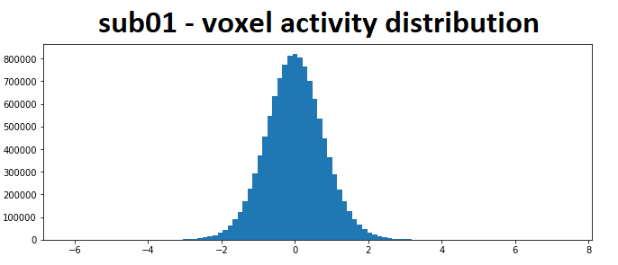
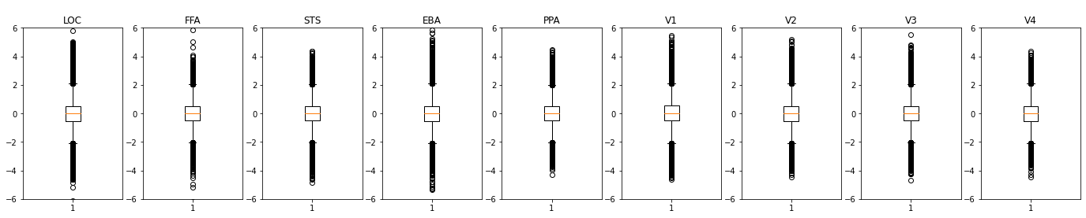
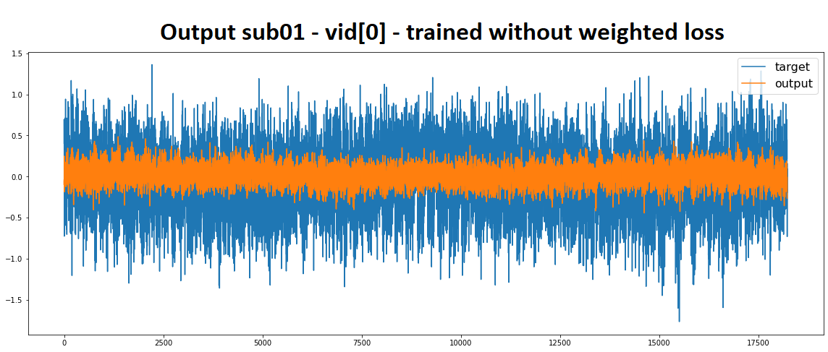
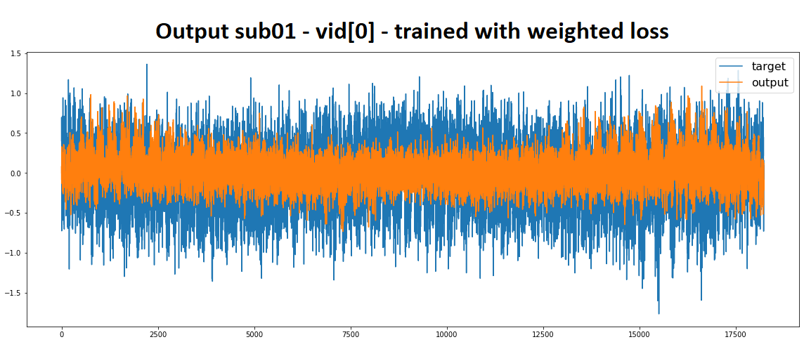
Training

Slide 6
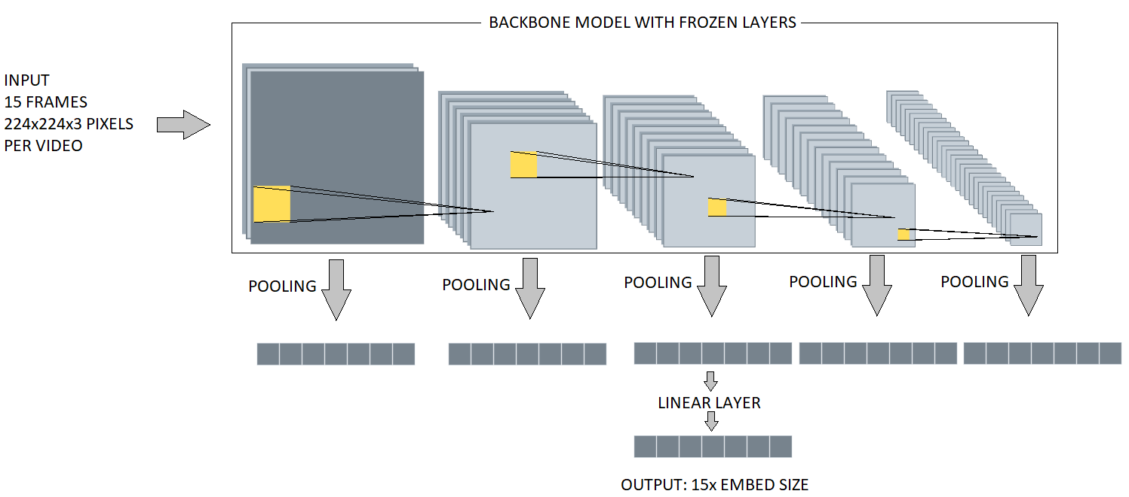
Models (encoder)

Slide 7
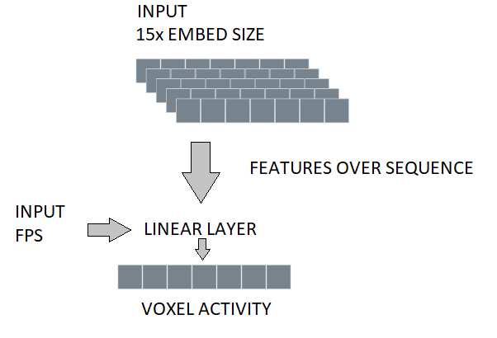
Models (decoder)

Slide 8

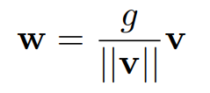
Models (linear layer – weight norm ^{[2]})
m = torch.nn.Linear(5, 10)
[print(p[0], np.shape(p[1])) for p in m.named_parameters()]
bias: torch.Size([10])
weight: torch.Size([10, 5])
m_wnorm = torch.nn.utils.weight_norm(torch.nn.Linear(5, 10))
[print(p[0], np.shape(p[1])) for p in wnorm.named_parameters()]
bias: torch.Size([10])
weight_g: torch.Size([10, 1])
weight_v: torch.Size([10, 5])

Slide 9
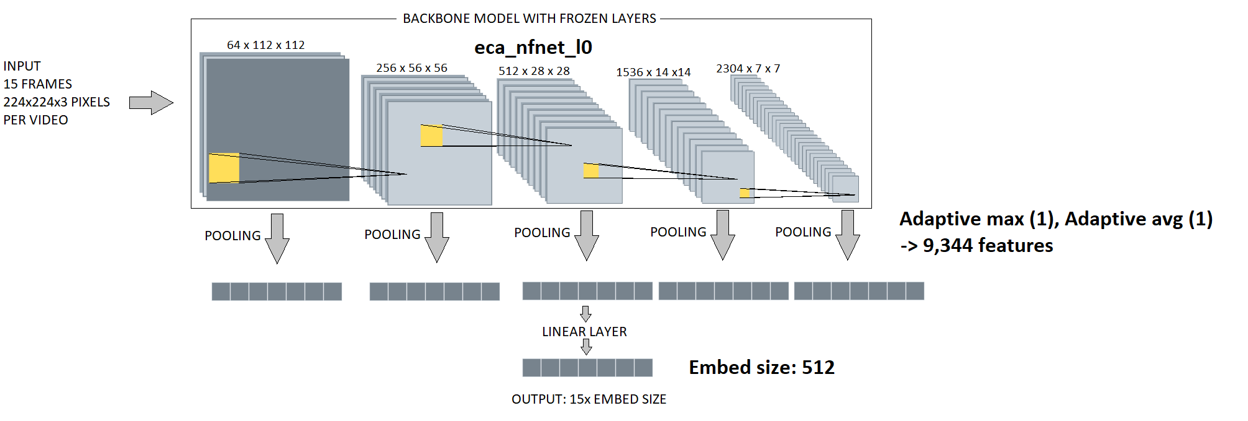
Model A (encoder)

Slide 10
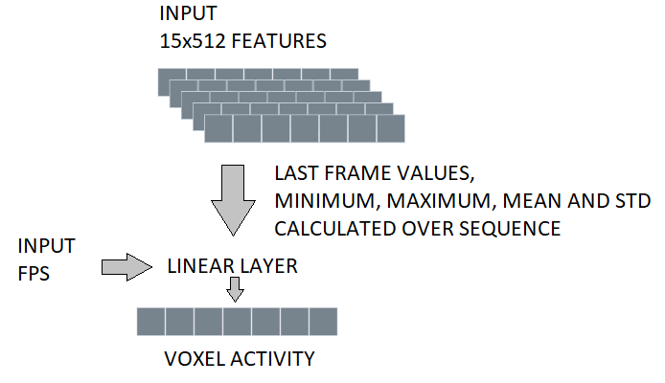
Model A (decoder)

Slide 11
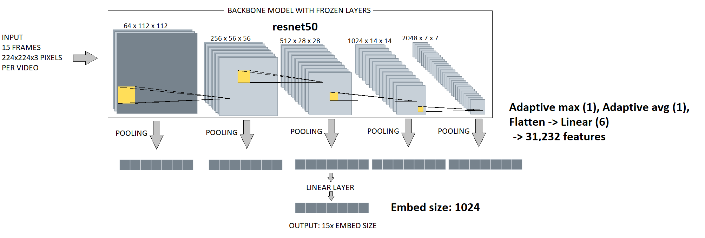
Model B (encoder)

Slide 12
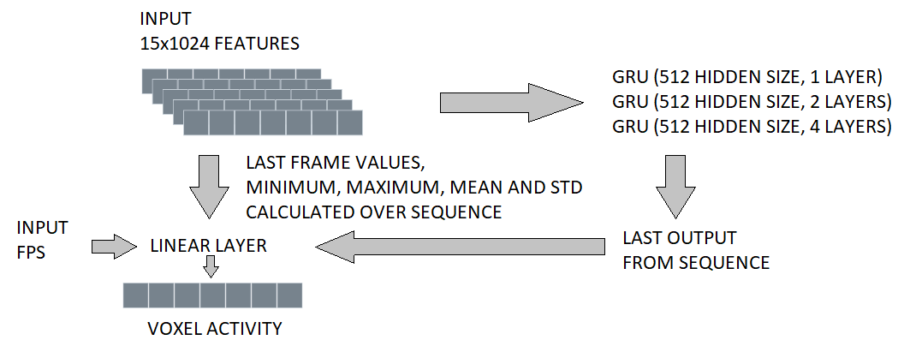
Model B (decoder)

Slide 13
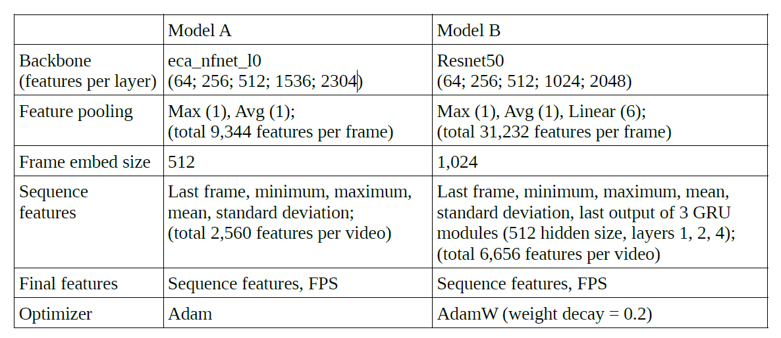
Models

Slide 14
Ensemble
Full Track: mean output of best models
Mini Track: mean output of last models

Slide 15
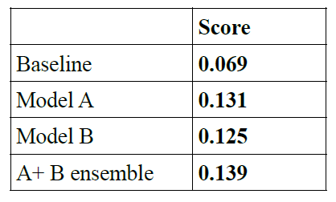
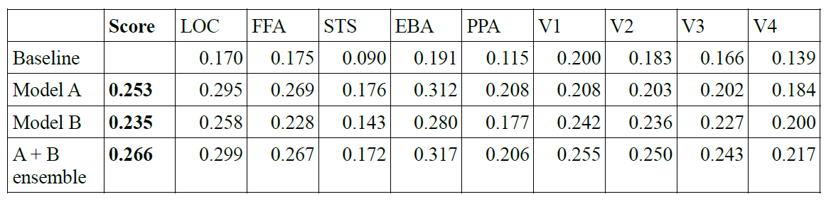
Results - validation

Slide 16
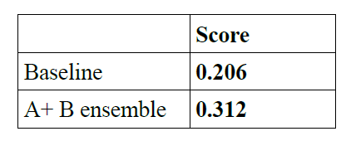
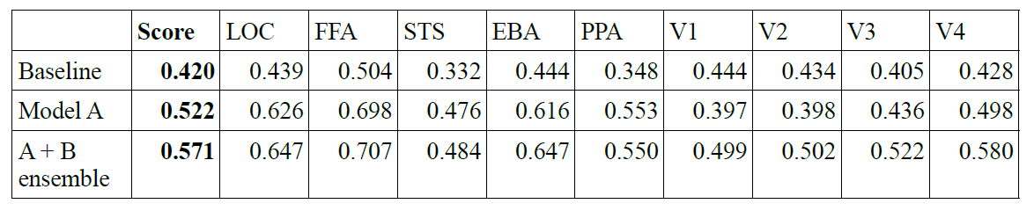
Results - final

Slide 17
Interesting findings
Model A performs well for higher-level regions but bad for V1-V4
  Max(1) and Avg(1) pool are not enough for V1-V4
  Model A learnable parameters are only encoding linear layer and final linear layer
FPS as a feature
Useful to address target values imbalance
Ensembling models works well

Slide 18
Thank you for your attention.

Slide 19
Bibliography
Ross Wightman. (2019). PyTorch Image Models. https://github.com/rwightman/pytorch-image-models
Tim Salimans, & Diederik P. Kingma. (2016). Weight Normalization: A Simple Reparameterization to Accelerate Training of Deep Neural Networks. https://arxiv.org/pdf/1602.07868.pdf
Andrew Brock, Soham De, Samuel L. Smith, & Karen Simonyan. (2021). High-Performance Large-Scale Image Recognition Without Normalization. https://arxiv.org/pdf/2102.06171.pdf

