Slide 1

Vertex degree in Undirected Graph
What is Graph
A graph is a collection of vertices (nodes) and edges (connections) between them.
Graphs can be directed (edges have a direction) or undirected (edges go both ways).
There are other categories like weighted (edges has weights “numbers” representing cost) and unweighted (all edges are treated equally, no weights).
And there are many other types of Graphs….

Slide 2
Vertex degree in Undirected Graph
Undirected Graph
Directed Graph
A
A
B
B
C
D
C
D
Unweighted Graph
Weighted Graph
A
A
5
B
B
6
3
C
2
C
D
D

Slide 3
Vertex degree in Undirected Graph
Undirected Graph
Undirected graph is composed from two components:
A
Vertex
B
Edge
Our goal is to get the number of edges at each vertex.
(vertex degree)
C
D

Slide 4
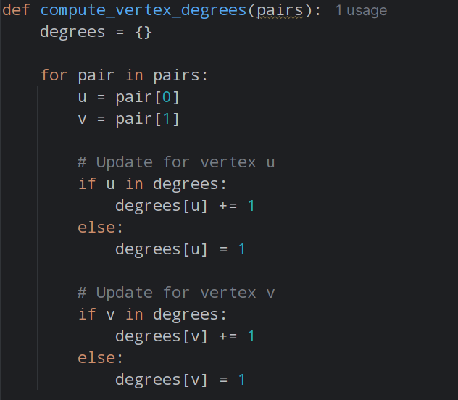
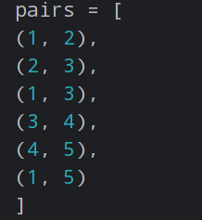
Vertex degree in Undirected Graph
How to get the vertex degree in python

Slide 5
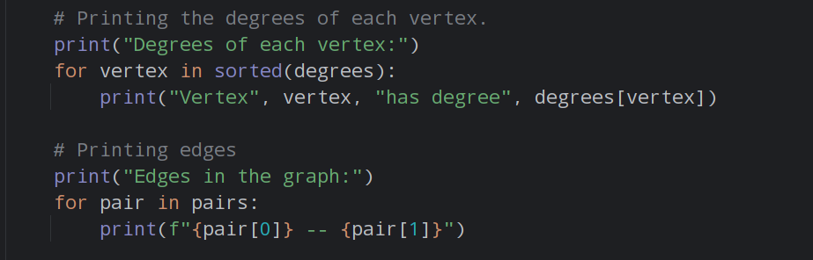
Vertex degree in Undirected Graph
How to get the vertex degree in python

Slide 6
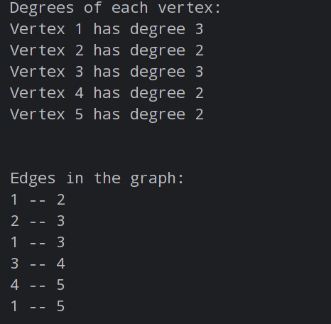
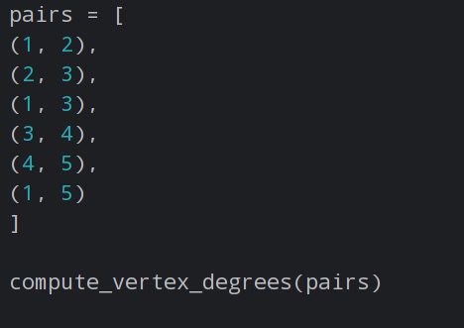
Vertex degree in Undirected Graph
How to get the vertex degree in python
1
2
5
3
4

Slide 7
Thank you

