Slide 1


DEFECT
DETECTION
MODEL
AI
SUPERVISED BY
DR. AHMED SHAWKY MOUSSA
TA. ANDREW MAHER
IMPLEMENTED BY
AHMED GAMAL 20190021
AHMED ADEL 20190042
HASNAA MOUNIR 20190180
ZEYAD MAHER 20190224
MENNATULLAH RASHED 20190554

Slide 2
Table of contents
01
Introduction
03
Implementation stages - Optimization
02
Implementation stages - Initial stage
04
Mobile Application
01
03
04
02
04
Conclusion
04

Slide 3
01
Introduction
A Brief Introduction to the Project Concept

Slide 4
Introduction
As the American Society of Quality reports [1], many organizations have quality-related costs of up to 40% of their total production revenue.
40%
[1]
https://asq.org/quality-resources/cost-of-quality#:~:text=Many%20organizations%20will%20have%20true,10%2D15%25%20of%20operations.

Slide 5

The previous solutions to the problem
Manual quality inspection is a step in ensuring the success and sustainability of a business.
Decreased efficiency
Wasted resources
Lost
profits

Slide 6

Project Idea
IDEA
SCOPE
developing a more efficient and accurate way of defect detection model.
Focusing on the
manufacturing industry.
By detecting defective products.
Using
AI, deep learning, and computer vision

Slide 7
Expected Benefits
One application with a big potential to benefit from AI – Computer vision is Automated quality control.
Performance
Quality
Cost
Localization
9

Slide 8








SOFTWARE
Python
tensorflow
Flask
Flutter
Google Colab
Android studio

Slide 9
02
Implementation stages
Clarifying the various stages, we have passed

Slide 10

Objective
Develop a model capable of detecting
the state of a product and determining
whether it is good or defective.
Create a mobile application with
scanning capabilities.

Slide 11
AI System Components - Hierarchical Structure
AI Defect Detection System
Object Detection
Object Calsification
Mobile Application
Model Maker
MobileNet SSD
TFlite
Flask
Random CNN Architecture
VGG-16

Slide 12
2.1
Initial Stage
Model Exploration and Observations

Slide 13
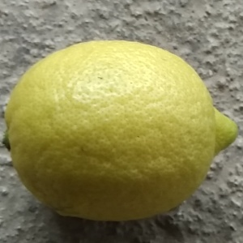
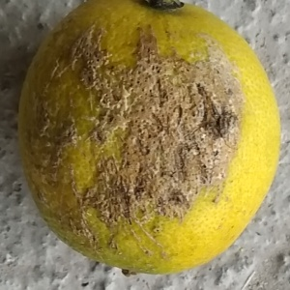
Initial Stage Dataset
A dataset of 1,600 images for lemons was acquired, containing both good and rotten samples.
Non-defect
Defect

Slide 14
Initial Stage Object Detection - Model Maker
A library provided by TensorFlow that simplifies the process of building machine learning models.
It offers pre-trained models and tools for training and deploying custom models.

Slide 15
Initial Stage Object Classification
A simple CNN architecture consisting of 4 layers is used in the model.
Input
Conv2D
Max
Pooling
Dense
Dense
Output

Slide 16
Initial Stage Observations
Dataset’s size affected the accuracy of the model
Shallow network limits feature learning
Observation
Inadequate for large datasets and multiple classes
Low accuracy

Slide 17
2.2
Final Stage
Model Enhancement and Optimization

Slide 18
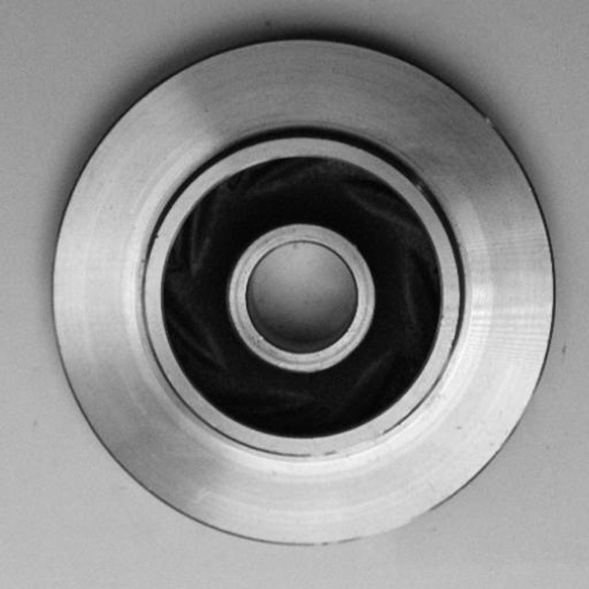
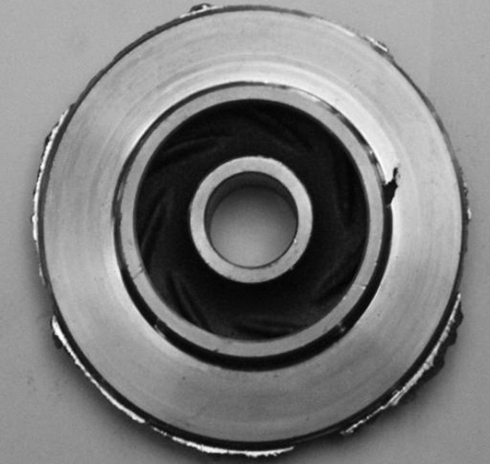
Final Stage Dataset
A dataset of 15,000 images for Casting products was acquired, containing both good and defected samples.
Characteristic : microproducts
Non-defect
Defect

Slide 19
Final Stage Object Detection - MobileNet SSD
MobileNet is A CNN architecture used in TensorFlow for building object detection models.
MobileNet
SSD is a Single Shot Detector, uses MobileNet as a
backbone for object detection
SSD

Slide 20


Advantages of MobileNet SSD
Balance between speed and accuracy
2.0
Optimized for resource-constrained environments, offering a balance between
speed and accuracy.
Lightweight model
1.0
Lightweight model for embedded devices or mobile platforms.

Slide 21
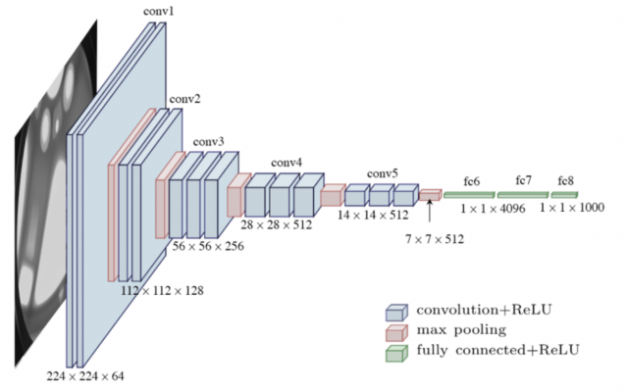
Final Stage Object Classification - VGG16
Visual Geometry Group (VGG-16)
Successful CNN Architecture, Well Understand, acceptable to implement. using 13 Convolution + 3 fully connected + 5 max-pooling layers

Slide 22
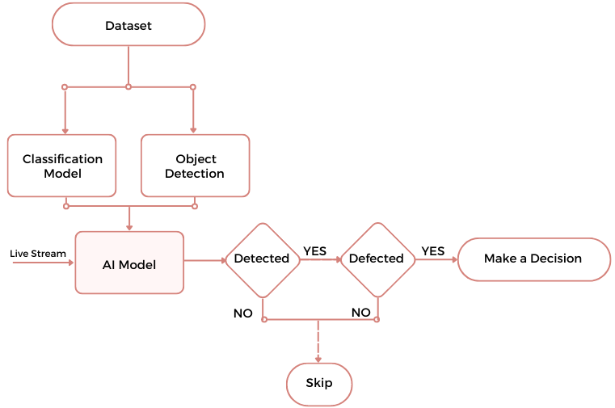

System Architecture

Slide 23
AI Model
Demo

Slide 24


Mobile APP
IoT Simulation
Movable System
The mobile app was developed to simulate limited computational resources in the IoT.
Fixed products like solar energy cells are scanned using drones

Slide 25
Mobile APP
Develop an interface to the system using Flutter and integrate our AI Model the model using TFlite.
TFLite is a tensorFlow's framework for deploying ML models on mobile.
Observation : The accuracy of the model is reduced when converting it to TFLite.

Slide 26
Mobile APP
Develop an interface to the system using Flutter and integrate our AI model using Flask and the server Ngrok.
Observation : The integration did not have a negative impact on the AI model, and it worked as expected

Slide 27
Mobile App
Demo

Slide 28
04
Conclusion

Slide 29
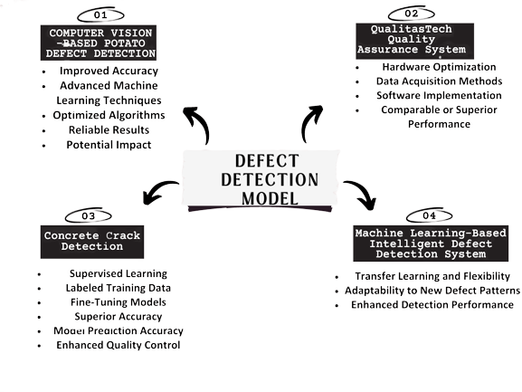

Slide 30
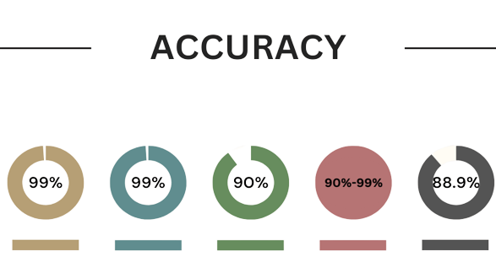
Defect
Detection
Model
QualitasTech Quality Assurance System
Computer Vision-based Potato Defect Detection
Concrete Crack Detection
ML-Based Intelligent Defect Detection System

Slide 31
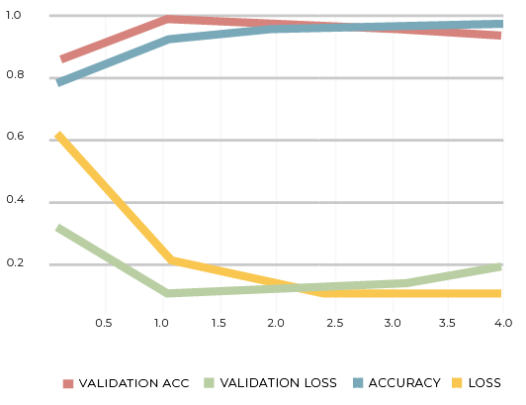
Line Chart for Model Accuracy

Slide 32
Thank you !
Any Questions?

