Slide 1
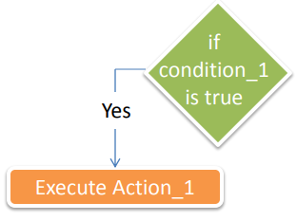
If statement
Case_1 : Only if condition
Syntax if Condition: Action_1

Slide 2
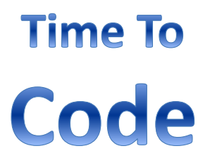
Lab 1
Write a code to calculate employee salary in a week based on his working hours, hour rate is 50. The program will ask the user to enter the working hours, then it will print his salary. But if the working hours are less than 40 hours, a 10% deduction will be applied.
Expected output
Please enter your working hours: 50
Your salary is: 2500 Please enter your working hours: 20
Your salary is: 900

Slide 3
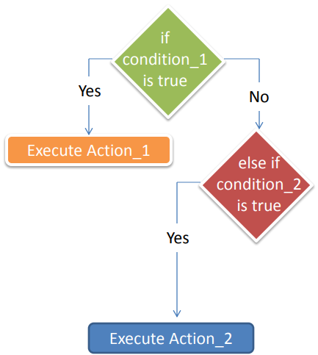
If statement
Case_2 : if, else if statement
Syntax if Condition_1: Action_1
Elif Condition 2: Action_2

Slide 4
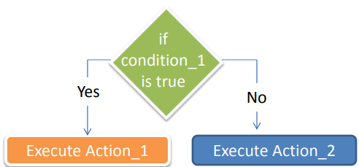
If statement
Case_3 : if, else statement
Syntax if Condition_1: Action_1
Else: Action_2

Slide 5
Lab 2
Write a code that ask the user to enter a number and check if it is Even or Odd number.
Expected output
Please enter a number: 6
Number is even. Please enter a number: 7
Number is odd.

Slide 6
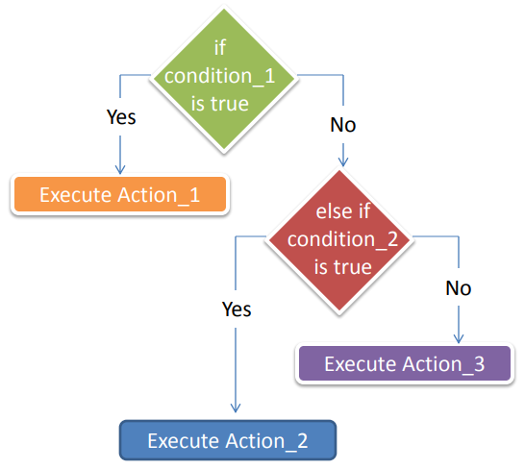
If statement
Case_4 : if, else if , else condition
Syntax if Condition_1: Action_1
Elif Condition 1: Action_2
Else: Action_3

Slide 7
Lab 3
Write a code to ask the user to enter his grade and the program will print his rating.
0 <= grade < 50 ------> Failed
50 <= grade < 65 ------> Normal
65 <= grade < 75 ------> Good
75 <= grade < 85 ------> Very Good
85 <= grade ------> Excellent.
Expected output
Please enter your grade: 63
Your rating is normal.
Please enter your grade: 92
Your rating is Excellent. Please enter your grade: 45
Your rating is Failed.

Slide 8
If statement
elif statement is optional, you may have no else if, you may have one, you may have more, no limit
else statement is optional, you can have only one else statement.
No code is allowed to be written between if and elif or else.
Nested if is allowed.
if the condition in if statement is a combination between many conditions, use round brackets ( ) with each condition to avoid precedence issues.

Slide 9

Question
What will be the output of the following code … ?
x=10
if x==10:
print(“Ahmed")
x=10
else:
print(“Essam")

Slide 10
Lab 4
Login System:
Write a code that ask the user to enter his ID and then the program will print his name. Available IDs are:
1234-> Ahmed
5678 -> Youssef
1145 -> Mina
Any other number, the program will print Wrong ID
Expected output
Please enter your ID: 1234
Welcome Ahmed.
Please enter your ID: 4445
Wrong ID.

Slide 11
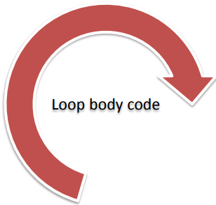
For loop
Used to apply the code for defined number of iterations.
Index starts form 0
Syntax for variable in sequence:
# code to be executed in each iteration
Example
for i in range(5):
print("Iteration", i)
Iteration 0
Iteration 1
Iteration 2
Iteration 3
Iteration 4

Slide 12
Lab 5
Write a code that will print your name 10 times
Expected output
Ahmed
Ahmed
Ahmed
Ahmed
Ahmed
Ahmed
Ahmed
Ahmed
Ahmed
Ahmed

Slide 13
Lab 6
Write a code to print the first ten natural numbers
Expected output
The first 10 natural numbers is:
1
2
3
4
5
6
7
8
9
10

Slide 14
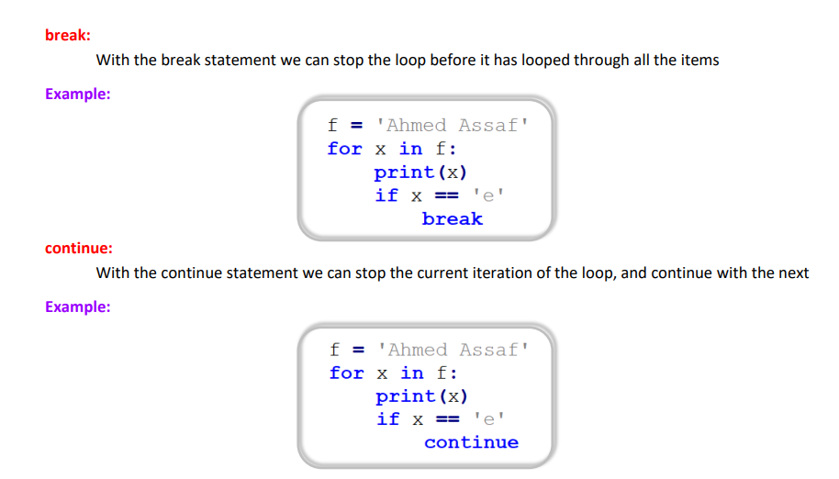
Break and continue

Slide 15
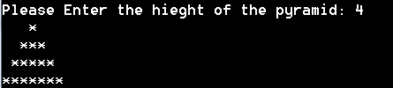
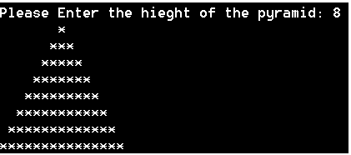
Lab 7
Write a program that draw a pyramid of stars with height entered by the user
Expected output

Slide 16
List
Index starts form 0
Lists are versatile and widely used in Python.
They are mutable, ordered, and can store elements of different data types.
Understanding list methods is essential for efficient programming.
Syntax
List_name=[]
Example
my_list = [1, 2, 3, "hello", True]

Slide 17
List methods
Accessing Elements
Slicing
Modifying Elements
Adding Elements
extend
Removing Elements
Finding Elements
Sorting
Pop
Copy
Clear
Reversing
List Comprehension
Length of a List
Membership

Slide 18

Lab 8
Given a list of lists, find the sum of the squares of all the numbers in the inner lists.

Slide 19
Lab 9
Write a code that ask the user to enter 10 numbers, then ask him to enter another number to search on it in the 10 numbers and print its location in case it is found.
In case the number is not found, it will print number not exist
Expected output
Enter Number 1: 5
Enter Number 2: 6
Enter Number 3: 8
Enter Number 4: 9
Enter Number 5: 11
Enter Number 6: 14
Enter Number 7: 34
Enter Number 8: 58
Enter Number 9: 12
Enter Number 10: 6
Enter a value to search: 12 value is exist at element number 9

Slide 20
String methods
capitalize()
upper()
lower()
title()
swapcase()
casefold()
center()
count()
encode()
Startswith()
endswith()
isalnum()
replace()
Slicing
concatenation (+)
strip()
rstrip()
lstrip()
zfill()
Startswith()
split()
Indexing
join()
splitlines()
expandtabs()
find()

Slide 21
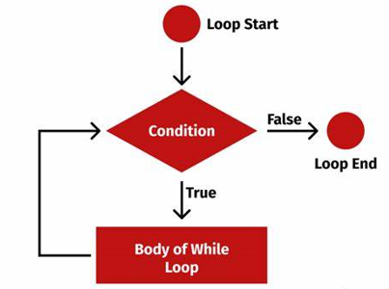




While Loop
Syntax
While condition : action
Example x=[3,2,4,8,9]
i=0
While x[i]!=8:
print(f“this number is {x[i]}”)
i+=1

Slide 22
Tuple
Tuple Items Are Enclosed in Parentheses
You Can Remove The Parentheses If You Want
Tuple Are Ordered, To Use Index To Access Item
Tuple Are Immutable => You Can’t Add or Delete
Tuple Items Is Not Unique
Tuple Can Have Different Data Types
Operators Used in Strings and Lists Available In Tuples

Slide 23
Tuple
Tuple with one element
Concatenation
Tuple, list, string repetition (*)
Count(), index()
Destruct (_)

Slide 24
Dictionary
Items Are Enclosed in Curly Braces
Items Are Contains (Key : Value)
Value Can Have Any Data Types
Dict Key Need To Be Unique
Is Not Ordered You Access Its Element With Key

Slide 25
Task 1
Write python code that manage a small school. The school has 3 classes each class
contains 10 students. Define three lists for the three classes each one with a
length of 10. Save a random numbers in all list elements to indicate the student grade. The program will calculate and display the following statistics:
1- Number of passed students
2- Number of Failed students
3- Highest grade
4- Lowest grade
5- Average grade
Knowing that the total grade is from 100 and the minimum passing grade is 50.

Slide 26
