Slide 1

Graduation Project
Embedded system AVR

Slide 2

Name and Contact
Name: Ahmed Mohamed Abd Elmenim
Email: Ahmedabdelmenim2022@gmail.com
Phone: 0109 154 4496

Slide 3
Objective
Develop a comprehensive smart home system that prioritizes security through multi-level login modes,
facilitates precise temperature control using LM35 sensors and ADC conversion,
enables lighting control in multiple rooms for both administrators and guests,
and ensures seamless communication between microcontrollers using SPI protocol.

Slide 4
Drivers Used
BIT_MATH LIB -STD_TYPES_LIB
ADC DRIVER
LCD DRIVER
KPD DRIVER
SPI DRIVER

Slide 5
Components
2- ATmega32 microcontroller
Keypad
LCD
temperature sensor(lm35)
7-LED

Slide 6
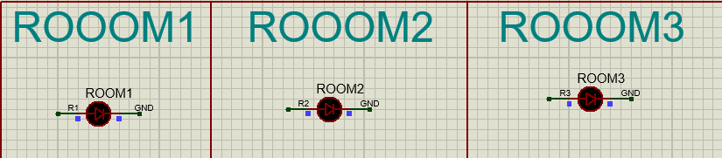
1-Leds
Turn on if admin or guest turned on

Slide 7
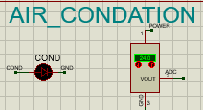
2-air condation
Turn off when temperature achieve to 23

Slide 8
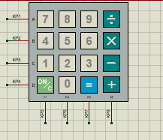
Key pad
Input all order by it

Slide 9
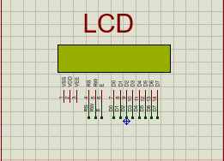
lcd
Display states of microcontroller

Slide 10
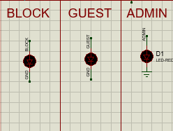
Led modes
Turn on in specific modes

Slide 11
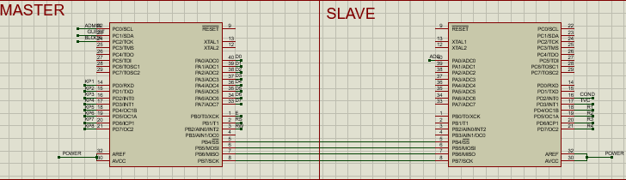
Master and slave
Control the whole system through it

Slide 12

Specifications
1- Security:
2. Temperature Controller
3. Light System
4. Ability to Access:

Slide 13
1-Security
Login Modes: Users can access the system in either admin or guest mode by entering a password using a keypad. All information is displayed on an LCD screen.
Admin Control: Administrators have control over all features, functions, and settings.
User Access: Regular users have limited access to certain features.

Slide 14
2.Temperature Controller
-Control Method: The system utilizes an air conditioning unit and a temperature sensor (LM35).
- Sensor Function: The LM35 sensor sends analog signals to the microcontroller, which converts them into binary and makes decisions based on the input.
- Signal Conversion: The microcontroller performs analog-to-digital conversion (ADC) to process temperature data.

Slide 15
3. Light System
Control Access: Both administrators and guests can control lighting in all three rooms

Slide 16
4. Ability to Access:
Communication Protocol: The system communicates between two microcontrollers using the Serial Peripheral Interface (SPI) communication protocol

Slide 17
Next version:
Ability to add or remove guests or administrators.
Utilize ultrasonic technology and incorporate additional features.
Detect the presence of carbon dioxide (CO2) in the air.
Receive data from slave devices and monitor the status of LEDs

Slide 18
thanks

