Slide 1

Flutter Course Apps 5

Slide 2
BMI Calculator
Design and build the BMI calculator in the next slide,
Take 2 input from user (weight – height ) then Show the result to the user
This reference will help you to get data about BMI
https://www.dummies.com/article/body-mind-spirit/physical-health-well-being/diet-nutrition/general-diet-nutrition/how-to-figure-your-body-mass-index-202183

Slide 3
BMI Calculator
Use Bloc(Cubit)
1-After That show user’s BMI Information and write tips for user depends on BMI’s value.

Slide 4
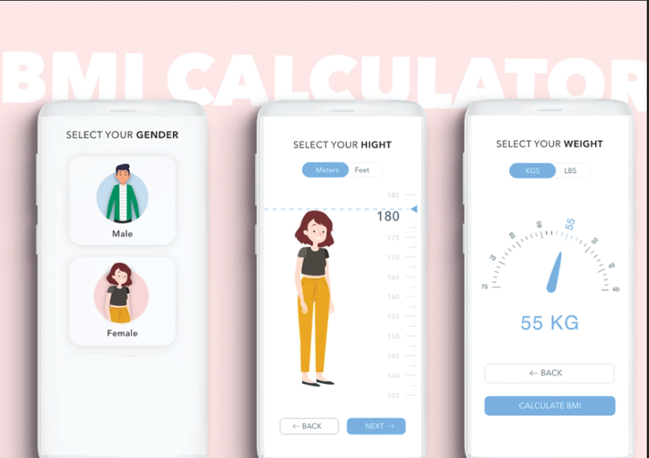

Slide 5
Thank You !

