Slide 1
SLAM Projects 1

Slide 2
Using the road markings from LIDAR data for mapping and localisation
The LIDAR data carries information about the road reflected intensity and it is possible to extract the road markings to understand the road map and for vehicle precise localisation.
This approach is new and have some challenges but is quite promising. The challenges are on the robotic issues related to intensity based detection and classification of road markins and also involves using the computer vision library of opencv.

Slide 3
Challenges
Robust detection of the road marks
Classification of the road marks
Using road marks for localisation/ using standard localisation pkgs hdl/Loam

Slide 4
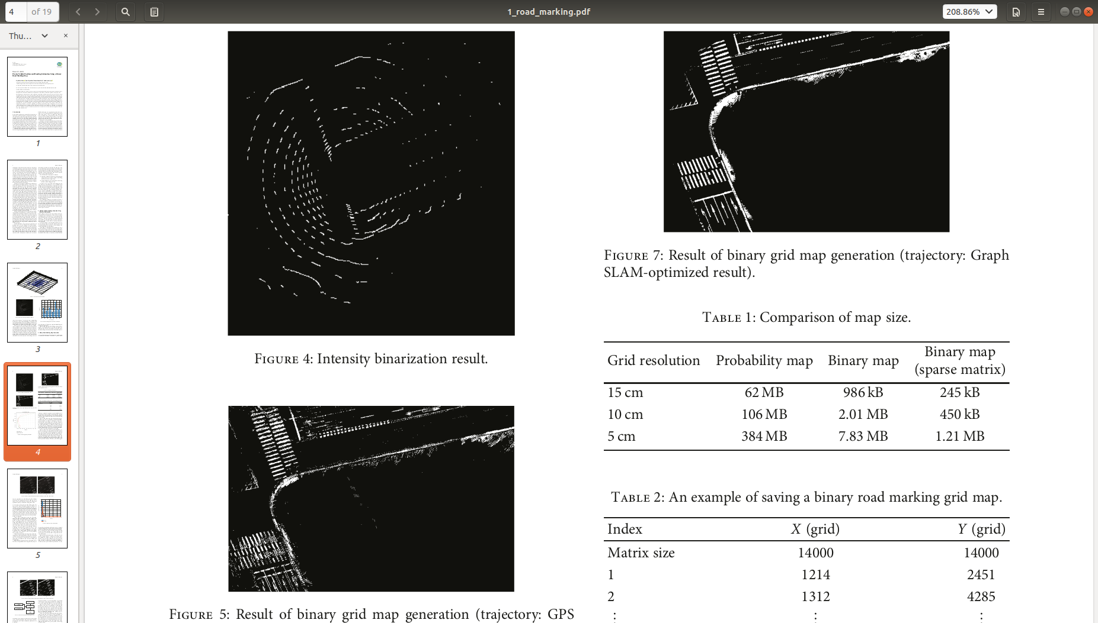

Slide 5
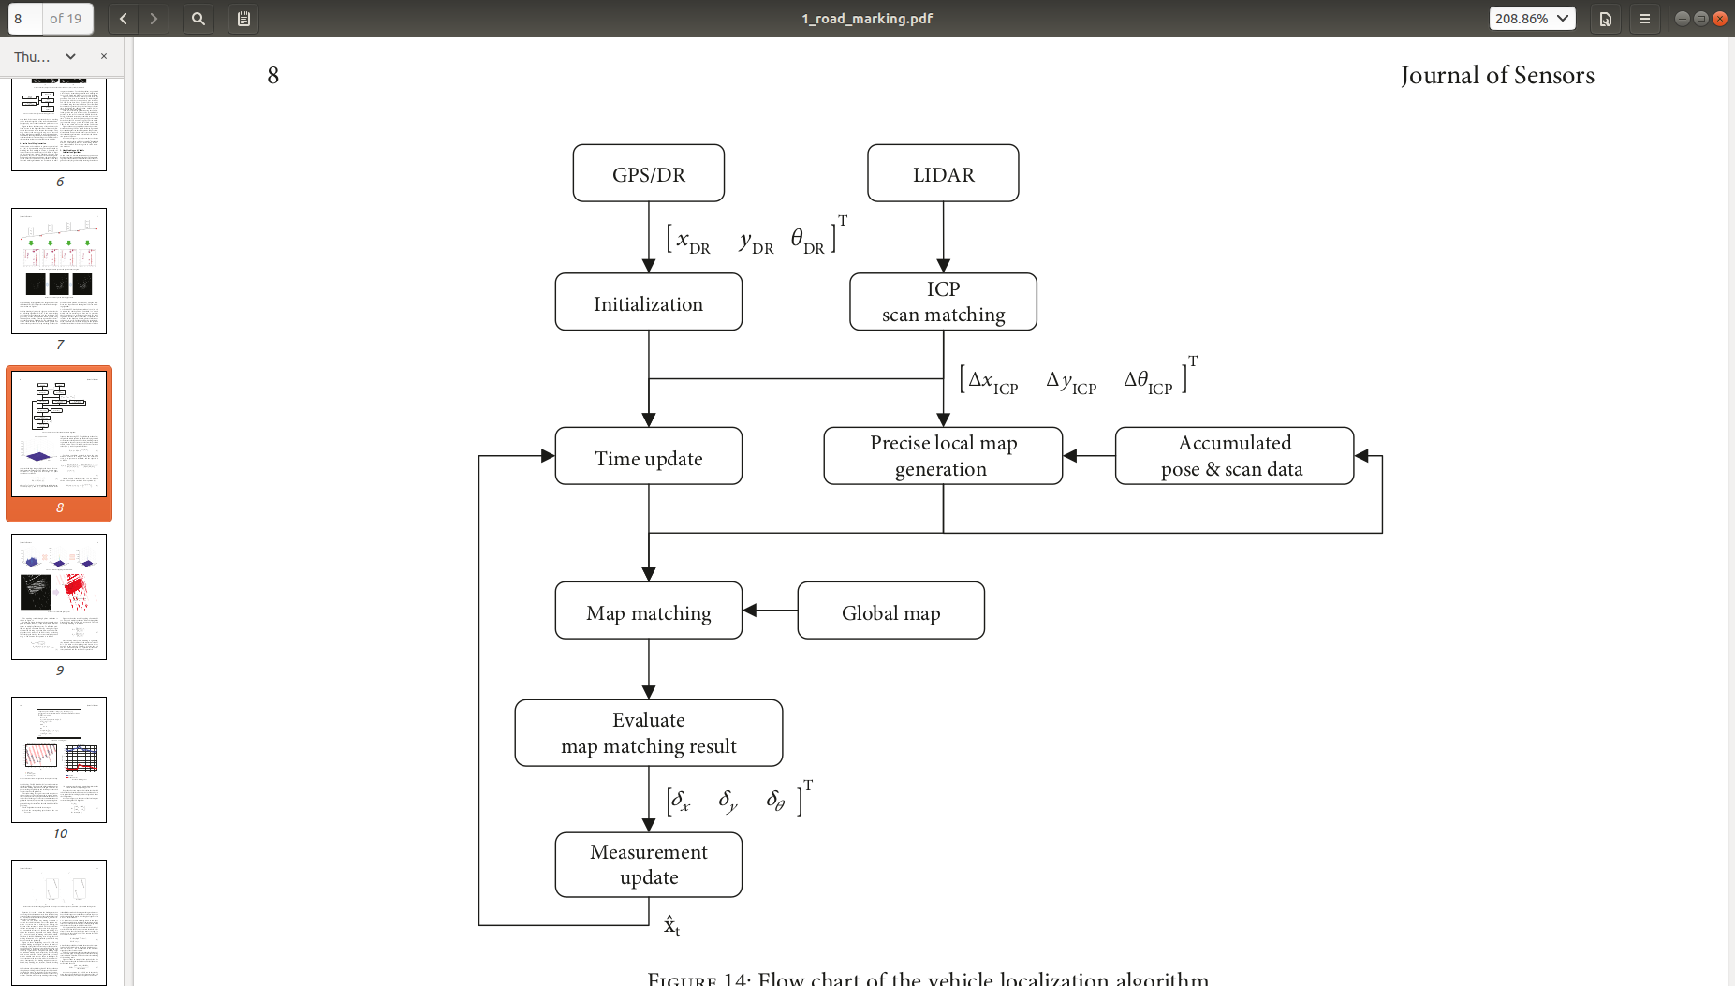

Slide 6
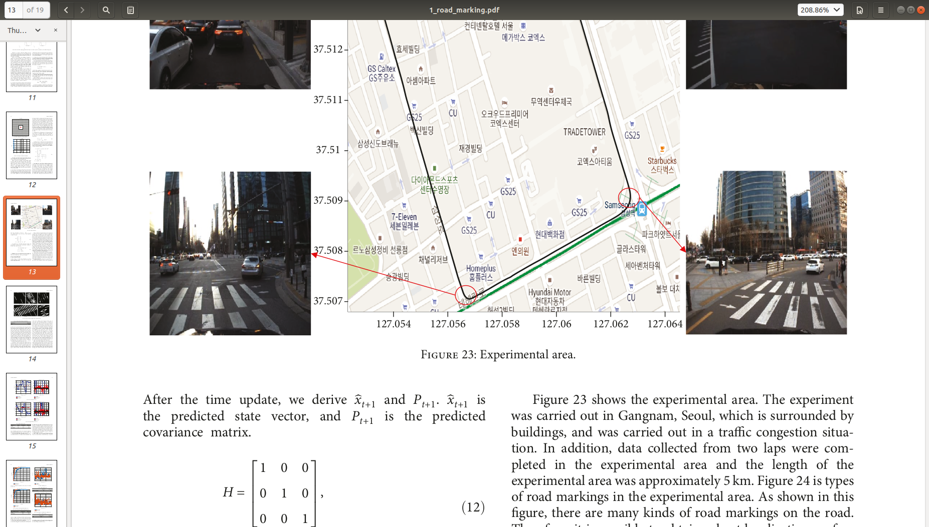

Slide 7
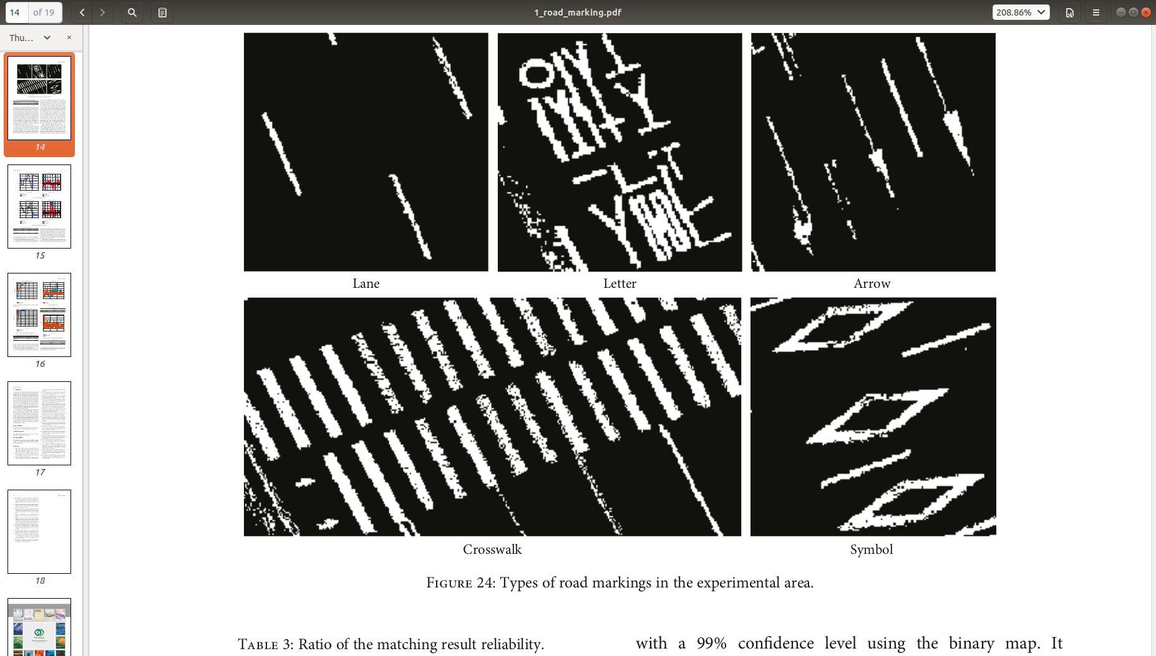

Slide 8
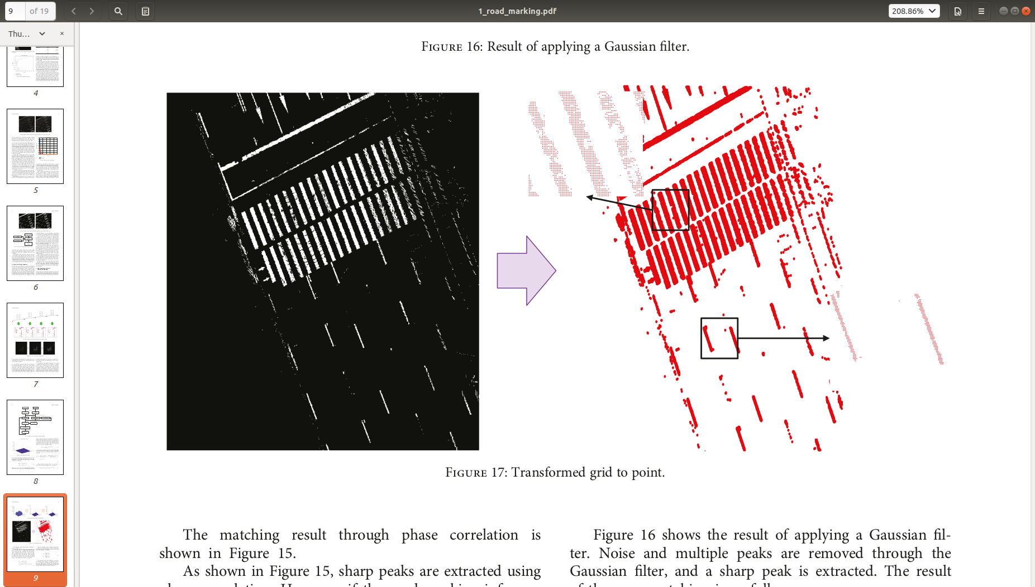

Slide 9
SLAM Projects 2

Slide 10
Study of the selection criteria of point features for efficient SLAM
The computational complexity of SLAM algorithms can be viewed as a result of using all available scene features which are usually huge. We are not sure if all features are really needed or contribute to improve the algorithm results. Considering the objective of reaching an algorithm that can be accurate and works with minimal computational load, we can build a feature selection strategy that works with features expected to contribute well to accuracy enhancement based on physical and geometrical merits.
The selection works needs an academic study to explore its history and aspects, in addition to assessment based on experiments in difficult scenarios where few features ( outdoors) are only available or redundant features such as repeated pattern corridors(indoor). The work can be done with state of art SLAM algorithms whether based on Lidar or visual camera. The assessment metric will consider the accuracy achieved per computational complexity which is quite relevant for real industrial applications.

Slide 11
Challenges
We need to limit the number of used point clouds to get efficient computaions for maps and for localisation.
The information content of the points decides to a large extent if they will be useful or not such as depth variance.
Potential metrics relate to the geometry of viewing and the parallax angle as seen in the next slide.

Slide 12
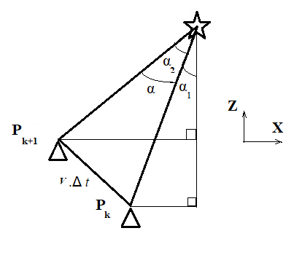
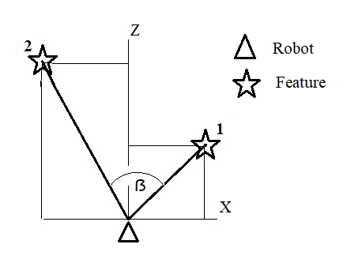

Slide 13
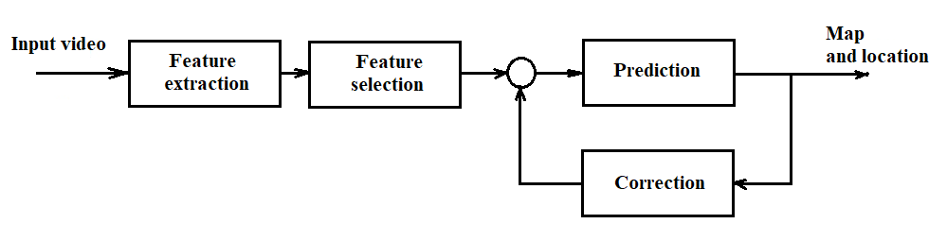

Slide 14
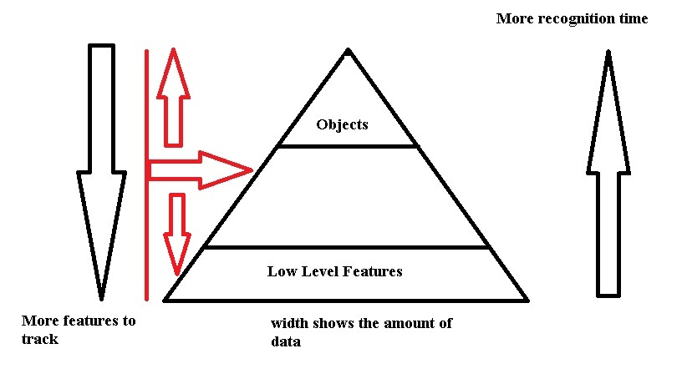

Slide 15
