Slide 1
Image Colorization using Deep Learning
#
Prepared By: Ahmed Alaa El-kady

Slide 2
Motivation
A number of proposed solutions are available for colorization of Black and White images
There is a lot of research going on in this fied tp obtain images as realistic as possible
The challenge lies in focusing on accurately colorizing standard components of image like skin-tone, eyes, hair, water and other components

Slide 3
What is Image Colorization
Image colorization is the process of taking an input grayscale (black and white) image and then producing an output colorized image that represents the semantic colors and tones of the input

Slide 4
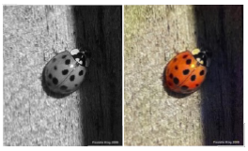
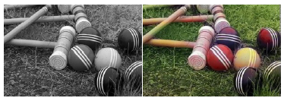
Introduction
In this paper the approach we are going to use here instead relies on deep learning. We will utilize a Convolutional Neural Network capable of colorizing black and white images with results that can even “fool” humans!

Slide 5
Introduction
Fully automatic approach (self-supervised deep learning algorithm)
Aim: estimate the 2 unknown color dimensions from the known color dimension

Slide 6
The Goal
our goal is not necessarily to recover the actual ground truth color, but rather to produce a plausible colorization that could potentially fool a human observer. Therefore, our task becomes much more achievable: to model enough of the statistical dependencies between the semantics and the textures of grayscale images and their color versions in order to produce visually compelling results

Slide 7
Paper Approach
Zhang et al. decided to attack the problem of image colorization by using Convolutional Neural Networks to “hallucinate” what an input grayscale image would look like when colorized.
To train the network Zhang et al. started with the ImageNet dataset and converted all images from the RGB color space to the Lab color space.
Similar to the RGB color space, the Lab color space has three channels. But unlike the RGB color space, Lab encodes color information differently:
The L channel encodes lightness intensity only
The a channel encodes green-red.
And the b channel encodes blue-yellow

Slide 8
Colorization process
Since the L channel encodes only the intensity, we can use the L channel as our grayscale input to the network.
From there the network must learn to predict the a and b channels. Given the input L channel and the predicted ab channels we can then form our final output image.
The entire (simplified) process can be summarized as:
Convert all training images from the RGB color space to the Lab color space.
Use the L channel as the input to the network and train the network to predict the ab channels.
Combine the input L channel with the predicted ab channels.
Convert the Lab image back to RGB.
To produce more plausible black and white image colorizations the authors also utilize a few additional techniques including mean annealing and a specialized loss function for color rebalancing

Slide 9
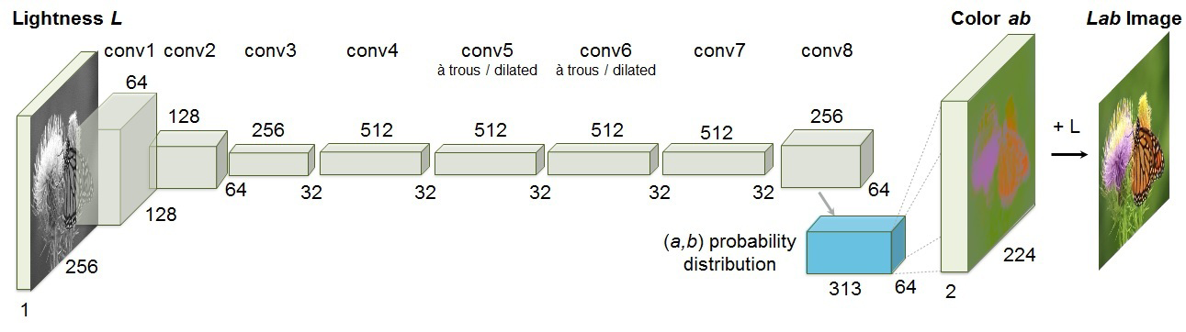
Network architecture
Each conv layer refers to a block of 2 or 3 repeated conv and ReLU layers, followed by a BatchNorm layer. The net has no pool layers. All changes in resolution are achieved through spatial downsampling or upsampling
between conv blocks.

Slide 10
Experimental Details
▶ Data used:
1.3 million training images from ImageNet training set (only 10k in my project)
First 10K images for validation from ImageNet validation set (only 2k)
A separate set of 10k images for testing from ImageNet validation set (only 2k)
▶ CNN trained on various loss functions
Regression (L2-loss)
Classification, without rebalancing
Classification, with rebalancing (Full method)
Larsson, Dahl methods
Random colors and gray scale images

Slide 11
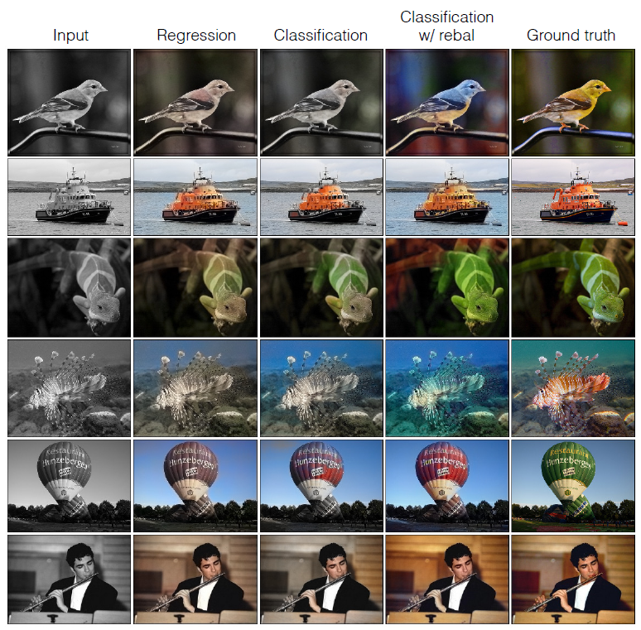
Success cases

Slide 12
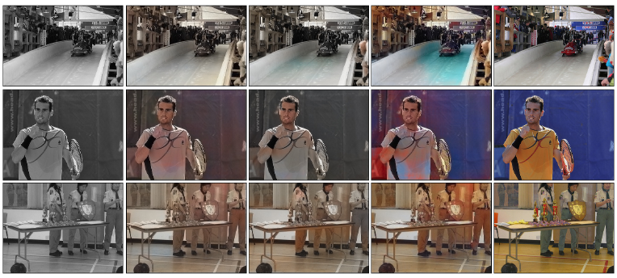
Failure cases

Slide 13
Conclusion
Pros
Any image can be used in training.
Easley visualize the blackbox.
Statistical preventing the overfitting problem (class re-balancing)
Easy to apply transfer learning.
Cons
Probability distribution works not as excepted.
Fixed image size.

Slide 14
Project Using And The Interface

