Slide 1
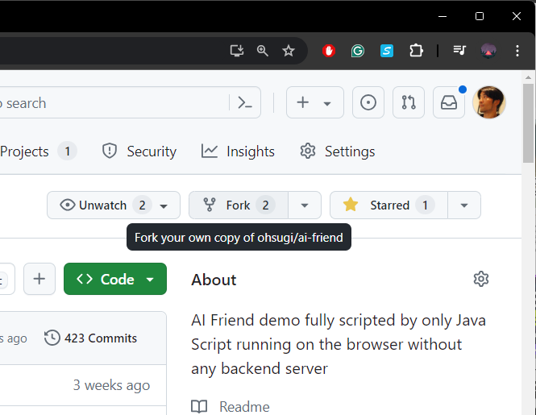
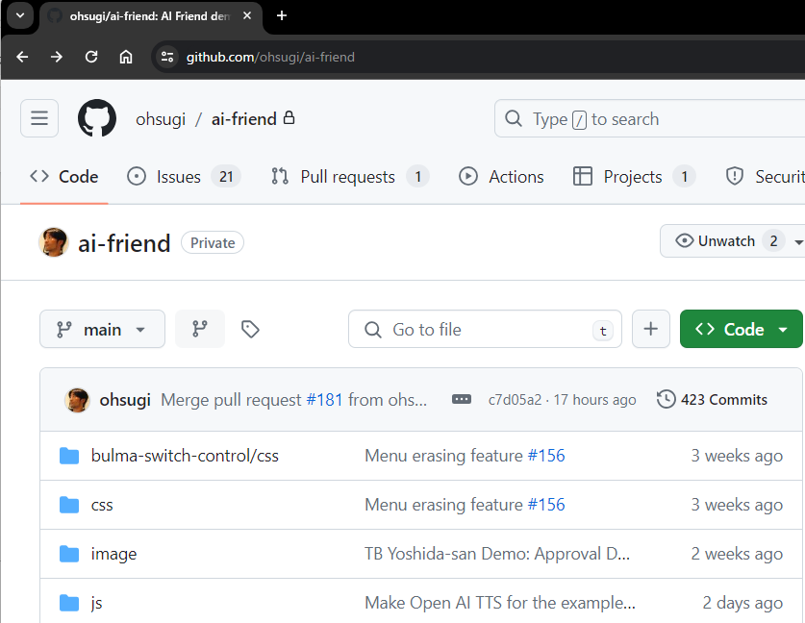
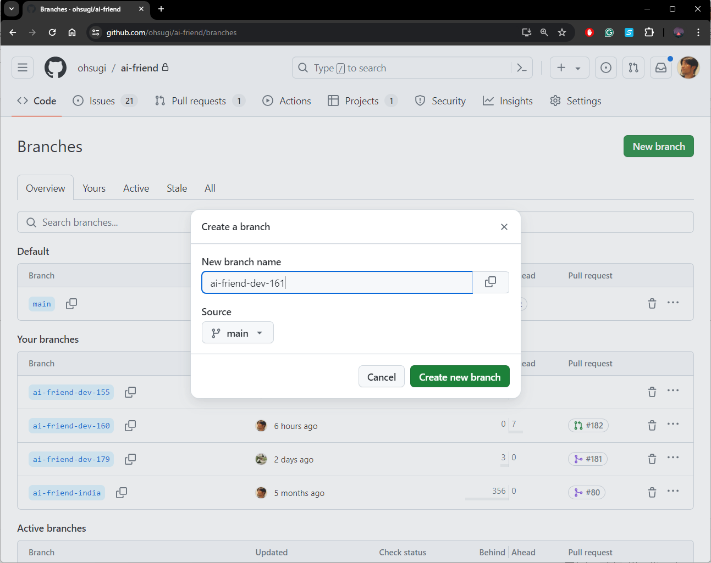
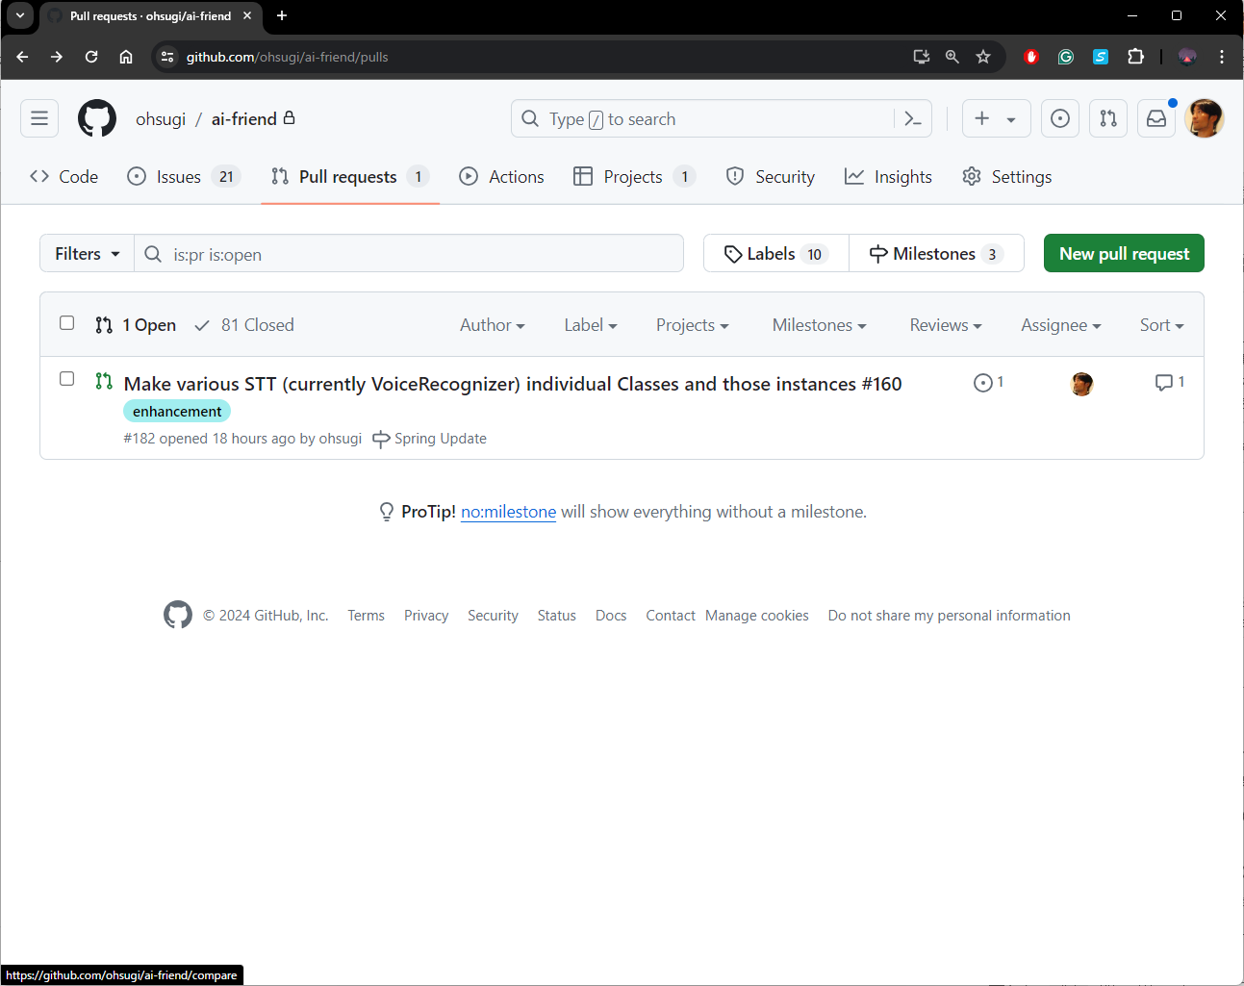
ohsugi/main
(main branch)
Modification for #161
#161 merged
fork on GitHub
Pull request to merge #161 to ohsugi/main on GitHub
<your account>/main
(forked your main branch)
create branch on GitHub
for #161
create branch
for #173
Merge #161 to main
<your account>/devel-161
(feature branch) 161=ticket number
Modification for #161
Delete devel-161
<your account>/devel-173
(the other feature branch)
Modification for #173

Slide 2
< other’s account>/devel-164
(feature branch)
Mod for #164
<other’s account>/main
(forked other’s main branch)
Merge #164 Pull Request to main
#161 merged
ohsugi/ai-friend/main
(main branch)
Mod for #164
Conflicts btw #164 vs. #173
<your account>/main
(forked your main branch)
<your account>/devel-173
(feature branch)
Mod for #173

Slide 3
< other’s account>/devel-164
(feature branch)
Mod for #164
<other’s account>/main
(forked other’s main branch)
Merge #164 Pull Request to main
#161 merged
ohsugi/ai-friend/main
(main branch)
Mod for #164
Mod for #173 & #164
#173 merged
Git pull from ohsugi/main
Pull request to ohsugi/main
<your account>/main
(forked your main branch)
Mod for #164
Conflicts btw #164 vs. #173
<your account>/devel-173
(feature branch)
Mod for #173
Mod for #173 & #164
Merge main updates to feature branch and resolve conflicts

Slide 4
EdgeGhost
1
SceneManager
Scene
1
1
*
1
LayoutManager
Layout
1
1
*
1
BackgroundManager
Background
1
*
CharacterManager
Character
EvaCharacter
1
1
*
1
Prompt
FlowiseAICharacter
1
Avatar
FunctionCallingCharacter
1
1
SpeechToText
Function
1
*
1
TextToSpeech
Parameters
1
1
1
ExtraContent
0..*
Property
0..*

Slide 5
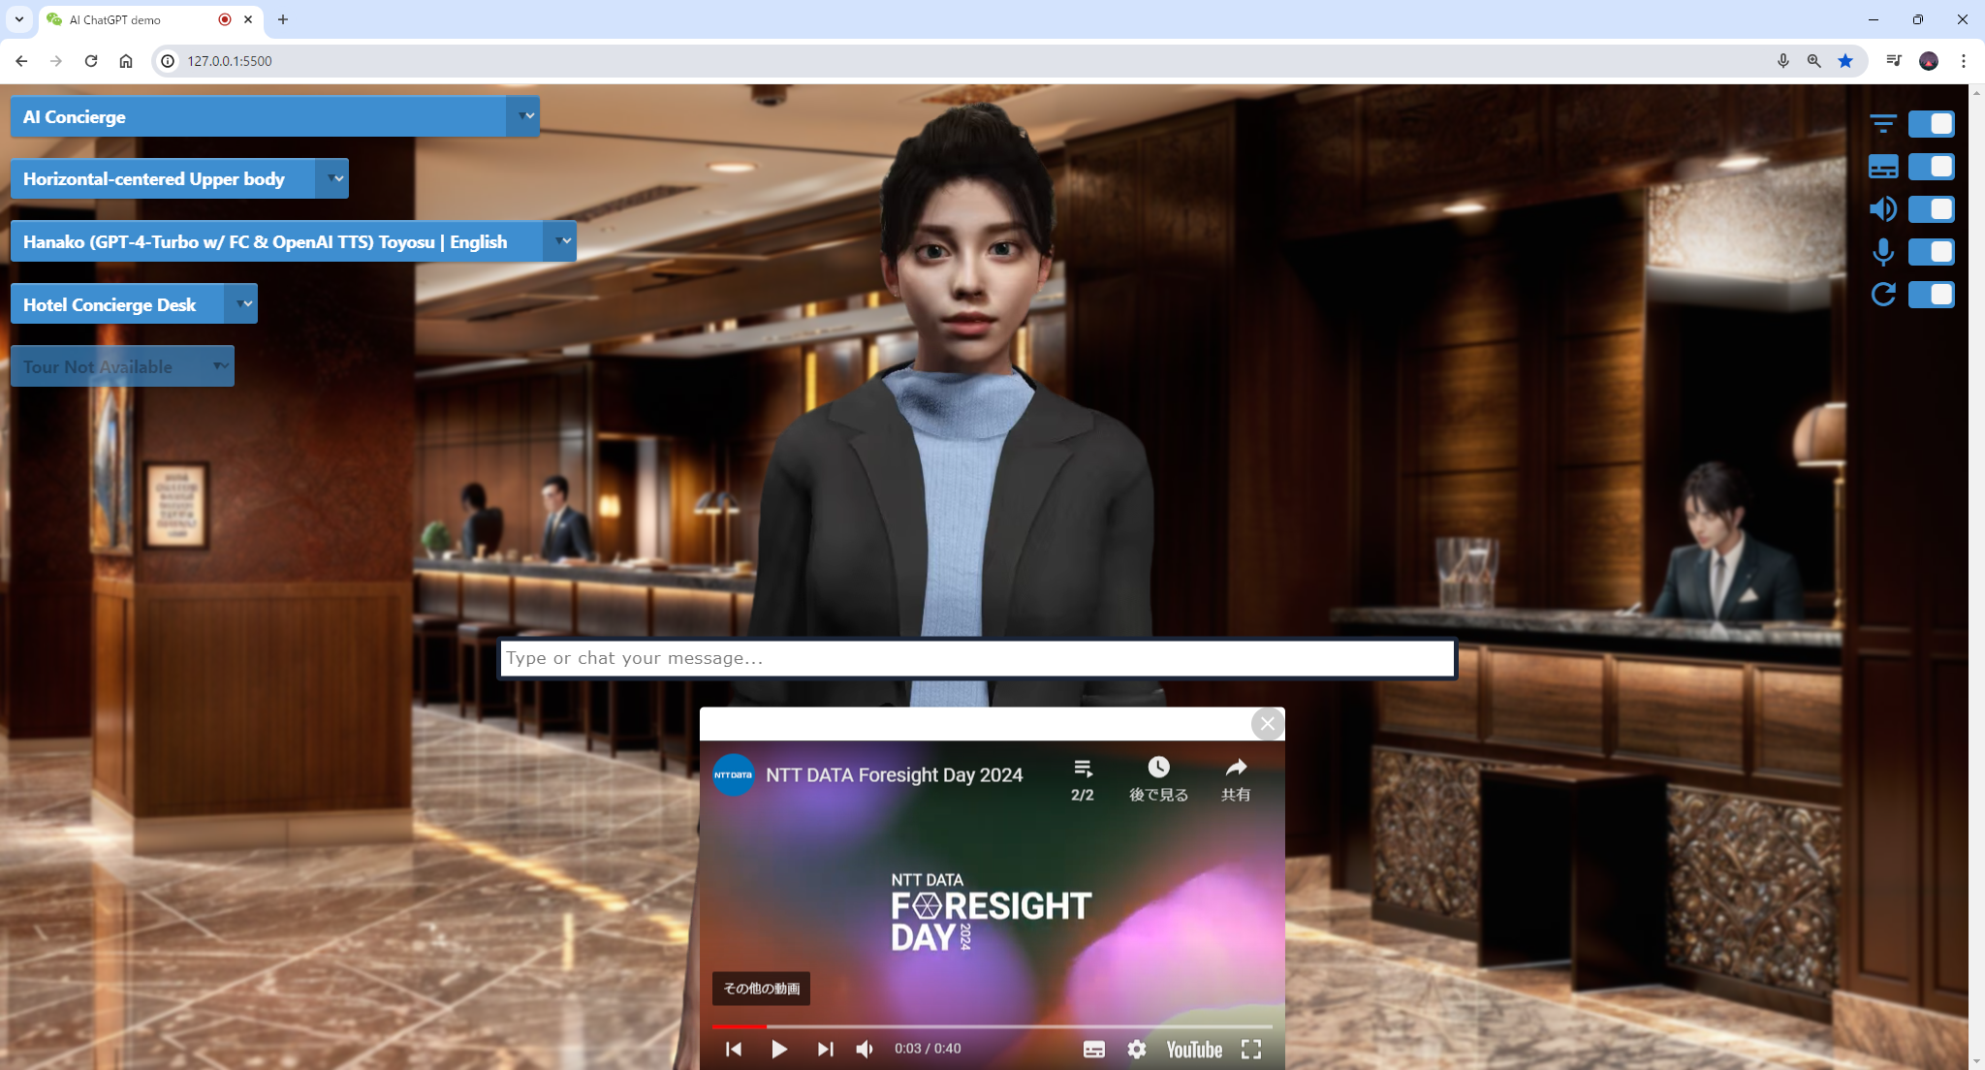
←SceneManager & Scenes
←LayoutManager & Layouts
←CharacterManager & Characters
←BackgroundManager & Backgrounds
←Tour List (Background’s property)
←Avatar
←Background
←Layout
(the avatar position on the screen, e.g.,
this layout is “Horizontal-centered Upper body )
←ExtraContent

Slide 6



Talk to
Edge-Ghost
Talk to
Edge-Ghost
User
Ask generating response to Open AI
Ask generating response to Open AI
Speech
response to the user
Function.call(parameters)
Creating result(s)
Creating Web components
Speech
response to the user
Ask result(s)
for generation
Edge-Ghost
(Avatar from the user’s perspective)
Invoke external API(s) if needed
Function.
onAvatarTalk(result, document)
Generating
chat response
Ask back request calling function(s)
Generating
chat response
Open AI
Usual chat response generation
Response generation with Function Calling
Web component creation & presentation

Slide 7

EDGE-GHOST
On-Browser AI Orchestrator

