Slide 1
PROJECT OVERVIEW
PLANTCARE AI
Potato Leaf Disease Classification
& Explainable AI
EARLY BLIGHT
LATE BLIGHT
HEALTHY
A complete AI pipeline: dataset → training → evaluation → XAI → API
Samsung Innovation Campus • Final Project
Computer Vision | Deep Learning | MLflow | FastAPI | Grad-CAM
SAMSUNG INNOVATION CAMPUS • PLANTCARE AI
1

Slide 2
THE PROBLEM
Potato leaf diseases can threaten crop health
The project explores an AI-assisted image classification workflow—not a replacement for expert agronomy.
WHY THIS MATTERS
PROJECT QUESTION
Early and late blight affect potato leaves and can reduce crop productivity.
Visual symptoms may be difficult to assess consistently from a single image.
A fast image-based screening tool can help flag a leaf for closer review.
Can a trained vision model classify a potato leaf image into Early Blight, Late Blight, or Healthy—and provide a visual explanation?
Scope: 3 classes • image classification • educational prototype
SAMSUNG INNOVATION CAMPUS • PLANTCARE AI
2

Slide 3
PROJECT PIPELINE
From raw images to an explainable web experience
The work followed the capstone sequence: data → preprocessing → experiments → evaluation → application → deployment-ready packaging.
1
Dataset
2
Preprocess
3
EDA
4
Train
PlantVillage potato leaf images
Validate folders, split, resize, augment
Counts, class balance, sample inspection
Custom CNN + 2 pretrained architectures
5
Evaluate
6
Explain
7
Serve
8
UI
Validation selection + held-out test
Grad-CAM visual heatmap
FastAPI prediction endpoint
Upload image and display result
Model training is performed in the notebook; FastAPI loads the exported model for inference.
SAMSUNG INNOVATION CAMPUS • PLANTCARE AI
3

Slide 4
DATASET & SOURCE
PlantVillage: a public plant-health image repository
Dataset source framing: PlantVillage research dataset—not Kaggle as the primary source.
54K+
14
38
3
images in the broader PlantVillage collection
crop species in the original collection
crop–disease/health categories
potato classes used in this project
SOURCE & CITATION
POTATO LABELS
PlantVillage is an open-access image repository introduced for research on image-based plant disease diagnosis. The project used the Potato-only subset organized into three labeled folders.
Early Blight
Late Blight
Healthy
Hughes & Salathé (2015); Mohanty, Hughes & Salathé (2016)
SAMSUNG INNOVATION CAMPUS • PLANTCARE AI
4

Slide 5
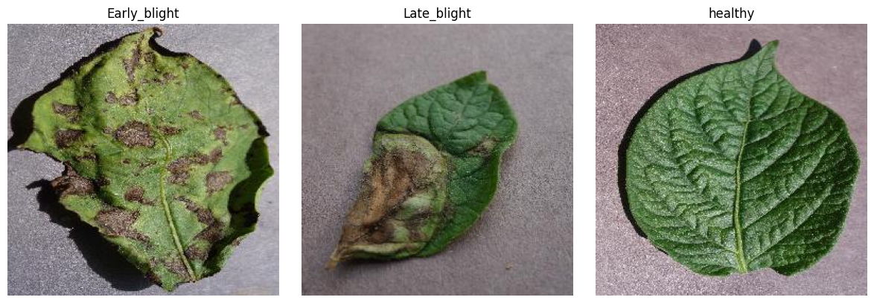
DATASET CONTENTS
What the model sees
Each example is an RGB image of a potato leaf paired with a class label.
IMAGE CHARACTERISTICS
Color leaf photographs (RGB)
One image → one class label
Image size for model: 256 × 256
Three potato categories only
Sample images from the notebook's training split
Note: the notebook does not document camera metadata or a real-field acquisition protocol.
SAMSUNG INNOVATION CAMPUS • PLANTCARE AI
5

Slide 6
PREPROCESSING & AUGMENTATION
Preparing consistent inputs for learning
Implemented in the notebook using Python, TensorFlow / Keras, PIL, NumPy and scikit-learn.
1
Validate
2
Split
3
Resize
Check source folders and expected class directories.
Stratified split per class with fixed random seed.
Load images at 256 × 256 pixels.
4
Augment train
5
No eval augmentation
6
Batching
Rotation ±10°, horizontal flip, zoom 0.1.
Validation/test use plain ImageDataGenerator.
Batch size 32; sparse labels; shuffle train.
Purpose: increase training variation while keeping validation and test evaluation unchanged.
SAMSUNG INNOVATION CAMPUS • PLANTCARE AI
6

Slide 7
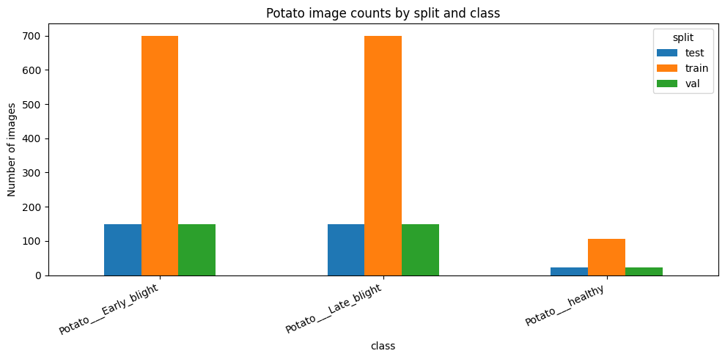
EXPLORATORY DATA ANALYSIS
Class distribution and visual inspection
EDA checked image counts by class and split, then displayed representative examples.
EDA QUESTIONS
Are the three classes represented?
Is class balance consistent?
Do sample images look plausible?
Is the Healthy class smaller?
The healthy class is notably smaller than the two blight classes; this is visible in the split counts.
SAMSUNG INNOVATION CAMPUS • PLANTCARE AI
7

Slide 8
DATA SPLITTING
A reproducible 70 / 15 / 15 split
Notebook uses train_test_split per class with random_state=SEED; existing split folders are reused.
Class
Train 70%
Validation 15%
Test 15%
Total
Early Blight
700
150
150
1,000
Late Blight
700
150
150
1,000
Healthy
106
23
23
152
TOTAL
1,506
323
323
2,152
Healthy: 152 images total (106 train + 23 validation + 23 test).
Total: 2,152 images • Test set: 323 images • 3 classes
SAMSUNG INNOVATION CAMPUS • PLANTCARE AI
8

Slide 9
MODEL EXPERIMENTS
Three architectures were trained and compared
All experiments share the same dataset split and training pipeline.
01
02
03
Custom CNN
MobileNetV2
EfficientNetB0
BUILT FROM SCRATCH
TRANSFER LEARNING
TRANSFER LEARNING
Conv2D → MaxPool blocks → Flatten → Dense(64) → Softmax
ImageNet backbone (include_top=False) → GAP → Dropout(0.2) → 3-class Dense
ImageNet backbone (include_top=False) → GAP → Dropout(0.2) → 3-class Dense
Adam • Sparse Categorical Crossentropy
Adam(1e−3) • sparse categorical crossentropy
Adam(1e−3) • sparse categorical crossentropy
All layers trainable
Backbone frozen; train classification head
Backbone frozen; train classification head
SAMSUNG INNOVATION CAMPUS • PLANTCARE AI
9

Slide 10
TRAINING STRATEGY
Shared training controls and weight strategy
Exact settings read from the notebook's training functions.
20
32
Adam
3
maximum epochs
batch size
optimizer
classes / softmax outputs
CALLBACKS
WEIGHT HANDLING
EarlyStopping: monitor val_loss, patience=4, restore_best_weights=True
ReduceLROnPlateau: factor=0.2, patience=2, min_lr=1e−6
Custom CNN: weights learned from scratch
MobileNetV2 & EfficientNetB0: ImageNet pretrained weights
Transfer-learning backbones frozen; trainable classifier head
SAMSUNG INNOVATION CAMPUS • PLANTCARE AI
10

Slide 11
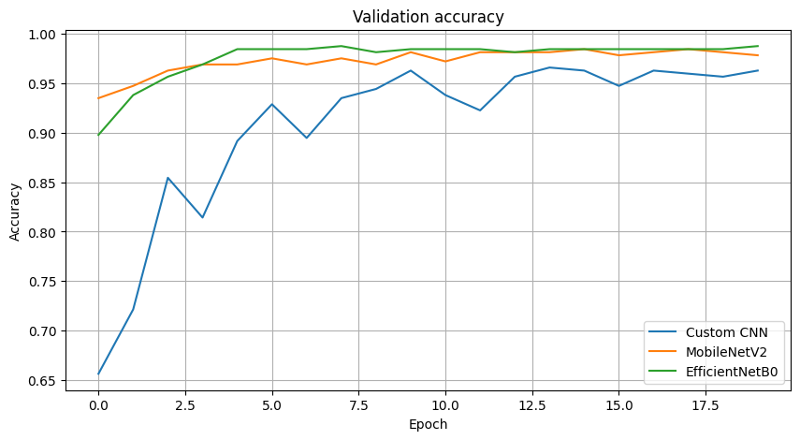
VALIDATION RESULTS
EfficientNetB0 achieved the highest validation accuracy
Selection is performed using the validation accuracy recorded in RUNS.
BEST VALIDATION RUN
98.76%
EfficientNetB0
Selected by the notebook's max(val_accuracy) rule—not by test accuracy.
Observed validation accuracy: Custom CNN 96.59% • MobileNetV2 98.45% • EfficientNetB0 98.76%
SAMSUNG INNOVATION CAMPUS • PLANTCARE AI
11

Slide 12
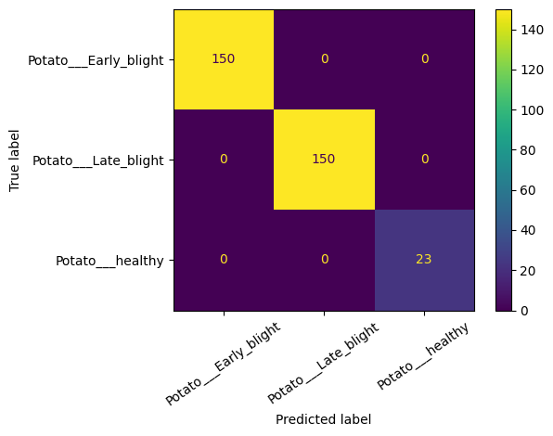
FINAL MODEL & TEST EVALUATION
EfficientNetB0 was selected, then evaluated on the held-out test set
The final test evaluation was run once on the selected model.
100%
0.0272
323 / 323
0
test accuracy (323 images)
test loss
correct test predictions
off-diagonal errors
PER-CLASS TEST SUPPORT
Early Blight: 150 / 150 correct
Late Blight: 150 / 150 correct
Healthy: 23 / 23 correct
Important: perfect performance on this held-out PlantVillage split does not guarantee field performance.
SAMSUNG INNOVATION CAMPUS • PLANTCARE AI
12

Slide 13
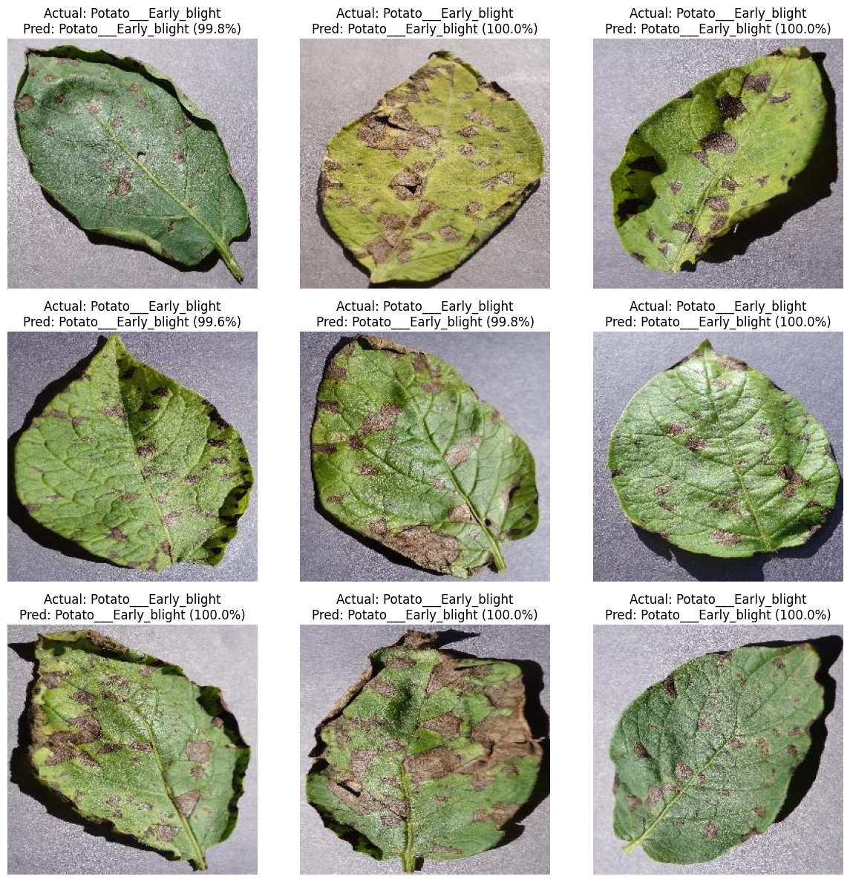
PREDICTION EXAMPLES
Inference on sample test images
Notebook displays actual label, predicted label, and the model's highest class score.
Prediction score is the model output for the selected class; it is not a calibrated probability or a guarantee.
SAMSUNG INNOVATION CAMPUS • PLANTCARE AI
13

Slide 14
EXPERIMENT TRACKING — MLFLOW
Experiments and evaluation are tracked in MLflow with SQLite
Tracking URI in the notebook: sqlite:///.../mlflow.db
01
02
03
04
05
Run
Params
Metrics
Artifacts
Final test
Each architecture starts a separate MLflow run
Model name, image size, batch size, epochs, class set, optimizer, dataset scope
Validation loss/accuracy, training duration, epochs completed
Training history JSON and logged TensorFlow model
Selected model, test accuracy/loss, classification report JSON
SQLite stores MLflow tracking metadata; model export is saved separately as backend/models/plant_model.keras.
Artifacts logged per run: training_history.json + model artifact. Final run logs test metrics and test_classification_report.json.
SAMSUNG INNOVATION CAMPUS • PLANTCARE AI
14

Slide 15
EXPLAINABLE AI — GRAD-CAM
Grad-CAM adds a visual explanation layer
The API attempts to generate a heatmap overlay for the predicted class.
WHAT THE HEATMAP COMMUNICATES
HOW IT FITS IN THE PIPELINE
Uses gradients to estimate which image regions influence the class score.
Highlights regions with stronger contribution to the prediction.
Can help inspect whether the model focuses on leaf symptoms or background.
1
Predict
2
Gradients
Choose the class with the highest score.
Compute class-specific importance.
3
Heatmap
4
Overlay
Build spatial activation map.
Blend map over source image.
Grad-CAM is a qualitative explanation—not proof of causal reasoning or a disease-specific diagnostic marker.
SAMSUNG INNOVATION CAMPUS • PLANTCARE AI
15

Slide 16
APPLICATION — FASTAPI & FRONTEND
The trained model is served through a REST API
FastAPI performs inference; the web frontend uploads an image and renders the JSON response.
Browser UI
POST /predict
Preprocess
Keras Model
Response
→
→
→
→
Upload image
UploadFile
RGB • 256×256
EfficientNetB0
Class • score • probs • Grad-CAM
FASTAPI ENDPOINTS
FRONTEND FEATURES
GET / • GET /health • POST /predict
Swagger docs: /docs
Upload/preview image, prediction label, confidence scores
Grad-CAM overlay when available; history in browser
Exported model: backend/models/plant_model.keras • class labels: backend/models/class_names.json
SAMSUNG INNOVATION CAMPUS • PLANTCARE AI
16

Slide 17
LIMITATIONS & NEXT STEPS
What the current prototype does—and what should happen next
A strong capstone presentation should state scope and limitations clearly.
CURRENT LIMITATIONS
NEXT IMPROVEMENTS
PlantVillage images are controlled-background images; field conditions differ.
Healthy class has fewer samples than disease classes.
Test set is a random image split; potential near-duplicate/leakage should be checked.
Grad-CAM is approximate and confidence is not calibrated.
Test on independent field images from varied lighting/backgrounds.
Audit duplicate leaves and split leakage.
Add calibrated confidence and a low-confidence warning.
Containerize API + UI and run end-to-end tests.
SAMSUNG INNOVATION CAMPUS • PLANTCARE AI
17

Slide 18
PROJECT SUMMARY
PlantCare AI: an end-to-end potato leaf classification prototype
DATA
MODEL
TEST
APP
2,152 Potato-only images
3 classes
EfficientNetB0
98.76% validation
100% on 323 held-out images
from this split
FastAPI + frontend
Grad-CAM attempt
A clear proof of concept—ready for further validation on real-world potato leaf images.
Thank you • Questions
SAMSUNG INNOVATION CAMPUS • PLANTCARE AI
18

Slide 19
REFERENCES
Dataset and research references
Use these references when presenting the dataset provenance and motivation.
Hughes, D. P., & Salathé, M. (2015).
Hughes, D. P., & Salathé, M. (2015).
An open access repository of images on plant health to enable the development of mobile disease diagnostics through machine learning and crowdsourcing.
An open access repository of images on plant health to enable the development of mobile disease diagnostics through machine learning and crowdsourcing.
https://arxiv.org/abs/1511.08060
https://arxiv.org/abs/1511.08060
Mohanty, S. P., Hughes, D. P., & Salathé, M. (2016).
Mohanty, S. P., Hughes, D. P., & Salathé, M. (2016).
Using deep learning for image-based plant disease detection. Frontiers in Plant Science, 7, 1419.
Using deep learning for image-based plant disease detection. Frontiers in Plant Science, 7, 1419.
https://doi.org/10.3389/fpls.2016.01419
https://doi.org/10.3389/fpls.2016.01419
PlantVillage Dataset repository.
PlantVillage Dataset repository.
Public repository and documentation for the PlantVillage image collection.
Public repository and documentation for the PlantVillage image collection.
https://github.com/spMohanty/PlantVillage-Dataset
https://github.com/spMohanty/PlantVillage-Dataset
Project implementation source.
potato_training_mlflow.ipynb — split, model definitions, training, evaluation, MLflow, and export.
Metrics and implementation details in this deck were taken from the uploaded notebook outputs.
SAMSUNG INNOVATION CAMPUS • PLANTCARE AI
19

