Slide 1
House Price Prediction Big Data Diploma Final Project-Feb 2021
Prepared by : Ahmed Aly Hassan Mahmoud
ID : 192006

Slide 2
Agenda
Introduction
Business Understanding
Data Understanding
Data Preparation
Exploratory Data Analysis
Modeling Building
Evaluation
Conclusion

Slide 3
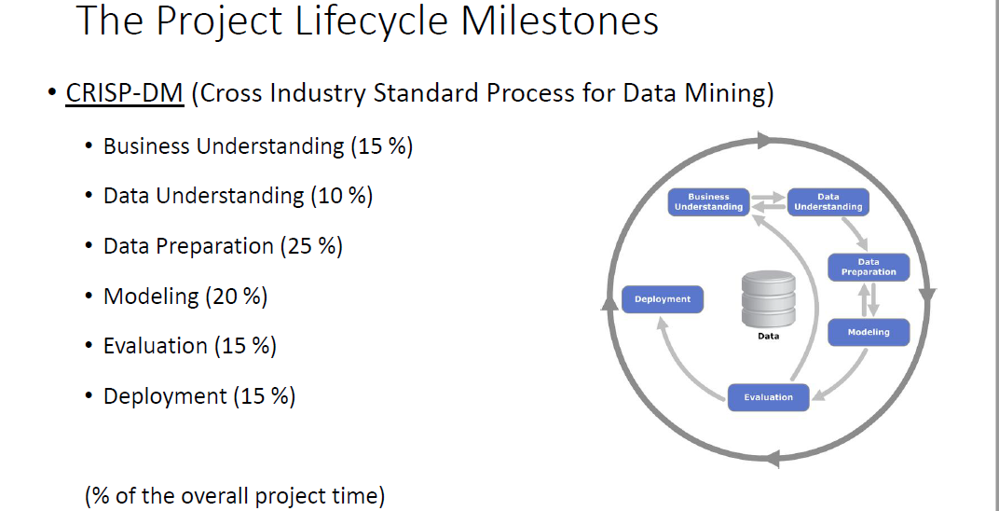

Slide 4
Introduction
In last decade has witnessed recurrent inconsistency in the U.S. housing market due to economic fluctuations & market changes. In the United States, the annual sales of existing single-family homes from 2005 to 2008 fell by 30%, while their average price dropped about 26%, and new construction declined by a 64%.
Investment in Real state is still the safest way as many people consider. As House prices increase every year, there is a need for a system to predict house prices in the future.
House price prediction can help buyer, seller and broker to determine the selling price of a house and can help the customer to arrange the right time to purchase a house. There are many factors that influence the price of a house which include physical conditions, concept and location.

Slide 5
Business Understanding
The descent in home values raises questions among home owners and shoppers regarding how accurately the value of homes can be assessed and what attributes determine the desirability of certain homes compared to other houses on the market.
This instability in the housing market necessitates the need for better methods for assessing housing prices. Consequently, the predictive accuracy of housing models has gained much attention among scholars and has been extensively studied.
Regardless of motives of buying and selling real estate, both sides agree on a price. It is always good to know how much a house is worth, what is the expected transaction price. Furthermore, it may be even more important why the price is like that, what has an impact on it.

Slide 6
Business Understanding
Let us start with a couple of questions that allow to define and understand problems regarding house pricing.
The seller does not know how to increase the value of the apartment so that the investment outlay is lower than the added value.
The seller does not know how much to sell the apartment for (he makes an offer on the portal and does not know if the price is adequate).
The buyer does not know how much the apartment is worth (as above, whether the price is adequate).
An accurate prediction on the house price is important to prospective homeowners, developers, investors, appraisers, tax assessors and other real estate market participants, such as, mortgage lenders and insurers
Over the years, the problem of property evaluation was solved in many different ways. Statistical tools used by analysts to explain house prices range from simple linear regression to more complex techniques such as artificial neural networks.

Slide 7
Data Understanding
This dataset contains data on all Real Property parcels that have sold since 2013 in Allegheny County, the City of Pittsburgh(Pennsylvania).
Data Source : Open Data Online Source
By searching with House Price as a key word I got the following dataset download link
https://catalog.data.gov/dataset/allegheny-county-property-sale transactions/resource/5a6688a2-d307-44a7-9bac-82af2f2b0509
Data contains 24 house features containing the price and the id columns, along with 307K observations.

Slide 8
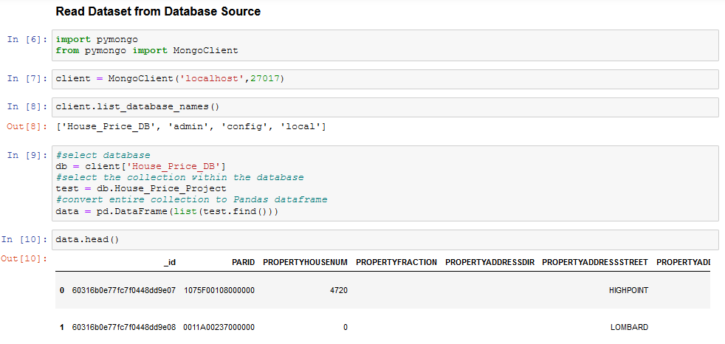
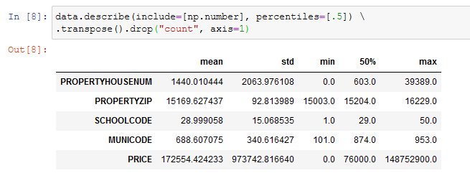
Data Preparation
Read from Database source (Mongodb)
statistical information about the numeric columns in our dataset

Slide 9
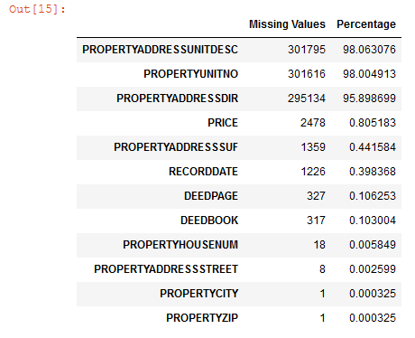

Data Preparation
Data Cleaning
Dealing with Missing Values
Deleting Unimportant Columns

Slide 10
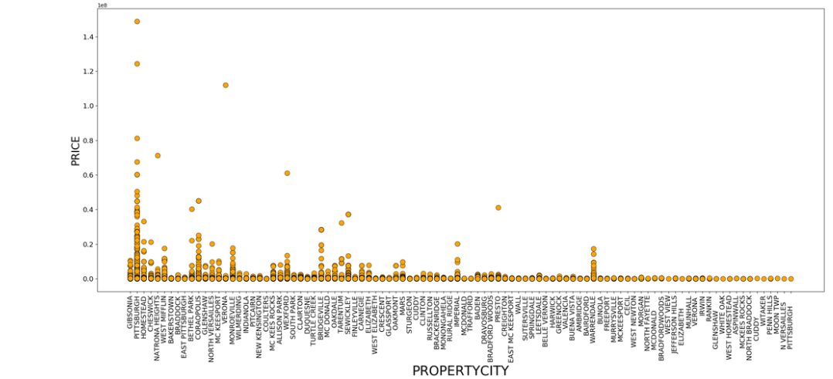
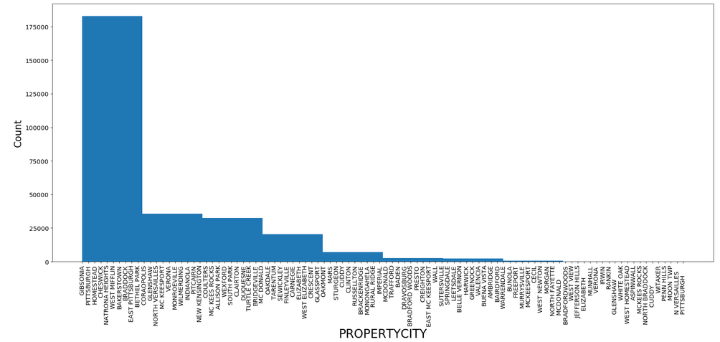
Data Preparation - EDA
Relationship between PROPERTYCITY and PRICE
Definitely the property price is changing by the City where the property is physically located. For the below relationship we can find that the highest property price is in PITTSBURGH city which equal 124,400,000 $
Relationship between PROPERTYCITY and number of properties.
From the below figure we can conclude that the PITTSBURGH city has the most sold properties with count of 166,634 property. Which is almost 54 % of the total properties in the whole dataset.

Slide 11
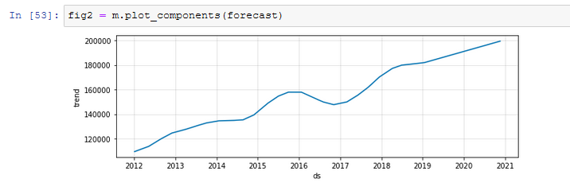
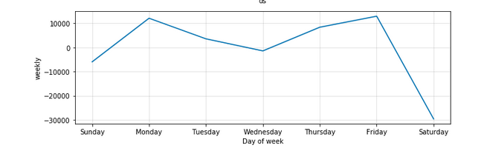
Data Preparation – EDA: Time series analysis using Prophet in Python
Price forecast – Yearly: price was increasing from 2012 to 2016 then it slightly fall at 2017. It has become upwards again gradually till the end of 2020.
Price forecast – Day of the week: Highest prices are recorded on Mondays and Fridays. Whereas Saturdays is almost the lowest which is normal behavior because it’s the weekend.

Slide 12
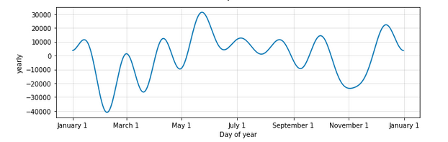
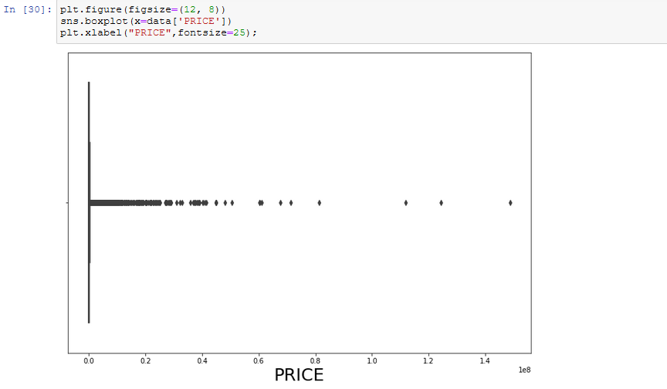
Data Preparation – EDA: Time series analysis using Prophet in Python
Price forecast– Day of Year: Lowest prices was recorded January and March and the highest sale price is found between May and July.
Boxplot to check Price outliers: figure indicate that there are outliers that should be removed from the target column - Price

Slide 13
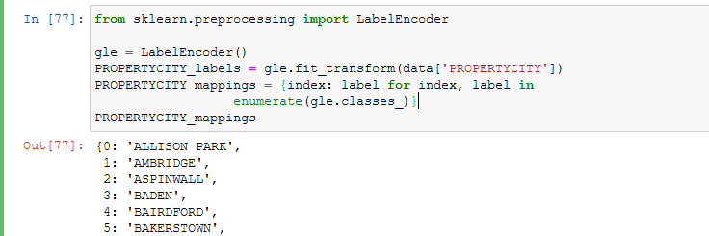
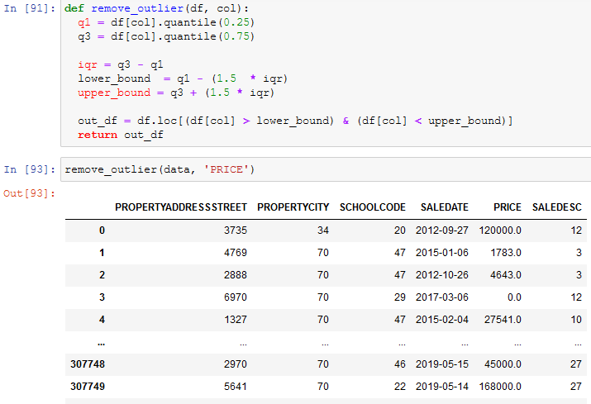
Data Preparation - Feature Engineering
Transforming Nominal Attributes using Lable Encoder for PROPERTYCITY, PROPERTYADDRESSSTREET and SALEDESC
Outlier Removal

Slide 14
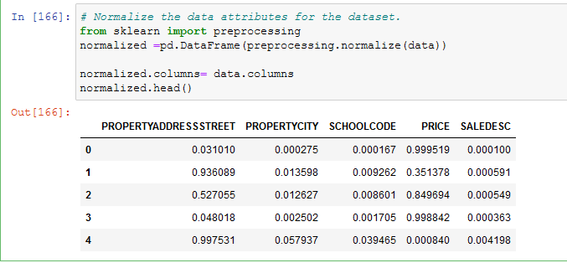
Data Preparation - Feature Engineering
Data Normalization : is a common practice in machine learning which consists of transforming numeric columns to a common scale.
Train – Test Split
Train Dataset: Used to fit the machine learning model.
Test Dataset: Used to evaluate the fit machine learning model.

Slide 15
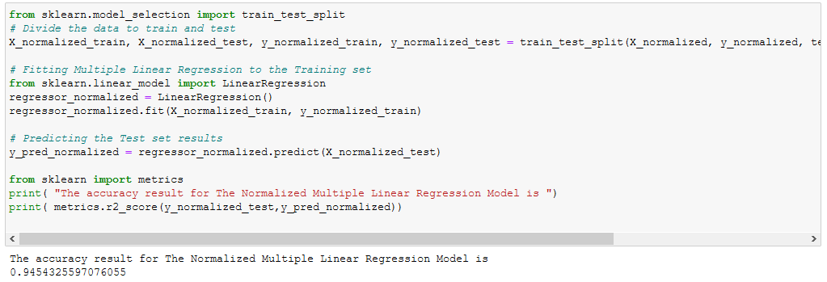
Model Building
Multiple Linear Regression: Multiple Linear Regression (MLR) is a supervised technique used to estimate the relationship between one dependent variable and more than one independent variables. Identifying the correlation and its cause-effect helps to make predictions by using these relations, the prediction accuracy of the model is essential; the complexity of the model is of more interest. However, Multiple Linear Regression is prone to many problems such as multi collinearity, noises, and overfitting, which effect on the prediction accuracy.

Slide 16
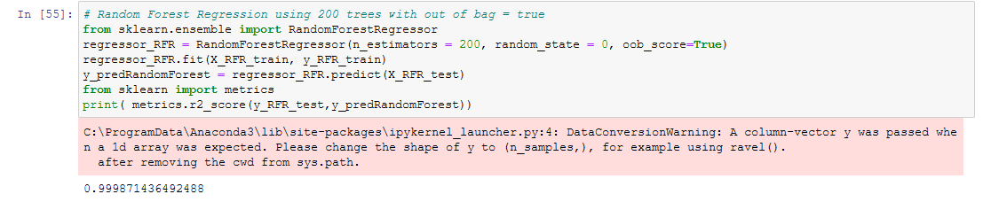
Model Building
Random Forest Regression: It is supervised in the sense that during training, it learns the mappings between inputs and outputs. For example, an input feature (or independent variable) in the training dataset would specify that an apartment has “3 bedrooms” (feature: number of bedrooms) and this maps to the output feature (or target) that the apartment will be sold for “$200,000” (target: price sold).
Ensemble algorithms combine multiple other machine learning algorithms, in order to make more accurate predictions than any underlying algorithm could on its own. In the case of random forest, it ensembles multiple decision trees into its final decision.

Slide 17
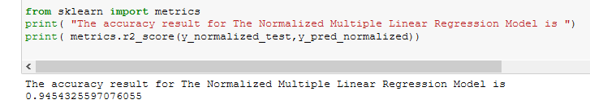
Evaluation
Coefficient of Determination – R2 score
R2 with MLR:
R2 with Random Forest Regression

Slide 18
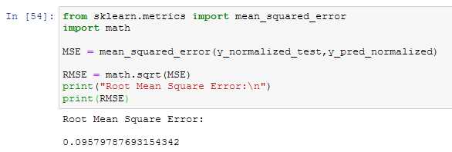
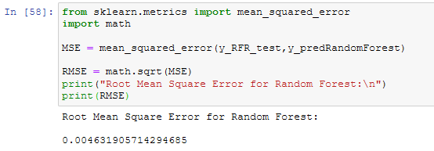
Evaluation
Root Mean Square Error (RMSE)
RMSE with linear Regression Model
RMSE with Random Forest Model

Slide 19
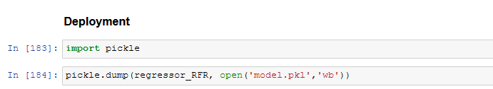
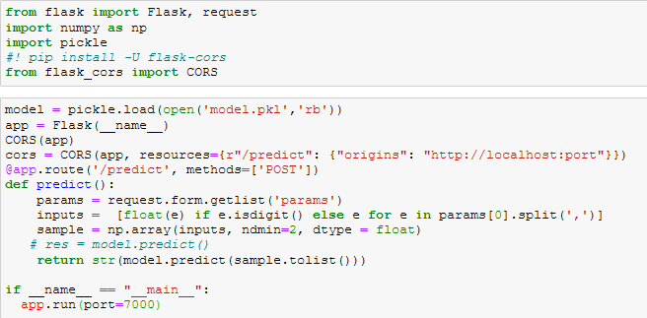
Deployment
Convert the model to deployable file using pickle
Using flask as intermediate webserver to read the model and handle http request

Slide 20
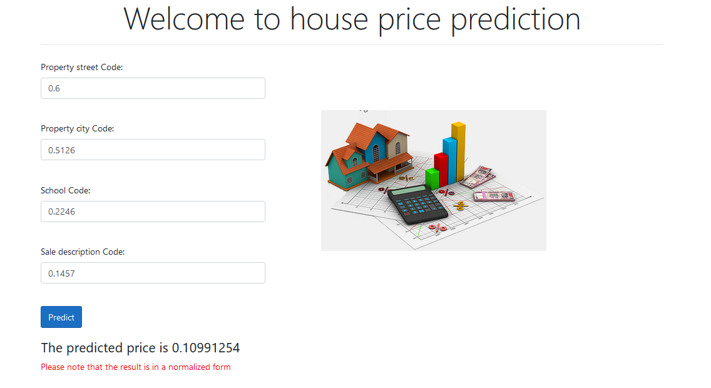
Deployment
Create UI (website) by using Asp MVC .Net core.

Slide 21
The end

