Slide 1
Faculty of Sciences of Sfax — P2I2
Macro tech
Inventory Management System for a Computer Store
Course: Programmation Web
Instructors : Sahar Dammak & Wiem Hachicha
Academic Year: 2025-2026
Project group: Ahmed Amine Khaled& Rayen belghith
1

Slide 2
Presentation Overview
01
Introduction
05
Category Management
02
06
Product Management
Technologies used
03
07
Database Design
Stock Management
04
Home Page
08
Search & Sorting
2

Slide 3
Introduction
Managing computer store inventory manually is both time-consuming and prone to errors. To address this issue, the Macro Tech team developed a web-based Inventory Management System designed specifically for a computer retail store. It provides an admin centered graphical interface that enables efficient access to tech information,buying and selling products, This system allows staff to efficiently manage products, categories, and stock levels through a clean and dynamic user interface. Built using HTML, CSS, PHP, and MySQL.
.
Team: Macro Tech | Web Programming — Academic Year 2025-2026
3

Slide 4
Project Objectives
.
Category management
Product management
Stock management and real-time updates
Product browsing and search
4

Slide 5




Technologies Used
The foundational language for structuring web pages. Organizes content with tags for headings, paragraphs, images, and links. It is the foundation of every visible web interface in the browser.
phpMyAdmin is the graphical interface that simplifies database management. It works with MySQL, a relational database management system. Together, they allow easy creation, modification, and querying of data.
A server-side scripting language for building dynamic websites. Handles forms, sessions, and database communication. Commonly paired with MySQL for full-stack web applications.
5

Slide 6
Database Design
Products table
id INT UNSIGNED PRIMARY KEY,
name VARCHAR(100)
description VARCHAR(255)
created_at DATETIME CURRENT_TIMESTAMP,
updated_at DATETIME NULL DEFAULT NULL ON UPDATE CURRENT_TIMESTAMP,
Categories table
id INT UNSIGNED primary key
reference VARCHAR(50)
designation VARCHAR(150)
description TEXT NULL,
brand VARCHAR(100)
price DECIMAL(10,2)
quantity INT NOT NULL
photo_path VARCHAR(255)
category_id INT UNSIGNED
created_at DATETIME (date)
updated_at DATETIME NULL DEFAULT
NULL ON UPDATE CURRENT_TIMESTAMP
6

Slide 7
Database Design
id INT UNSIGNED PRIMARY KEY
sale_id INT UNSIGNED
product_id INT UNSIGNED
quantity INT
unit_price DECIMAL(10,2)
line_total DECIMAL(12,2)
Sales table
sale_items table
id INT UNSIGNED AUTO_INCREMENT PRIMARY KEY,
product_id INT UNSIGNED
movement_type ENUM('IN', 'OUT', 'ADJUST')
quantity INT NOT NULL,
reason VARCHAR(255) NULL,
related_sale_item_id INT UNSIGNED
created_at DATETIME DEFAULT CURRENT_TIMESTAMP,
Stock movements table
id INT UNSIGNED PRIMARY KEY, sale_date DATETIME CURRENT_TIMESTAMP
total_amount DECIMAL(12,2)
created_by VARCHAR(100) NULL,
created_at DATETIME DEFAULT CURRENT_TIMESTAMP
7

Slide 8

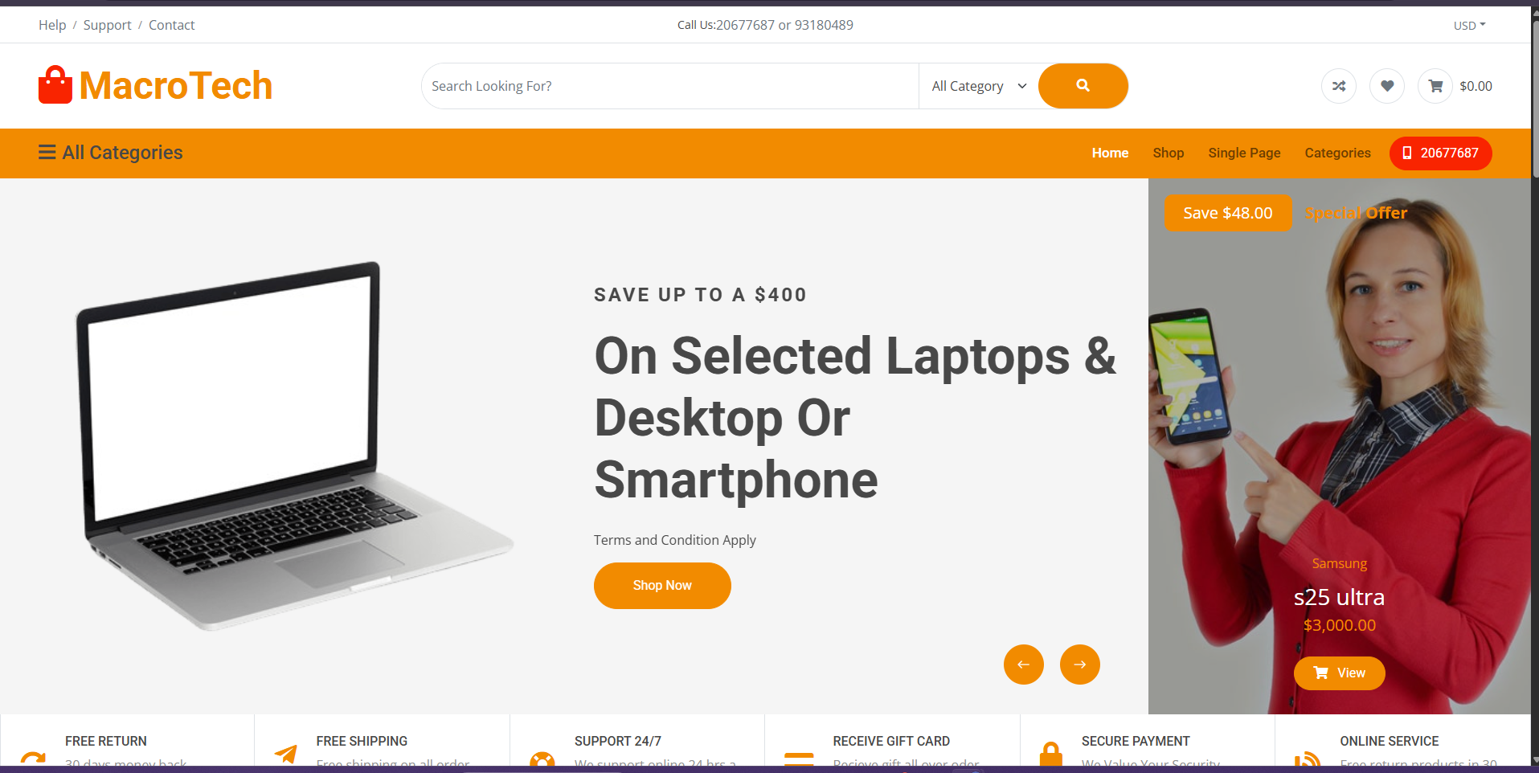
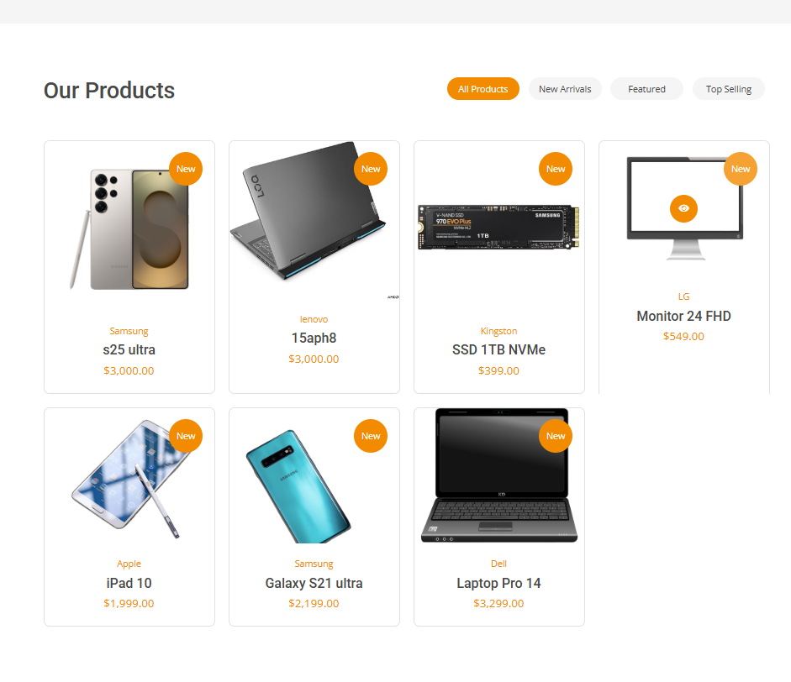
Home Page
Page Structure:
Navigation Bar
Store name + main navigation links
Side Menu
List of all clickable categories
Main Content Area
Product Table
Search Bar
Real-time filtering by product name
8

Slide 9
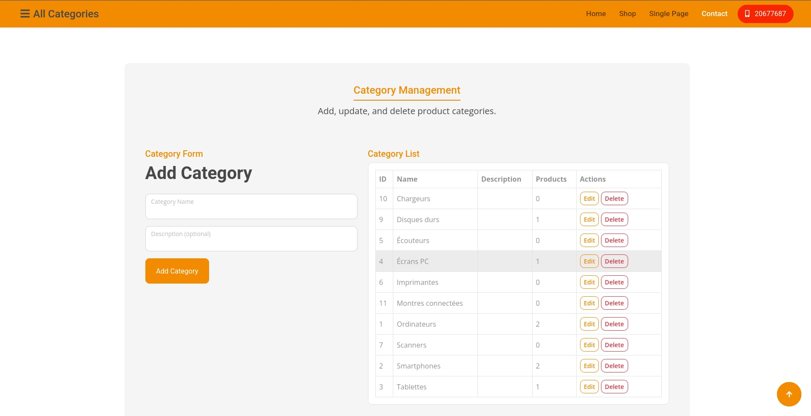
Category Management
Dynamic Display
Sidebar menu pulls all categories from the database
Click on Category
Shows products in a table (Ref, Name, Description, Brand, Price, Qty, Photo)
Add Category
Form available when category does not yet exist
Duplicate Prevention
Server-side check: duplicate names are rejected
9

Slide 10
Product Management
Ajouter
Modifier
Supprimer
Reference (unique)
Name
Description
Brand
Price (> 0)
Quantity (≥ 0)
Photo
Category (required)
All fields editable
EXCEPT the reference
(read-only)
Allowed only
if quantity = 0
10

Slide 11
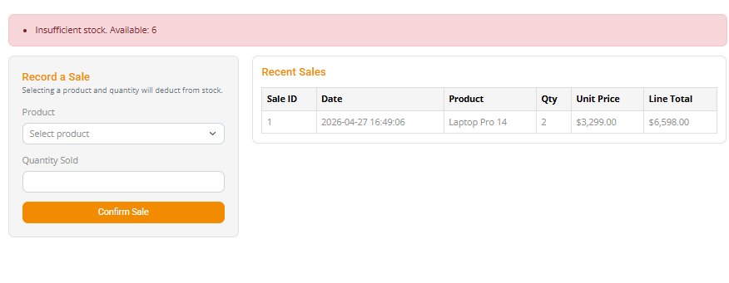
Stock Management
Sale Made
Enter quantity sold
Check: Stock Qty ≥ Sold Qty?
Update in Database
New Qty = Current Qty − Sold Qty
▶
▶
▶
NO ↓
❌ Error:
Insufficient Stock
If stock is insufficient, an error is triggered and no update is made.
11

Slide 12
Search & Sorting
🔍 Search by Product Name
A text search field that filters products within the selected category in real time (or on form submission).
↕ Sort by Price
↕ Sort by Price
A button or dropdown to sort products from lowest to highest price, or in reverse.
🏷 Sort by Brand
🏷 Sort by Brand
;
Alphabetical sorting by brand to easily group products from the same manufacturer.
12

Slide 13
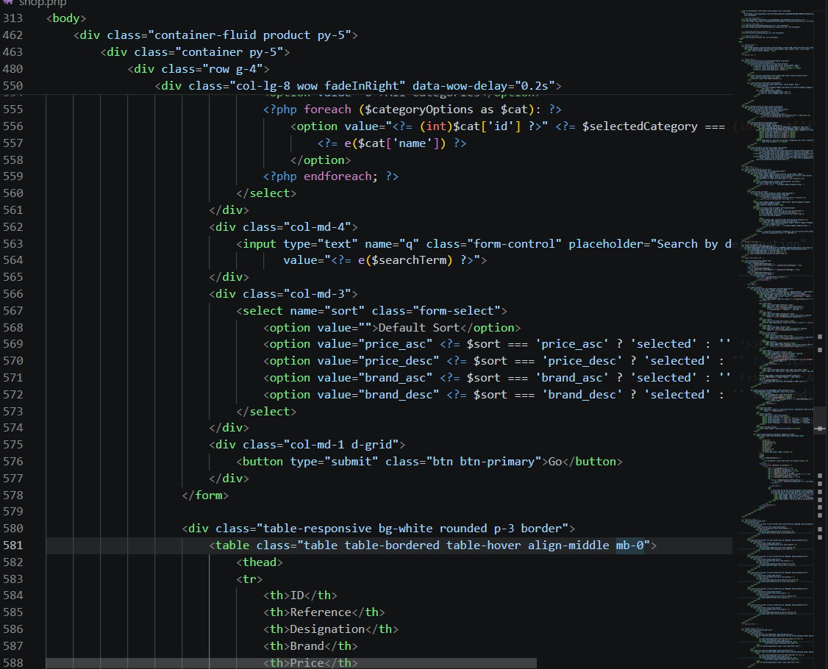
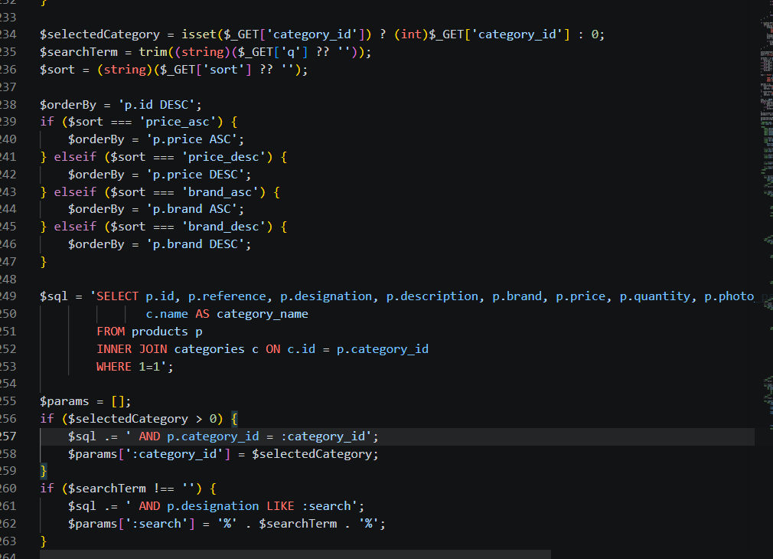
🏷 Sort by Brand
13

Slide 14
Application showcase
14

Slide 15
Thank you for your attention
15

